Slide 1
Load and store use different result paths
Address: forwarded Rs + Sign Extension (imm8)
Rs=0020（32）
offset=FFFF（-1）
EX address ADD
Effective Address=001F（31）
MEM full EA check
0000 ... 00FF
DM request
LDR
Data Memory OUT
WB load select
RF write
STR
Rd
store_data16
MEM write
Notes:
Presenter D. Target 1:00.
For 2BFF, LDR R2 from R3 minus one, the base comes from forwarded Rs and the offset is FFFF. With base 0020, the address is 001F. MEM checks the full address and performs a read. WB writes the returned memory value, not the effective address. Store uses the same address calculation, but forwarded Rd travels separately as store_data. It writes DM at the MEM ending edge and has no RF or flag write. Both source paths need forwarding. Success store has a WB bubble; an illegal-address store keeps a fault token while blocking the memory request.
Sources: 16位流水线CPU核心设计文档 v1.4 (2026-10-08), §§1–4 §3.2.2; diagrams/instruction_memory.svg; T03/T17 logs

Slide 2
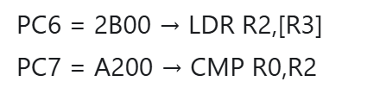
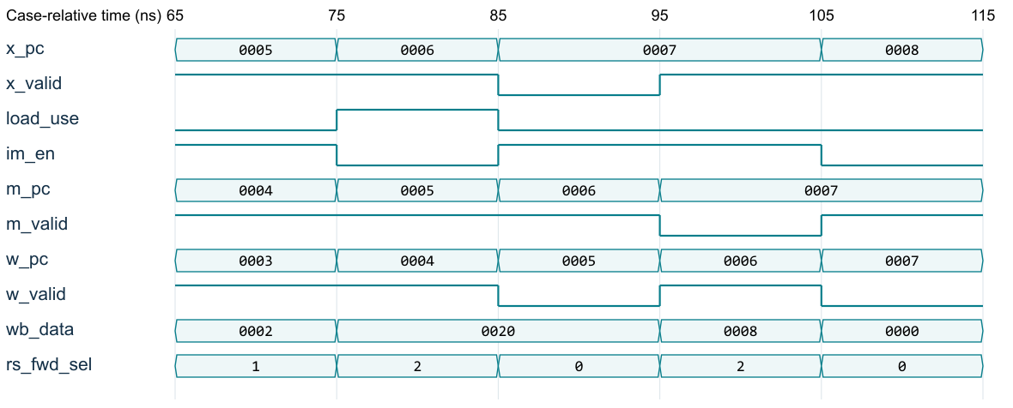
Load-use: hold the front end, advance the back end
C9 stall, C10 EX bubble, C11 WB-load forwarding
Notes:
Presenter D. Target 1:05.
In the baseline, load at PC six is followed by CMP at PC seven. At cycle nine the load occupies EX and CMP occupies ID. The decoder says CMP actually reads the load destination, so load_use asserts. PC and ID hold, fetch is disabled, and the next EX slot is a bubble. The load still advances to MEM and then WB. At cycle eleven CMP uses the WB load data. Older WB and the cycle-nine MEM store are allowed to complete during the front-end hold. A MOV immediate to the same destination has no old-value source and must not stall. We tested that case separately.
Sources: rtl/datapath_core.sv; tb/tb_datapath.sv; datapath.log; BASELINE trace C9–C11; LOAD_MOV_NO_FALSE_STALL

Slide 3
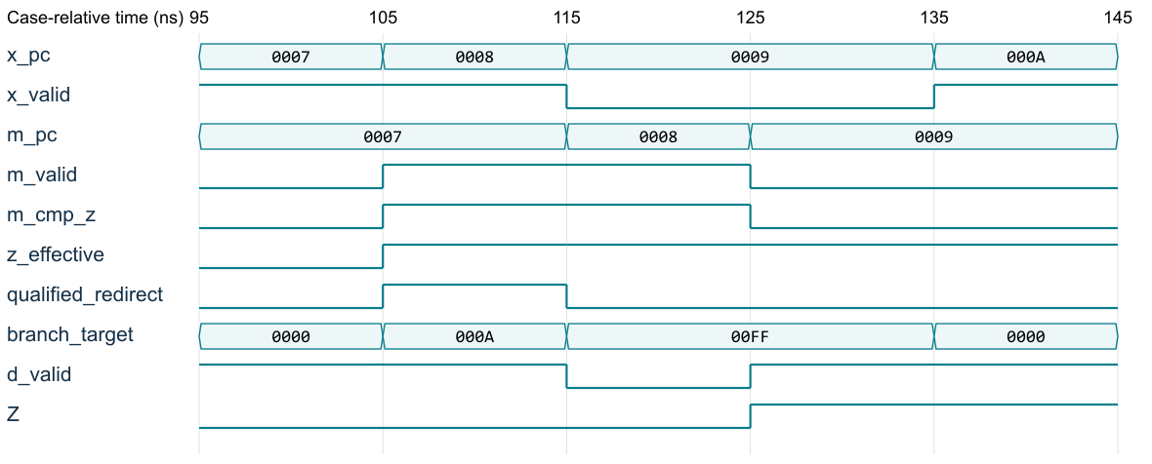
CMP to JZ: latest Z is used
Notes:
Presenter D. Target 1:00.
CMP produces an equality candidate and carries it with ZW. The following JZ selects the latest older valid CMP: MEM first, then WB, then architectural Z. The baseline branch at PC eight resolves in cycle twelve using the MEM CMP candidate. Its own PC tag and signed offset produce target A. The ending edge redirects PC and clears the two younger slots. The wrong-path MOV at PC nine cannot write. If MEM carries an ADD rather than CMP, it has no ZW and must not shadow the WB CMP. We also checked consecutive CMP results, including a latest zero overriding an older one.
Sources: 16位流水线CPU核心设计文档 v1.4 (2026-10-08), §§1–4 §3.2.3; BASELINE/T02/T15

