Slide 1
Pre4: Pipelined Datapath
16-bit CPU course project · Week 6
Notes:
Presenter A. Target 0:20.
Today we present the datapath for ISA version 1.4. We connect the instruction semantics to the five-stage hardware, trace arithmetic, memory and branch instructions, and show actual Vivado validation. The source, testbench and diagrams use the same design version.
Sources: 16位流水线CPU核心设计文档 v1.4 (2026-10-08), §§1–4

Slide 2
DATAPATH DESIGN
PRE4 / SYSTEM ARCHITECTURE
From ISA requirements to a five-stage pipeline
01 CPU COMPOSITION
02 DESIGN METHODOLOGY
CPU = Datapath + CU
Hardware is derived from instruction behavior
01
02
03
04
ISA
Operations
Hardware
Datapath
DATAPATH
CONTROL UNIT
Instruction
semantics
Read · compute
store · branch
RF · ALU · MUX
IM · DM
Interconnect &
select data paths
Processes and
transfers data
Selects operations
and timing
EXAMPLE
ADD: RF → ALU → RF
LDR: RF → ALU → DM → RF
03 PIPELINE ORGANIZATION
SINGLE ISSUE · IN ORDER
Five execution stages, separated by four pipeline registers
IF
Fetch
ID
Decode
EX
Execute
MEM
Memory
WB
Writeback
PC · IM
Decoder · RF
MUX · ALU
Data memory
RF · Flags
IF/ID
ID/EX
EX/MEM
MEM/WB
Pipeline registers carry each instruction's data, control signals, PC and valid bit.
Notes:
Speaker note: This slide introduces (1) CPU functional decomposition into Datapath and Control Unit; (2) ISA-driven derivation of data operations, hardware units and their connections; and (3) IF-ID-EX-MEM-WB with four pipeline boundaries.
[Sources]
User-provided Pre4 CPU design description and current conversation.

Slide 3
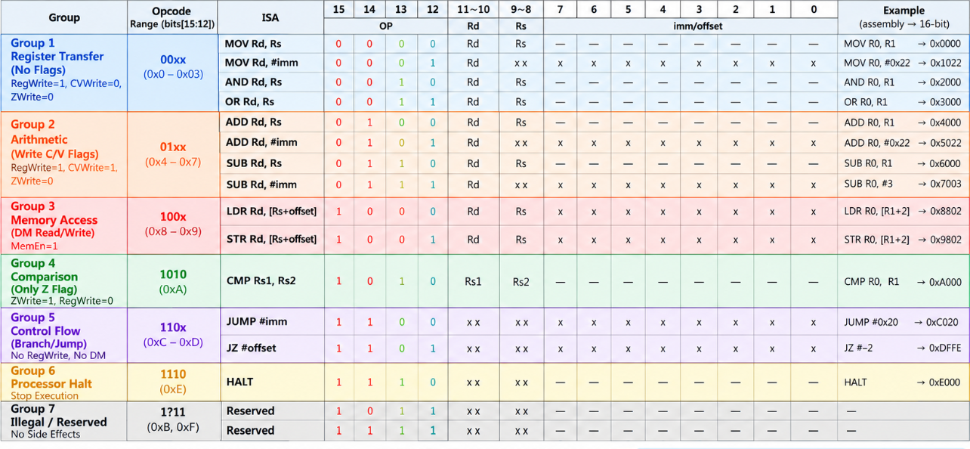

Slide 4
Five-stage pipeline
Illustrative snapshot without stalls or flushes. I1 is oldest.
qualified EX target to PC
IF
ID
EX
MEM
WB
Request
instruction
Decode / read
sources
Select /
compute
Access DM /
pass value
Qualified
state updates
IF/ID*
ID/EX
EX/MEM
MEM/WB*
WB data + address + write enable
Shared RF
Same-address WB-to-ID bypass is inside this RF.
ID read ports
WB write port
Same clock | IF | ID | EX | MEM | WB
Instruction | I5 | I4 | I3 | I2 | I1
* Registered IM/DM outputs form the data boundaries beside matching core tags. No extra IR / MDR.
PRE4 B 1/5
Notes:
Presenter B. English script:
These five hardware tasks overlap across different instructions. IF requests an instruction. ID decodes it and reads the sources. EX computes, MEM accesses data memory or passes the result, and WB performs qualified state updates. Here, I one is oldest and I five is newest. The four labels mark the pipeline boundaries. Registered IM and DM outputs supply the starred data boundaries beside matching core tags. There is one shared register file: ID reads it and WB supplies its write port. The qualified EX target returns to the fetch PC.
指图顺序：沿五阶段讲职责，再指四边界与无停顿/无冲刷快照。说明I1最旧、I5最新。星号对应已寄存RAM输出旁的核心标签，而不是额外IR/MDR。保留共享RF和合格EX目标反馈。
Evidence boundary:
Basis: v1.4, 2026-10-08. Snapshot is illustrative and assumes no stalls or flushes.
Sources (relative to Pre4_数据通路设计与验证/):
00_实现说明与阅读导航.md
Vivado/rtl/datapath_core.sv
Vivado/rtl/sync_memories.v
Vivado/rtl/regfile4x16.v

Slide 5
STR uses two data paths
Illustrative example: STR R1, [R2 + 4] Encoding 0x3604
ID: RF outputs
EX: separate roles
EX/MEM
MEM: write DM
R2 = 0x0020
Forward Rs / ALU
m_exec_value
DM
base address
0x0020 + 0x0004
EA = 0x0024
0x0024
Address
0x0024
SExt(0x04) = 0x0004
R1 = 0x00A7
Forward Rd
m_store_data
Stored value
0x00A7
value to store
x_store_data
= rd_fwd = 0x00A7
0x00A7
Both fields belong to the same STR instruction.
Word addressing. Check the full 16-bit EA before the MEM write.
PRE4 B 2/5
Notes:
Presenter B. English script:
This illustrative store has encoding hex three six zero four. Forwarded R two provides the base address. The ALU adds the signed offset four and produces hex zero zero two four. This CPU uses word addresses, so the offset counts words. Forwarded R one independently supplies hex zero zero A seven. EX/MEM keeps the address as m exec value and the value as m store data. Both fields belong to this same store. MEM checks the full sixteen-bit address before it can write. This page explains the two paths rather than a measured cycle trace.
指图顺序：先读教学例子及机器码0x3604。Rs=R2算字地址，Rd=R1沿独立路径提供写入值。数值不是BASELINE波形截图。本页只讲路径，逐拍访存和冒险验证留给D，排练时避免重复完整解释STR双路径。
Evidence boundary:
Illustrative input values. Encoding=(3<<12)|(1<<10)|(2<<8)|4=0x3604. This is not a BASELINE waveform excerpt.
Sources (relative to Pre4_数据通路设计与验证/):
docs/ISA_v14.md
Vivado/rtl/isa_decode.v
Vivado/rtl/datapath_core.sv

Slide 6
Data forwarding: age and readiness
Illustrative example: ADD in EX sees two older writes to R1
MOV R1,#3
MOV R1,#7
ADD R3,R1
Older: WB
Newer: MEM
Selected
Consumer: EX
R1 value = 0x0003
R1 value = 0x0007
R3 starts at 0x0001
R1 input = 0x0007
EX result = 0x0008
Not selected
Priority: ready eligible MEM, then eligible WB, then captured operand.
Eligible: valid, fault-free, register-write intent, matching destination.
Load readiness
MEM load
WB load
exec_value = address
wb_data = returned value
An unready newest load blocks older same-name values.
PRE4 B 3/5
Notes:
Presenter B. English script:
Why do we select seven rather than three? This is a teaching example. WB carries three, while the newer MEM carries seven for the same R one. The solid MEM path supplies seven and the dashed WB path stays unselected. With R three initially one, EX computes eight. Forwarding supplies an available operand before the producer reaches WB. Qualified WB updates R three later. Only valid, fault-free producers with register-write intent and a matching destination can forward. A MEM load still carries its address. The newest unready load blocks older values until its returned data is available in WB.
指图顺序：指出教学例子的3/7和R3初值1。MEM实线Selected，WB虚线Not selected。结果8是EX候选值，后续合格WB才更新R3。Eligible条件包括valid、无故障、写寄存器和目的匹配。最新MEM load未就绪时阻挡旧WB，不能跳过它。这里只讲选择原理，暂停排程留给D。
Evidence boundary:
Illustrative program 0x1403, 0x1407, 0x4D00 with initial R3=0x0001. The existing directed NEWEST_M_OVER_W uses a different program: 0x1001, 0x1002, 0x0400, 0xE000. Its receipt demonstrates the same MEM-over-WB rule, not these exact numerical inputs.
Sources (relative to Pre4_数据通路设计与验证/):
Vivado/rtl/operand_forward.v
Vivado/tb/tb_datapath.sv
Vivado/case_results.csv

Slide 7
Data, control and tags travel together
Illustrative STR: normal packet above, different input in the fault row
Data
Control
Status tags
EA = 0x0024
store value = 0x00A7
MW=1 (store intent)
RW=ZW=CVW=0
pc=0x0010, valid=1
fault=0
dm_we = m_mem_write AND mem_ok
mem_ok: active mode, no reset, valid, fault-free, EA in range
STR input / EA | At MEM | Next WB slot
Normal: 0x0024 | DM[0x0024] gets 0x00A7 | bubble: valid=0
Other input: 0x0100 | DM blocked: dm_we=0 | stop token: valid=1, fault=1
R2=0x00FC gives EA=0x0100. MEM detects a fault and WB keeps a valid stop token.
PRE4 B 4/5
Notes:
Presenter B. English script:
The normal store packet keeps data, control and tags together. M W means store intent. Register and flag write intents stay zero. The actual d m write enable also needs an active mode, no reset, valid, no fault and an in-range address. The normal case writes in MEM and leaves a WB bubble. The fault row uses a different input: R two is hex zero zero F C. Adding the same offset four produces hex zero one zero zero, outside data memory. MEM detects this new address fault and suppresses the write. WB then carries valid one and fault one as a stop token. Valid marks occupancy rather than unconditional permission to write.
指图顺序：上方是正常EX/MEM包，fault=0。橙色MW是存储意图，m_mem_write携带它；实际dm_we还要通过mem_ok。故障行是另一组输入：R2=0x00FC而offset仍为4，故EA=0x0100。MEM新检测地址故障，禁止DM写入，随后W槽valid=1/fault=1用于停止处理。不要把上方正常包与下方故障行当作同一输入。
Evidence boundary:
Normal input R2=0x0020, offset=4 gives EA=0x0024. Different fault input R2=0x00FC, offset=4 gives EA=0x0100. The range fault arises in MEM and joins the valid fault token in WB.
Sources (relative to Pre4_数据通路设计与验证/):
docs/ISA_v14.md
Vivado/rtl/isa_decode.v
Vivado/rtl/datapath_core.sv

Slide 8
IM response and ID tag alignment
XSim VCD reconstruction: first BASELINE instruction fetches (ns)
IF request
IM dout + matching D tags
ID consumes
30
35
40
45
50
55
clk
Rising edge
im_addr
0x0000
0x0001
0x0002
im_en
1
im_dout
0x0000
0x1005
0x1403
d_pc
0x0000
0x0001
d_valid
0
1
After the 35 ns rising edge: im_dout=0x1005, d_pc=0x0000, d_valid=1
im_addr=0x0001 already addresses the next request.
Registered IM dout + D tags form IF/ID. No extra IR.
LDR (not plotted): DM dout + W tags at MEM edge, RF write at the next edge.
PRE4 B 5/5
Notes:
Presenter B. English script:
These traces reconstruct the first baseline instruction fetches from the saved XSim VCD. Before thirty-five nanoseconds, IM sees address zero with enable one. After the rising edge updates settle, the output is instruction hex one zero zero five. Its matching ID tags are PC zero and valid one. The visible address one already belongs to the next request. The highlighted region pairs the instruction with its tags. This waveform shows IM only. For a load, DM output and W tags follow the same boundary rule, with RF write at the next edge. Registered RAM outputs avoid adding an extra IR or MDR.
指图顺序：先指Rising edge及35ns之前的地址0、使能1，再指同沿非阻塞更新完成后的im_dout=0x1005、d_pc=0x0000、d_valid=1。d_pc本来就是0，不必跳变。im_addr=0x0001属于下一请求。图只展示IM，底部LDR是实现类比而非本图中的DM证据。行为仿真不代表物理传播延迟或Fmax。
Evidence boundary:
Saved XSim VCD time unit: 1ps. All same-timestamp updates at 35ns must settle before reading the displayed values. The 30–55ns graph preserves the existing trace. DM is not plotted here.
Sources (relative to Pre4_数据通路设计与验证/):
Vivado/datapath.vcd
Vivado/case_timings.csv
Vivado/tb/tb_datapath.sv
Vivado/rtl/sync_memories.v
Vivado/rtl/datapath_core.sv

Slide 9
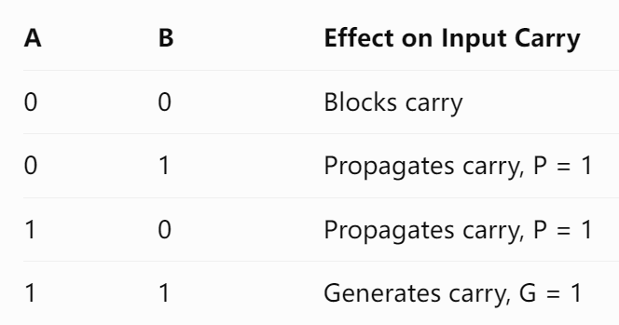
Two-level CLA arithmetic
Group lookahead: P/G do not depend on cin
$K_{1}=G_{0}∨\left(P_{0}K_{0}\right)$ $K_{2}=G_{1}∨P_{1}G_{0}∨P_{1}P_{0}K_{0}$
P0 / G0
P1 / G1
P2 / G2
P3 / G3
CLA4 group 0
bits [3:0]
cin = K0
CLA4 group 1
bits [7:4]
cin = K1
CLA4 group 2
bits [11:8]
cin = K2
CLA4 group 3
bits [15:12]
cin = K3
$p_{i}=a_{i}⊕b_{i}$Propagate $g_{i}=a_{i}∧b_{i}$Generate
08 PRE4 C / 1:00
Notes:
Presenter C. Target 1:00.
The ALU retains PASS_B, ADD, SUB, AND and OR as internal operations. ADD and SUB use one complement-and-carry path: subtraction flips b and sets the initial carry to one. Four CLA4 groups calculate bit propagation and generation. A separate group network computes K1 through K4 directly from the group P and G values. We do not chain one group’s output carry into the next group’s input. Group P and G are independent of carry-in. The source and RTL analysis view establish that structure. The FPGA mapping is a separate view, and by itself does not establish a speed advantage.
Sources: 16位流水线CPU核心设计文档 v1.4 (2026-10-08), §§1–4 §2.4.3; rtl/cla16.v; eda/rtl_cla16.pdf

Slide 10
ADD immediate through the datapath
Eg：ADD R0, 1
C1 / IF
C2 / ID
C3 / EX
C4 / MEM
C5 / WB
Fetch 5001
Tag pc=0000
Read R0：7FFF
ZExt(01)
CLA: 8000
C/V = 0/1
Pass result
No DM access
R0 = 8000
Write C/V
5001: R0=7FFF → R0=8000, C=0, V=1
C indicates no borrow in subtraction. V is signed overflow.
10 PRE4 C / 0:50
Notes:
Presenter C. Target 0:50.
Use machine word 5001 at PC zero with R0 equal to 7FFF. ID selects the old Rd and zero-extends the immediate. EX forwards the latest R0, selects a and b, then the CLA produces 8000, carry zero and overflow one. These candidate values enter EX/MEM, pass through MEM without a memory request, and reach WB. At the fifth ending edge, RF receives 8000 and C/V receive zero and one; Z holds. The candidate in EX is not yet architectural state. Every stage shown belongs to this instruction, while other instructions occupy other stages in parallel.
Sources: 16位流水线CPU核心设计文档 v1.4 (2026-10-08), §§1–4 §3.2.1; diagrams/instruction_add.svg

Slide 11
Load and store use different result paths
Address: forwarded Rs + Sign Extension (imm8)
Rs=0020（32）
offset=FFFF（-1）
EX address ADD
Effective Address=001F（31）
MEM full EA check
0000 ... 00FF
DM request
LDR
Data Memory OUT
WB load select
RF write
STR
Rd
store_data16
MEM write
Notes:
Presenter D. Target 1:00.
For 2BFF, LDR R2 from R3 minus one, the base comes from forwarded Rs and the offset is FFFF. With base 0020, the address is 001F. MEM checks the full address and performs a read. WB writes the returned memory value, not the effective address. Store uses the same address calculation, but forwarded Rd travels separately as store_data. It writes DM at the MEM ending edge and has no RF or flag write. Both source paths need forwarding. Success store has a WB bubble; an illegal-address store keeps a fault token while blocking the memory request.
Sources: 16位流水线CPU核心设计文档 v1.4 (2026-10-08), §§1–4 §3.2.2; diagrams/instruction_memory.svg; T03/T17 logs

Slide 12
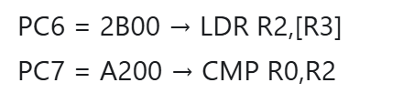
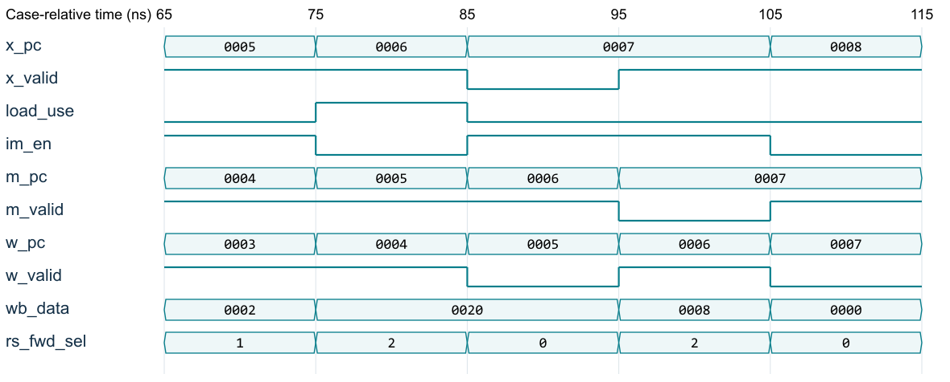
Load-use: hold the front end, advance the back end
C9 stall, C10 EX bubble, C11 WB-load forwarding
Notes:
Presenter D. Target 1:05.
In the baseline, load at PC six is followed by CMP at PC seven. At cycle nine the load occupies EX and CMP occupies ID. The decoder says CMP actually reads the load destination, so load_use asserts. PC and ID hold, fetch is disabled, and the next EX slot is a bubble. The load still advances to MEM and then WB. At cycle eleven CMP uses the WB load data. Older WB and the cycle-nine MEM store are allowed to complete during the front-end hold. A MOV immediate to the same destination has no old-value source and must not stall. We tested that case separately.
Sources: rtl/datapath_core.sv; tb/tb_datapath.sv; datapath.log; BASELINE trace C9–C11; LOAD_MOV_NO_FALSE_STALL

Slide 13
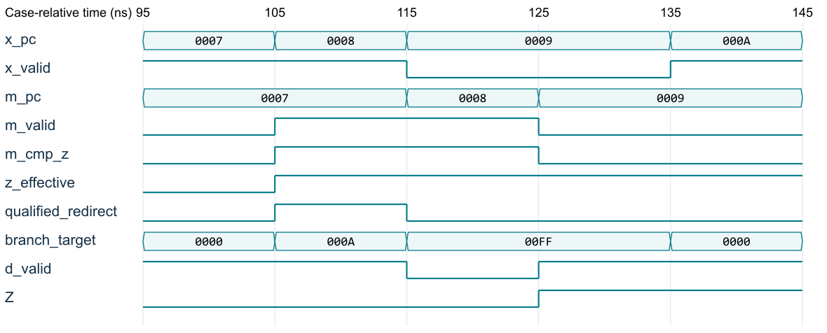
CMP to JZ: latest Z is used
Notes:
Presenter D. Target 1:00.
CMP produces an equality candidate and carries it with ZW. The following JZ selects the latest older valid CMP: MEM first, then WB, then architectural Z. The baseline branch at PC eight resolves in cycle twelve using the MEM CMP candidate. Its own PC tag and signed offset produce target A. The ending edge redirects PC and clears the two younger slots. The wrong-path MOV at PC nine cannot write. If MEM carries an ADD rather than CMP, it has no ZW and must not shadow the WB CMP. We also checked consecutive CMP results, including a latest zero overriding an older one.
Sources: 16位流水线CPU核心设计文档 v1.4 (2026-10-08), §§1–4 §3.2.3; BASELINE/T02/T15

Slide 14
Datapath Code Organization
IF Fetch
ID Decode
EX Execute
MEM Access
WB Writeback
→
→
→
→
PRE4 · Datapath Implementation & Verification 01
Notes:
Introduce this section's flow: parallel module connections, pipeline-register advancement, result writeback, then checks using the benchmark and load-dependency waveform. All code comes from the 13 RTL files provided by the user; this presentation excludes the fault-protection topic.

Slide 15
IF Fetch: PC to IM, Instruction to ID
IF Fetch
ID Decode
EX Execute
MEM Access
WB Writeback
PC module ── PC_fetch / im_addr ──→ External IM ── im_dout / d_inst ──→ ID
datapath_core.sv · Code excerpt
41 assign im_addr = PC_fetch;
…
43 pc16 u_pc (.clk(clk), .rst(rst), .hold(pc_hold),
44 .redirect(qualified_redirect), .target(branch_target), .pc(PC_fetch));
…
49 wire [15:0] d_inst = im_dout;
L43–44: The PC module connects its pc output to PC_fetch.
L41: PC_fetch drives the IM address. L49: The instruction from IM feeds ID.
PRE4 · Datapath Implementation & Verification 01
Notes:
Slide 1 | IF Fetch: PC to IM, Instruction to ID
Start with instruction fetch, focusing only on address and instruction connections. Lines 43–44 instantiate the PC module. .pc(PC_fetch) connects its pc output port to the PC_fetch signal. Line 41 connects PC_fetch to the instruction-memory address interface im_addr, sending the PC-generated address to external instruction memory.
The memory returns the instruction through im_dout. Line 49 uses it directly as d_inst for the ID stage on the next slide. In short: PC outputs an address, IM receives it and returns an instruction, and ID receives that instruction. We focus on ports and connections rather than the internal PC increment or branch logic.
[Sources and Notes]
Source: datapath_core.sv L41, L43–44, L49. The diagram illustrates source-code connections; IM is external synchronous instruction memory. Enable, address-qualification and tag logic are omitted. In the instance, .pc is the port name and PC_fetch is the connected signal.

Slide 16
ID Decode: Instruction to Operands and Immediate
IF Fetch
ID Decode
EX Execute
MEM Access
WB Writeback
d_inst → Decoder → Register IDs / imm → RF read / Immediate extension → ID/EX → EX
datapath_core.sv · Code excerpt
58 isa_decode u_decode (
59 .inst(d_inst), .rd(d_rd), .rs(d_rs), .imm(d_imm),
…
67 imm_ext16 u_ext (.imm(d_imm), .sign_mode(d_imm_signed), .value(d_imm_ext));
…
104 .raddr_a(d_rd), .raddr_b(d_rs), .rdata_a(d_rd_value), .rdata_b(d_rs_value)
…
299 x_rd_value <= d_rd_value; x_rs_value <= d_rs_value; x_imm_ext <= d_imm_ext;
L59: The decoder takes the instruction and outputs d_rd, d_rs and d_imm.
L104 / L67: Read-address ports provide value; the immediate feeds the extender. L299: Latch and pass to EX.
PRE4 · Datapath Implementation & Verification 02
Notes:
Slide 2 | ID Decode: Instruction to Operands and Immediate
ID receives d_inst from the previous stage and sends it to the decoder. .inst(d_inst) on line 59 is this input connection. The decoder outputs register IDs d_rd and d_rs, plus immediate d_imm. Line 104 connects the IDs to the register-file read-address ports, producing d_rd_value and d_rs_value at the read-data ports. Line 67 connects the immediate to the extender, producing the 16-bit d_imm_ext.
Finally, line 299 latches these three values at the clock edge into x_rd_value, x_rs_value and x_imm_ext for EX. ID thus connects the instruction to register-read and immediate-extension paths, then passes the prepared data to the next stage. Note that rd and rs are register IDs, while signals containing value carry the actual read data. Omitted control information also travels with its instruction.
[Sources and Notes]
Source: datapath_core.sv L58–59, L67, L104, L299. Line 104 shows selected ports of u_rf; line 299 is inside a posedge clk sequential block. Other decoder ports, complete instances and control-tag updates are not shown. The diagram omits control lines to emphasize data connections.

Slide 17
EX Execute: Operands to ALU, Result to MEM
IF Fetch
ID Decode
EX Execute
MEM Access
WB Writeback
ID/EX → Forwarding & input selection → alu_a / alu_b → ALU → alu_result → EX/MEM
datapath_core.sv · Code excerpt
154 alu16 u_alu (.a(alu_a), .b(alu_b), .op(x_alu_op), .result(alu_result),
155 .eq(alu_eq), .illegal(alu_illegal), .carry(alu_c), .overflow(alu_v));
156 wire [15:0] x_store_data = rd_fwd;
…
315 m_pc <= x_pc; m_rd <= x_rd;
316 m_exec_value <= alu_result; m_store_data <= x_store_data;
317 m_cmp_z <= alu_eq; m_c <= alu_c; m_v <= alu_v;
L154–155: Operands feed input ports; x_alu_op drives operation control; ALU result feeds alu_result
L316: alu_result → m_exec_value; STR data separately enters m_store_dat.
m_exec_value carries the result or address; m_store_data carries the actual data to store in memory
PRE4 · Datapath Implementation & Verification 03
Notes:
Slide 3 | EX Execute: Operands to ALU, Result to MEM
Operands saved by ID pass through forwarding and input selection to form alu_a and alu_b. Line 154 connects them to ALU inputs a and b, with x_alu_op driving operation control. The ALU result port drives alu_result. We focus on operand, control and result connections, not internal ALU algorithms.
Line 316 shows the connection to the next stage: alu_result is latched into m_exec_value at the clock edge. STR has a separate path: line 156 connects forwarded Rd to x_store_data, which line 316 latches into m_store_data. On entering MEM, m_exec_value carries the arithmetic result or access address, while m_store_data carries the actual data to store. The PC, destination register and candidate flags are also passed onward.
[Sources and Notes]
Source: datapath_core.sv L154–156, L315–317. Lines 315–317 are original excerpts from the posedge clk block. Input selection, forwarding internals and qualification controls are not shown. m_exec_value carries an ordinary result or effective memory address; m_store_data is the independent STR data path.

Slide 18
MEM Access: Address and Data to DM, Results Onward
IF Fetch
ID Decode
EX Execute
MEM Access
WB Writeback
EX/MEM ── Address / Write data / Enable ──→ External DM; ALU result ── MEM/WB ──→ WB
datapath_core.sv · Code excerpt
205 assign dm_addr = m_exec_value;
206 assign dm_din = m_store_data;
207 assign dm_en = mem_ok && (m_mem_read || m_mem_write);
208 assign dm_we = mem_ok && m_mem_write;
…
328 w_pc <= m_pc; w_rd <= m_rd; w_exec_value <= m_exec_value;
…
333 w_wb_sel <= m_wb_sel;
L205–206: Address → dm_addr, store data → dm_din. L207–208: Access enables.
L207-208: Connect access enable and write enable
L328 / L333: Latch the result, destination register and writeback selection into WB.
LDR returns data via dm_dout to WB; STR writes memory in MEM, not general registers.
PRE4 · Datapath Implementation & Verification 04
Notes:
Slide 4 | MEM Access: Address and Data to DM, Results Onward
After MEM receives the EX information, line 205 connects m_exec_value to data-memory address interface dm_addr, and line 206 connects m_store_data to write-data interface dm_din. Lines 207–208 connect access and write enables. Thus the address, data and controls needed for memory access connect to external DM in this stage.
Different instructions follow different paths. LDR receives data from dm_dout and enters WB on the next slide. STR writes memory through dm_din without writing general-purpose registers. Ordinary arithmetic does not read DM; line 328 instead latches m_exec_value into w_exec_value. The destination register ID and writeback-selection signal on line 333 also enter WB, telling it which data to select and where to write.
[Sources and Notes]
Source: datapath_core.sv L205–208, L328, L333. mem_ok is the access qualification generated by the full design and is not expanded here. L328 and L333 are inside a sequential block; w_wb_sel is latched with its instruction. DM is external synchronous data memory.

Slide 19
WB Writeback: Select the Result, Return to RF
IF Fetch
ID Decode
EX Execute
MEM Access
WB Writeback
dm_dout / w_exec_value → WB selection → wb_data → RF write port → Later instruction reads
datapath_core.sv · Code excerpt
93 wire [15:0] w_load_data = dm_dout;
94 wire [15:0] wb_data = w_wb_sel ? w_load_data : w_exec_value;
…
102 regfile4x16 u_rf (
103 .clk(clk), .rst(rst), .we(rf_we), .waddr(w_rd), .wdata(wb_data),
…
105 );
106 flags_reg u_flags (
107 .clk(clk), .rst(rst), .z_we(z_we), .cv_we(cv_we),
108 .z_in(w_cmp_z), .c_in(w_c), .v_in(w_v), .Z(Z), .C(C), .V(V)
109 );
wdata: write value; waddr: destination register; we: write enable;
PRE4 · Datapath Implementation & Verification 05
Notes:
Slide 5 | WB Writeback: Select the Result, Return to RF
WB first connects two result sources to the writeback selector. Line 93 uses dm_dout as load data w_load_data. Line 94 selects between load data and w_exec_value using w_wb_sel, producing the unified wb_data. In the register-file instance, wdata connects to wb_data for the write value, waddr connects to w_rd for the destination register, and we connects to rf_we to enable the write.
The code below also connects candidate flags to the flag register, with corresponding write enables controlling updates. This completes the main datapath: IF fetches instructions, ID prepares operands, EX produces a result or address, MEM accesses memory or passes on results, and WB writes back selected data. Later instructions can read the updated register values in ID, closing the loop.
[Sources and Notes]
Source: datapath_core.sv L93–94, L102–103, L105–109. The RF read ports on line 104 were shown on the ID slide. These are original non-contiguous excerpts. rf_we, z_we and cv_we come from the complete top-level qualification logic; only connections are shown here.

Slide 20
Measured baseline: Program and Final Results
PC Instruction (decimal immediates)
00 MOV R0, #5
01 MOV R1, #3
02 ADD R0, R1
03 SUB R1, #1
04 MOV R3, #32
05 STR R0, [R3+0]
06 LDR R2, [R3+0]
07 CMP R0, R2
08 JZ #1
09 MOV R1, #255 ← skipped
0A HALT
Final state (hexadecimal)
R0 / R1 / R2 / R3
0008 / 0002 / 0008 / 0020
DM[0020] = 0008
Z / C / V = 1 / 1 / 0
halted = 1
17 cycles / 10 effective instructions
1 load-use; 1 taken branch
PRE4 · Datapath Implementation & Verification 06
Notes:
Slide 6 | Measured baseline: Program and Final Results
Next, the benchmark checks whether these connections produce the expected results. It writes 5 and 3 to R0 and R1, adds them to obtain R0 = 8, then decrements R1 to 2. It stores 8 at address 0020 and loads it into R2. CMP compares R0 and R2; because they are equal, JZ skips the MOV that changes R1, and execution ends with HALT. Immediates on the left are decimal, while state values on the right are hexadecimal.
The final register and memory values reported in the source material match this sequence. Z comes from CMP; C and V retain the preceding SUB results of no borrow and no overflow. There are 11 static instruction words, one of which is skipped, leaving 10 effective instructions. With five-stage pipeline overhead, one load-use stall and one taken-branch overhead, execution takes 17 cycles, counted through HALT completing WB. These are existing simulation results from the source material; simulation was not rerun for this presentation.
[Sources and Notes]
Sources: original Pre4_Datapath_V14_EN.pptx slides 14 and 20, plus the benchmark in the accompanying guide. Machine words: 1005,1403,4100,7401,1C20,3300,2B00,A200,D001,14FF,E000. Of 11 static words, pc9 is skipped; the 10 effective dynamic instructions include HALT.

Slide 21
Verification evidence and coverage
Counts show the tested scope, not coverage of every state or program.
Scope | Passed counts reported in source material
Exhaustive small-unit tests | CLA4 512; decoder 65,536; extender 512; flags 512
16-bit arithmetic / ALU | CLA16, addsub: 564,300 each; ALU 2,257,200
Main pipeline suite | 28 directed/benchmark + 100 bounded random = 128
Reset / ISA execution | 16 reset probes; 14/14 legal opcodes
Main-suite completion events | 3,380 effective completions; zero failures reported
PRE4 · Datapath Implementation & Verification 08
Notes:
Slide 8 | Verification evidence and coverage
This slide summarizes the test scope reported in the source material. Small input spaces, such as CLA4, the decoder and immediate extender, can be exhaustively enumerated. For example, CLA4 has two 4-bit inputs and a carry input, giving 512 combinations. The 16-bit arithmetic and ALU input spaces are larger, so testing covers a defined bounded range; many passing tests do not establish coverage of all inputs.
The main CPU suite includes 28 directed or benchmark cases and 100 bounded-random cases, plus 16 reset probes, and covers execution of all 14 legal opcodes. Main-suite and independent stress-test counts are reported separately. These numbers show tested scope, not coverage of every program or state. Test code and original logs define the exact methods and passing results.
[Sources and Notes]
Counts are transcribed from original PPT slide 16 and the delivery guide, not reverified here. The main suite has 28 directed/benchmark plus 100 bounded-random cases; 16 reset probes are counted separately. Independent stress tests are separate from the main suite. Original logs and result files support the pass claims. This slide does not expand on the topic excluded by the user.

Slide 23
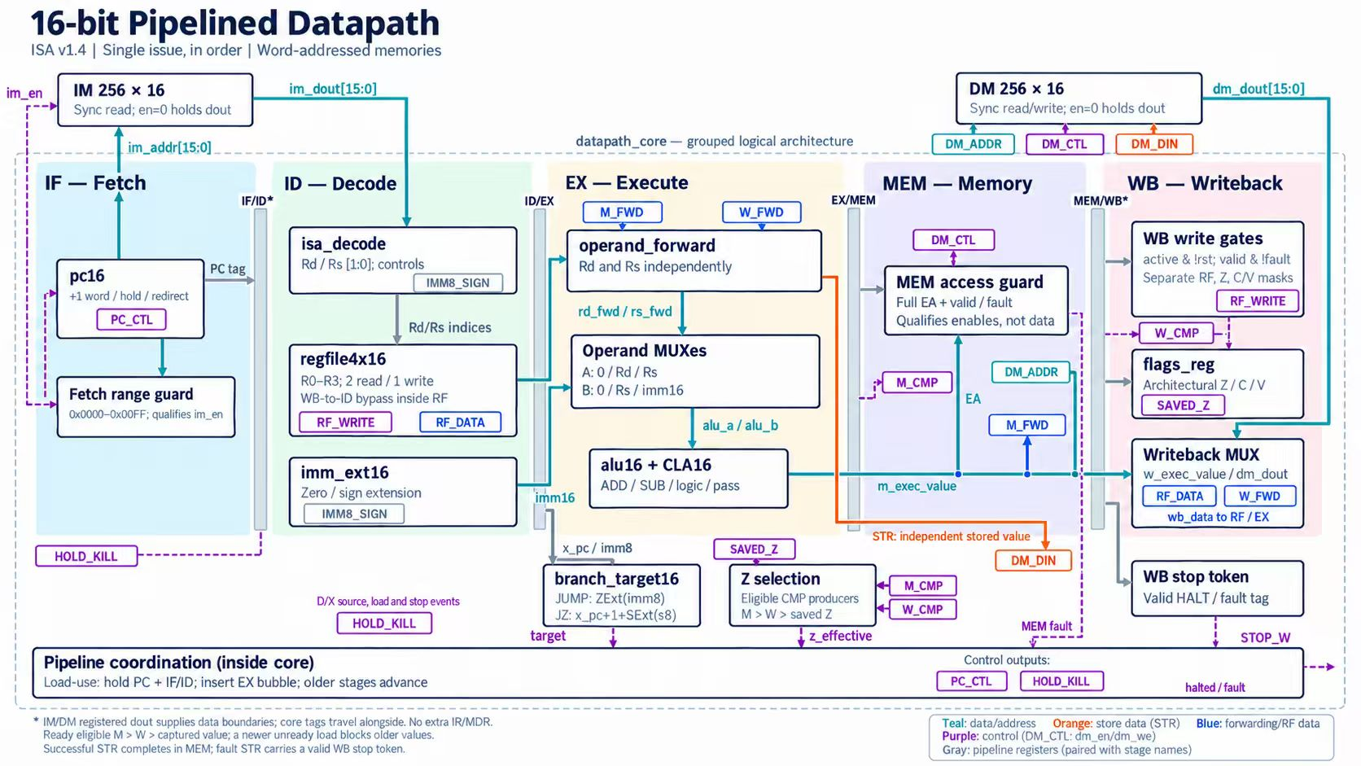
Appendix:

Slide 24
Appendix: Testbench Check Criteria
Operation | How TB generates expected values | Actual values compared
ADD / SUB | Call arithmetic_oracle; independently check C, V | Result, C/V Also check write destination in CPU tests
MOV / AND / OR | Use direct expressions | Output / writeback data
CMP | Direct comparison | eq, Z; flag write enables
LDR / STR | Maintain independent reference memory with the CPU's initial state, then update it independently by instruction rules. | Access address, store data Writeback value after load
JUMP / JZ | Update ref_pc. TB stores the expected instruction-completion sequence. For each valid CPU instruction completion, check against expectations. | PC of valid completed instruction and subsequent state
PRE4 · Datapath Implementation & Verification 07
Notes:
Slide 7 | What Criteria Does the Testbench Use?
The tests on slide 8 can determine a pass because the testbench independently calculates expected values for the same inputs and compares them with actual RTL outputs. ADD and SUB do not use another CLA as the oracle: integer addition or subtraction produces an exact result, then the low 16 bits are taken. Addition carry checks whether the result exceeds 65535; subtraction no-borrow checks whether a >= b. For overflow, operands are interpreted as signed values and the exact result is checked against -32768 to 32767. Logic operations use direct AND/OR expressions, MOV copies the source, and CMP directly tests equality.
For memory accesses and branches, the reference model maintains separate registers, a memory array and a PC. STR updates reference memory; LDR reads the expected value from it. Branches calculate the next execution position from the reference PC, immediate and reference Z, then compare against actual CPU completion events. The actual code line below compares the result and C/V with expected values; any mismatch enters the next line, $fatal, stopping the test. PASS is printed only after all checks finish. Independent stress tests also compare all registers, flags and 256 memory words after each clock-edge update. Thus the checking rules come from our test code, while Vivado XSim executes the simulation.
[Sources and Notes]
The three actual TB source files were checked; simulation was not rerun. Sources: tb_units.sv L87–103 arithmetic_oracle, L116–122 CLA and add/sub comparisons, L128–137 ALU and eq; tb_datapath.sv L38–87 reference, L120–133 event comparisons, final checks from L229; tb_stress.sv advance_nonstore, advance_store and per-edge checks in execute. ADD/SUB V checks whether the exact integer result is outside [-32768,32767], rather than copying RTL Boolean formulas. C uses addition >65535 or subtraction x>=y. Reference memory and registers start from the same initial state, then update independently. The reference model increments ref_pc by 1 after branch handling, so the JUMP branch subtracts 1 first. The main TB pregenerates an event sequence; stress independently advances on observed completion and checks the full architectural state each cycle. Decoder control_oracle independently packs an ISA-based control table; extension uses (mode&&i>=128)?i+65280:i; flags derive expected_flags from the old state, reset and mask.

Slide 25
Appendix: Simulation Waveform: Using Data Just After a Load
PC=0005 STR R0,[R3] → PC=0006 LDR R2,[R3] → PC=0007 CMP R0,R2
① Stall
② EX bubble
③ WB forwarding
PRE4 · Datapath Implementation & Verification 09
Notes:
Slide 9 | Simulation Waveform: Using Data Just After a Load
This actual waveform corresponds to STR, LDR and CMP, where CMP needs the data loaded by LDR. From 75 to 85 ns, LDR is in EX, load_use = 1 and im_en = 0, pausing further instruction fetch. From 85 to 95 ns, EX valid becomes 0, inserting a bubble while LDR continues into MEM. Thus the front end stalls, rather than all stages stopping together.
From 95 to 105 ns, CMP enters EX and LDR reaches WB. wb_data is 0008 and rs_fwd_sel is 2, selecting WB data for forwarding. This links the stage connections discussed earlier to the actual returned data. Read each PC together with its corresponding valid signal; a residual PC in an invalid slot does not identify an actively executing instruction.
[Sources and Notes]
Source: user-provided wave_load (2).png, unchanged. x = EX, m = MEM, w = WB. Time is case-relative ns; PC and data are hexadecimal, while rs_fwd_sel is a decimal encoding. The image has no clk signal, so no artificial clock is added. Intervals follow the original axis: 75–85 stall, 85–95 bubble, 95–105 WB forwarding.

Slide 26
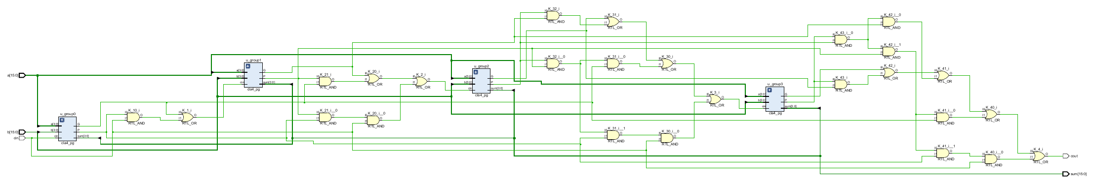
Appendix: CLA16 analysis
22 PRE4 Backup / Q&A
Notes:
Presenter Backup. Target Q&A.
Actual EDA diagram from the same delivered design source. The RTL and mapping views have different purposes. Zoom the original PDF for exact pins and instance names. Resource optimization may remove diagnostic PC tags unused by the synthesized interface; RTL simulation retains these tags for event checking. No placement/routing claim is made.
Sources: eda/rtl_cla16.pdf; eda.tcl

Slide 27
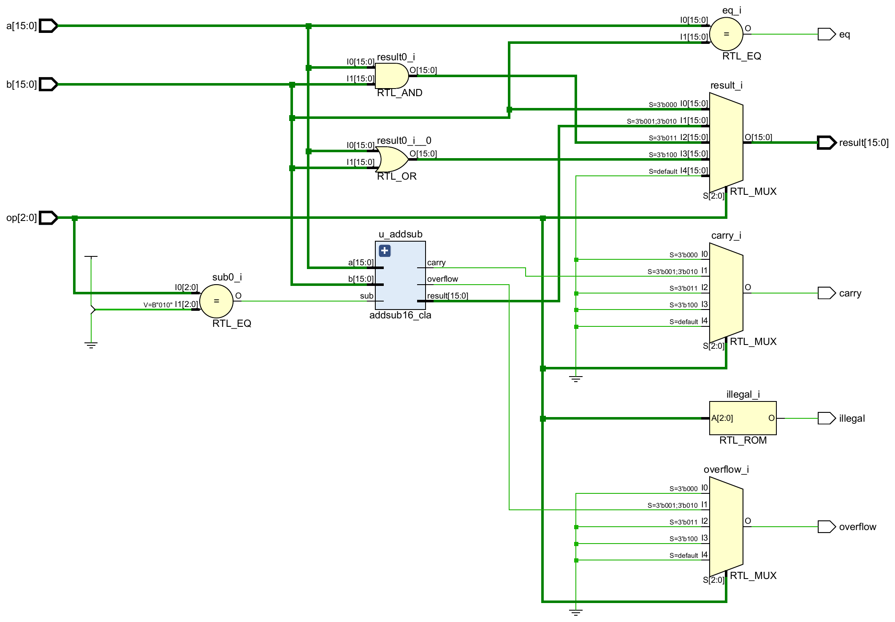
Appendix: ALU analysis
23 PRE4 Backup / Q&A
Notes:
Presenter Backup. Target Q&A.
Actual EDA diagram from the same delivered design source. The RTL and mapping views have different purposes. Zoom the original PDF for exact pins and instance names. Resource optimization may remove diagnostic PC tags unused by the synthesized interface; RTL simulation retains these tags for event checking. No placement/routing claim is made.
Sources: eda/rtl_alu.pdf; eda.tcl

Slide 28
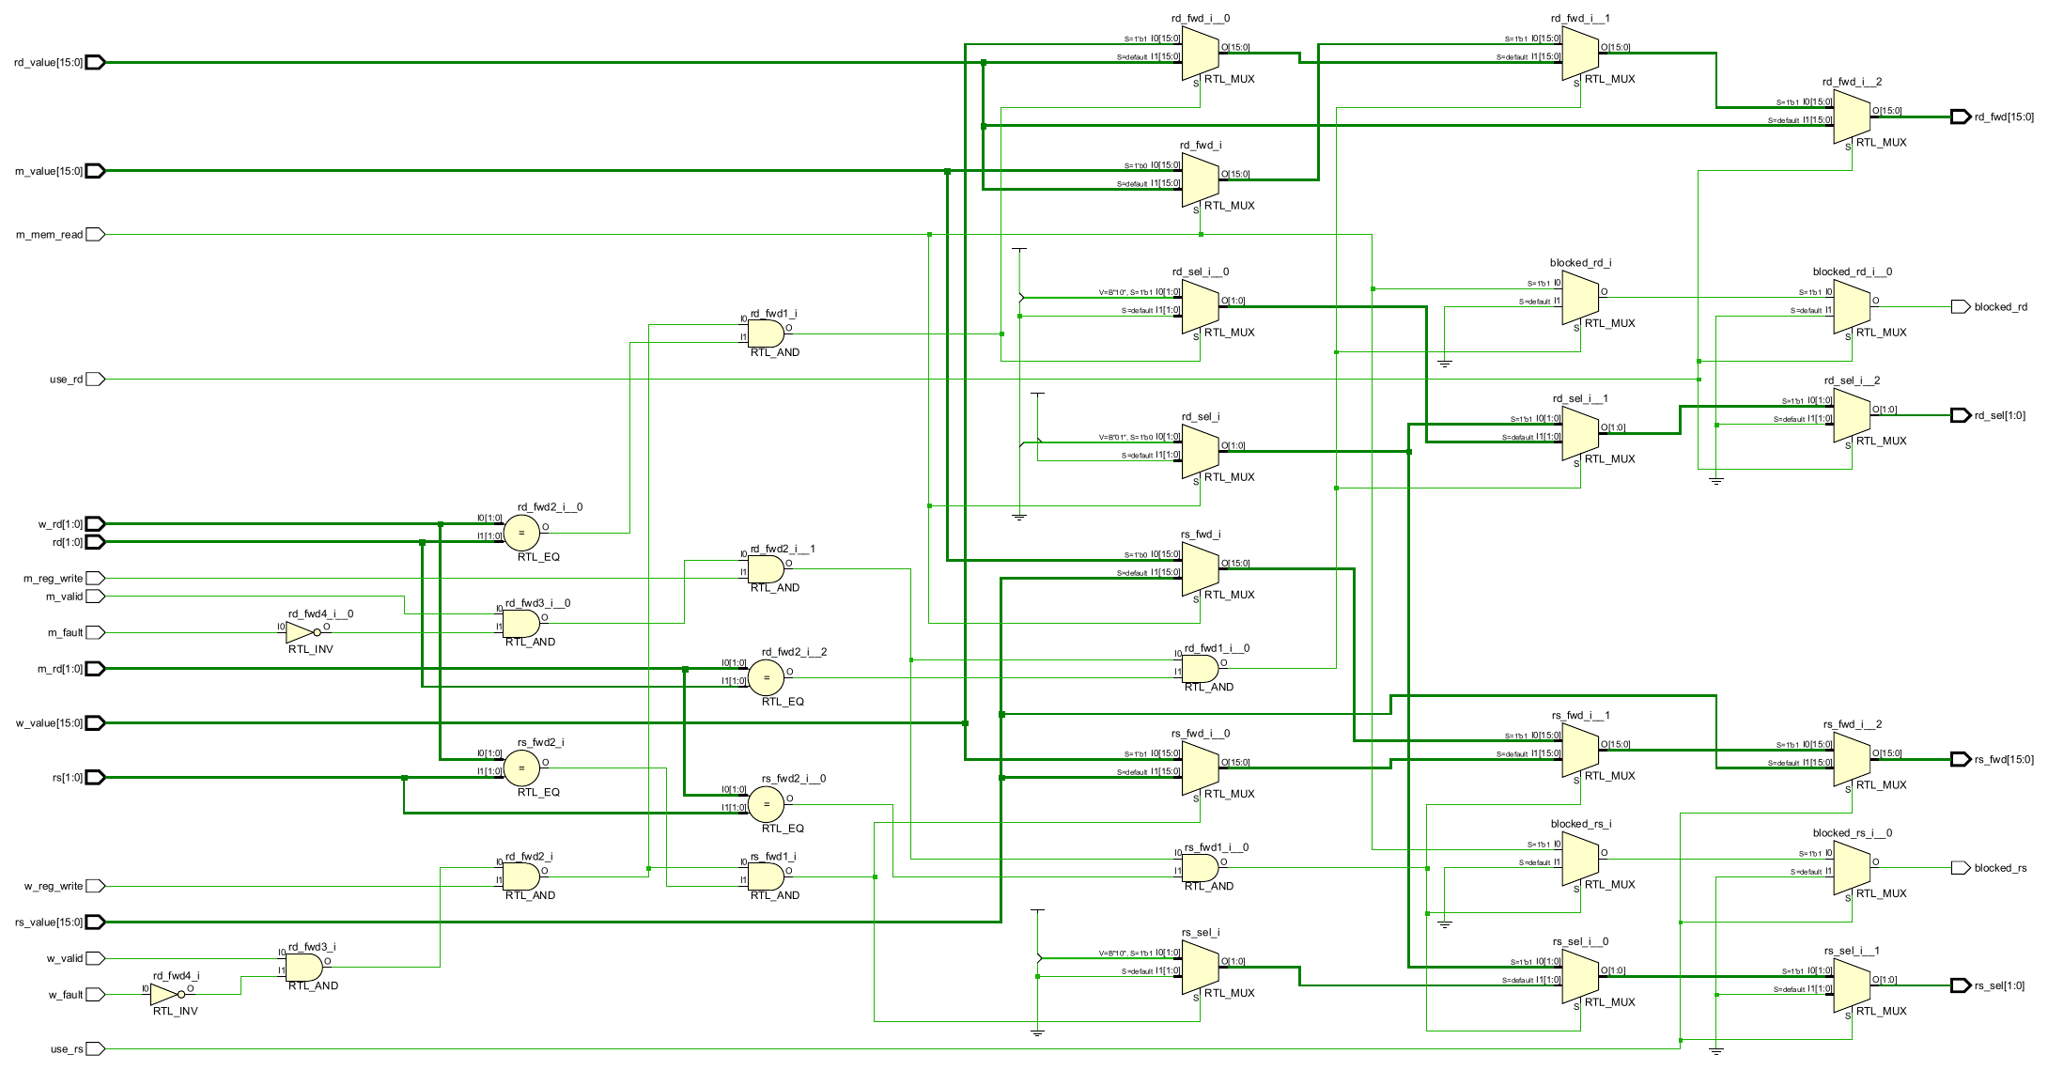
Appendix: Forwarding analysis
24 PRE4 Backup / Q&A
Notes:
Presenter Backup. Target Q&A.
Actual EDA diagram from the same delivered design source. The RTL and mapping views have different purposes. Zoom the original PDF for exact pins and instance names. Resource optimization may remove diagnostic PC tags unused by the synthesized interface; RTL simulation retains these tags for event checking. No placement/routing claim is made.
Sources: eda/rtl_forward.pdf; eda.tcl

Slide 29
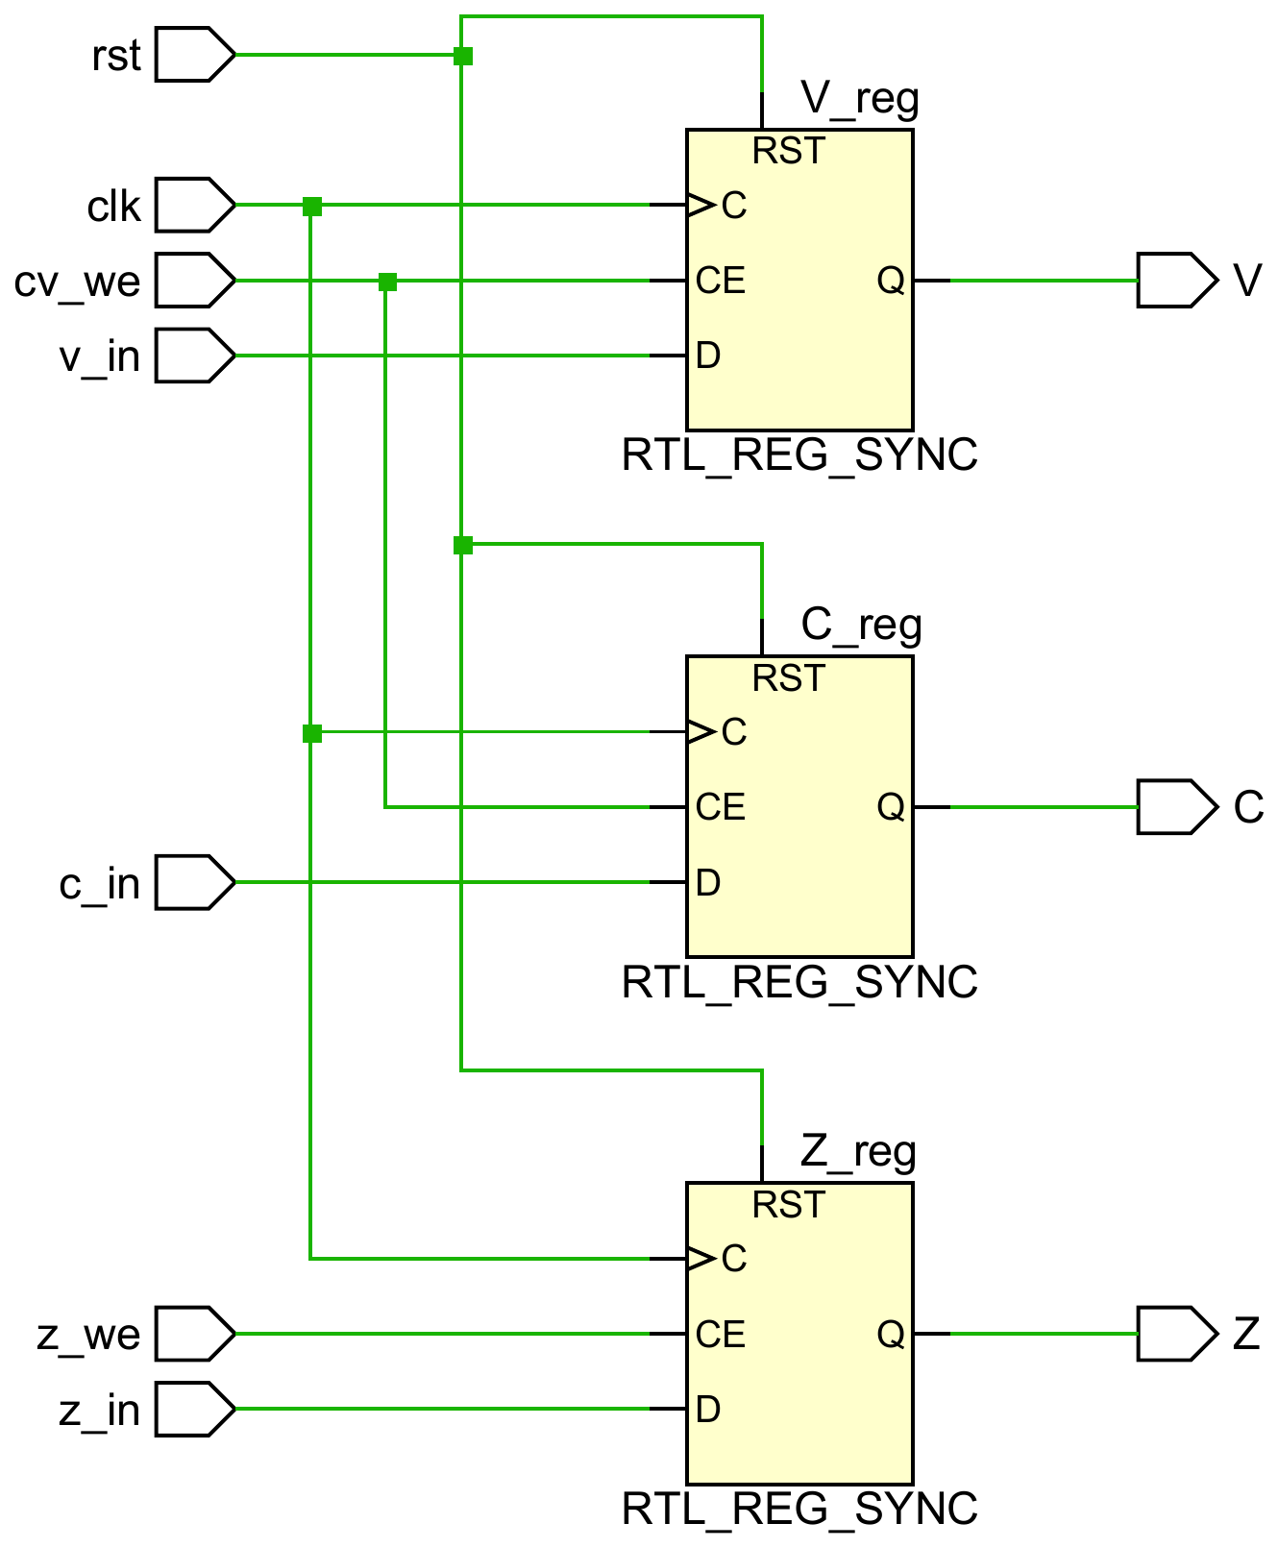
Appendix: Flags analysis
25 PRE4 Backup / Q&A
Notes:
Presenter Backup. Target Q&A.
Actual EDA diagram from the same delivered design source. The RTL and mapping views have different purposes. Zoom the original PDF for exact pins and instance names. Resource optimization may remove diagnostic PC tags unused by the synthesized interface; RTL simulation retains these tags for event checking. No placement/routing claim is made.
Sources: eda/rtl_flags.pdf; eda.tcl

Slide 30
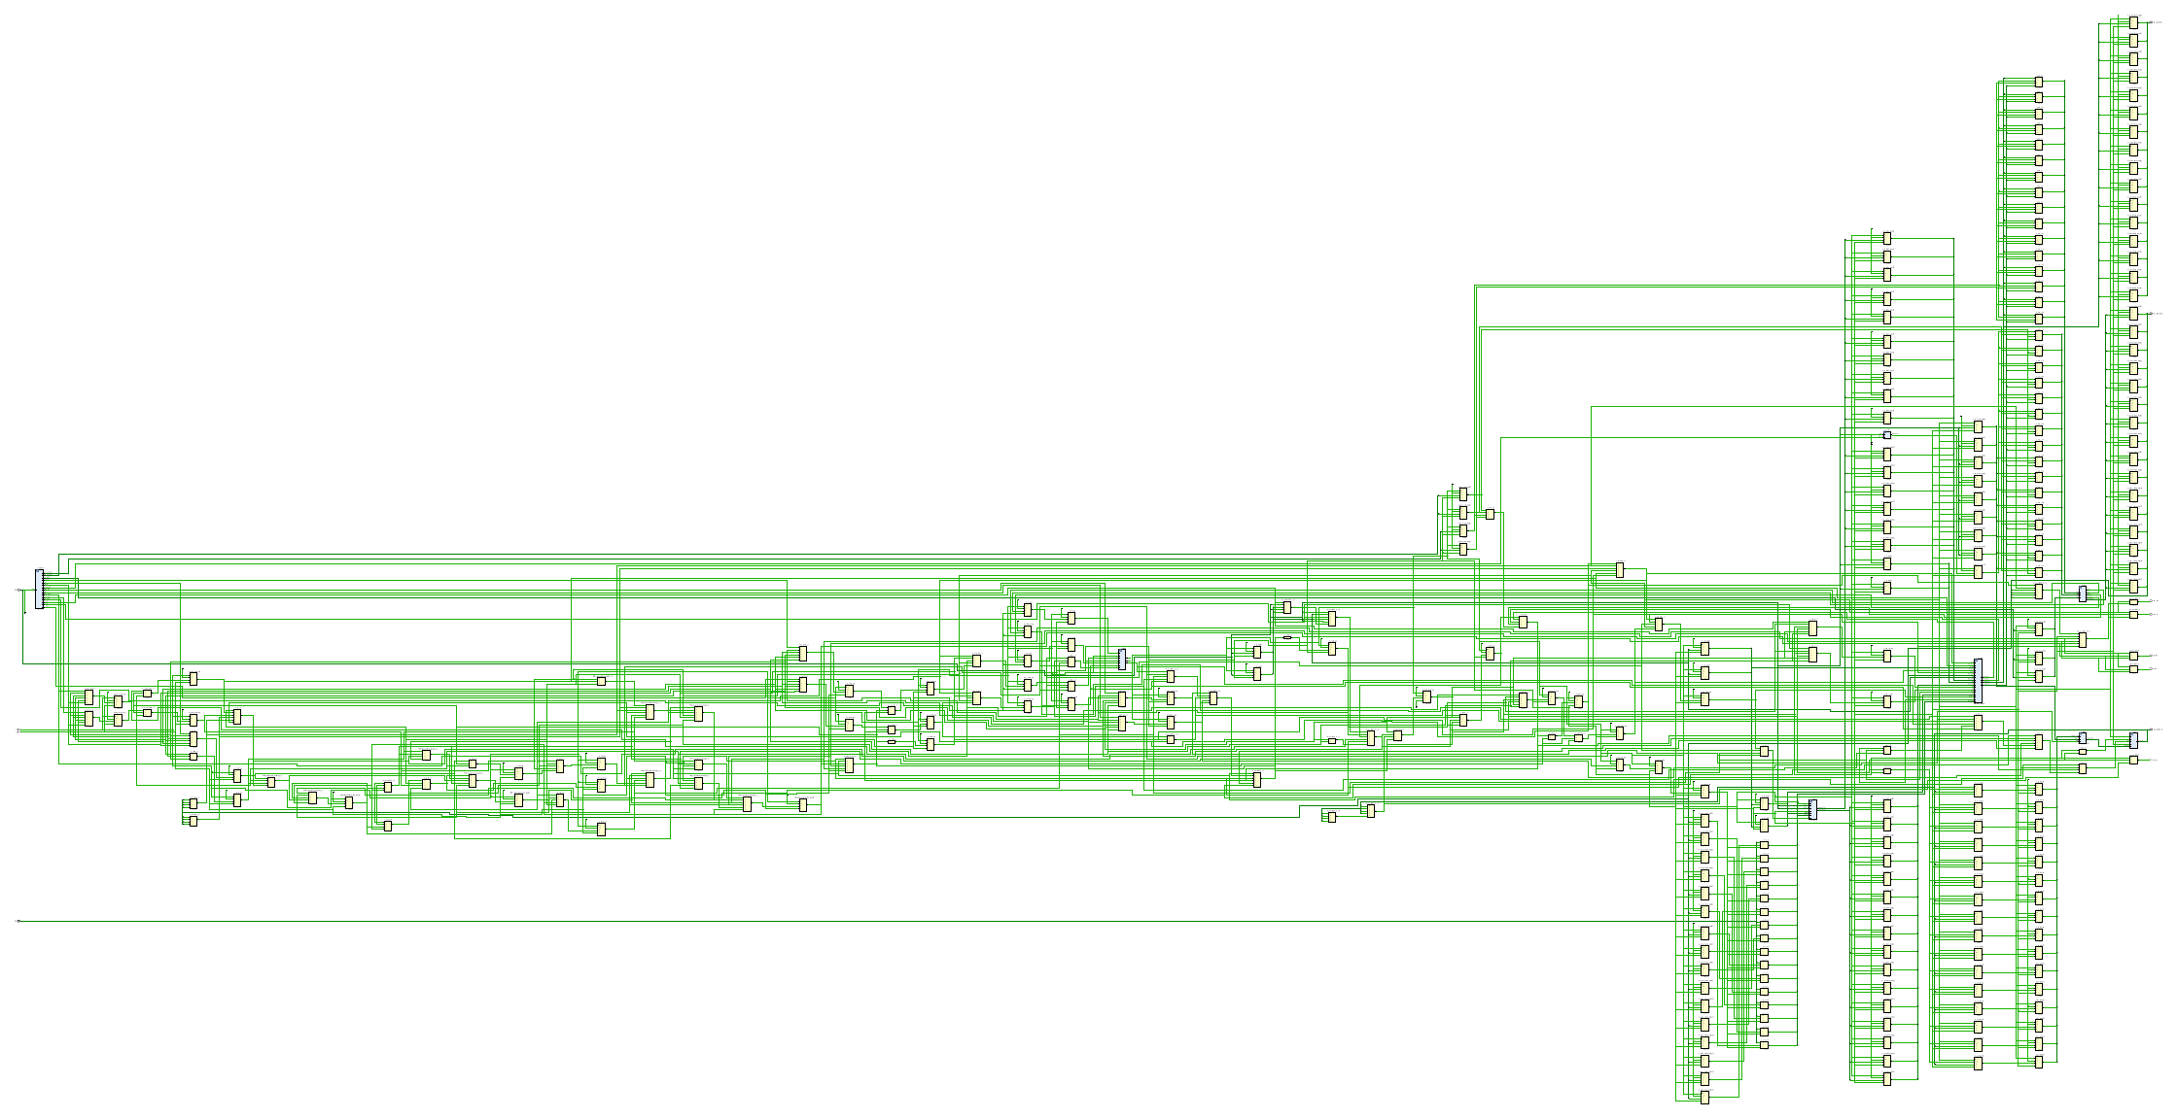
Appendix: Mapped core
26 PRE4 Backup / Q&A
Notes:
Presenter Backup. Target Q&A.
Actual EDA diagram from the same delivered design source. The RTL and mapping views have different purposes. Zoom the original PDF for exact pins and instance names. Resource optimization may remove diagnostic PC tags unused by the synthesized interface; RTL simulation retains these tags for event checking. No placement/routing claim is made.
Sources: eda/mapped_core.pdf; eda.tcl

