Slide 1
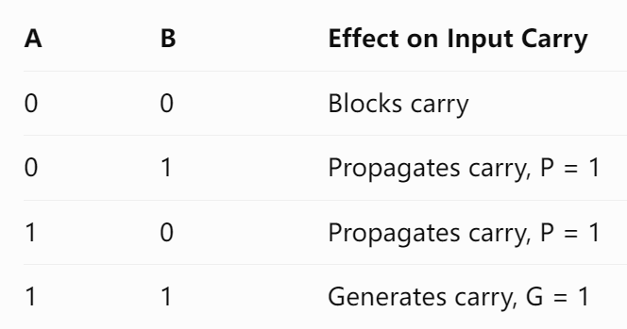
Two-level CLA arithmetic
Group lookahead: P/G do not depend on cin
$K_{1}=G_{0}∨\left(P_{0}K_{0}\right)$ $K_{2}=G_{1}∨P_{1}G_{0}∨P_{1}P_{0}K_{0}$
P0 / G0
P1 / G1
P2 / G2
P3 / G3
CLA4 group 0
bits [3:0]
cin = K0
CLA4 group 1
bits [7:4]
cin = K1
CLA4 group 2
bits [11:8]
cin = K2
CLA4 group 3
bits [15:12]
cin = K3
$p_{i}=a_{i}⊕b_{i}$Propagate $g_{i}=a_{i}∧b_{i}$Generate
08 PRE4 C / 1:00
Notes:
Presenter C. Target 1:00.
The ALU retains PASS_B, ADD, SUB, AND and OR as internal operations. ADD and SUB use one complement-and-carry path: subtraction flips b and sets the initial carry to one. Four CLA4 groups calculate bit propagation and generation. A separate group network computes K1 through K4 directly from the group P and G values. We do not chain one group’s output carry into the next group’s input. Group P and G are independent of carry-in. The source and RTL analysis view establish that structure. The FPGA mapping is a separate view, and by itself does not establish a speed advantage.
Sources: 16位流水线CPU核心设计文档 v1.4 (2026-10-08), §§1–4 §2.4.3; rtl/cla16.v; eda/rtl_cla16.pdf

Slide 2
ADD immediate through the datapath
Eg：ADD R0, 1
C1 / IF
C2 / ID
C3 / EX
C4 / MEM
C5 / WB
Fetch 5001
Tag pc=0000
Read R0：7FFF
ZExt(01)
CLA: 8000
C/V = 0/1
Pass result
No DM access
R0 = 8000
Write C/V
5001: R0=7FFF → R0=8000, C=0, V=1
C indicates no borrow in subtraction. V is signed overflow.
10 PRE4 C / 0:50
Notes:
Presenter C. Target 0:50.
Use machine word 5001 at PC zero with R0 equal to 7FFF. ID selects the old Rd and zero-extends the immediate. EX forwards the latest R0, selects a and b, then the CLA produces 8000, carry zero and overflow one. These candidate values enter EX/MEM, pass through MEM without a memory request, and reach WB. At the fifth ending edge, RF receives 8000 and C/V receive zero and one; Z holds. The candidate in EX is not yet architectural state. Every stage shown belongs to this instruction, while other instructions occupy other stages in parallel.
Sources: 16位流水线CPU核心设计文档 v1.4 (2026-10-08), §§1–4 §3.2.1; diagrams/instruction_add.svg

