Slide 1

Wine Suggestion App
December 11, 2018
By team DrinkDrankDrunk

Slide 2
Overview
Want to go on a hot, romantic date, but you only have 30 minutes to buy a drink? Want to show your significant other how classy you are, but you have no clue about wine? Worry no more! Come to our site and find the perfect choice of wine that will fit your food, your budget, and your needs! Our application is designed to help you find the perfect wine that fulfills your requirements and also provides you with information about the choice we suggested! If you are not satisfied with our choice, then go find your own :) !!! Please do not forget to read our No Refund Guarantee Policy.

Slide 3
Tools And Database We Used
Tools
Database
Python
Pandas
Numpy
Flask
Re
JavaScript
Plotly
D3
Node.js (npm)
Gulp.js
Jquery
HTML/CSS
MongoDB

Slide 4

Data Scraping and Cleaning

Slide 5
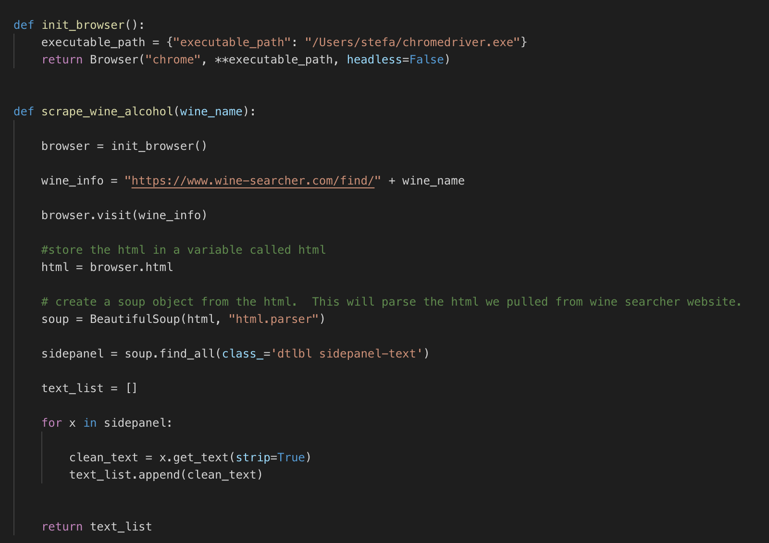
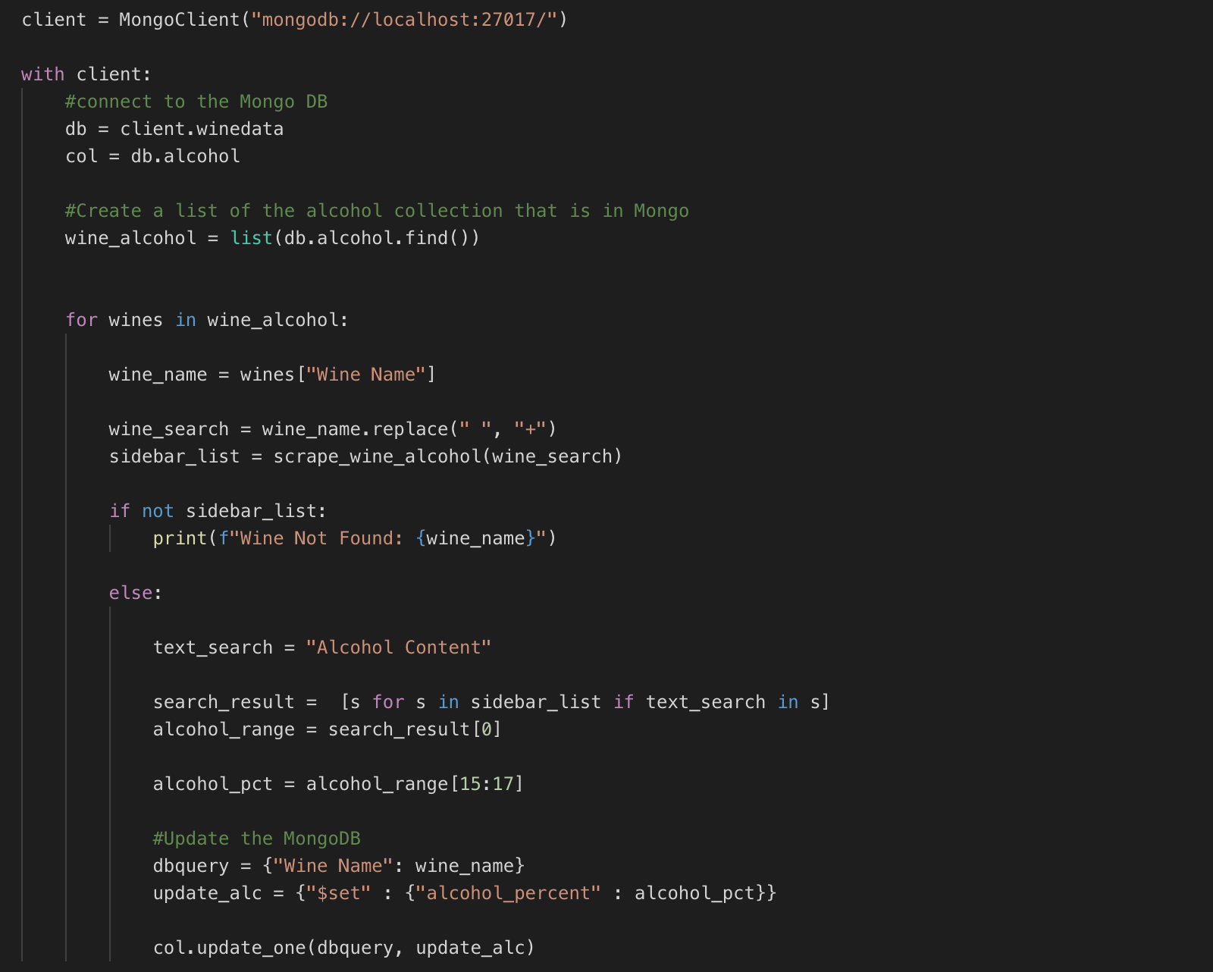
Scraping From wine-searcher.com

Slide 6
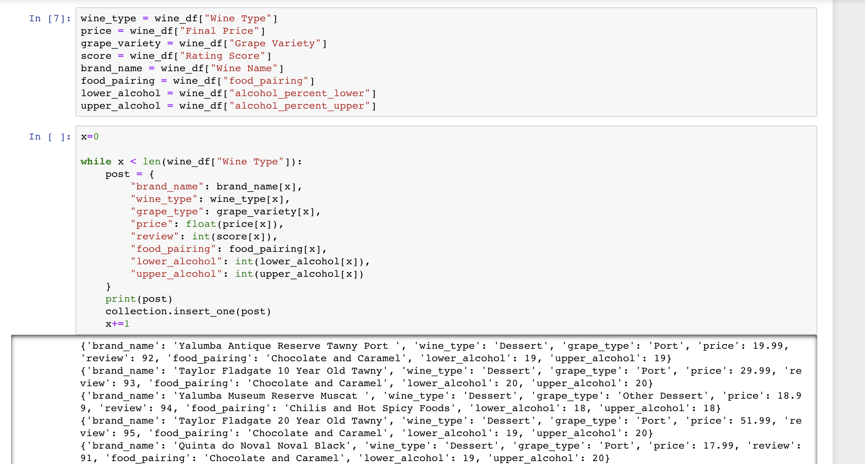
Data Resource And Cleaning
Data Resources:
http://insightmine.com/bring-your-own-data-analyzing-wine-market/ (Credible Reviews based on Wine Enthusiasts)
Jupyter Notebook
We use jupyter notebook to do drop N/A and return the cleaned dataframe

Slide 7
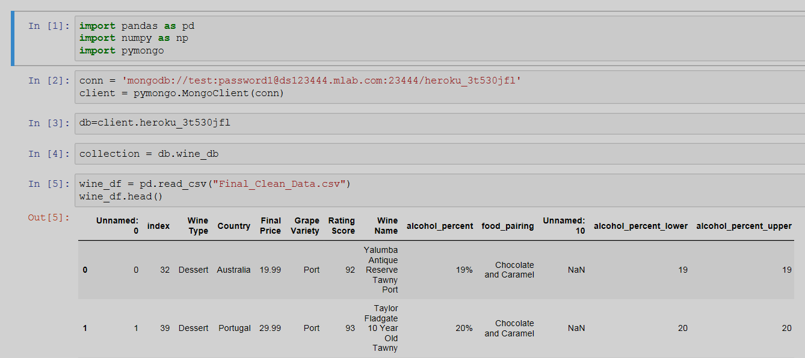
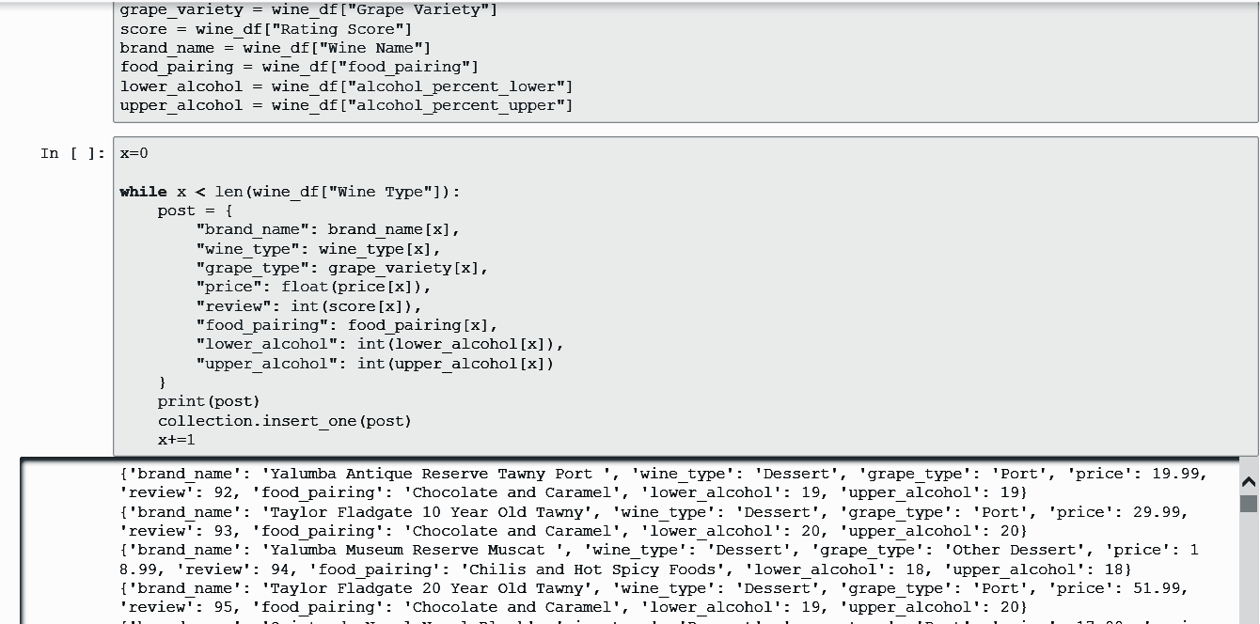
Update MongoDB
Jupyter Notebook
Some notes:
Although pandas may recognize csv data as int or float, mongo may not read it the same way. Thus, when creating the object, we still need to add int(), and float() in front of the data to ensure it become the correct dType.

Slide 8
Wine analysis
Each of us chose a factor to make the wine analysis.
The factors we used included:
Food Pairing
Wine Review vs Price
Wine Taste
Jan
Feb
Mar
Apr
May
Jun
Jul
Jul
Jan
Feb
Mar
Apr
May
Jun
Jul
Jul
12/01 | 12/04 | 12/06 | 12/08 | 12/11
Get Mongo database ready
Deployment
Working on project
Collecting and cleaning Data
Present the app

Slide 9




Team #DrinkDrankDrunk
Edward Chen
Stefanie Huckleberry
Xinyue Shi
Yu Hsuan Liu
Final Product Link: https://whatwine.herokuapp.com/
GitHub Repo: https://github.com/Donthave1/DrinkDrankDrunk
PLEASE DRINK RESPONSIBLY
Copyright © Data Bootcamp 2018

