Slide 1

Teamwork Management System
Batch: A05
Members:
D Deepthi - 22BQ1A0553
Ch Bala Prameela Rani - 22BQ1A0529
D Leela Chaitanya - 22BQ1A0540
A Chaitanya - 23BQ5A0502
Project Guide :
Mrs. D . Vamsi
(Assistant Professor)

Slide 2
Abstract:
Traditionally, guides and students relied on methods such as notes, emails, spreadsheets, or verbal updates to manage tasks. These fragmented approaches often led to miscommunication, missed deadlines, and challenges in tracking progress. The lack of a centralized platform resulted in disorganized teamwork, incomplete tasks, and reduced productivity.
Our project introduces a web application designed to transform teamwork management for guides and students. Guides can efficiently assign tasks, add users and can form teams, and track progress, while students gain access to comprehensive task details, guide information, and progress update options. By streamlining communication and emphasizing deadlines, boosts productivity. With a focus on clarity, this solution empowers users to complete their tasks with efficiency and ease.

Slide 3
Purpose:
This will be very useful for guides , who can able to assign the task to students and see their progress updatedly.
Modules :
User Management Module
Guides Module
Users Module
Connection Module

Slide 4
1.User management module
Features :
User can Register and sign in
Role-based access control
Designing of home page
Profile setup
Costumer roles and permission password reset

Slide 5
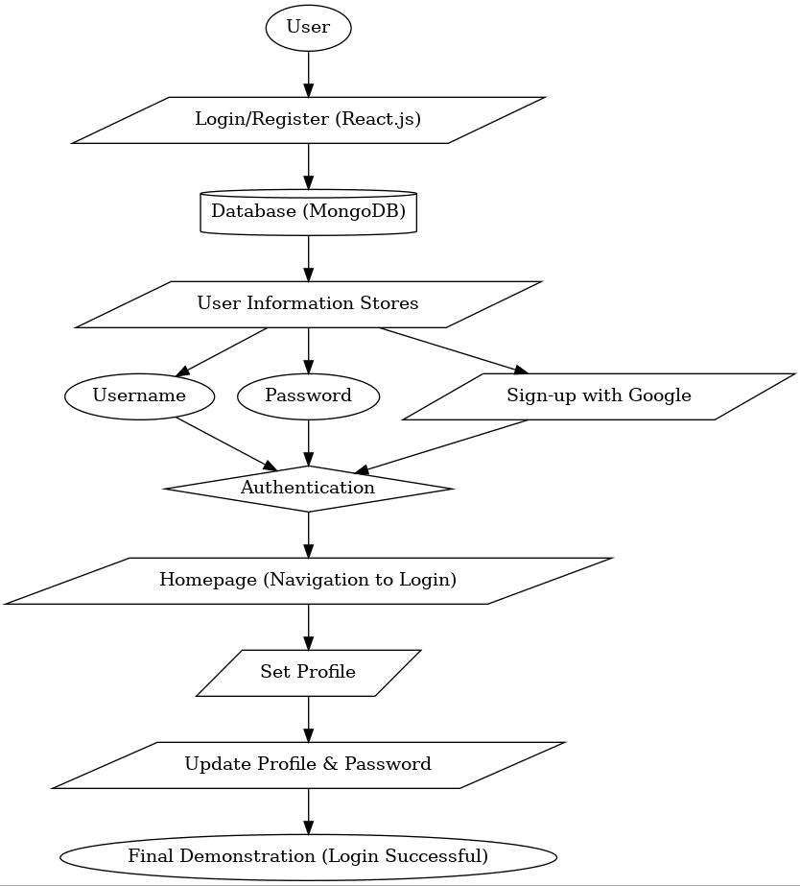
Flow Chart

Slide 6
2 . Guide Module
Features :
Adding users.
Able to create teams of existing users.
Assign tasks and deadlines to users.
Monitor progress of teams.
Creating Dashboard

Slide 7
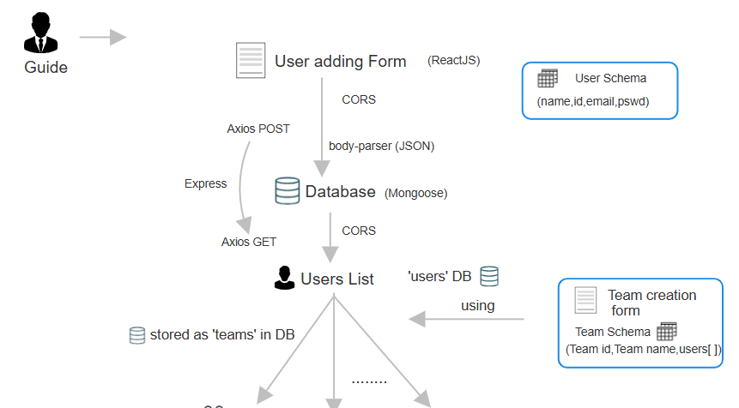
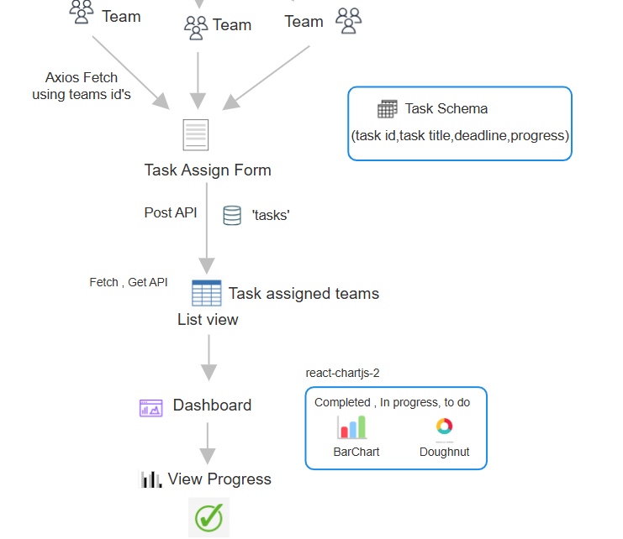
Flow chart:

Slide 8
3 . User Module
Features :
View assigned tasks and deadlines.
Accessing the task related assets.
Submit task updates and progress.
Inform to Guide when tasks are issued.
Progress Visualization.

Slide 9
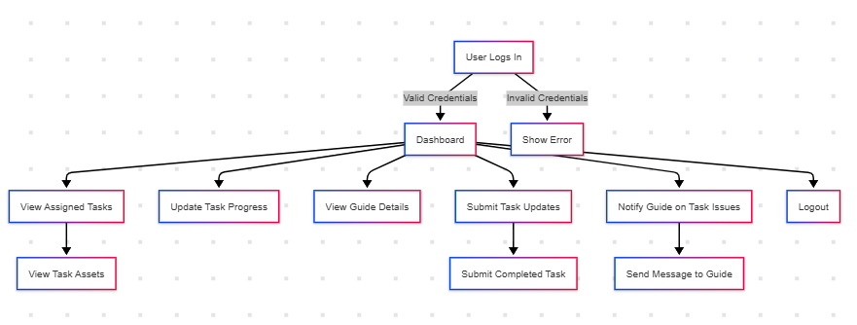
Flow Chart

Slide 10
4 . Connection Module
Features :
Task-Specific Discussions.
File sharing and Attachments.
Loading assets
Implementing settings
Getting reviews/feedback

Slide 11
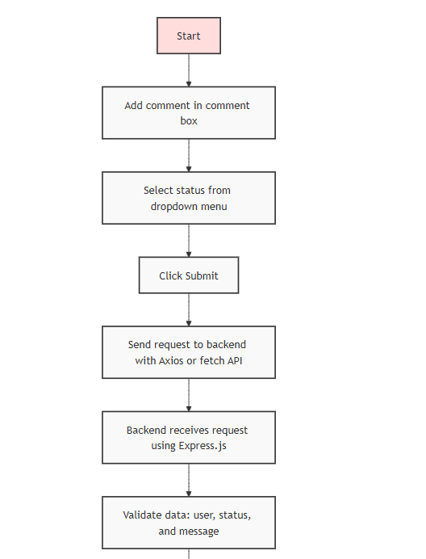
Flow Chart
For comment Section

Slide 12
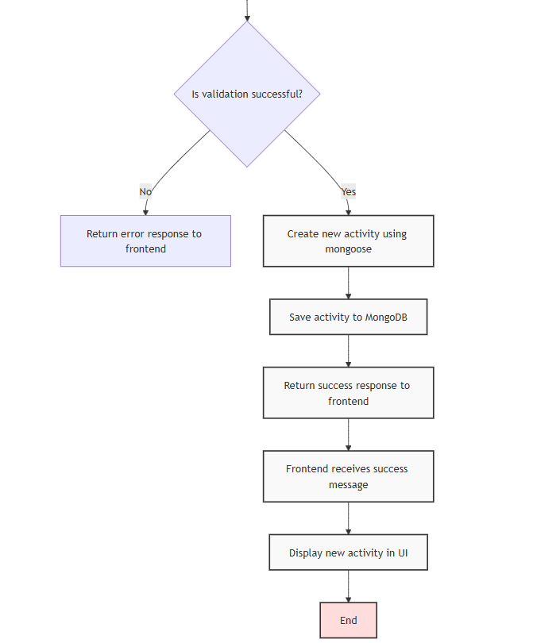

Slide 13
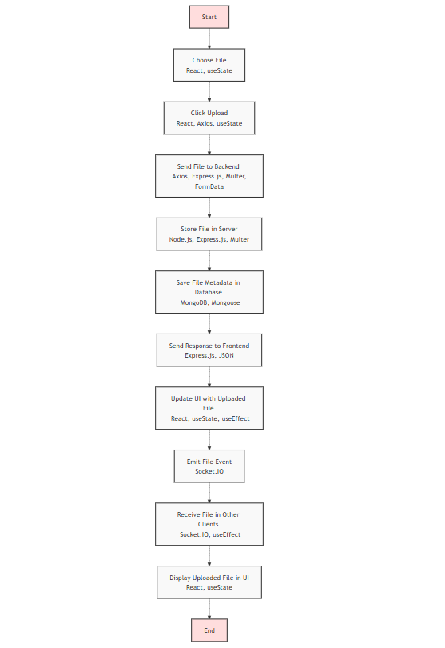
FOR FILE UPLOAD

