Slide 1

Architecture and Design Document
Education to People having
no access to formal education

Slide 2
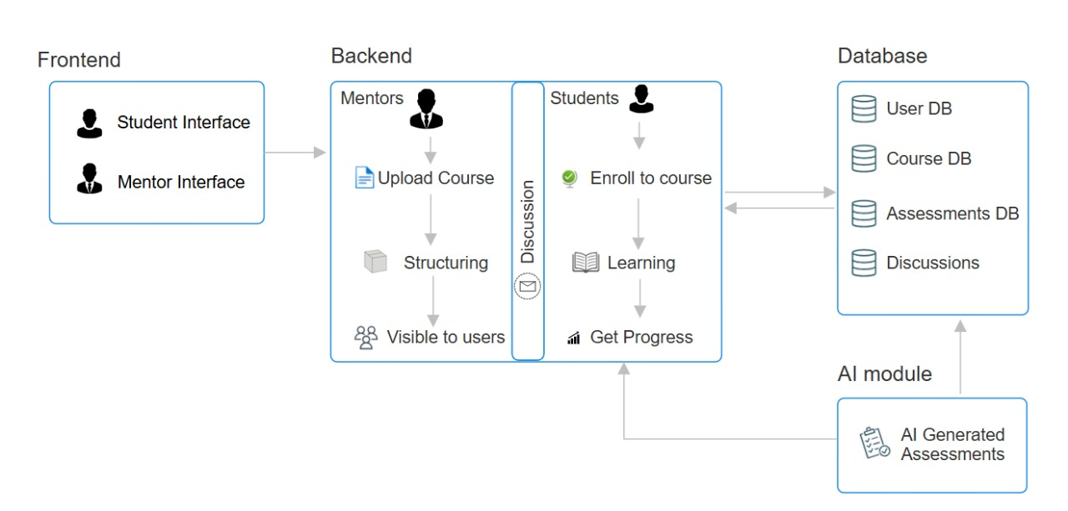
Architecture Document
1. Architecture Diagram

Slide 3
2. Flow of Information Between Blocks
Frontend (Student & Mentor Interface) → Backend
Mentors upload courses.
Students enroll in courses, learn, and track progress.
Backend → Database
Courses, users, assessments, and discussions are stored in respective databases.
Backend ↔ AI Module
AI generates assessments and sends them to the database.
Student progress and learning data are analyzed by AI for improvements.
Backend ↔ Discussion System
Students and mentors communicate through discussions, stored in the database.
Backend → Frontend (Students & Mentors)
Students access courses, assessments, and discussions.
Mentors track student progress and update course content.

Slide 4
3. Explanation of the blocks
Frontend
Acts as the user interface where students, mentors interact with the system.
Provides access to learning courses, progress, discussion sessions, and assessments.
Backend
Responsible for processing assessments, loading courses, and posting responses.
Acts as the bridge between the Learning Portal and the Database.
Database
Learning courses for students , Assessment results submitted by students , Discussion session data for future reference, enrolled students list for mentors etc.
AI
Providing the course that we want to take assessment and get the assessment on that course and the result of that assessment.

Slide 5
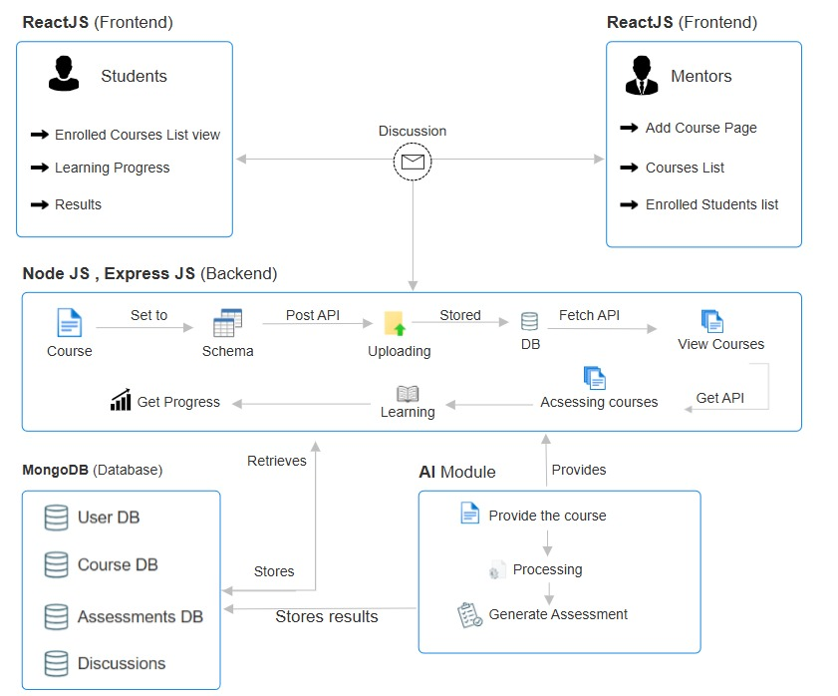
Design Document
1. Technology Diagram

Slide 6
2. Flow of information between blocks
Mentors :
Mentor (ReactJS) → Sends course data → Node.js backend → Stores in MongoDB.
Students :
Student (ReactJS) → Requests course data (API call) → Node.js fetches from MongoDB → Sends to Student UI.
Assessments & Progress Tracking:
Student takes an assessment → Data sent to AI module → AI processes and evaluates → Results stored in MongoDB.
Discussion Between Students & Mentors:
Messages shared between students & mentors → Stored in MongoDB → Retrieved when needed.
AI Module Enhancements:
AI generates course recommendations & assessments → Sends them to the backend → Available for students.

Slide 7
3. Explanation of the blocks
ReactJS (Frontend) – Students & Mentors
Students and Mentors interact with the platform via the frontend built with ReactJS.
Student Features:
View enrolled courses
Track learning progress
Check assessment results
Mentor Features:
Add new courses
View course list
Check enrolled students
Discussion Module
A communication channel between students and mentors.
Supports Q&A, doubts resolution, and collaboration.

Slide 8
3. Node.js & Express.js (Backend)
Handles API requests from the frontend.
Features:
Stores courses, learning progress, assessments in the database.
Fetches data from the database for students and mentors.
Uploads and retrieves course materials.
4. MongoDB (Database)
Stores all platform data:
User DB: Student and mentor details.
Course DB: Course content and structure.
Assessments DB: Student scores and progress.
Discussions: Stores conversations between students and mentors.
5. AI Module
Enhances learning through automation and intelligence.
Features:
Generates personalized course recommendations.
Creates and evaluates assessments.

