Slide 1
HYDROCULTURE USING IOT
VIDYA JYOTHI INSTITUTE OF TECHNOLOGY
Autonomous Insitution
Aziz Nagar, Hyderabad - 500075
Under the guidance of
Ms.K.Nirosha
Asst.Professor
AI dept.
By:
D . Vaishnavi (20911A3521)
S . Chaithrika (20911A3555)
E . Soujanya (21915A3505)
B . Saritha (20911A3570)

Slide 2
Problem Statement
Technological developments today make the combination of science very common, including in Computer Science and Agriculture, where both sciences complement each other. This project aims to develop an automated control system for managing nutrient flow, environmental conditions (temperature control using artificial light), and water management ,in hydroponic plants, employing an Arduino microcontroller
Additionally, we plan to integrate this hydroponic system with HTML for recording sensor readings and providing recommendations. This integration will allow users to monitor the system remotely, access historical data, and receive real-time recommendations for optimizing plant growth. By combining hardware automation with web-based interfaces, we aim to create a comprehensive solution for modern hydroponic farming practices.
8/25/2023

Slide 3
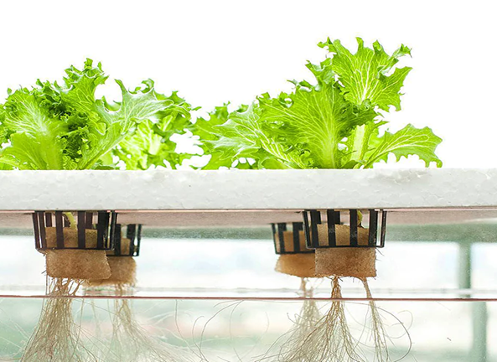
Introduction
Hydroponics is a type of horticulture and a subset of hydroculture which involves growing plants, usually crops or medicinal plants, without soil, by using water-based mineral nutrient solutions. Terrestrial or aquatic plants may grow with their roots exposed to the nutritious liquid or the roots may be mechanically supported by an inert medium such as perlite, gravel, or other substrates.

Slide 4
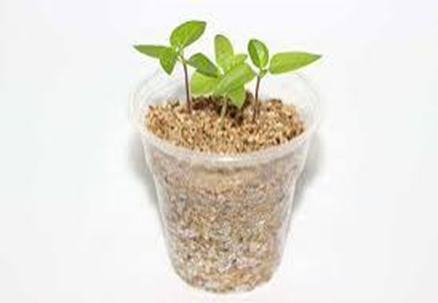
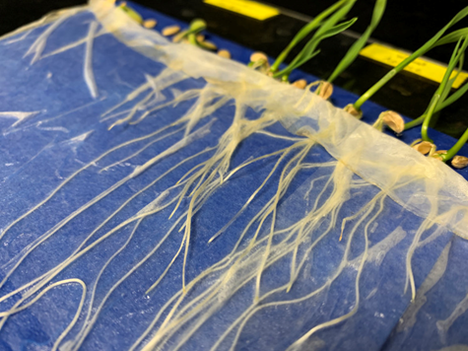
Introduction
Germination methods utilizing a solid substrate such as peat moss, coco coir, perlite, or vermiculite are often used, but transplanting requires removing all the substrate from the roots to avoid its introduction into the hydroponic system.
Few seeds can germinate submerged in water and thus cannot be planted directly into the nutrient solution in liquid hydroponics. Submersion in water inhibits oxygen diffusion across seed membranes and prevents germination.
For maximum uniformity, seeds should be germinated separately and transplanted into the main system when roots are long enough to be in contact with the nutrient solution immediately after transplanting

Slide 5
Literature Survey
JOHN SMITH , MARY JOHNSON[2022]
“IoT-Enabled Smart Hydroponics : A comprehensive review of IoT applications in hydroponics, highlighting benefits, challenges, and future directions”
Publication : Journal of Agriculture Technology (25% and Rank1)
EMILY BROWN , DAVID LEE [2020]
“Automation and Control of Nutrient Delivery in Hydroponic Systems :Discusses automated nutrient delivery systems, their impact on crop yield, and the role of IoT in enhancing nutrient management”
Publication : Agricultural Engineering Conference (20% and Rank2)

Slide 6
ALAN CLARK , SARAH GREEN [2021]
“Data Analytics for Precision Agriculture in Hydroponics :Explores the use of data analytics to optimize hydroponic crop production, including real-time monitoring and decision-making.”
Publication : International Journal of Agricultural Science (15% and Rank3)
JAMES WILSON , MARIA MARTINEZ [2019]
“Scalability and Sustainability in Smart Hydroponic Farming :Examines the scalability challenges and sustainability implications of IoT-enabled hydroponics systems, offering recommendations for large-scale adoption”
Publication : Sustainable Agriculture Symposium (15% and Rank4)

Slide 7
Existing System
There is a manual hydroponic system, growers take a hands-on approach to every aspect of plant cultivation, from nutrient delivery to environmental control. This traditional method relies on the grower's expertise and vigilant monitoring to ensure optimal conditions for plant growth. Nutrients are mixed and administered manually, following a predetermined schedule based on plant needs and growth stages.
Growers meticulously observe environmental factors like temperature, humidity, and light levels, making adjustments as necessary to maintain the ideal growing environment. This approach offers a deep level of control and customization, allowing growers to tailor every aspect of the system to suit the specific requirements of their plants.
8/25/2023

Slide 8
Existing System
Despite its labor-intensive nature, manual hydroponics offers advantages in terms of flexibility and adaptability. Growers have the freedom to experiment with different nutrient formulations, lighting regimes, and growing techniques to optimize crop yield and quality.
This hands-on approach fosters a strong connection between growers and their plants, enabling them to respond swiftly to any signs of stress or disease.
While it may require more effort and time compared to automated systems, manual hydroponics remains a valuable and reliable method for those who relish the art and science of tending to plants and seek a deeper understanding of their growth.
8/25/2023

Slide 9
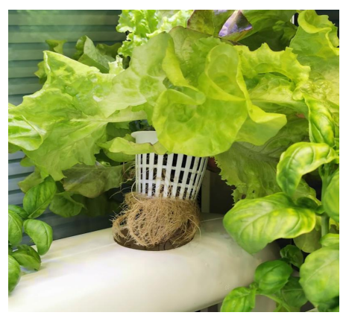
Existing System

Slide 10
Limitations
Initial Cost:
Setting up a hydroponic system can involve higher initial costs compared to traditional soil-based methods. Expenses include infrastructure, pumps, nutrient solutions, and monitoring equipment.
Complexity:
Hydroponic systems can be complex and require a certain level of technical knowledge. Beginners may find it challenging to set up and maintain an efficient hydroponic system.
Dependency on Technology:
Hydroponic systems heavily rely on technology, such as pumps, sensors, and controllers. Power outages or technical failures can disrupt the system, potentially impacting plant health.

Slide 11
Limitations
Sensitivity to Environmental Factors:
Hydroponic systems are sensitive to environmental factors like temperature and humidity. Fluctuations in these conditions can impact nutrient uptake and plant growth.
Disease Spread:
While hydroponic systems can reduce the risk of soil-borne diseases, they are not immune to pathogens. Diseases can still spread through water systems, affecting multiple plants.
Nutrient Imbalance:
Maintaining the correct balance of nutrients is crucial in hydroponics. If not properly monitored and adjusted, nutrient imbalances can occur, leading to deficiencies or toxicities in plants.

Slide 12
Limitations
Risk of System Failures:
Mechanical failures, such as pump malfunctions or clogging in nutrient delivery systems, can occur. These failures may lead to inadequate nutrient supply, affecting plant growth.
Dependency on Electricity:
Hydroponic systems often rely on electricity to power pumps, lights, and environmental control systems. Dependence on electricity poses a vulnerability, especially in regions with unreliable power infrastructure.
Skill and Knowledge Requirements:
Successful hydroponic cultivation demands a certain level of expertise and ongoing attention. Novice growers may struggle to grasp the nuances of nutrient management, pH control, and environmental optimization.

Slide 13
Objective
The objective of a hydroculture using the Internet of Things (IoT) is to enhance the efficiency, productivity, and sustainability of hydroponic farming practices by integrating advanced technologies and data-driven solutions.
Hydroponics is a method of growing plants without soil, using nutrient-rich water solutions. By incorporating IoT technologies into hydroponics systems, the goal is to optimize various aspects of plant cultivation, resource management, and monitoring.
In addition to its hardware automation capabilities, our hydroponic system is poised to embrace the digital realm through seamless integration with HTML. This integration represents a crucial step towards enhancing user accessibility and data management. By incorporating HTML, users will gain the ability to remotely access and interact with the hydroponic system via web-based interfaces

Slide 14
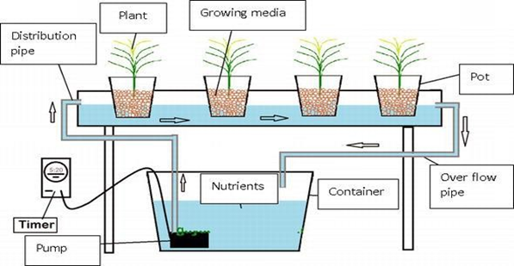
Methodology

Slide 15
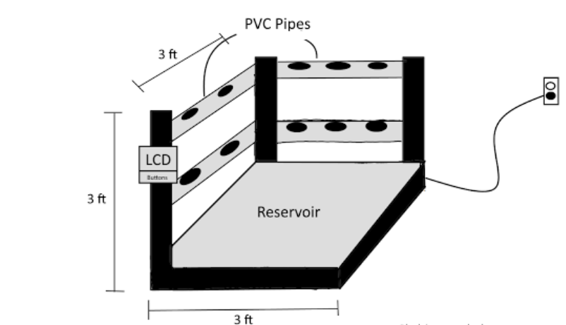
Methodology
Physical Structure
Open-air tower structure, approximately 3 feet tall with the water reservoir mounted underneath the base of the structure containing about 10 gallons of water.
Main tower structure contains about 15-20 plant bays for plants to grow out of. The plant bay will be slightly slanted outwards at an angle from the center of the tower.
This configuration allows for gravity to assist in water drainage back into the reservoir.
An even amount of light should be projected to all plants on the tower.

Slide 16
Methodology
Water Level Management
The water pump must be strong enough to pump water up and through the tower system.
This implies that for a ten gallon system, the water pump should be able to pump at the minimum rate of five gallons per hour at a head height of about 6ft.
The ideal pH range for most hydroponic plants is between 5.5 and 6.5.
The ideal water temperature range is between 65 and 80 degrees Fahrenheit.
An oxygen stone will be needed to reside in the water reservoir in order to properly oxygenate the water as it is pumped to the plants.

Slide 17
Methodology
Environment control
Maintain an optimal temperature range for the specific plant species being grown.
This range can vary but is typically between 68°F (20°C) and 78°F (26°C).
Use heating systems to raise temperatures during cooler periods.
Provide appropriate lighting conditions for plant growth, especially when using indoor hydroponic systems.

Slide 18
Methodology
Nutrient Management
Maintaining healthy plant growth and maximizing crop yields.
Effective nutrient management involves providing the right balance of essential nutrients, monitoring nutrient levels, and maintaining proper pH levels.
Maintain the pH of the nutrient solution within the recommended range for the specific plant species (commonly between 5.5 and 6.5).
pH levels affect nutrient uptake; deviations can lead to nutrient imbalances and plant stress. Use pH meters and pH-adjusting chemicals to control and adjust pH as needed.

Slide 19
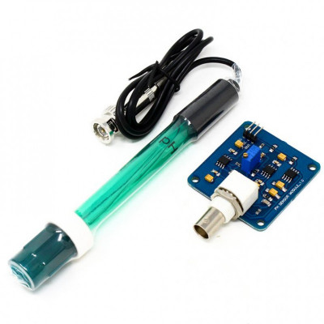
Components
pH Sensors:
pH sensors in hydroponics measure the acidity or alkalinity of the nutrient solution, ensuring it falls within the optimal range of 5.5 to 6.5 for most hydroponic plants.
Maintaining the correct pH level is crucial for nutrient availability and absorption by plant roots.
Regular monitoring and adjustment of pH levels prevent nutrient imbalances that can lead to deficiencies or toxicities, impacting overall plant health and growth.
8/25/2023

Slide 20
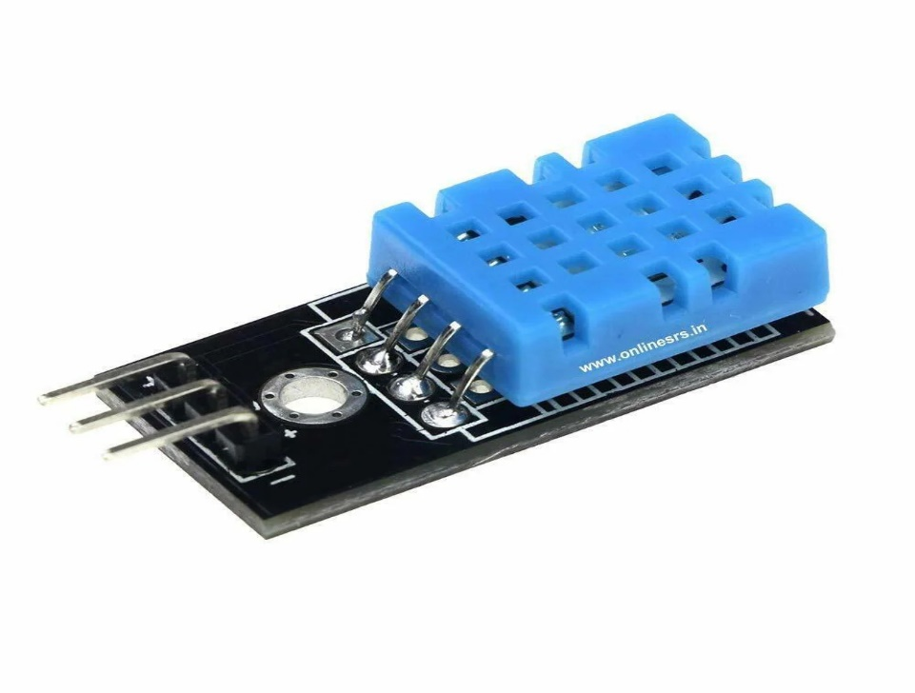
Components
Temperature Sensors:
Temperature sensors in hydroponics monitor both the nutrient solution and the surrounding environment.
Maintaining an optimal temperature range (typically 18-24°C or 65-75°F) is critical for enzymatic activity, nutrient uptake, and overall plant metabolism.
These sensors allow growers to identify and rectify temperature fluctuations that could negatively impact plant growth and health.

Slide 21
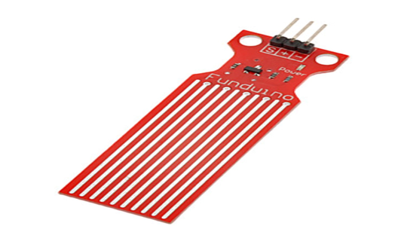
Components
Water Level Sensor:
The water level sensor, often connected to an analog pin, measures the depth of the nutrient solution in the reservoir.
It provides real-time data on the water level, ensuring continuous monitoring of the nutrient solution's availability to the plants.
The sensor's readings dictate the activation or deactivation of the water pump based on predefined thresholds.

Slide 22
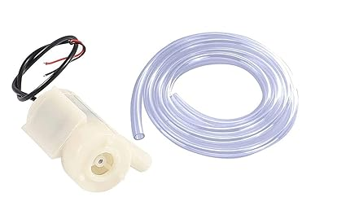
Components
Water Pump:
The water pump, controlled by a dedicated pin, is responsible for circulating the nutrient solution through the hydroponic system.
It activates when the water level sensor detects a decrease in the nutrient solution below a specified threshold.
The pump ensures a continuous flow of nutrient-rich water to the plant roots, promoting optimal nutrient absorption.

Slide 23
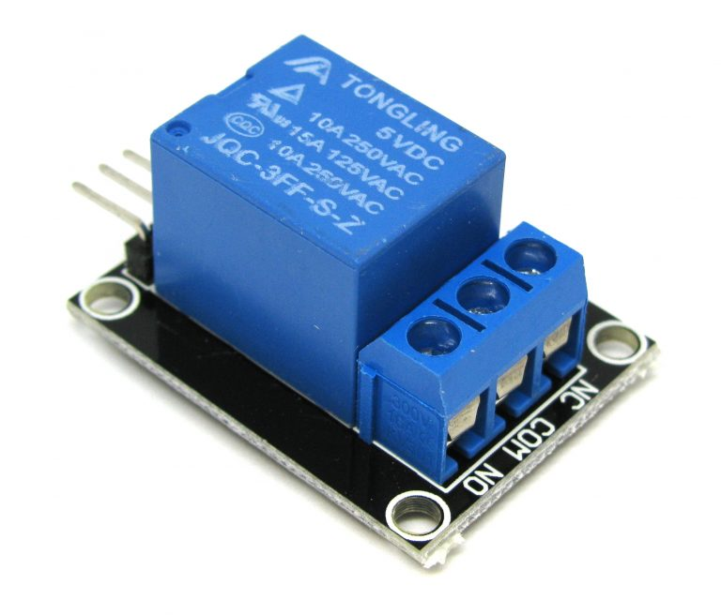
Components
Relay:
It is known as a single channel because only one relay is used and it operates on 5V.
Relay module consists of six pins such as normally open pin , normally closed, common, signal, Vcc and ground pins.
Signal Pin: It is used to control the relay. This pin can be active low or active high.

Slide 24
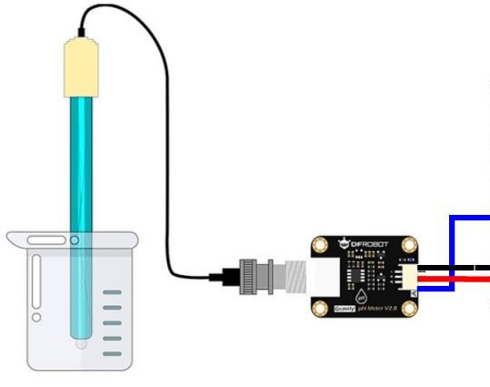
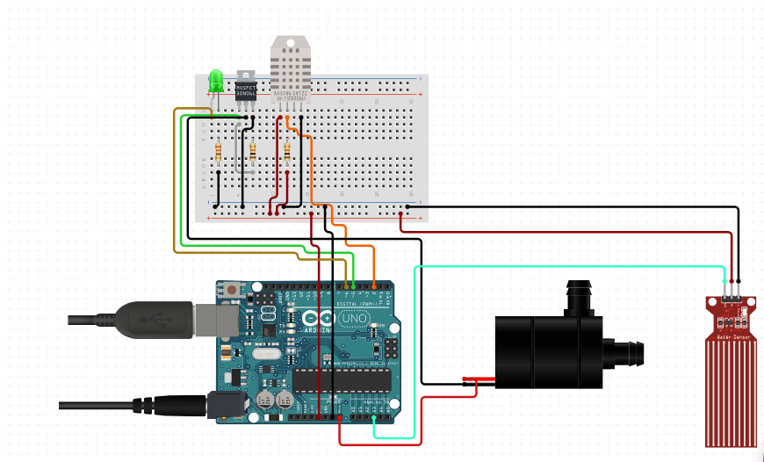
Circuit Diagram
8/25/2023

Slide 25
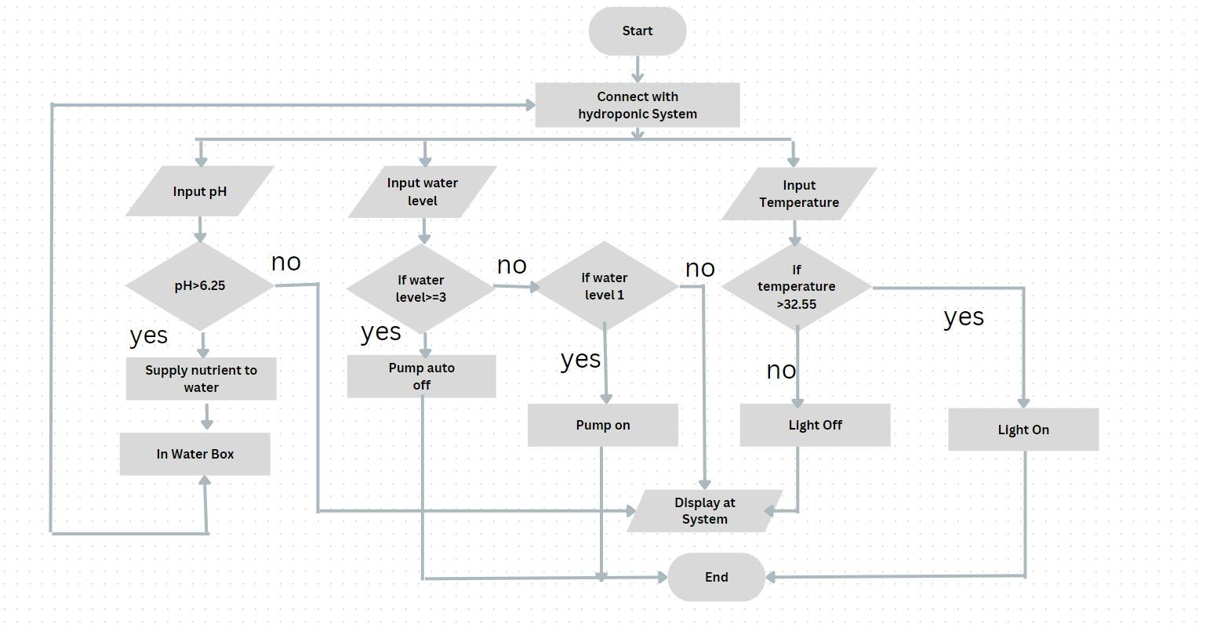
Flow Chart

Slide 26
Advantages
Needs No Soil
Conserves Water
Facilitates a Micro-Climate
Predictability and Seasonality
Crops Grow Faster
Maximizes Space
Produces Higher Yields
Require Less Labor
Shortens the Supply Chain
Produces Higher Quality Food

Slide 27
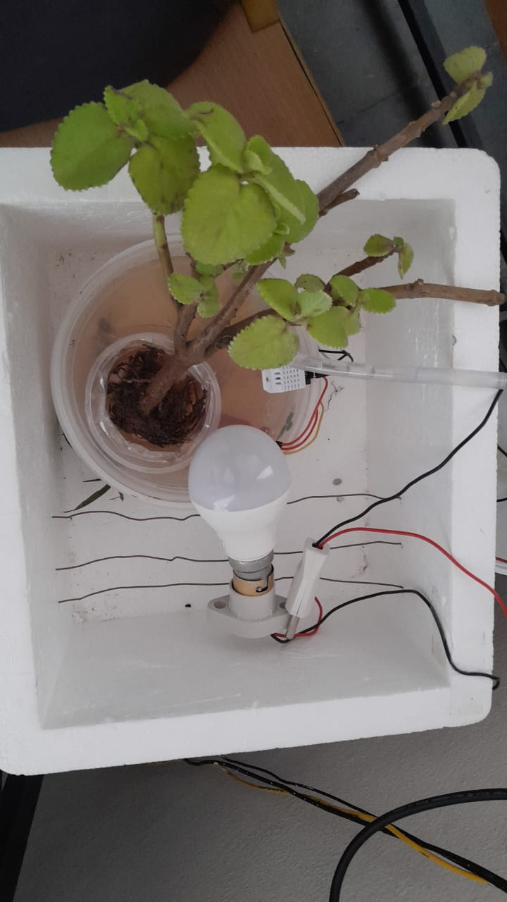
Results
Maintaining the right temperature is crucial for plant growth in hydroponic systems.
The IoT system ensure that the temperature is controlled automatically, reducing the risk of heat stress or cold damage to the plants.
Proper light management is essential for photosynthesis and plant development.

Slide 28
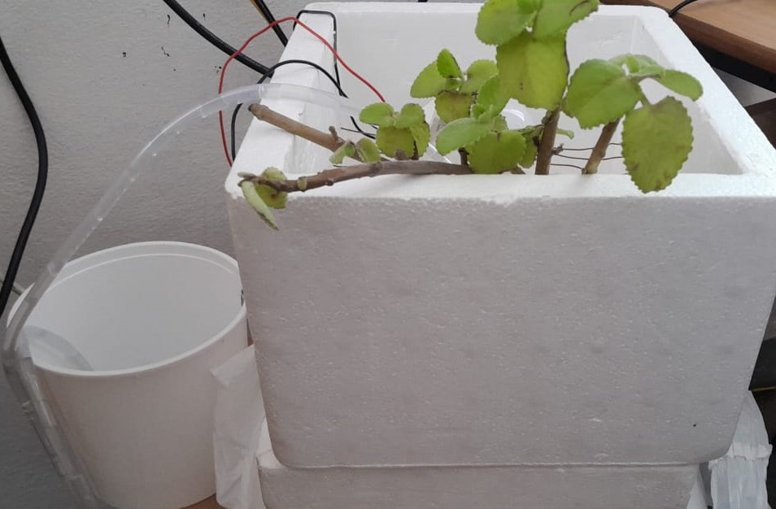
Results
Maintaining the correct water level is critical for plant nutrient delivery and overall system stability.
The IoT system's ability to detect low water levels and activate the water pump ensures continuous nutrient circulation and prevents plant dehydration.
This feature also helps conserve water by avoiding overflows.

Slide 29
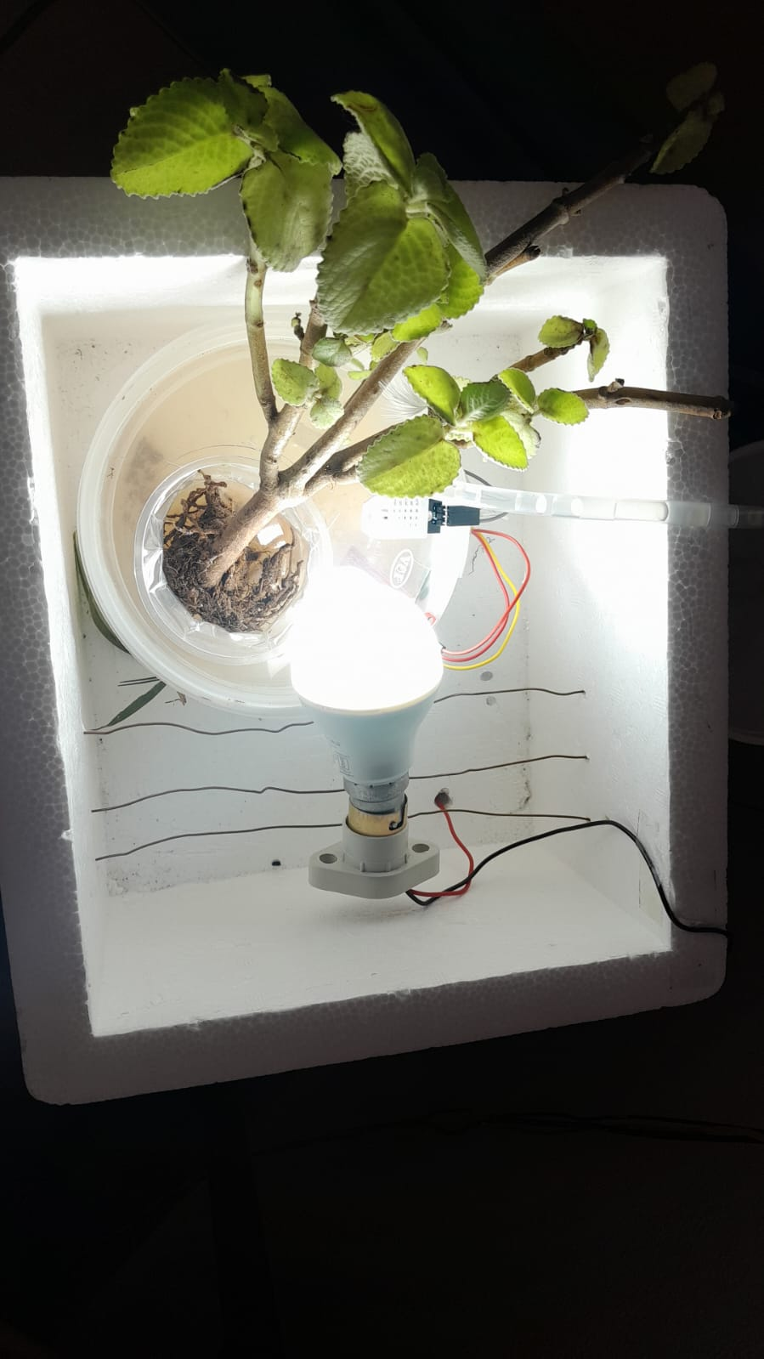
Results
Efficient temperature and light control reduce energy consumption, making the system eco-friendlier.
Proper water management minimizes water wastage and promotes responsible water use.

Slide 30
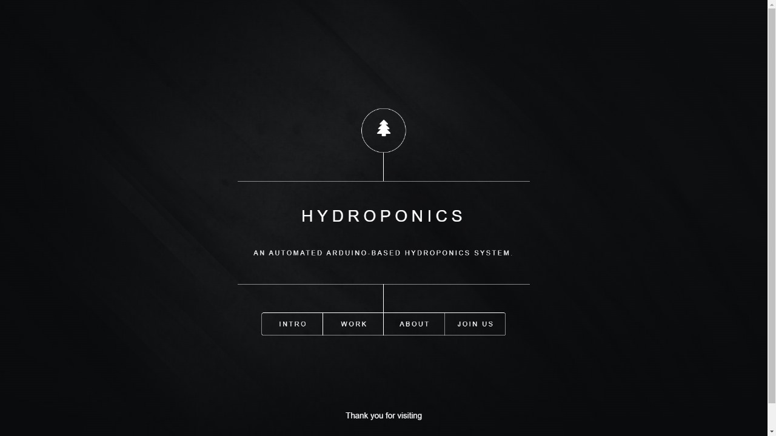
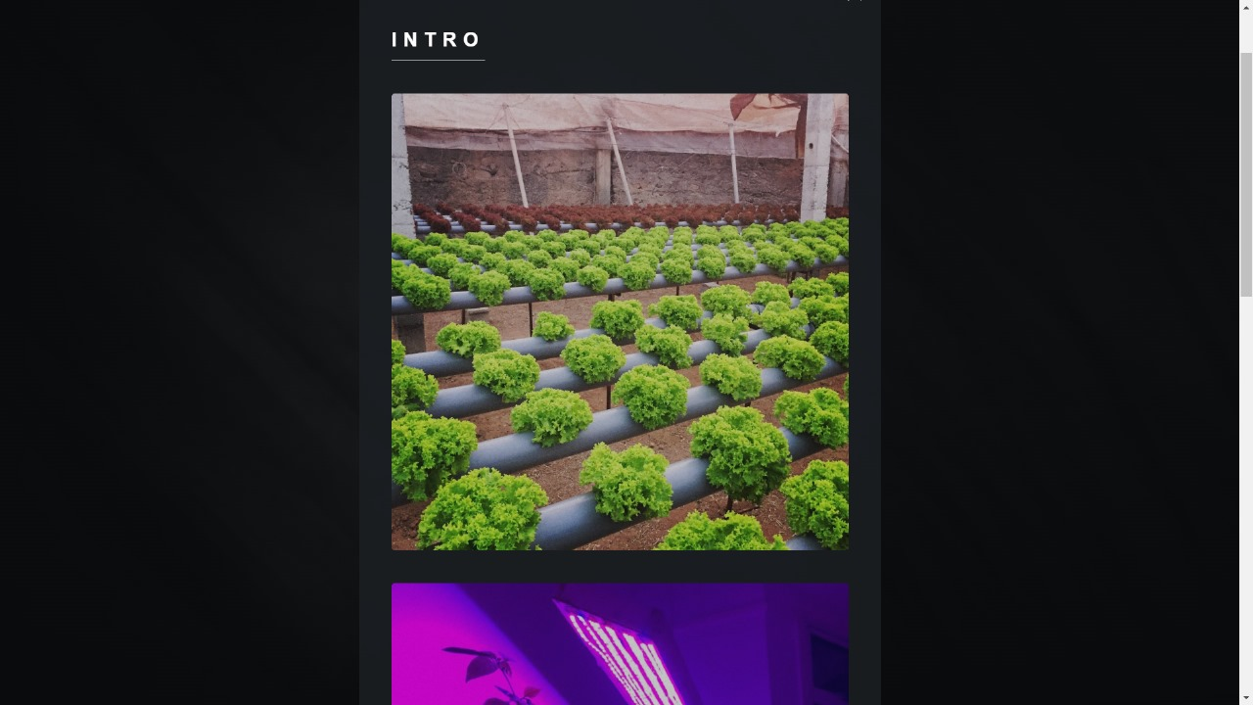
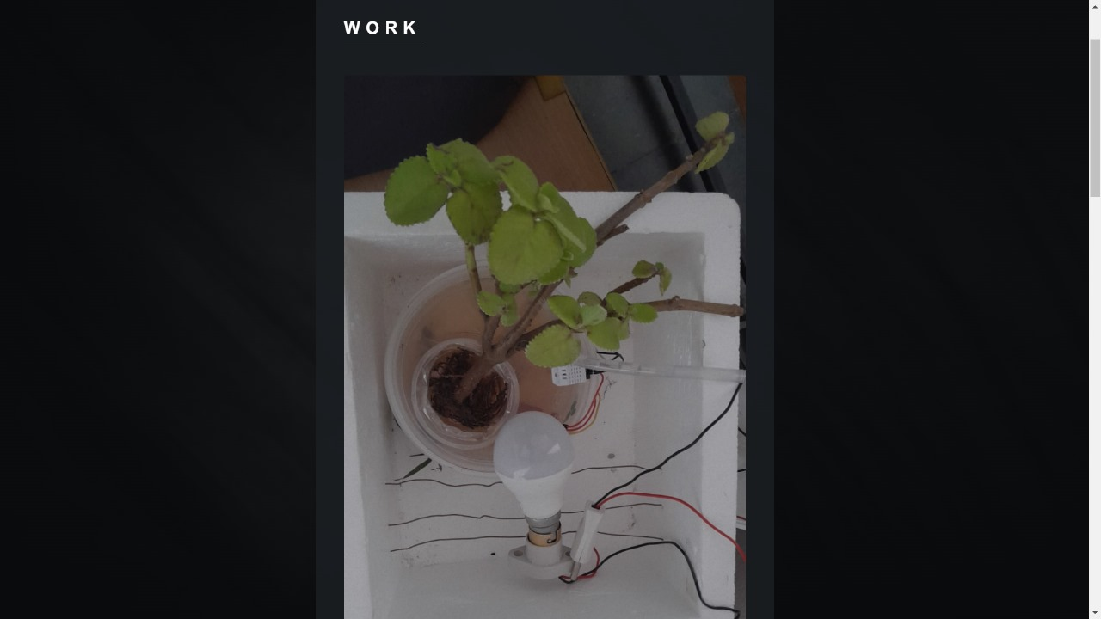
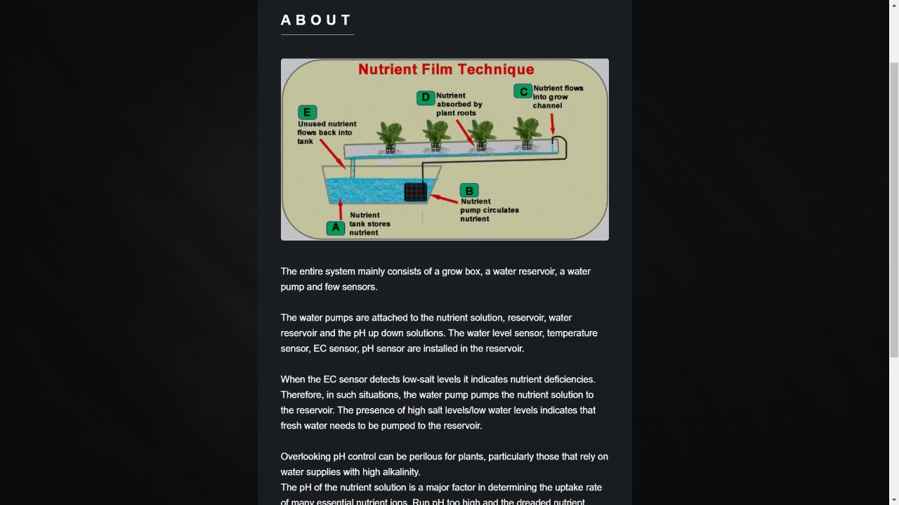

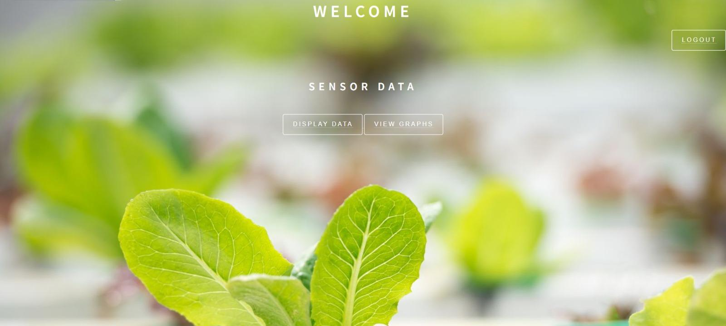
Html Integration
Webpages Created

Slide 31
Conclusion
In this project, we have introduced a novel model of automation system for hydroponic plant irrigation using Arduino Uno Microcontroller based on Android is presented in this paper. Nutritional water flow system by utilizing sensor distance has been successfully done. The water level in the hydroponic tube can be adjusted according to the need of hydroponics, and this is made into a basic guideline for watering or not. The sensor results are sent to Arduino Uno microcontroller and communication with an Android smartphone. Likewise, the temperature setting has been successfully done well. The room temperature can be determined according to his needs. In our experiments, it was shown that the mixture of water and nutrients was automatically transferred to plant roots in hydroponic tubes. The water level is maintained up to 6 cm in hydroponic tubes because the system will drain water periodically if there is a water shortage.

Slide 32
Future Scope
For future extension deals with the integration of a Wi-Fi module, allowing for enhanced monitoring and control capabilities. This addition enables growers to remotely manage key parameters such as nutrient solution levels, pH, temperature, and humidity using a smartphone or computer. Data logging and analysis become more accessible, facilitating the tracking of trends over time and the optimization of growing conditions for improved plant health and productivity. Alerts and notifications can be configured to alert growers of any deviations from optimal conditions, ensuring timely intervention. Furthermore, integration with smart home systems enables seamless control through voice commands and automation, enhancing the overall efficiency and convenience of hydroponic cultivation.

Slide 33
References
N A Karina , Poltak Sihombing , Jos Timanta Tarigan , M I Syarif . Automated hydroponics nutrition plants systems using arduino uno microcontroller based on android. DOI:10.1088/1742-6596/978/1/012014
Velazquez L A, Hernandez M A, Leon M, Dominguez R B and Gutierrez J M 2013 First Advances on the Development of a Hydroponic System for Cherry Tomato Culture Proc. of IEEE 10th Int. Conf. on Elect. Eng. Comp. Sc. and Automatic Control (CCE).
Kumar RR and Cho JY 2014 Reuse of Hydroponic Waste Solution Environ Sci Pollut Res Int http://link.springer.com/article/10.1007/s11356-01430243.
Chenzhong Y, Yinchun H and Weihong Z 2004 Research of Hydroponics Nutrient Solution Control Technology Proc. 5’ World Congress on Intelligent Control and Automation 1.
S. Navulur, et al., “Agricultural management through wireless sensors and internet of things,” International Journal of Electrical and Computer Engineering (IJECE), vol. 7, no. 6, pp. 3492-3499, 2017. Mohanraj, et al., “Field Monitoring and Automation using IOT in Agriculture Domain,” Procedia Computer Science, vol. 93, pp. 931-939, 2016.

Slide 34
THANK YOU
HOD SIR
Dr.A.Obulesh
and
All the Teaching Faculty

