Slide 1


Group 03
TechLabs/Schickler Hackathon
Group members:
Artem Dontsov
Nour Abdennebi
Muhammad Affan Qamar

Slide 2
Goal
Ranking system for existing articles
Score is total amount of seconds users were reading the article
Predicition of the score for newly written articles using a machine learning model

Slide 3
Approach
Data Science
Clean the data
Get some metrics out of the article full text
We used ARI (automated readability index)
Create a feasible feature set for the machine learning model
We used all available features
We used a linear support vector machine for categorization
Web development
Create a frontend prototype to display the score distribution for the article
Create a form that calls an API to predict the score for a new article

Slide 4
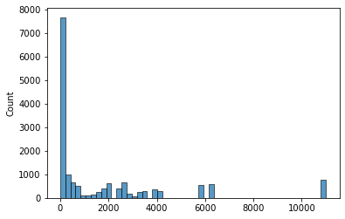
Result /1
Y_Prediction
Time spend on articles in total (seconds)

Slide 5

Result /2
Y_Test
Time spend on articles in total (seconds)

Slide 6
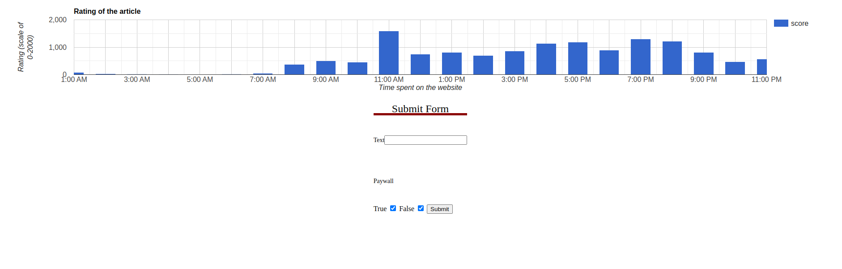
Result /3

Slide 7
Result /4
Stored the trained model, so we can reload it every time the API starts without needing to retrain it
Python API using FastAPI

Slide 8
Result /5 - Possible errors
Used dataset has not all categorical values (for example portal_id was not complete)
Using only a batch of the page view resulted in many scores being zero, as the graphs show

Slide 9
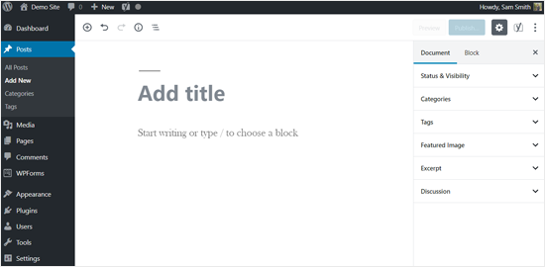
Example Business Case
Your article score: 50

Slide 10
Next Steps
Advanced feature selection
Training the model with the complete dataset
Take into consideration the time when the content was published
Add sentiment analysis into API, currently all sentiment result values are assumed as 0

