Slide 1
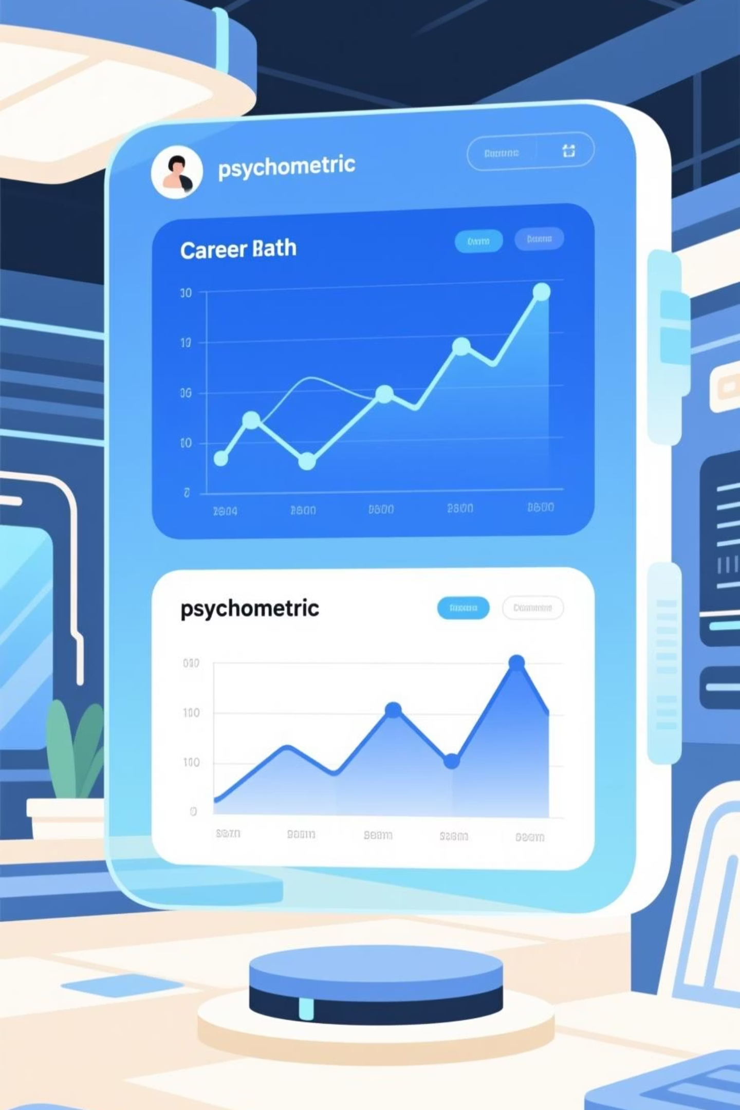
Career Guide / Psychometric Management System
This Business Requirements Document (BRD) outlines the needs and functionality for a new Career Guidance and Psychometric System.

Slide 2

Purpose of the System
Assist Students
Automated Testing
Intelligent Recommendations
Help students choose suitable career paths.
Utilize psychometric testing for insights.
Provide smart career suggestions.

Slide 3

Key Stakeholders
Primary Stakeholders
Secondary Stakeholders
Students
School Administrators
Direct users seeking career guidance.
Oversee system implementation and usage.
School Guidance Counsellors
Parents
Interested in their children's career development.
Professionals who will utilize system data.
Developers / IT Staff
Responsible for system development and maintenance.

Slide 4
Core Business Requirements
1
2
Student Profiles
Secure Login
Allow registration and profile creation.
Students must log in with secure credentials.
3
4
Psychometric Test
Career Mapping
Provide a comprehensive career test.
Map responses to predefined career fields.
5
6
Automated Scoring
Career Recommendations
Compute scores automatically.
Recommend careers based on test results.

Slide 5

Admin & Data Management
Admin Management
Secure Data Storage
Manage questions, careers, and options.
All data must be stored securely in a database.
View Results
User-Friendly Interface
Admin can view student test results.
Provide simple and intuitive interfaces.

Slide 6

Functional Requirements: Student View
1
2
Account Creation
Login
Students can create and update their profiles.
Students can log in with email and password.
3
4
Take Test
View Results
Students can take the career test, answering all questions.
System displays recommended careers and result history.

Slide 7
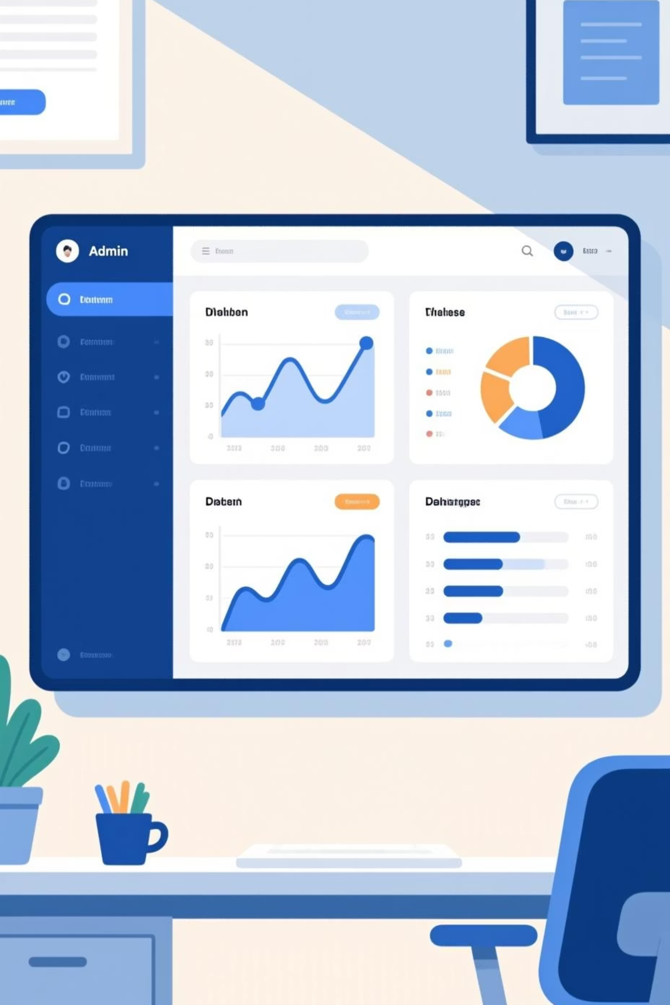
Functional Requirements: Admin View
Admin Login
1
Admin can securely log in to the system.
Content Management
2
Admin can add, edit, and delete careers, questions, and test options.
Student Oversight
3
Admin can view registered students and their test results.

Slide 8
Non-Functional Requirements
Performance
Security
Usability
Pages load within 3 seconds; supports 200-500 concurrent users.
Hashed passwords, admin access control, SQL injection prevention.
Intuitive interface; test completion within 10-15 minutes.
Reliability
Compatibility
99% availability; automated backup support.
Must work on major web browsers.

Slide 9
Business Rules & Constraints
Business Rules
Constraints
All test questions must be completed before results appear.
Developed using PHP and MySQL.
A career needs at least one mapped test option.
Runs on standard school computer lab setup.
Admin accounts cannot be created by students.
Internet connection may not always be available.
Students can take the test once, unless reset by admin.
One selected option contributes to only one career.

Slide 10

Success Criteria & Assumptions
Success Criteria
Assumptions
Accurate Recommendations
Student Tech Literacy
Students receive precise career guidance.
Students understand basic computer operations.
Easy Admin Management
Admin Career Knowledge
Admin can effortlessly manage system data.
Admin is knowledgeable about career fields.
Reduced Workload
Updated Info
Guidance counsellors experience less administrative burden.
School provides current career information.
Improved Decision-Making
Students report better career choices.

