Slide 1

Road Accident Analysis in India: Patterns, Causes, and High-Risk Factors
Data Collection, Cleaning and Exploratory Data Analysis (EDA)
Data: MoRTH Road Accident Reports · data.gov.in · WHO | Tools: Python, pandas, NumPy, Matplotlib
Notes:
Introduce the project: an exploratory study of road accidents in India using official government data, organised around three questions — patterns, causes and high-risk factors.

Slide 2



Why study road accidents in India?
Road crashes kill more Indians every year than almost any other preventable cause
4.88 lakh
1.77 lakh
4.71 lakh
road accidents recorded in 2024
people killed in 2024 (≈ 485 per day)
people injured in 2024
Project objectives
Patterns
Causes
High-risk factors
How have accidents and deaths changed over time, and which states and cities are worst affected?
Which traffic violations, collision types and road conditions lead to the most deaths?
Who is most at risk — by road-user type, safety-device use, age, gender and licence?
Notes:
2024 figures come from the MoRTH annual series used in the notebook (annual 2020-2024 file). 1,77,175 deaths / 365 ≈ 485 per day.

Slide 3
Data collected: 16 datasets, 2008 – 2024
Official MoRTH reports and data.gov.in, plus WHO data for the country comparison
Theme | Datasets | Years
National trend | Annual accidents / deaths / injuries; vehicle registrations & road density | 2014 – 2024
States & cities | State-wise accidents and fatalities; 50 cities by traffic violation | 2020 – 2024
Causes | Type of violation; type of collision; road features (potholes, curves, bridges…) | 2018, 2023 – 24
Over-speeding | State-wise persons killed and injured due to exceeding lawful speed | 2008 – 2016
Victims | Road-user category; victim vs crime vehicle; helmet / seat-belt; age & gender; licence type | 2016 – 2024
Global | Road deaths per 1 lakh people — India vs 12 countries / regions (WHO) | 2019
Notes:
16 raw CSV files were loaded with pandas. They come from different report years, so each analysis uses the most recent file available for that topic.

Slide 4
Problems found in the raw data
Every file needed cleaning before any numbers could be analysed
1
Numbers stored as text
2
Extra "% share" rows
3
Total & footnote rows
Indian comma format, e.g. "3,72,181" — no maths possible
Percentage rows mixed in between the real data rows
"All India" totals and notes at the bottom of tables
4
Empty columns
5
Missing values (NA)
6
Provisional flags
Blank columns such as "Unnamed: 8"
Up to 52 nulls per file — states not yet formed, data not reported
Values like "6498 (P)" in road-length data

Slide 5

How the data was cleaned
Each missing value was handled according to why it was missing
Issue | Action | Reason
Telangana before 2014 | Filled with 0 | State did not exist until 2014
Other gaps in speed data | Filled with the state's own average | Keeps each state's typical level
Ladakh 2020 | Filled with 0 | Counted inside J&K that year (per footnote)
Vehicles / road length 2023–24 | Rows dropped for vehicle analysis | Values not published; cannot be guessed
Rank & % change columns | Dropped | Held most nulls; recomputed when needed
Text numbers, '(P)' flags | Custom make_numeric() function | Strips commas, converts to numbers
Result
18
clean CSV files saved to a separate cleaned_data folder
0
null values left in any cleaned dataset
Notes:
Raw files were kept untouched; cleaned versions saved separately so the ML stage can reuse them directly.

Slide 6

Analysis approach
The EDA follows the three questions in the project title
1. Collect
2. Clean
3. Part A — Patterns
4. Part B — Causes
5. Part C — Risk factors
16 CSV files from MoRTH, data.gov.in and WHO
Fix types, remove junk rows, handle missing values
Trends, severity, states, cities, world comparison
Violations, over-speeding, collisions, road features
Road users, safety devices, age, gender, licence
Key metric used throughout: severity = deaths per 100 accidents — it shows how deadly accidents are, not just how many happen.

Slide 7

Part A: Patterns
Trends over time, severity, states, cities and global comparison

Slide 8

Deaths keep rising even when accidents fall
Road deaths grew 26% from 2014 to 2024 while accidents stayed flat
What it shows
COVID dip: accidents fell to 3.72 lakh in the 2020 lockdown.
Recovery: by 2024 accidents were back near pre-COVID levels (4.88 lakh).
Deaths up: 1.40 lakh (2014) → 1.77 lakh (2024), +26.4%. Accidents are becoming more deadly.
Source: MoRTH, road accidents, registrations & density 2014–24

Slide 9
About 36 of every 100 accidents end in a death
National severity has barely moved in five years
36.3
deaths per 100 accidents in 2024 (India average)
-0.85
point change from 2020 to 2024 — very little improvement
This severity value is used as the benchmark for states, violations and collision types in the rest of the deck.
Source: MoRTH annual road accidents 2020–2024

Slide 10
Vehicles nearly doubled; risk per vehicle fell
Safer per vehicle, but the fast-growing fleet still pushes total deaths up
What it shows
Fleet: 19 crore vehicles (2014) → 35.4 crore (2022).
Death rate: 7.0 → 4.8 deaths per 10,000 vehicles.
Net effect: the per-vehicle gain is outpaced by fleet growth, so total deaths keep rising.
Source: MoRTH registrations & density 2014–22 (2023–24 not published)

Slide 11
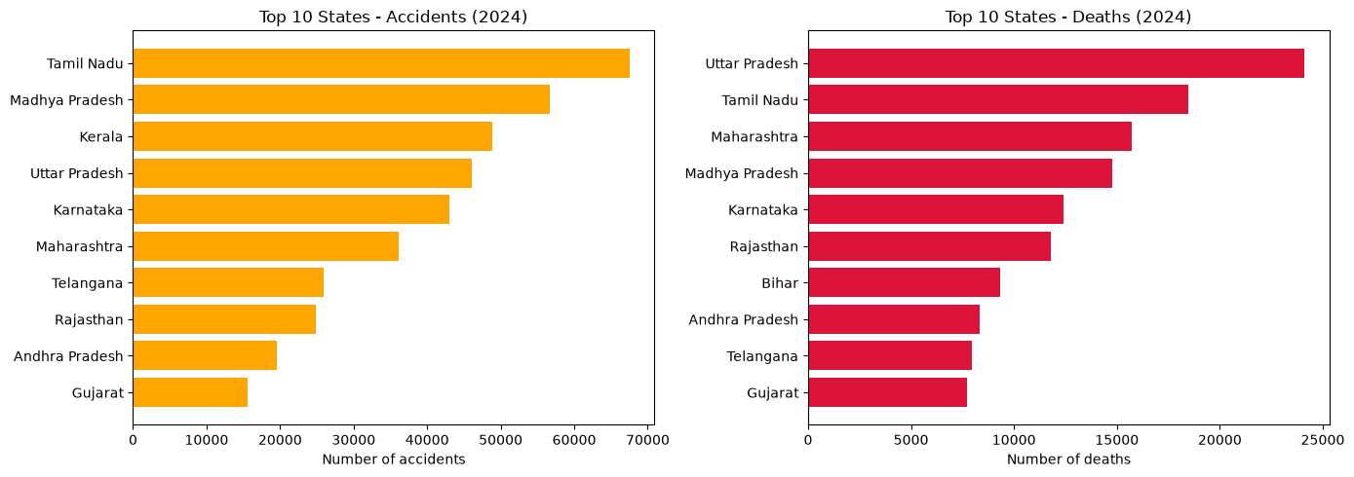
Five states account for nearly half of all deaths
Top 10 states by accidents (left) and deaths (right), 2024
48.2%
of all 2024 road deaths come from UP, TN, Maharashtra, MP and Karnataka
UP: most deaths (24,118)
Tamil Nadu: most accidents
Kerala: 3rd in accidents, not in top 10 for deaths
Source: MoRTH state-wise accidents and fatalities 2024 (notebook figure A5)

Slide 12
Severity varies 10× between states
Deaths per 100 accidents, 2024 — five most and five least severe states (≥1,000 accidents)
What it shows
Bihar, Jharkhand, Punjab: ~80 deaths per 100 accidents — over 2× the national average.
Kerala: only 7.9, the lowest.
Why: under-reporting of minor crashes and differences in trauma care can explain the gap.
Source: Computed from MoRTH state-wise data 2024

Slide 13
Where deaths are growing fastest
% increase in road deaths, 2020 → 2024 (states with ≥1,000 deaths in 2020)
Accidents vs deaths
r = 0.86
correlation between state accidents and deaths
Outliers: UP far above the trend (very deadly); Kerala far below it.
Note: 2020 was a lockdown year, so some growth is expected everywhere.
Source: Computed from MoRTH state-wise fatalities 2020–2024

Slide 14
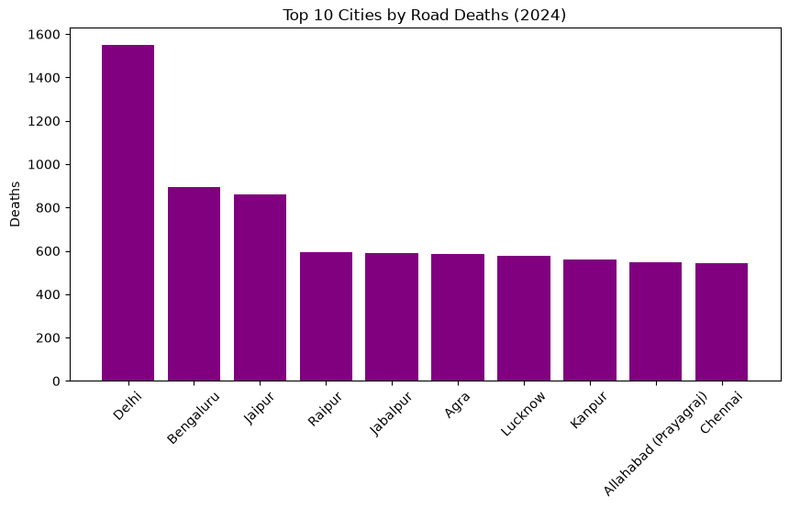

Delhi leads all cities in road deaths
Top 10 cities by road deaths, 2024
1,551
deaths in Delhi in 2024
Almost double Bengaluru (894) and Jaipur (860), the next two cities.
Source: MoRTH 2024, 50 million-plus cities (notebook figure A9)

Slide 15
India vs the world
Road deaths per 1 lakh people, 2019 — India sits near the world average
What it shows
Rate: India 15.6 per lakh — equal to South Asia, below the world (16.7).
Scale: with 140 crore people, even an average rate means the world's largest absolute toll.
Source: WHO via Data For India, 2019

Slide 16

Part B: Causes
Traffic violations, over-speeding, collision types and road conditions

Slide 17
Over-speeding causes 70% of road deaths
Share of 2024 deaths by traffic violation, and how deadly each one is
Violation | Deaths | Severity*
Mobile phone | 2,002 | 40.6
Drunk driving | 3,204 | 38.7
Wrong side | 8,327 | 37.0
Others | 38,592 | 36.6
Over-speeding | 1,24,522 | 36.1
Red light | 528 | 33.9
*Deaths per 100 accidents. Mobile-phone use and drunk driving are rarer but the most deadly per accident.
Source: MoRTH, type of traffic violation 2024

Slide 18
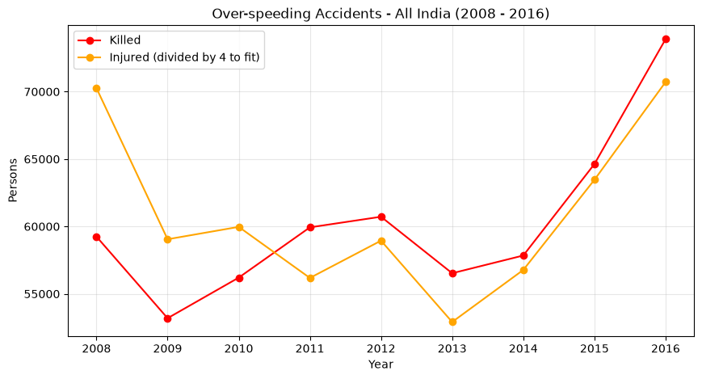

Over-speeding deaths rose 25% in 2008–2016
All-India persons killed and injured in over-speeding accidents
59,246 → 73,896
people killed due to over-speeding, 2008 vs 2016
Top states: Maharashtra and Tamil Nadu, followed by Karnataka and Andhra Pradesh.
Persistent: speed was the main killer a decade ago and still is in 2024.
Source: data.gov.in, accidents due to exceeding lawful speed 2008–2016 (notebook figure B2)

Slide 19
Hit-and-run is the deadliest collision type
2024 deaths by type of collision, with severity (deaths per 100 accidents)
Source: MoRTH, type of collision 2024
Notes:
Hit from back causes the most deaths overall, but hit-and-run kills almost half its victims — the injured person is left on the road without help. Overturns and run-off-road crashes are similarly deadly.

Slide 20
Potholes are the most deadly road condition
Accidents and severity by road feature, 2018
Source: MoRTH Road Accidents in India 2018, Annexure 23
Notes:
Most accidents happen on straight roads, probably because people drive fast there. But per accident, potholes (41.4), steep grades and road works are the most deadly — poor road condition is a high-risk factor.

Slide 21
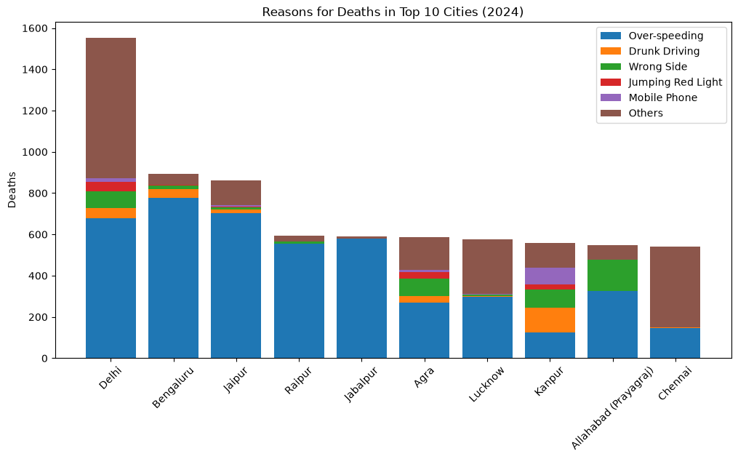
Each city has a different main cause
Reasons for road deaths in the top 10 cities, 2024
What it shows
Speed: almost all deaths in Bengaluru, Jaipur, Raipur and Jabalpur.
Kanpur: high share of drunk driving and mobile use.
Prayagraj: many wrong-side deaths.
Delhi, Chennai: large "Others" — cause not recorded.
Source: MoRTH 2024 city-wise fatalities by violation (notebook figure B5)

Slide 22

Part C: High-Risk Factors
Who is dying — road users, safety devices, age, gender and licence

Slide 23


Two-wheeler riders and pedestrians: 2 in 3 deaths
Persons killed by road-user category, 2024
46.2%
two-wheeler riders (81,780)
20.6%
pedestrians (36,526)
Both groups grew in 2024 (+5.5% and +3.7%) — the most vulnerable road users.
Source: MoRTH, fatality by road-user category 2024

Slide 24
Who hits whom?
Deaths by victim (rows) and the vehicle that caused the crash (columns), 2024
Victim ↓ / Crime vehicle → | Bicycle | Two Wheeler | Auto | Car/Taxi/LMV | Truck | Bus | Non-Motor | Others
Pedestrian | 76 | 10,378 | 1,256 | 9,302 | 5,165 | 2,257 | 235 | 7,857
Bicycle | 43 | 1,137 | 248 | 1,039 | 718 | 333 | 80 | 563
Two Wheeler | 247 | 30,561 | 2,620 | 18,682 | 14,017 | 4,485 | 495 | 10,673
Auto | 39 | 602 | 1,196 | 1,461 | 1,151 | 508 | 94 | 608
Car/Taxi/LMV | 147 | 3,344 | 645 | 8,705 | 5,240 | 1,570 | 212 | 2,125
Truck | 85 | 1,846 | 293 | 1,563 | 3,717 | 666 | 117 | 1,400
Bus | 59 | 740 | 147 | 564 | 792 | 958 | 86 | 509
Non-Motor | 33 | 298 | 157 | 374 | 251 | 171 | 138 | 207
Others | 99 | 3,632 | 406 | 2,072 | 1,311 | 526 | 199 | 3,645
What it shows
30,561 two-wheeler riders killed by other two-wheelers — the largest cell.
Cars & trucks kill another 32,699 two-wheeler riders.
Pedestrians are hit mostly by two-wheelers and cars.
Source: MoRTH, victims vs crime vehicle 2024

Slide 25

No helmet: linked to 2 in 3 two-wheeler deaths
Deaths of people not using safety devices, 2024
54,122
66.2%
deaths without a helmet
of all two-wheeler deaths
14,466
27%
deaths without a seat belt
of helmet deaths were pillion passengers
Source: MoRTH, non-use of safety devices 2024

Slide 26
Young men are the most affected group
Road deaths by age group and gender, 2018
86%
of people killed are male
~70%
of deaths are aged 18–45; 25–35 is the peak
Working-age victims — a heavy loss for families and the economy.
Source: MoRTH Road Accidents in India 2018, Table 2.9

Slide 27
A valid licence does not mean safe driving
Accidents by driver's licence type, 2020–2024
What it shows
~68% of accidents involve drivers with a valid licence.
"Not known" nearly doubled: 53k → 1.03 lakh, a growing data-recording gap.
Implication: licensing quality and testing matter more than licence possession.
Source: MoRTH, type of driving licence 2020–2024

Slide 28
Summary of findings
Answers to the three questions in the project title
Patterns
Causes
High-risk factors
Deaths +26% (2014–24) while accidents stayed flat
~36 deaths per 100 accidents nationally
5 states = 48% of deaths
Bihar, Jharkhand, Punjab ~80 per 100; Kerala ~8
Over-speeding: ~70% of deaths
Mobile phone & drunk driving deadliest per accident
Hit-and-run & overturns: ~50 deaths per 100
Potholes: deadliest road condition (41.4)
Two-wheeler riders (46%) and pedestrians (21%)
No helmet: 66% of two-wheeler deaths
Males 86%; ages 18–45 ≈ 70%
68% of crashes by licensed drivers

Slide 29




Suggested actions
Measures that follow from the findings
Enforce speed limits
Helmets for rider and pillion
Speed cameras and penalties on highways and city corridors — speed drives ~70% of deaths.
Strict helmet checks, including passengers (27% of helmet deaths).
Protect pedestrians
Faster trauma care
Footpaths, safe crossings and traffic calming where two-wheelers and cars mix with walkers.
Golden-hour ambulance and trauma centres in high-severity states (Bihar, Jharkhand, Punjab, UP).
Fix road defects
Improve data recording
Prioritise pothole repair and safe signage at road works and steep grades.
Reduce "Others" and "Not known" entries so causes can be targeted.

Slide 30


Limitations and next steps
What the data cannot tell us yet, and where the project goes next
Data limitations
Next steps (Part 2)
State-level aggregates only — no accident-level records
Files span different years (2008 – 2024), so topics are not directly comparable
Some years and states have missing values
Many cases recorded as "Others" or "Not known"
Feature engineering on the 18 cleaned datasets
Cluster states into risk levels (e.g. K-Means on accidents, deaths, severity, growth)
Build a model to predict accident severity
Turn results into targeted, state-specific recommendations

Slide 31
Thank you
Questions & discussion
Road Accident Analysis in India: Patterns, Causes, and High-Risk Factors

