Slide 1
Swayam
Free online Education
Govt of India courses

Slide 2









Govt of India Initiative 1000+ Courses Regional languages including Malayalam
AICTE | CEC | IGNOU | IIMB | NCERT | NIOS | NITTTR | NPTEL

Slide 3
National Coordinators as given below have been appointed to produce the best quality content for students of various streams
AICTE (All India Council for Technical Education) for self-paced and international courses
NPTEL (National Programme on Technology Enhanced Learning) for Engineering
UGC (University Grants Commission) for nontechnical post-graduation education
CEC (Consortium for Educational Communication) for under-graduate education
NCERT (National Council of Educational Research and Training) for college education
NIOS (National Institute of Open Schooling) for college education
IGNOU (Indira Gandhi National Open University) for out-of-school students
IIMB (Indian Institute of Management, Bangalore) for management studies
NITTTR (National Institute of Technical Teachers Training and Research) for Teacher educational progra

Slide 4
Courses that are taught in classrooms from 9th class till post-graduation.
The courses hosted on SWAYAM is in 4 quadrants.
Categories of courses include - Engineering, Science, Humanities, Management, Language, Mathematics, Arts and Recreation, Commerce, General, Library, Education.

Slide 5
SWAYAM platform (www.swayam.gov.in) has been developed by MHRD and AICTE with the assistance of Microsoft to supply hosting of about 2000 courses in several streams including engineering, law, post-graduate and under-graduate courses, and a few other professional courses. The academic study material such as lectures is also available from class 9th to 12th.
SWAYAM (Study Webs of Active-learning for Young Aspiring Minds); India Chapter of Massive Open Online Courses. SWAYAM is an indigenous developed IT platform, initiated by Government of India, which is instrumental for self-actualisation providing opportunities for a life-long learning.
Online Swayam Registration | New User Sign Up

Slide 6

Online Swayam Registration | New User Sign Up
Below is that the step by step procedure to finish Swayam portal registration. Follow steps 1 through 5 to complete your registration at swayam.gov.in and start learning.
Step 1: Go to the official website on SWAYAM Portal at https://swayam.gov.in
Steps for registration

Slide 7
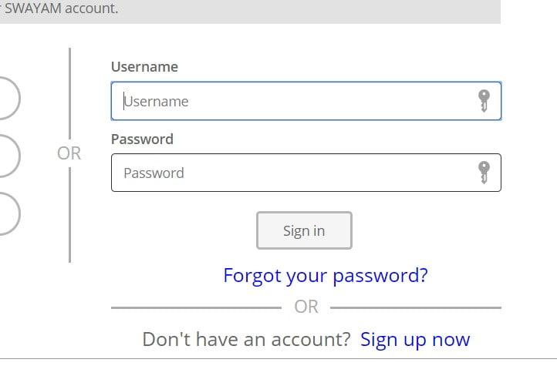
Step 2: Then click on the SIGN IN / REGISTER button on the top right corner as given in the below image.

Slide 8
Step 3: A new page will open, click the Sign up now link below the login form as given in the below image.
Step 4: Fill all the required details in the form including the verification code received on email by clicking the Send Verification Code button and submit the form by clicking on the CREATE button at the bottom.

Slide 9
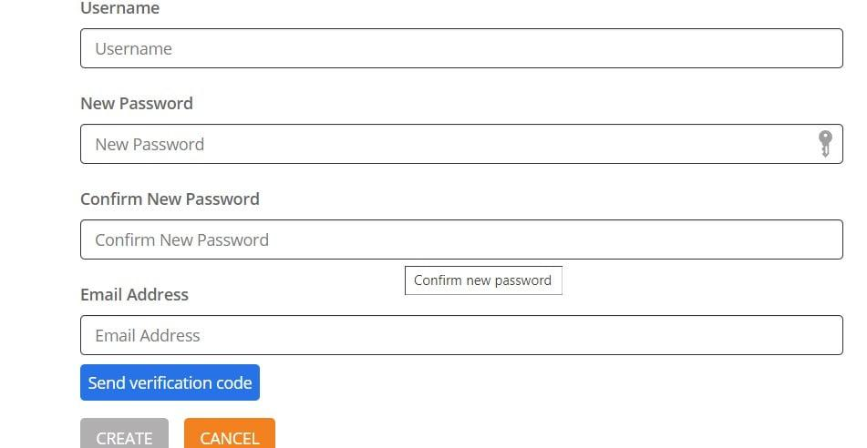

Slide 10
Step 5: Your registration on the Swayam portal is complete and you can now log in and start learning.
After login on this portal, you’ll access and learn the specified courses. The portal shows you the name of all the courses and therefore the name of professors and their experiences. The list of Swayam courses is often accessed at the below link.
Swayam Portal Login : Online Free Course Registration, Enroll @swayam.gov.in
If you are interested in any of the courses and want to enroll, you must log in to your Swayam account. Once logged in, visit the concerned course page and proceed with the enrollment
Swayam Mobile App
Registered candidates also can access all the Swayam courses on its mobile app which is out there at the google play store for android mobile phones.

Slide 11
BRANCHES
Humanities (61)
Business (83)
Programming (20)
Mathematics (40)
Social Sciences (75)
Data Science (6)
Education & Teaching (36)
Computer Science (36)
Health & Medicine (13)
Personal Development (10)
Science (131)
Engineering (167)
Art & Design (21)

Slide 12
Business Studies XI Part-I from NCERT
Accountancy XI Part-I from NCERT
Business Studies XII Part-I from NCERT
Secondary : Data Entry Operations (229) from NIOS
Secondary : Business Studies (215) from NIOS
Secondary : Accountancy (224) from NIOS
Sr.Secondary : Accountancy (320) from NIOS
Senior Secondary : Business Studies (319) from NIOS
Innovation and Start-up Policy from IILM Institute for Higher Education
Consumer Buying Behaviour from Welingkar Institute of Managem
Corporate Finance from CEC
Special Services Marketing in India from Savitribai Phule Pune University
Organizational behaviour from CEC
Ecommerce Technologies from CEC
ENTREPRENEURSHIP DEVELOPMENT from CEC
Fundamentals of Financial Accounting from Savitribai Phule Pune University
International Business from CEC
International Tourism Destinantions from CEC
Fundamentals of Office Management & Methods from Savitribai Phule Pune University
Supply Chain Management from Avianshilingam Institute for Home Science and Higher Education for Women, Coimbatore
Business (83)
Digital Marketing from UGC ★★★★★(117)
Introduction to Poultry Farming from IGNOU ★★★★★(1)
Geography of Tourism from University of Mysore ★★★★★(1)
Design Thinking – A Primer from Indian Institute of Technology Madras
Business Ethics from Indian Institute of Technology, Kharagpur
Human Resource Development from Indian Institute of Technology, Kharagpur
Leadership from Indian Institute of Technology, Kharagpur
Entrepreneurship and IP strategy from Indian Institute of Technology, Kharagpur
Principles of Management from Indian Institute of Technology, Kharagpur
Managing Services from Indian Institute of Technology Kanpur
Marketing Management-I from Indian Institute of Technology Kanpur
Business Statistics from Indian Institute of Technology Roorkee
Working Capital Management from Indian Institute of Technology Roorkee
Innovation, Business Models and Entrepreneurship from Indian Institute of Technology Roorkee
Mathematical Portfolio Theory from Indian Institute of Technology Guwahati
Decision-Making Under Uncertainty from Texas A&M University
Decision Support System for Managers from NPTEL
Financial accounting – IITMandi from NPTEL
New Product Development from Indian Institute of Management Bangalore
The Essence of Leadership: Explorations from Literature from Indian Institute of Management Bangalore
Organizational Design: Creating Competitive Advantage from Indian

Slide 13
Institute of Management Bangalore
Advanced Corporate Strategy from Indian Institute of Management Bangalore
Banking and Financial Markets: A Risk Management Perspective from Indian Institute of Management Bangalore
Strategic Management from Indian Institute of Management Bangalore
Financial Accounting and Analysis from Indian Institute of Management Bangalore
Quantitative Marketing Research from Indian Institute of Management Bangalore
Introduction to Retail Management from Indian Institute of Management Bangalore
Corporate Tax Planning from Netaji Subhas Open University, Kolkata
Building cost estimation simplified from IGNOU

Slide 14
Customer Relationship Management from Indian Institute of Management Bangalore
Introduction to Banking and Financial Markets from Indian Institute of Management Bangalore
Managing Innovation from Indian Institute of Management Bangalore
Management Accounting for Decision Making from Indian Institute of Management Bangalore
Introduction to Marketing Essentials from Indian Institute of Management
BHC-013: Event Coordination and Control from IGNOU
BHC-012: Event Planning from IGNOU
Production Management from IGNOU
BHC-011: Basics of Event Management from IGNOU
TS-2: Tourism Development Products from IGNOU
TS-1: Foundation Course In Tourism from IGNOU

Slide 15
Introduction to GST from Netaji Subhas Open University, Kolkata
Indian Agricultural Development from IGNOU
Organisation Behaviour from CEC
Basics of Digital Marketing from Devi Ahilya Viswavidyalaya, Indore
Financial Accounting from Devi Ahilya Viswavidyalaya, Indore
Hospitality Industry In Tourism from University of Mysore
Tourism And Travel Management from University of Mysore
Tourism Resources of India from University of Mysore
Tourism Transport and Travel Services from University of Mysore
HRM FOR NON-HR MANAGERS from CEC
Quantitative Techniques for Management from CEC
Fundamental of Insurance from CEC
Business Research Methods from CEC

Slide 16
Personal Development (10)
Soft Skills from Indian Institute of Technology Roorkee
Body Language: Key to Professional Success from Indian Institute of Technology
Stress Management from Indian Institute of Technology, Kharagpur
Soft Skills for Business Negotiations and Marketing Strategies from Indian Institute of Technology, Kharagpur
Developing Soft Skills and Personality from Indian Institute of Technology Kanpur
Mind Education from AICTE
Introduction to Visual Communication from CEC
Developing Life Skills from Central University o

