Slide 1
Chapter 3 (3.4 ~) 단어 임베딩을 사용하여 텍스트 유사성 계산하기
NCSOFT Vision AI Lab
김준호
https://github.com/taki0112

Slide 2
임베딩에서 개체의 클래스 찾기
Support Vector Machine

Slide 3
bin_file = os.path.join('pretrain_vector', 'GoogleNews-vectors-negative300.bin’)
model = gensim.models.KeyedVectors.load_word2vec_format(bin_file, binary=True) # long time
model.most_similar(positive=['Germany'])

Slide 4
bin_file = os.path.join('pretrain_vector', 'GoogleNews-vectors-negative300.bin’)
model = gensim.models.KeyedVectors.load_word2vec_format(bin_file, binary=True) # long time
model.most_similar(positive=['Germany'])
[('Austria', 0.7461064457893372), ('German', 0.717875063419342), ('Germans', 0.6628649830818176), ('Switzerland', 0.6506868004798889), ('Hungary', 0.6504982709884644), ('Germnay', 0.6493481993675232), ('Netherlands', 0.6437495946884155), ('Cologne', 0.6430779695510864), ('symbol_RSTI', 0.6389946937561035), ('Annita_Kirsten', 0.634294867515564)]

Slide 5
bin_file = os.path.join('pretrain_vector', 'GoogleNews-vectors-negative300.bin’)
model = gensim.models.KeyedVectors.load_word2vec_format(bin_file, binary=True) # long time
model.most_similar(positive=['Germany'])
[('Austria', 0.7461064457893372), ('German', 0.717875063419342), ('Germans', 0.6628649830818176), ('Switzerland', 0.6506868004798889), ('Hungary', 0.6504982709884644), ('Germnay', 0.6493481993675232), ('Netherlands', 0.6437495946884155), ('Cologne', 0.6430779695510864), ('symbol_RSTI', 0.6389946937561035), ('Annita_Kirsten', 0.634294867515564)]

Slide 6
bin_file = os.path.join('pretrain_vector', 'GoogleNews-vectors-negative300.bin’)
model = gensim.models.KeyedVectors.load_word2vec_format(bin_file, binary=True) # long time
model.most_similar(positive=['Germany'])
[('Austria', 0.7461064457893372), ('German', 0.717875063419342), ('Germans', 0.6628649830818176), ('Switzerland', 0.6506868004798889), ('Hungary', 0.6504982709884644), ('Germnay', 0.6493481993675232), ('Netherlands', 0.6437495946884155), ('Cologne', 0.6430779695510864), ('symbol_RSTI', 0.6389946937561035), ('Annita_Kirsten', 0.634294867515564)]
“국가”의 개념을 가장 잘 표현하려면 ?

Slide 7
국가 단어랑... 아닌 단어들 다 때려박기

Slide 8
countries = list(csv.DictReader(open('data/countries.csv'))) # make positive, negative words positive = [x['name'] for x in random.sample(countries, 40)] negative = random.sample(model.vocab.keys(), 5000)

Slide 9
countries = list(csv.DictReader(open('data/countries.csv'))) # make positive, negative words positive = [x['name'] for x in random.sample(countries, 40)] negative = random.sample(model.vocab.keys(), 5000)
['spokeswoman_Perri_Travillion', 'Jimmy_Irsay', 'IECQ', 'Peter_Wege']

Slide 10
countries = list(csv.DictReader(open('data/countries.csv'))) # make positive, negative words positive = [x['name'] for x in random.sample(countries, 40)] negative = random.sample(model.vocab.keys(), 5000)
['spokeswoman_Perri_Travillion', 'Jimmy_Irsay', 'IECQ', 'Peter_Wege']
# labelling labelled = [(p, 1) for p in positive] + [(n, 0) for n in negative] random.shuffle(labelled) x = np.asarray([model[w] for w, l in labelled]) y = np.asarray([l for w, l in labelled])

Slide 11
countries = list(csv.DictReader(open('data/countries.csv'))) # make positive, negative words positive = [x['name'] for x in random.sample(countries, 40)] negative = random.sample(model.vocab.keys(), 5000)
['spokeswoman_Perri_Travillion', 'Jimmy_Irsay', 'IECQ', 'Peter_Wege']
# labelling labelled = [(p, 1) for p in positive] + [(n, 0) for n in negative] random.shuffle(labelled) x = np.asarray([model[w] for w, l in labelled]) y = np.asarray([l for w, l in labelled])
[5040, 300], [5040,]

Slide 12
TRAINING_FRACTION = 0.7 cut_off = int(TRAINING_FRACTION * len(labelled)) clf = svm.SVC(kernel='linear') clf.fit(x[:cut_off], y[:cut_off]) res = clf.predict(x[cut_off:])

Slide 13
TRAINING_FRACTION = 0.7 cut_off = int(TRAINING_FRACTION * len(labelled)) clf = svm.SVC(kernel='linear') clf.fit(x[:cut_off], y[:cut_off]) res = clf.predict(x[cut_off:])
missed = [country for (pred, truth, country) in zip(res, y[cut_off:], labelled[cut_off:]) if pred != truth] print(100 - 100 * float(len(missed)) / len(res), missed)

Slide 14
항복 내에서 시멘틱 거리 계산
Similarity measure

Slide 15
country_to_idx = {country['name']: idx for idx, country in enumerate(countries)} country_vecs = np.asarray([model[c['name']] for c in countries])
[184, 300]

Slide 16
country_to_idx = {country['name']: idx for idx, country in enumerate(countries)} country_vecs = np.asarray([model[c['name']] for c in countries])
[184, 300]
dists = np.dot(country_vecs, country_vecs[country_to_idx['Canada']])

Slide 17
country_to_idx = {country['name']: idx for idx, country in enumerate(countries)} country_vecs = np.asarray([model[c['name']] for c in countries])
[184, 300]
dists = np.dot(country_vecs, country_vecs[country_to_idx['Canada']])
for idx in reversed(np.argsort(dists)[-10:]): print(countries[idx]['name'], dists[idx])

Slide 18
country_to_idx = {country['name']: idx for idx, country in enumerate(countries)} country_vecs = np.asarray([model[c['name']] for c in countries])
[184, 300]
dists = np.dot(country_vecs, country_vecs[country_to_idx['Canada']])
for idx in reversed(np.argsort(dists)[-10:]): print(countries[idx]['name'], dists[idx])
Canada 7.5440235 New_Zealand 3.9619699 Finland 3.9392405 Puerto_Rico 3.8381448 Jamaica 3.8102937 Sweden 3.8042784 Slovakia 3.7038736 Australia 3.6711009 Bahamas 3.624042 United_States 3.5374334

Slide 19
country_to_idx = {country['name']: idx for idx, country in enumerate(countries)} country_vecs = np.asarray([model[c['name']] for c in countries])
[184, 300]
dists = np.dot(country_vecs, country_vecs[country_to_idx['Canada']])
for idx in reversed(np.argsort(dists)[-10:]): print(countries[idx]['name'], dists[idx])
Canada 7.5440235 New_Zealand 3.9619699 Finland 3.9392405 Puerto_Rico 3.8381448 Jamaica 3.8102937 Sweden 3.8042784 Slovakia 3.7038736 Australia 3.6711009 Bahamas 3.624042 United_States 3.5374334

Slide 20
country_to_idx = {country['name']: idx for idx, country in enumerate(countries)} country_vecs = np.asarray([model[c['name']] for c in countries])
[184, 300]
dists = np.inner(country_vecs, country_vecs[country_to_idx['Canada']])
for idx in reversed(np.argsort(dists)[-10:]): print(countries[idx]['name'], dists[idx])
Canada 7.5440235 New_Zealand 3.9619699 Finland 3.9392405 Puerto_Rico 3.8381448 Jamaica 3.8102937 Sweden 3.8042784 Slovakia 3.7038736 Australia 3.6711009 Bahamas 3.624042 United_States 3.5374334

Slide 21
다른 거리계산 방식 ?
Cosine, and ...

Slide 22
TS-SS

Slide 23
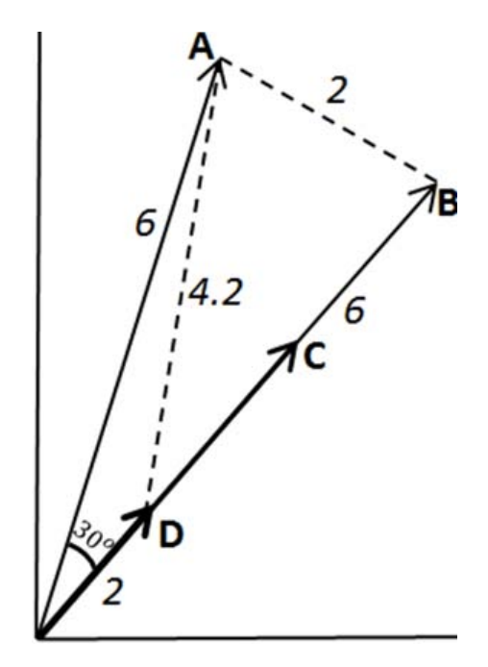
Cosine

Slide 24
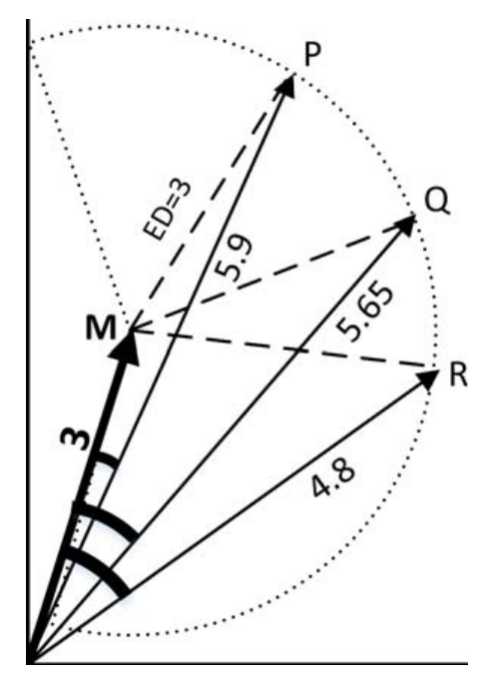
Cosine
Euclidean

Slide 25
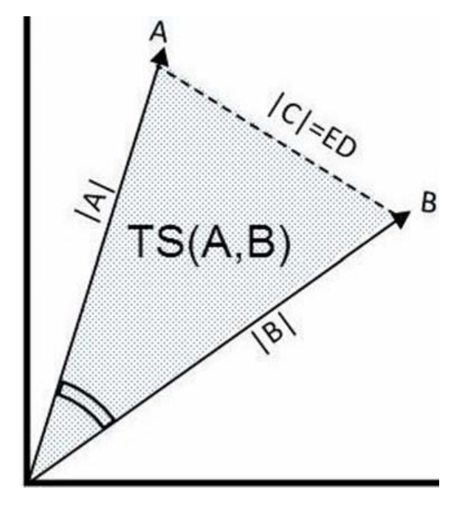
Cosine
Euclidean
Triangle

Slide 26
Cosine
Euclidean
Triangle
거리 무시

Slide 27
Cosine
Euclidean
Triangle
거리 무시
각도 무시

Slide 28
Cosine
Euclidean
Triangle
거리 무시
각도 무시
이걸로도 구할 수 있는지 몰랐음

Slide 29
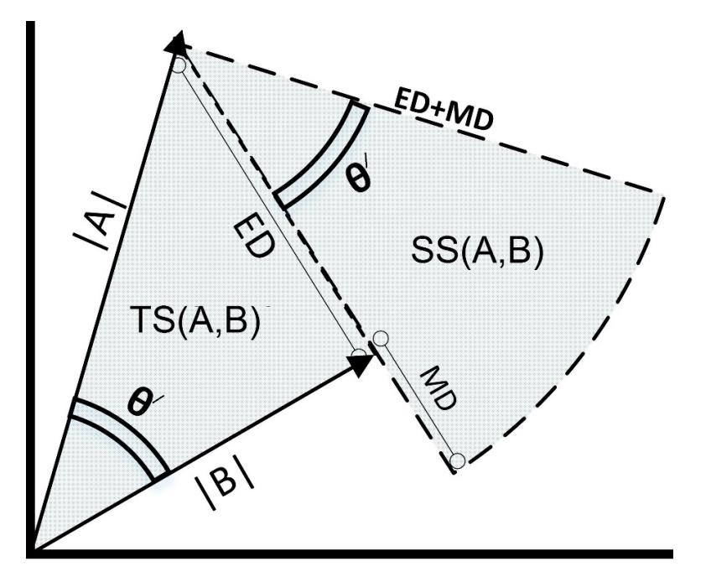

Slide 31
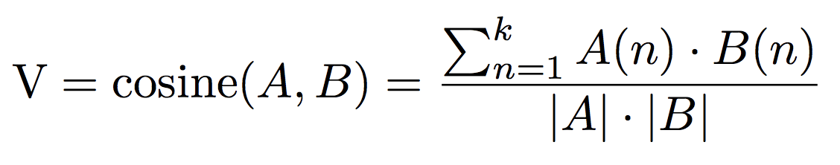

Slide 32
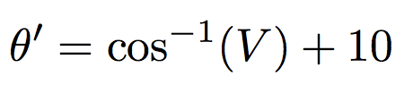

Slide 33
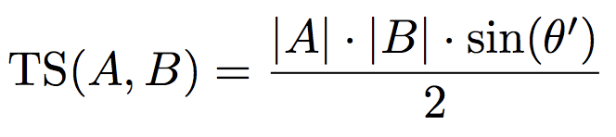

Slide 34
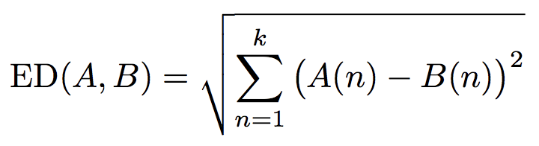

Slide 35
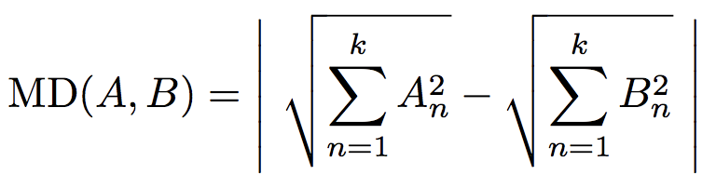

Slide 36
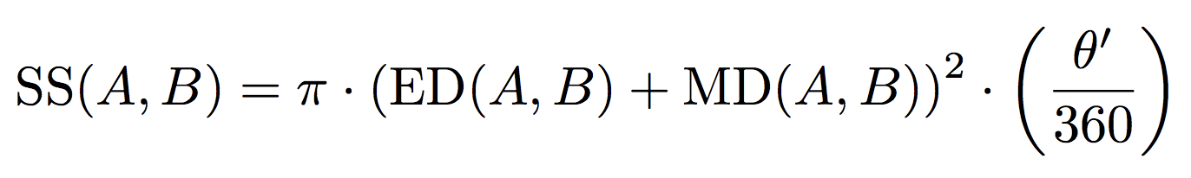

Slide 37
def euclidean(x, y) : return np.linalg.norm(x-y) def magnitude_difference(x, y) : return abs(np.linalg.norm(x) - np.linalg.norm(y))
def theta_(x, y) : return np.arccos(cosine_sim(x,y)) + np.radians(10)
def triangle(x, y) : theta = np.radians(theta_(x,y)) return (np.linalg.norm(x) * np.linalg.norm(y) * np.sin(theta)) / 2
def sector(x, y) : ED = euclidean(x, y) MD = magnitude_difference(x, y) theta = theta_(x, y) return np.pi * np.power((ED+MD),2) * theta/360
def cosine_sim(x, y) : result = np.inner(x, y) / (np.linalg.norm(x) * np.linalg.norm(y)) return result
def ts_ss(x, y) : return -(triangle(x, y) * sector(x, y))

Slide 38
END
https://github.com/taki0112
김준호

