Slide 1
Doodle Buddy
Danny / Ovieh / Sara

Slide 2
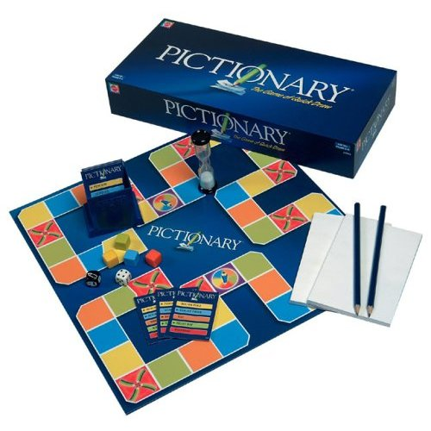
What is Doodle Buddy?
A multi-player game in which one user draws an image based on a prompt and the other user must guess what it is! Think Pictionary…

Slide 3
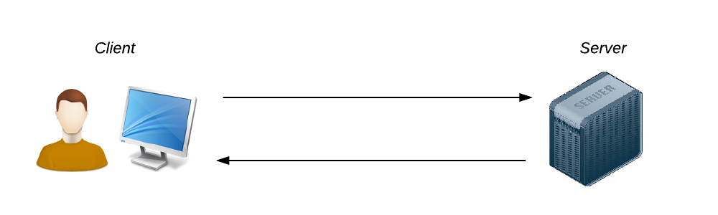
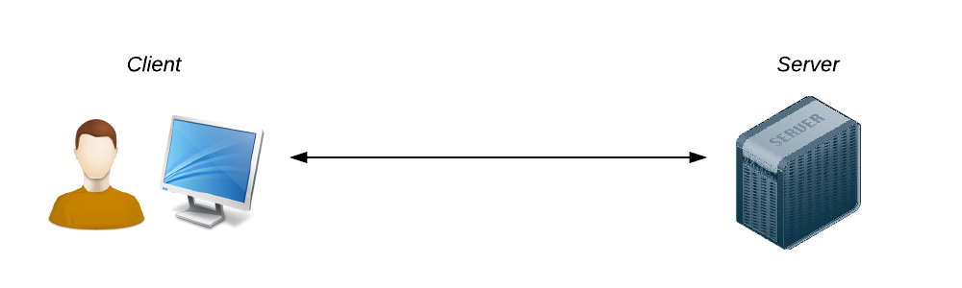
Motivation for Development
Create an interactive application centered around a new technology
WebSockets
Open a persistent connection the client and server
This allows for an interactive communication session
API allows the client to send messages to the server and receive event-driven responses
Client and server can send data at any time

Slide 4
Motivation for Development
Create an interactive application centered around a new technology
Socket.IO
JavaScript library for working with WebSockets
Separate client-side (browser) and server-side (node.js) libraries
Why use for Doodle Buddy?
Broadcast information to multiple sockets
Store data associated with each client
Asynchronous input/output
Lets users interact through chat and canvas

Slide 5
Technologies Used
body-parser
chance
express
express-handlebars
materialize-css
morgan
mysql
mysql2
nodemon
npm
sequelize
socket.io
webpack
/*
take a look inside our package.json file for dependencies and devDependencies
*/

Slide 6
Technologies Used
body-parser
chance
express
express-handlebars
materialize-css
morgan
mysql
mysql2
nodemon
npm
sequelize
socket.io
webpack
/*
CSS library,
designed by Google
*/

Slide 7
Technologies Used
body-parser
chance
express
express-handlebars
materialize-css
morgan
mysql
mysql2
nodemon
npm
sequelize
socket.io
webpack
/*
logger middleware,
logs requests to console,
helpful for debugging in node
*/

Slide 8
Technologies Used
body-parser
chance
express
express-handlebars
materialize-css
morgan
mysql
mysql2
nodemon
npm
sequelize
socket.io
webpack
/*
listens for file changes and establishes new server connection each time,
productivity++
*/

Slide 9
Technologies Used
body-parser
chance
express
express-handlebars
materialize-css
morgan
mysql
mysql2
nodemon
npm
sequelize
socket.io
webpack
/*
JavaScript library for real-time web applications,
uses persistent connection to make chat/canvas viewable to both users
*/

Slide 10
Technologies Used
body-parser
chance
express
express-handlebars
materialize-css
morgan
mysql
mysql2
nodemon
npm
sequelize
socket.io
webpack
/*
static module bundler,
packages files into into few static assets for use in browser (client-side)
*/

Slide 11
Design Process
Independent research for new technologies
Created an initial mock up to determine functional pieces of main webpage
Create new content on different branches in repository
Merge branches into master to combine work and check viability of all pieces
canvas, front-end, database, players, users, socket, etc…
Slack and class for communication and planning

Slide 12
Demonstration

Slide 13
Directions for Future Development
Scalability
Turn-taking and gameplay mechanics currently limited to 2 users
Expand for larger chatroom and collaborative gameplay
Utilize user data to create `buddies`
Akin to how Words With Friends allows users to start new games with known players
Sharing user id or game id
Saving images
Allow players to capture their images and post to social media
Create image gallery on landing page

