Slide 1
BlurBodyBalance
Team Blur1 Group 5
Members: Anthony Arbour, Adam Smith, Jacob Boudreau, Sam Beaudoin, Kenneth Seneres,
Henrikus Freeman

Slide 2
App Overview
Keeps track of weight, diet and workouts
Set goals
Motivates users to meet goals through passive aggressive comments when goals are not met.
View progress in a graph that also shows how far away your goal is

Slide 3
Updated User Stories
As a user I would like …
to keep track of my weight so I can see my weight loss progress.
a line graph that shows my weight over the past 7, 30, 90 days so I have a visual representation of my weight change.
to be able to set a weight goal and have that goal visible on the graph because setting goals is important.
As a user I would like …
to keep track of my diet.
to record the amount of calories I eat in a day so I don't overeat.
to be able to set a calorie limit/goal to help with diet.
to have a progress bar to display how close I am to my calorie limit/goal .

Slide 4
Updated User Stories
As a user I would like …
to keep track of my fitness
the app to track the amount of distance I walk/run to better improve my activity.
to set walking/running distance goals to help motivate
To be able to record my workout routine so I can have consistent workouts.
to look at pre-existing workout routines for users who don’t know/don’t have their own workout routine.
As a user I would like …
The app …
to allow me to customize the main window to display information I think is most important for me when I open the app.
to have tabs for weight, diet, and fitness to display more details than in the main window.
to have a user tab so I can see/edit personal info such as age, height, etc…

Slide 5
Functional/Non-functional requirements
(most important)

Slide 6
Important Use Cases
Notes:
Sam

Slide 7
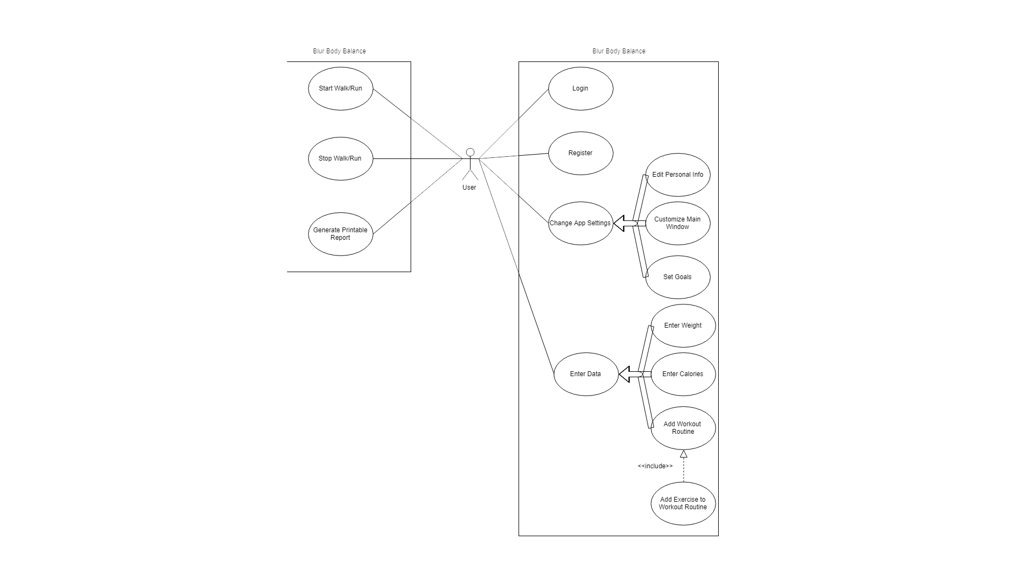

Slide 8
Important Use Cases
Use case: Login
Steps:
Actor Actions System Responses
1) Choose username field
2) Type in username
3) Choose password field
4) Type in password
5) Click “Login” button
6) check if user is registered
7) if wrong, display “username or password is incorrect”
8) if right, display main window of app
Notes:
Sam

Slide 9
Important Use Cases
Use Case: Change App Settings
Related Use Cases:
Generalization of:
Set Goals
Enter Personal Info
Customize Main Window
Steps:
Actor Actions System Responses
1) Navigate to “app settings”
2) select which setting to change
3) display setting change page
4) Invoke Set Goals/Enter Personal Info
/Customize Main Window
5) select save
6) save info
7) Update UI if applicable
Notes:
Sam

Slide 10
Important Use Cases
Use Case: Start Walk/Run
Steps:
Actor Actions System Responses
1) navigate to “exercise” tab
2) select “Start walk/run”
3) display the walk/run page
4) keep updating UI with new data
Use Case: Stop Walk/Run
Steps:
Actor Actions System Responses
1) select “stop walk/run”
2) record data
3) return to “exercise” tab
4) Update UI
Use Case: Generate Printable Report
Steps:
Actor Actions System Responses
1) select “generate printable report”
2) display all relevant information
Notes:
Sam

Slide 11
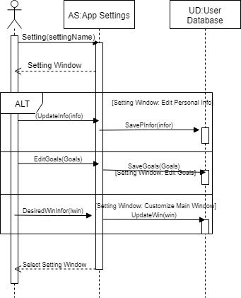
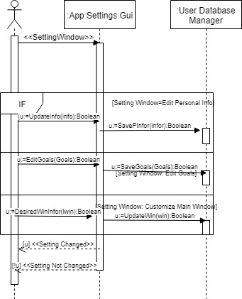
Important Sequence Diagrams
Notes:
Sam

Slide 12
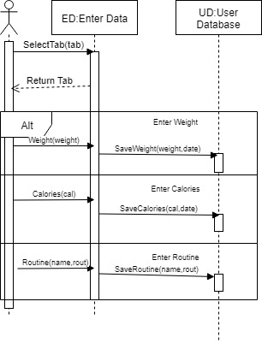
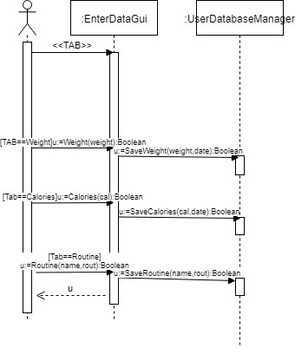
Important Sequence Diagrams
Notes:
Sam

Slide 13
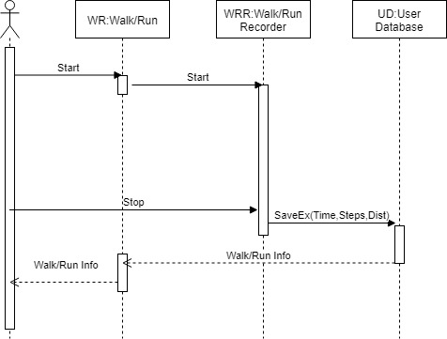
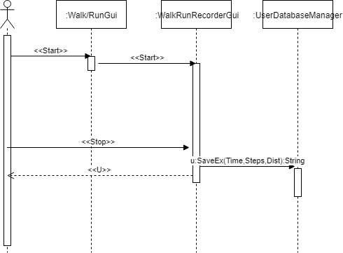
Important Sequence Diagrams
Notes:
Sam

Slide 14
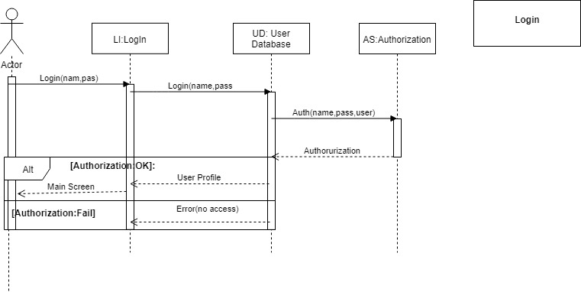
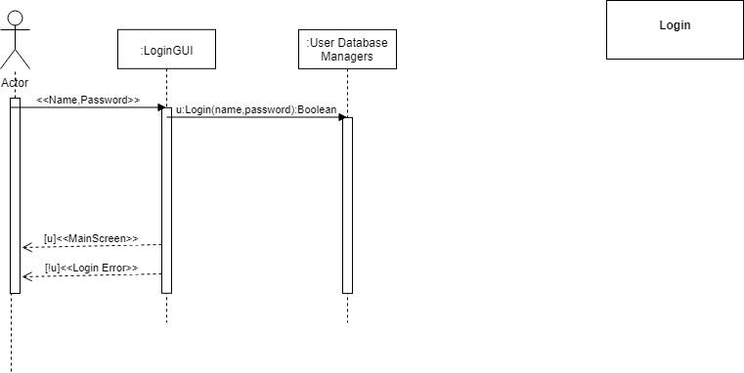
Important Sequence Diagrams
Notes:
Sam

Slide 15
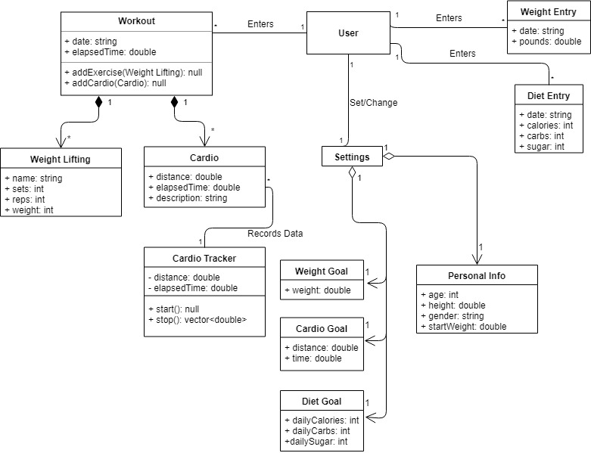
Domain Model and Design Diagrams
Notes:
Sam

Slide 16
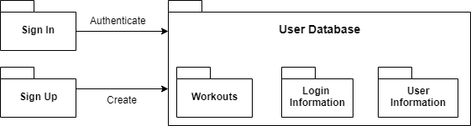
Architecture Design

Slide 17
Design Pattern

Slide 18
Design Pattern

Slide 19
Configuration Plans
Responsibilities
• Product Owner
– Manages the product backlog – Orders the items in the product backlog – Makes the product backlog visible to all – Determines what is ”done” and is acceptable in the sprint – May cancel a sprint if the sprint goal becomes obsolete
• Scrum Master
– Makes sure the development team is practicing in scrum properly – Facilitates the product owner’s and development team’s work – Interfaces with external entities
• Development Team
– Determines the work that needs to be done in a sprint – Works with the product owner to determine what ”done” is – Implements the user stories in the sprint – Manages the sprint backlog
Each sprint a different team member takes the role as product manager and scrum master. All other team members are developers
Software Configuration Items (CIs)
• Firebase Database
• Flutter
• User Interface
– Login/Register – Main Menu – System Settings – Weight Tracker – Diet Tracker – Exercise Tracker – Progress Bar – Line Graph
• Testing

Slide 20
Configuration Plans
Requesting Changes
Change request should be submitted using a Change Request Form in order to properly document the request so that it can be evaluated and approved.
Evaluating Changes
There are many things to consider when evaluating a change request.
• What are the consequences of making the change? Minor/Major change?
• Does it affect many users or just a few?
• Is it a costly change? Does it affect many system components? Will it take a long time?
• Production release cycle: If a new version of the app was just released, maybe make the change in the next one.
Approving or Disapproving Changes
Using the evaluation criteria described above, change requests are either denied and discarded, or approved and added to the kanban board/backlog.

Slide 21
Summary of Test Plan, Cases and Results

Slide 22
Focus Group Results
Complaints With Other Apps: Extra features too expensive. Confusing interface. Tedious to manually input data. | Requested Features: Tracking workouts, calories etc… User friendly interface. Nutrition and water suggestions. Roast mode was received well.

Slide 23
Security and Privacy Concerns Addressed

Slide 24
App Mock-up

Slide 25
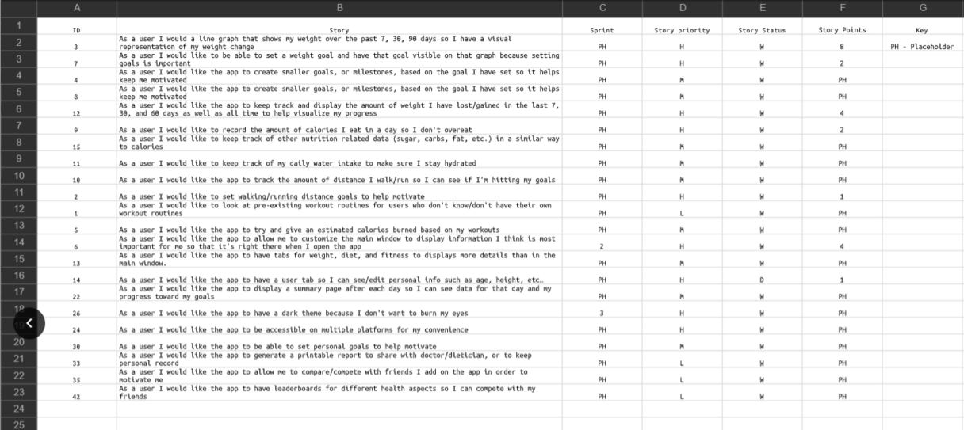
Product/Sprint Backlog Summary

Slide 26
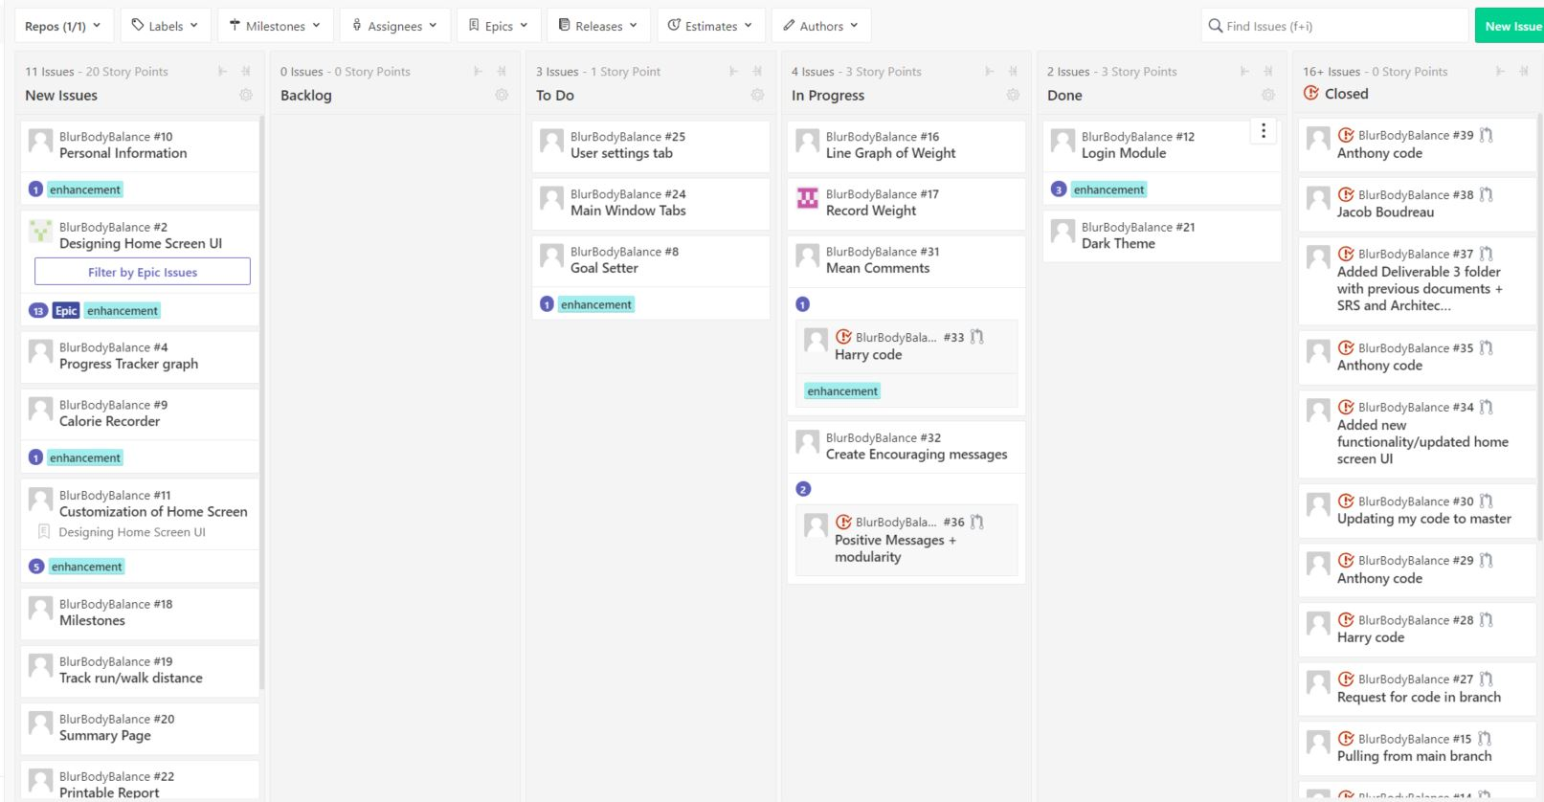
Kanban Board

Slide 27
What is Left

Slide 28
Github Link
https://github.com/Doom1201/BlurBodyBalance

