Slide 1
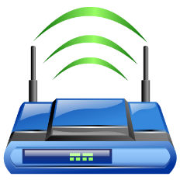


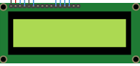


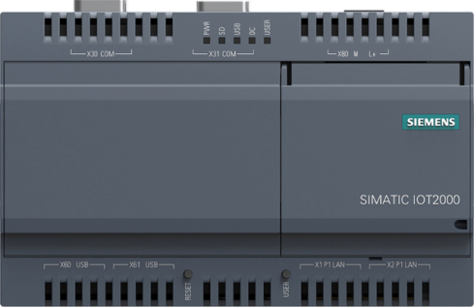


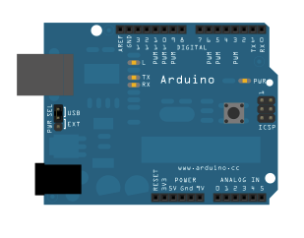



Internet
LCD Driver
Coded in Arduino Sketch
MQTT Connectivity
Coded in NodeJS
TCP Socket to Serial Bridge
Coded in C++
Fuel Tank

