Slide 1
Motion Planning
Jacob Knispel
Jay Shankar
Alec Tiefenthal

Slide 2
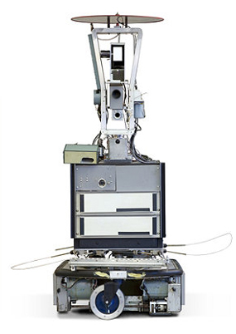
Shakey the Robot
Built by SRI’s AI center in 1966
“First electronic person”
Led to breakthroughs in image analysis, computer vision, and pathfinding
Notes:
Bullet 1: Stanford Research Institute
Bullet 2: Quote by Life magazine inserted mostly for a laugh
Bullet 3: Nils Nilsson developed A* with his colleagues as an improvement on Djikstra’s, which doe

Slide 3
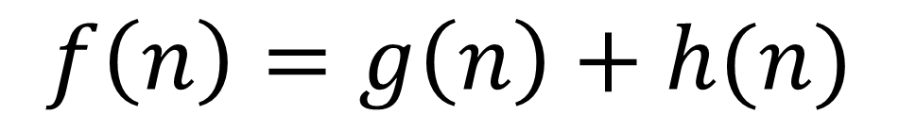
A* Algorithm
Avoids expanding paths that are quickly expensive
Uses application-based heuristic to estimate future cost
$$f\left(n\right)=g\left(n\right)+h(n)$$
Notes:
Top-right – unweighted, searching for path
Bottom-left – Heuristic valuing nodes closer to the destination makes for faster computation but less optimal paths
h(n) can never overestimate the actual path cost (assumes no obstacles, basically)
h(n) – heuristic that estimates cost (problem specific)
g(n) – cost of path from start to end

Slide 4
D* Algorithm
Dynamic A* search
Searches from goal to start, unlike A*
Like A*, guaranteed to find the optimal path between two nodes
Starts at the ending node instead of the beginning
Costs of nodes change throughout the execution of this algorithm. If an obstruction is found, the affected nodes have their cost raised, and this cost propagates backwards.

Slide 5
Notes:
Demonstration of why choosing the closest waypoint every time (“Greedy” search) is not always the best strategy – orange dots are waypoints, the blue dot is the starting point

Slide 6
http://www.rose-hulman.edu/~knispeja/

