Slide 1

Zero Trust Security – An Identity-Based Attack Evaluation in Enterprise Environments
School of Computer Science and Engineering
Department of Computer Science and Engineering
Awareness-driven experimental evaluation of identity-based attacks under weak and Zero Trust configurations
Submitted By: NAMAN JAIN
23FE10CSE00031
Supervised By: Dr. Susheela Vishnoi

Slide 2
Outline
Introduction
Literature Review
Problem Statement
Objectives
Proposed Methodology
Results
Outcome
References

Slide 3
Introduction
Active Directory in Modern Enterprises
Active Directory serves as the backbone of enterprise identity and access management.
It provides centralized authentication, authorization, and account control.
Identity-based attacks are among the most common enterprise threat vectors.
Credential compromise often enables reconnaissance and lateral movement.
AD is a high-value target in enterprise environments.
Over 90% of enterprises rely on Active Directory or AD-based identity systems for authentication and access control.
Notes:
https://www.sentinelone.com/cybersecurity-101/identity-security/active-directory-monitoring/ (Source for 90%)

Slide 4
Introduction
Shift Towards Zero Trust Security
Modern enterprises adopt Zero Trust security principles.
63% of organizations worldwide have implemented a Zero Trust strategy.
Only 10% of large enterprises are expected to achieve mature Zero Trust implementation by 2026.
Enforcement of least privilege access policies.
Policy-based hardening through Group Policy (GPO).
Host-based firewall enforcement and segmentation.
Secure-by-default configurations alter attack outcomes.
Notes:
https://www.gartner.com/en/newsroom/press-releases/2023-01-23-gartner-predicts-10-percent-of-large-enterprises-will-have-a-mature-and-measurable-zero-trust-program-in-place-by-2026
https://www.gartner.com/en/newsroom/press-releases/2024-04-22-gartner-survey-reveals-63-percent-of-organizations-worldwide-have-implemented-a-zero-trust-strategy

Slide 5
Literature Review
Exploitation-Focused Active Directory Studies
Many academic studies demonstrate:
Privilege escalation
Lateral movement
Domain takeover
Often assume:
Weak configurations
Disabled security controls
As a result, there is limited evaluation of attack behavior under enforced security controls.

Slide 6
Literature Review
Paper/ Study | Focus Area | Methodology | Key Contribution | Limitation/ Research Gap
ZTA + Federated Learning | Cross-domain IoT security | Simulation with decentralized FL | Privacy-Preserving authentication and adaptive models | Lacks enterprise environment and real attack validation
BELA (Model Inversion Protection) | ML security in federated learning | Encryption-based gradient protection | Prevents data leakage from model updates | Limited to ML domain; no network-level implementation
ZTA Adoption Factors Study | Organizational ZTA adoption | Survey + statistical analysis | Identifies key factors like IAM, segmentation | No experimental or technical validation
Healthcare Incident Response | AI-based incident response | Machine learning models | Improved detection accuracy and response time | Not focused on Zero Trust architecture
Zero Trust Survey paper | General ZTA framework | Literature survey | Defines core principles and architecture | Conceptual; lacks implementation
ZTA in Cloud Networks | Cloud security with ZTA | Analytical study | Highlights micro-segmentation and least privilege | No attack simulation or validation
Blockchain + ZTA (Finance/Metaverse) | Trust enhancement using blockchain | Conceptual architecture | Taper-proof IAM and trust mechanisms | High complexity; impractical for real-world labs
5G Industrial Zero Trust | Industrial network security | Architectural + gap analysis | Continuous authentication and trust evaluation | Implementation challenges not validated experimentally
Edge Computing DDoS + ZTA | Edge security + behavioral detection | Simulation with ML-based anomaly detection | Improved DDoS detection and resilience | Simulation-based; lacks enterprise attack scenarios
Access Layer ZTA System | Network access control | Trust evaluation (fuzzy logic) | Dynamic trust-based access decisions | Limited real-world validation
Enterprise ZTA Security Study | Enterprise security enhancement | Case studies + reports | Reduces insider threats and lateral movements | No controlled penetration testing validation

Slide 7
Literature Review
Identified Research Gap
Limited focus on failed attack behavior.
Insufficient evaluation of enforced security policies.
Limited analysis of log-based detection artifacts.
Need for awareness-driven evaluation of defensive mechanisms.

Slide 8
Problem Statement
Modern Active Directory environments increasingly adopt Zero Trust-aligned hardening and segmentation.
However, most academic demonstrations do not evaluate how identity-based attacks behave under enforced security controls.

Slide 9
Objectives
Model an SMB-based identity attack chain from discovery to file access on Windows 11.
Assess NTLMv2/SAM exposure and potential for escalation and lateral movement.
Deploy and harden a Zero Trust Active Directory environment.
Test identity-based attacks using low-privilege credentials against controls.
Evaluate feasibility of Golden and Silver Ticket attacks
Compare attack feasibility between weak and hardened Zero Trust environments.

Slide 10
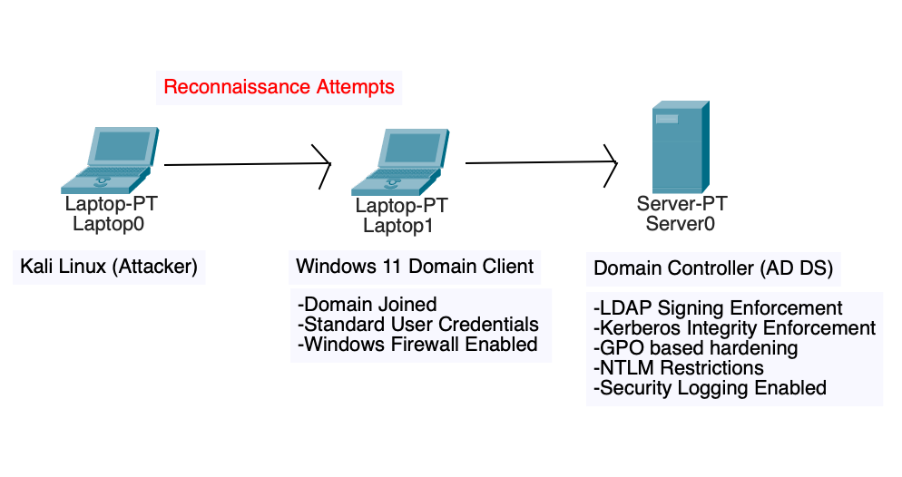
Proposed Methodology
Lab Architecture:
Windows Server Domain Controller (AD DS)
Windows 11 Domain Client
External attacker system (Kali Linux)
Controlled same-subnet lab environment.

Slide 11
Proposed Methodology
Two-Phase Approach:
The experimental setup follows a two-phase approach to evaluate attack behavior under different security conditions.
Phase 1: Attack simulation in standalone Windows 11 environment.
Phase 2: Attack simulation in hardened Active Directory environment.
Identity & Policy Configuration:
Domain setup and controller deployment
Creation of standard domain user
Client joined to domain
Low-privilege domain credentials used for attack simulation

Slide 12
Proposed Methodology
Hardening & Policy Enforcement
Group Policy Object (GPO)-based security configuration
LDAP signing enforcement
Kerberos integrity enforcement
NTLM usage restriction policies
Windows Firewall enabled and configured

Slide 13
Proposed Methodology
Attack Simulation Approach
Network reconnaissance and service enumeration
LLMNR/NBT-NS poisoning for credential capture
NTLMv2 hash capture and password cracking validation
LDAP enumeration testing
Authentication interaction testing
Security controls remained enabled
Log monitoring during attack execution

Slide 14
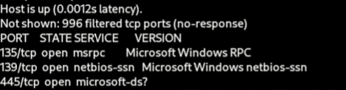
Phase 1 – Reconnaissance and Service Discovery

Slide 15
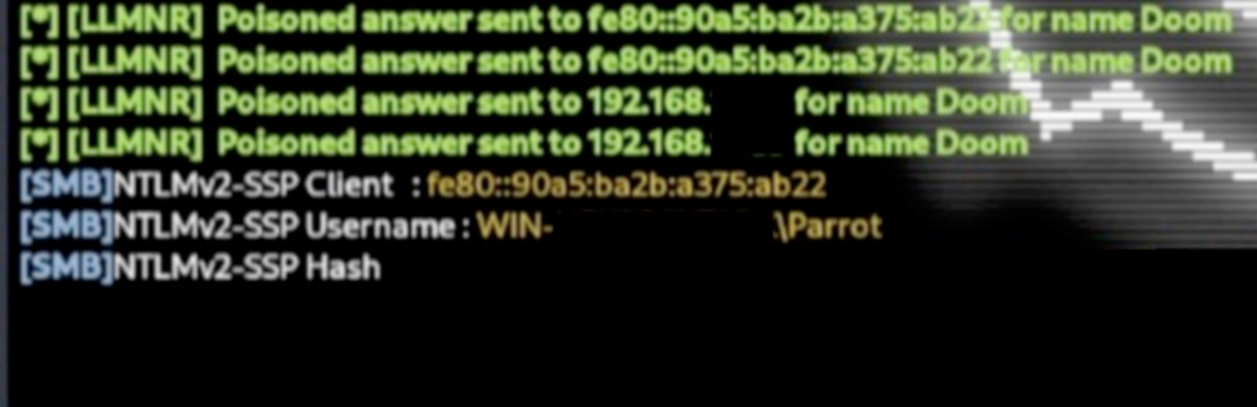
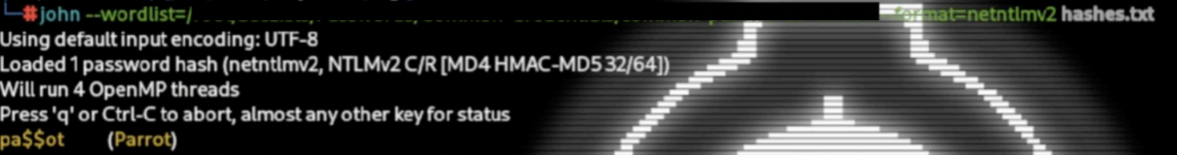
Phase 1 - Credential Compromise via LLMNR Poisoning

Slide 16
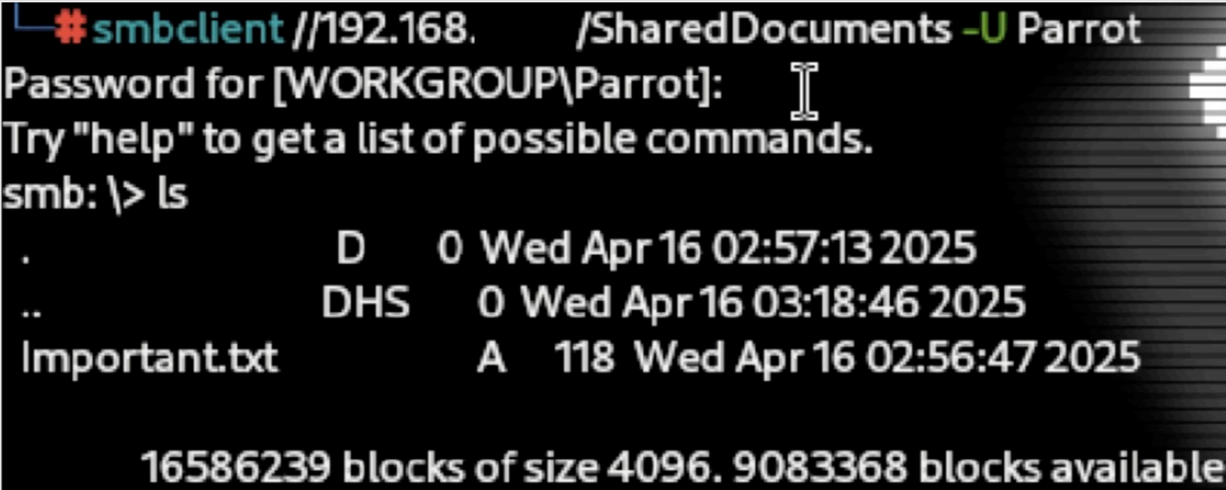
Phase 1 - Unauthorized Access via SMB

Slide 17
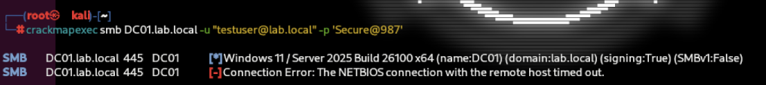
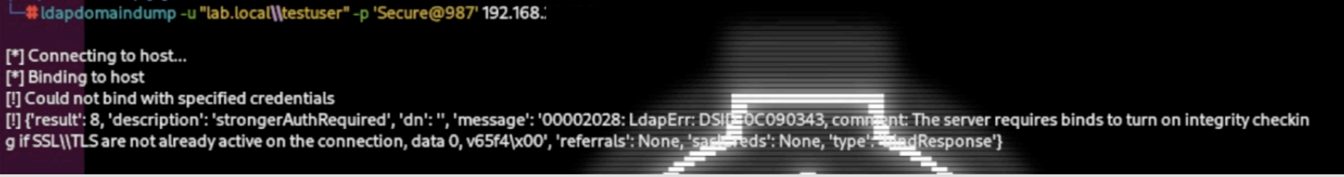
Phase 2 – Attack Restriction under Zero Trust Controls

Slide 18
Result
Attempt | Outcome | Reason
LLMNR / Credential Capture | Successful (Phase 1) / Blocked (Phase 2) | Disabled / no fallback
LDAP Enumeration | Blocked | LDAP signing enforced
Kerberos Interaction | Restricted | Integrity Enforcement
Lateral Access | Successful (Phase 1) / Restricted (Phase 2) | Firewall & segmentation
Privilege Escalation | Not achieved | Policy enforcement (Least Privilege)
Phase 1 demonstrated successful credential compromise and unauthorized access without exploiting software vulnerabilities.
Phase 2 significantly restricted attack progression under enforced Zero Trust controls.

Slide 19
Outcome
Hardened Active Directory lab successfully implemented
Comparative evaluation shows identity-based attacks succeed in weak environments but are restricted under Zero Trust controls
Zero Trust-aligned controls validated
Defensive enforcement and monitoring demonstrated.

Slide 20
References
NIST SP 800-207 Zero Trust Architecture Documentation
Microsoft Active Directory Security Documentation
Research on Identity-Based Attacks in Enterprise Environments
Academic studies on AD Hardening and Detection

Slide 21
References
Y. Liu, “Construction of network access layer security protection system based on zero trust architecture,” Procedia Computer Science, vol. 243,pp. 1013–1022, 2024.
R. Patel, K. M¨ uller, G. Kvirkvelia, J. Smith, and E. Wilson, “Zero trust security architecture raises the future paradigm in information systems,”Informatica and Digital Insight Journal, vol. 1, no. 1, pp. 24–34, 2024.
M. Hasan, “Enhancing enterprise security with zero trust architecture,” arXiv preprint arXiv:2410.18291, 2024.
N. Karunarathne and T. Samarasinghe, “Analyzing the implementation factors of zero-trust architecture as perceived by information security professionals in western province, sri lanka.
J. Barach, “Towards zero trust security in sdn: A multi-layered defense strategy,” in Proceedings of the 26th International Conference on Dis- tributed Computing and Networking, 2025, pp. 331–339.
Y. Kim, S.-G. Sohn, K. T. Kim, H. S. Jeon, S.-M. Lee, Y. Lee, and J. Kim, “Exploring effective zero trust architecture for defense cybersecurity: A study.” KSII Transactions on Internet & Information Systems, vol. 18, no. 9, 2024.
S. Ahmadi, “Zero trust architecture in cloud networks: Application, challenges and future opportunities,” Ahmadi, S.(2024). Zero Trust Architecture in Cloud Networks: Application, Challenges and Future Opportunities. Journal of Engineering Research and Reports, vol. 26,no. 2, pp. 215–228, 2024.
V. Veeramachaneni, “Integrating zero trust principles into iam for enhanced cloud security,” Recent Trends in Cloud Computing and Web Engineering, vol. 7, no. 1, pp. 78–92, 2025.
J. M. B. Murcia, E. C´ anovas, J. Garc´ ıa-Rodr´ ıguez, A. M. Zarca, and A. Skarmeta, “Decentralised identity management solution for zero-trust multi-domain computing continuum frameworks,” Future Generation Computer Systems, vol. 162, p. 107479, 2025.
T. Wu, G. Li, J. Wang, B. Xiao, and Y. Song, “Ppca: Privacy-preserving continuous authentication scheme with consistency proof for zero-trust architecture networks,” IEEE Internet of Things Journal, vol. 12, no. 11, pp. 17 596–17 609, 2025.
J. J. D. Rivera, A. Muhammad, and W.-C. Song, “Securing digital identity in the zero trust architecture: A blockchain approach to privacy- focused multi-factor authentication,” IEEE Open Journal of the Communications Society, vol. 5, pp. 2792–2814, 2024.
C. Daah, A. Qureshi, I. Awan, and S. Konur, “Simulation-based evaluation of advanced threat detection and response in financial industry networks using zero trust and blockchain technology,” Simulation Modelling Practice and Theory, vol. 138, p. 103027, 2025.

Slide 22
References
F. U. Ayomide, “Enhancing behavioral ddos detection through zero trust security models in edge computing,” Authorea Preprints, 2025.
A. A. Habib, A. Imtiaz, D. Tripura, M. O. Faruk, M. A. Hossain, I. Ara, S. Sarker, and A. Z. Abadin, “Distributed denial-of-service attack detection short review: issues, challenges, andrecommendations,” Bulletin of Electrical Engineering and Informatics, vol. 14, no. 1, pp. 438–446, 2025.
A. Y. Balogun, O. O. Olaniyi, A. O. Olisa, M. O. Gbadebo, and N. C. Chinye, “Enhancing incident response strategies in us healthcare cybersecurity,” Available at SSRN 5117971, 2025.
J. Suomalainen, I. Ahmad, A. Shajan, and T. Savunen, “Cybersecurity for tactical 6g networks: Threats, architecture, and intelligence,” Future Generation Computer Systems, vol. 162, p. 107500, 2025.
H. Zhang, Z. Zhang, and L. Chen, “Toward zero trust in 5g industrial internet collaboration systems,” Digital Communications and Networks, vol. 11, no. 2, pp. 547–555, 2025.
X. Ma, F. Fang, and X. Wang, “Dynamic authentication and granularized authorization with a cross-domain zero trust architecture for federated learning in large-scale iot networks,” arXiv preprint arXiv:2501.03601, 2025
S. A. Khowaja, P. Khuwaja, K. Dev, K. Singh, X. Li, N. Bartzoudis, and C. R. Comsa, “Block encryption layer (bela): Zero-trust defense against model inversion attacks for federated learning in 5g/6g systems,” IEEE Open Journal of the Communications Society, vol. 6, pp. 807–819, 2025.
M. A. Azad, S. Abdullah, J. Arshad, H. Lallie, and Y. H. Ahmed, “Verify and trust: A multidimensional survey of zero-trust security in the age of iot,” Internet of Things, vol. 27, p. 101227, 2024.
H. Fang, L. Xu, G. Nan, D. Zheng, H. Zhao, and X. Wang, “Accountable distributed access control with privacy preservation for blockchain- enabled internet of things systems: a zero-trust security scheme,” IEEE Internet of Things Journal, 2025.
M. A. Aleisa, “Blockchain-enabled zero trust architecture for privacy-preserving cybersecurity in iot environments,” IEEE Access, 2025.
I. U. Din, K. H. Khan, A. Almogren, M. Zareei, and J. A. P. Diaz, Securing the metaverse: A blockchain-enabled zero-trust architecture for virtual environments,” IEEE Access, vol. 12, pp. 92 337–92 347 2024.
C. E. Alozie and E. Chinwe, “Developing a cybersecurity framework for protecting critical infrastructure in organizations,” Iconic Research and Engineering Journals, vol. 8, no. 7, pp. 562–576, 2025.

Slide 23
Thank You

