Slide 1
Filters
ADC X Dynamic Cast 2022
Practical DSP
Harriet Drury (@druryharriet)

Slide 2
Audio Filters - Frequency Response
The frequency response of a filter is the given magnitude and phase of the output as a function of input frequency. There are 4 common types of filter:
High Pass
Low Pass
Band Pass
All Pass

Slide 3
Example: Low Pass Frequency Response
Given the following digital system, determine the frequency response:
y(n)=0.5x(n)+0.5x(n-1)

Slide 4
Example: Low Pass Frequency Response
Given the following digital system, determine the frequency response:
y(n)=0.5x(n)+0.5x(n-1)
Let’s break this down:
y(n) - Output Signal
x(n) - Input Signal
x(n-1) - Previous input signal

Slide 5
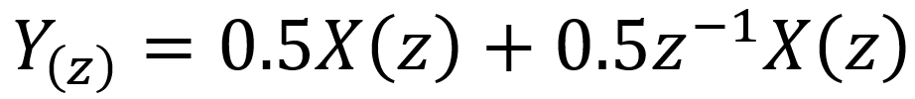
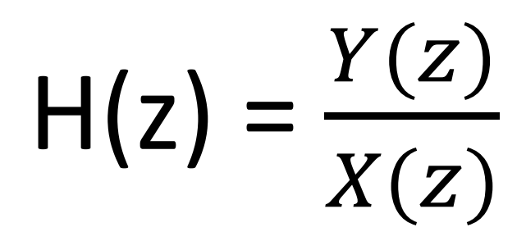
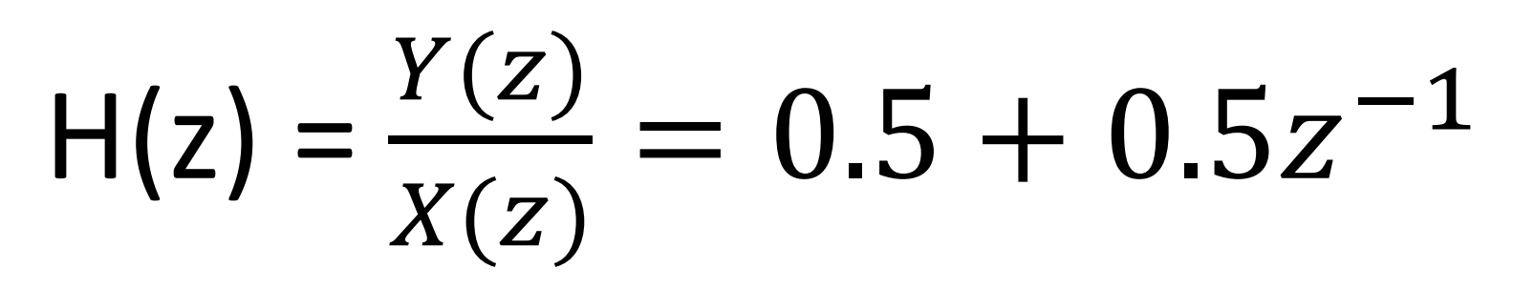
Solution
y(n)=0.5x(n)+0.5x(n-1)
Transform both sides into the Z domain
The transfer function can be found with:
Therefore:
(we’ve moved the X(z))

Slide 6
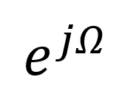
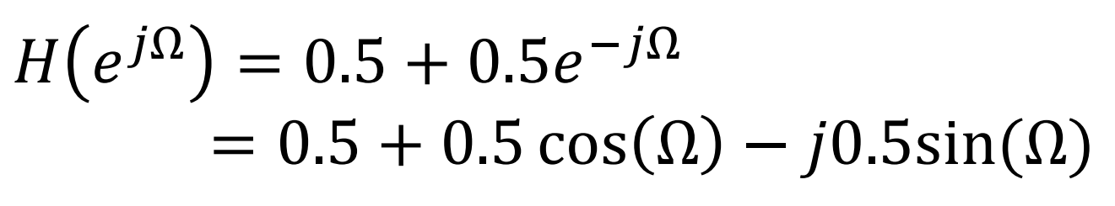
Solution
3. Substitute Euler’s identity ( )
4. Therefore, magnitude and phase response are given by:

Slide 7
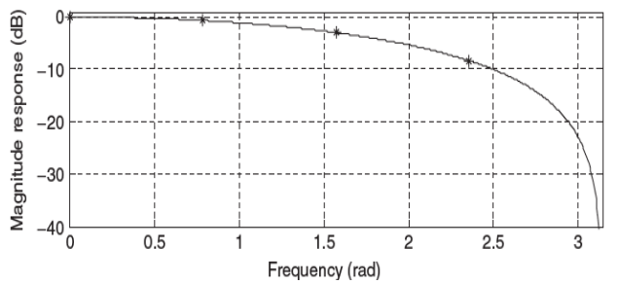
Solution
It is observed that when the frequency increases, the magnitude response decreases. The DSP system acts like a digital low pass filter, and its phase response is linear.

Slide 8
This is a Low Pass FIR Filter
What does that mean?
Finite Impulse Response filters (FIR) outputs are reliant on the current and previous input samples
y(n)=0.5x(n)+0.5x(n-1)
x(n): Current
x(n-1): Previous
We consider this a 1st order FIR filter x(n-1).

Slide 9
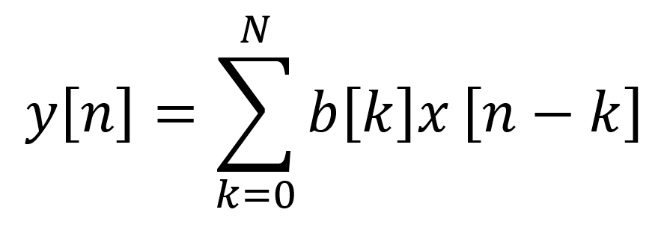
FIR Online Visualiser
https://fiiir.com/
You can describe the input/output relation of an FIR filter with:
Where N is the order of the FIR filter (its length-1) and those coefficients b[k] of length N+1 are the FIR filters impulse response, or the filter coefficients in practice.

Slide 10
FIR Filters: Pros and Cons
Pros
Easy
Stable
Robust
Cons
Large Storage Requirement
Computationally Expensive
Cannot simulate prototype analog filters

Slide 11
Infinite Impulse Response (IIR) Filters
For an infinite impulse response filter (IIR), the output of the filter is based not only on current and previous input samples, but also previous output samples. Given a difference equation:
We see that y(n-1) is added from the previous FIR filter difference equation.

Slide 12
Example
This is a second order IIR filter
(we’ve replaced the arbitrary numbers with a and b)
Changes from the FIR filter is the inclusion of previous output y(n) signals. Cool!
How do we find the impulse response?

Slide 13
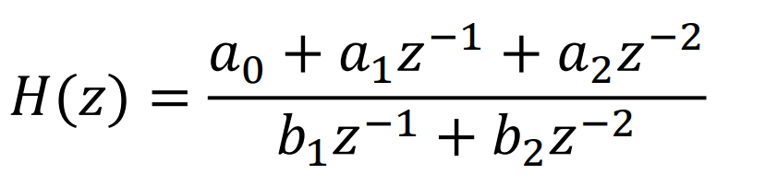
Solution
Transform into the Z domain
The transfer function can be found with:
Therefore:

Slide 14
IIR Transfer Function
So far:
The transfer function is quadratic in the numerator, and the denominator. This is in fact called a “biquadratic filter” or a “biquad” for short.
Higher order filters (like EQs) are made by chaining multiple biquads together. Biquads are a pretty important staple of DSP.

Slide 15
Poles and Zeros
The zeros of the quadratic equation in the numerator are also the ZEROS of the filter.
The zeros of the quadratic equation in the denominator are also the POLES of the filter.

Slide 16
Pole Zero Plot
Unlike FIRs which are relatively smooth and can only make certain frequencies lower, IIRs can cause frequency amplitudes to get much higher and even shoot off to infinity. That makes for some interesting sounds by adding distortion to certain frequency notes of an instrument but not others.
By solving the quadratic equations, we can find the poles and zeros of the IIR filter

Slide 17
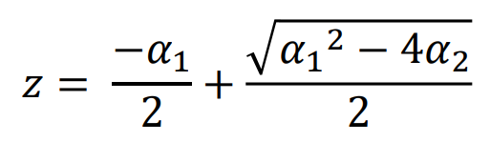
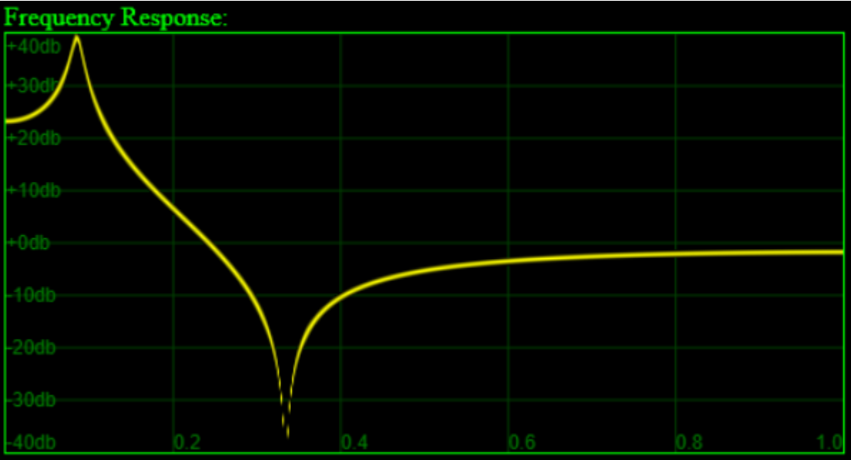
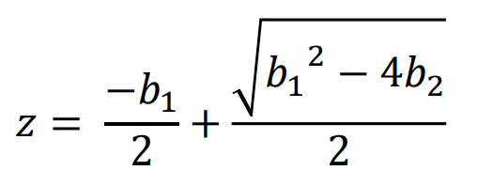
Pole Zero Plot
Zeros:
Poles:

Slide 18
IIR Filters: Pros and Cons
Pros
Implementation of IIR filter involves fewer parameters, less memory requirement, and lower computational complexity.
Easy to Design
Easy to Implement
Cons
IIR Filters become unstable
IIR filter has a feedback loop so they will accumulate rounding and noise error.

Slide 19
MATLAB
Let’s implement an IIR Filter…..

Slide 20
MATLAB Code:
% Various Plots for IIR Filtering
% h[n] = y[n]/x[n]
clc;
clear all;
num = [1 0]; % a -> coefficients of y[n] Changeable to see what happens
den = [1 -1]; % b -> coefficients of x[n] Changeable to see what happens
figure(1)
subplot(1,3,1)
zplane(num,den) % Z plane plot of h(n)
title('Pole Zero Plot')
w = 0:pi/32:pi; % Omega Frequency (Changeable)
[h,w]=freqz(num,den,w); % Freqz = frequency response
mag=abs(h); % Absolute Value for magnitude
phase=angle(h);
subplot(1,3,2)
plot(w/pi,mag)
title('Magnitude Plot for IIR LPF')
subplot(1,3,3)
plot(w/pi,phase)
title('Phase Plot for IIR LPF')

Slide 21
MATLAB Code:
% Basic butterworth filter example
% Uses a built in IIR filter
[dataIn, Fs] = audioread('Lo-Fi-Demo.mp3'); % Read an audio file
% Filter the signal
fc = 800; % Make higher to hear higher frequencies.
% Design a Butterworth filter.
[b, a] = butter(6,fc/(Fs/2));
freqz(b,a)
% Apply the Butterworth filter.
filteredSignal = filter(b, a, dataIn);
% Play the sound.
player = audioplayer(filteredSignal, Fs);
play(player);

Slide 22
Thanks!

