Slide 1
SIMULATION OF IOT BASED HOME AUTOMATION SYSTEM USING PROTEUS
Group Members : Supervisor:
T. Doondi Ashlesh (19B81A3311) Dr. R. Raja
B. Nikhil (19B81A3327) Associate Professor
S. Sharath Chandra Reddy(19B81A3344) Dept. Of CSIT

Slide 2
PROBLEM STATEMENT
The field of Automation has been well advanced in Industries, majority of manufacturing ,processing plants and other major sectors. But automation has yet to find stability in home environment.
If automation was to be used in homes then everyday life activities would become easier to manage and monitor.

Slide 3
PROPOSED SOLUTION
The scope of this work is to develop a Home Automation system by using Raspberry Pi which acts as an interface between the devices.
The proposed system includes multiple sensors which coordinate with the help of raspberry pi .
PIR motion sensor to detect human presence
LDR sensor ,temperature sensor to control and regulate LED light, DC motor fan by automatically comparing the preset values of Temperature ,light intensity.
Gas detection sensor to trigger the buzzer alarm and send alerts using gsm module on detection of smoke to concerned host.

Slide 4


TECHNOLOGIES USED
Python3
Proteus 8.9 professional – simulation software
Python3 – language used for programming

Slide 5
PYTHON LIBRARIES USED
spidev : Library used to work with spi protocol based devices (ADC module ) in python.
time : Library used to add time related specifications such as delay during code execution etc.
RPi.GPIO: Library used to access and work with General purpose input-output(GPIO) pins of raspberry pi
pio and Ports : Library used for working with serial communication devices (GSM module) in python

Slide 6
LIBRARY METHODS USED
spidev.SpiDev() : Used to create a spi variable for establishing connection
spidev.open() :used to open the spi communication. Connects to the specified SPI device .
spidev.xfer2() : Perform a SPI transaction: a list of bytes is written to the SPI device and as each byte in that list is sent out, it is replaced by the data simultaneously read from the SPI slave device over the MISO line.
ljust() : method used to left align the string, using a specified character .
Ports.uarts() : used to create a variable for serial communication. The UART serial port allows you to open a login session from a serial terminal application such as PuTTY.

Slide 7
LIBRARY METHODS USED
GPIO.setup() :Used to declare whether a pin is used as output or input
GPIO.setmode() :It tells the library which pin numbering system you are going to use. BOARD signifies using the physical pin numbers on the RPi
GPIO.setwarnings() :warns us if any current pin is previously used(set to false)
GPIO.input() :input([pin]) function is used to read an input pin value. The input() function will return either a True or False indicating whether the pin is HIGH or LOW.
GPIO.output() :output([pin]) is used to display the value of an output pin
time.sleep() :sleep function is used to add delay in the execution of a program.

Slide 8
HARDWARE COMPONENTS USED IN SIMULATION
Raspberry Pi 4 model B
MOTOR-DC (5-12v,1000RPM)
MQ-2 GAS SENSOR (300-10000 ppm)
NPN transistor
PIR MOTION SENSOR (~ 7 meters , ~110 degree measuring angle)
RELAY module – 1channel 5v
RESISTOR – 1k Ohm
TORCH_LDR sensor (50-100 k ohms)
DC operated buzzer module(85dB,2-2.6KHz)
L293D motor driver ic
LED-RED
LM016L LCD Module (16x2)
LM35 temperature sensor – Centigrade (100-500feet)
MCP3208 – Analog to Digital Conversion module(~100 ksps ,max 12 bit resolution)

Slide 9
PHASES OF DEVELOPMENT
Programming the Home automation system schematic circuit – Using libraries and functions to define the working and conditional parameters for the connected devices
Simulation Software Installation – proteus version 8.9 with required libraries (PIR sensor library and gas sensor library) and create new project with raspberry pi as firmware
Hardware Schematic Design of Home automation system – Connecting the mentioned sensors and modules to gpio pins of raspberry pi on the simulation board to setup the system circuit
Evaluation of final system simulation model –Run the simulation to test the working of the Automation system on different cases

Slide 10
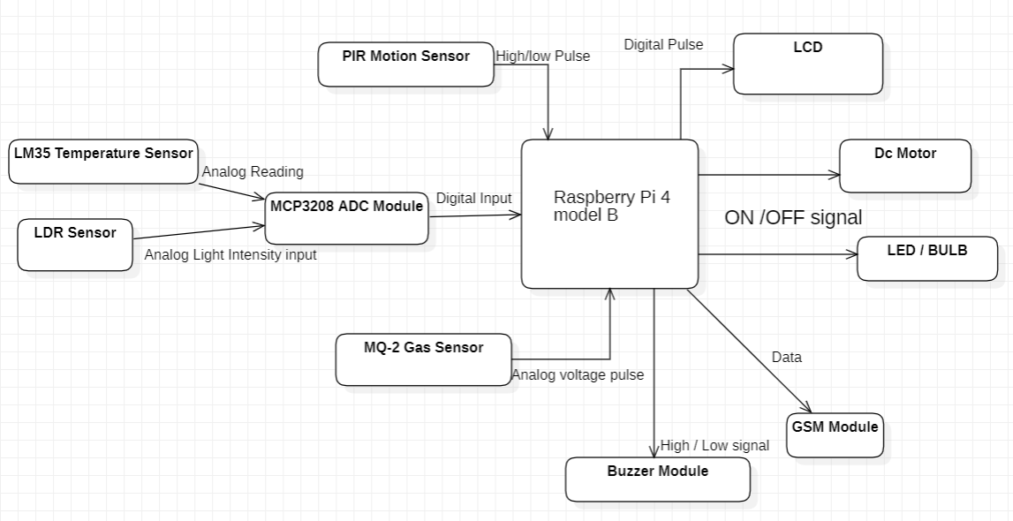
HOME AUTOMATION SYSTEM ARCHITECTURE

Slide 11
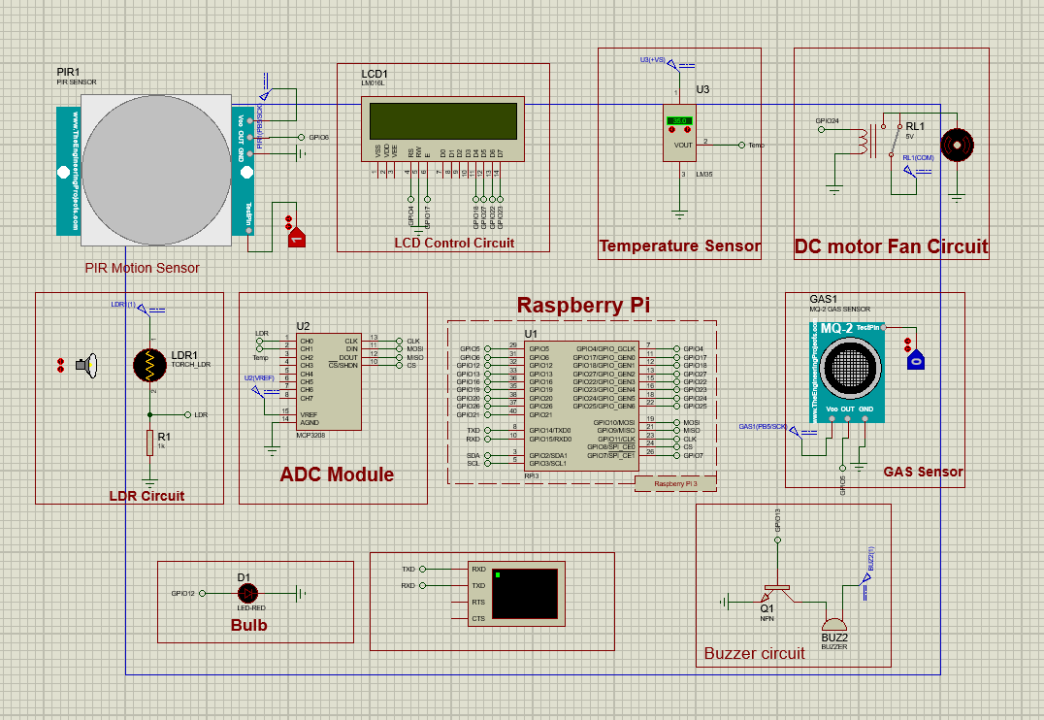
HOME AUTOMATION SYSTEM SCHEMATIC DESIGN

Slide 12
CIRCUIT DESIGN PROCESS
Create a new project with raspberry pi as the firmware.
Select the component to be simulated from the components list and drag them onto the circuit board.
Connect the respective pins of a component as specified with other components, raspberry pi gpio pins to establish a circuit connection.
The connections are made virtually by using names given to pins of the components respectively.
After establishing the connections, arrange the components in proper order to finish the circuit.

Slide 13
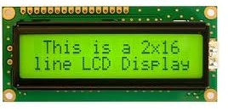
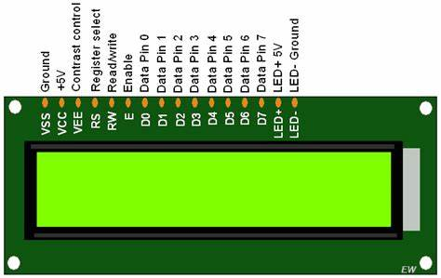
CIRCUIT DESIGN PROCESS
LCD Connections :
RW pin to ground
RS pin to GPIO4 pin of raspberry pi
Enable (E) pin to GPIO17 pin
D4 to GPIO 18 pin
D5 to GPIO 27 pin
D6 to GPIO 22 pin
D7 to GPIO 23 pin
16x2 LCD module

Slide 14
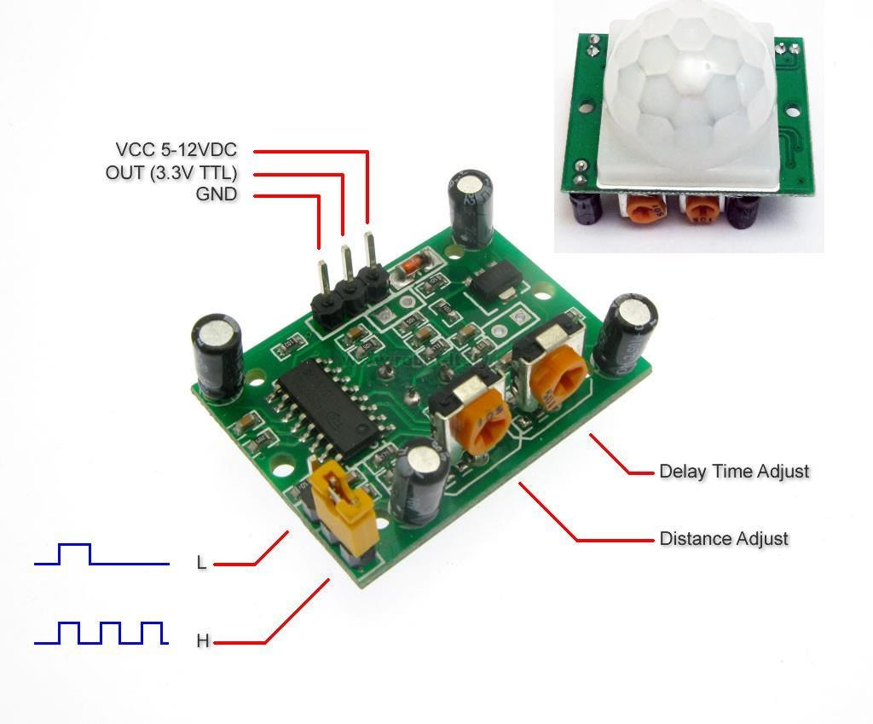
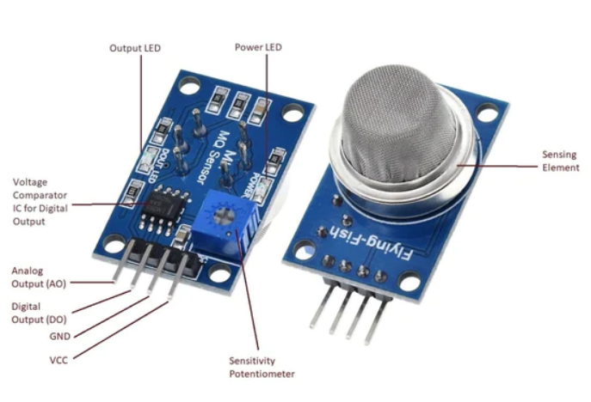
CIRCUIT DESIGN PROCESS
PIR Motion Sensor Connections:
Test Pin to Logic State
GND pin to Ground
OUT pin to GPIO6 pin of raspberry pi
VCC pin to DC supply (5v)
MQ-2 Gas Sensor Connections:
Test pin to Logic state
GND to Ground
OUT to GPIO5 pin of raspberry pi
VCC pin to DC supply (3.3v)
PIR motion sensor
MQ-2 Gas sensor

Slide 15
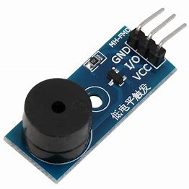
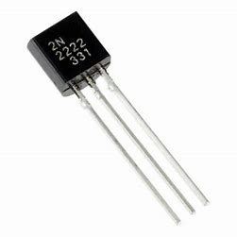
CIRCUIT DESIGN PROCESS
DC Operated Buzzer Module Connections:
First Pin to DC supply(5v)
Second Pin to NPN transistor 1st pin
Transistor 2nd pin to ground
Transistor input pin to GPIO 13
Set the operating voltage of buzzer to 5v
GSM Module(virtual terminal):
RXD pin of GSM to TXD(GPIO14) pin of Raspberry Pi
TXD pin of GSM to RXD(GPIO15) pin of Raspberry Pi
NPN transistor
Active Buzzer Module

Slide 16
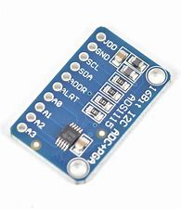
CIRCUIT DESIGN PROCESS
MCP3208 ADC module connections:
CLK pin of ADC to CLK(GPIO11) pin of Raspberry Pi
DIN Pin to MOSI(GPIO 10) pin
DOUT pin to MISO (GPIO9) pin
CS pin of ADC to CS(SS) pin of raspberry Pi
VREF pin to DC supply (3.3v)
AGND pin to Ground
8 channel 12 bit MCP3208 ADC module

Slide 17
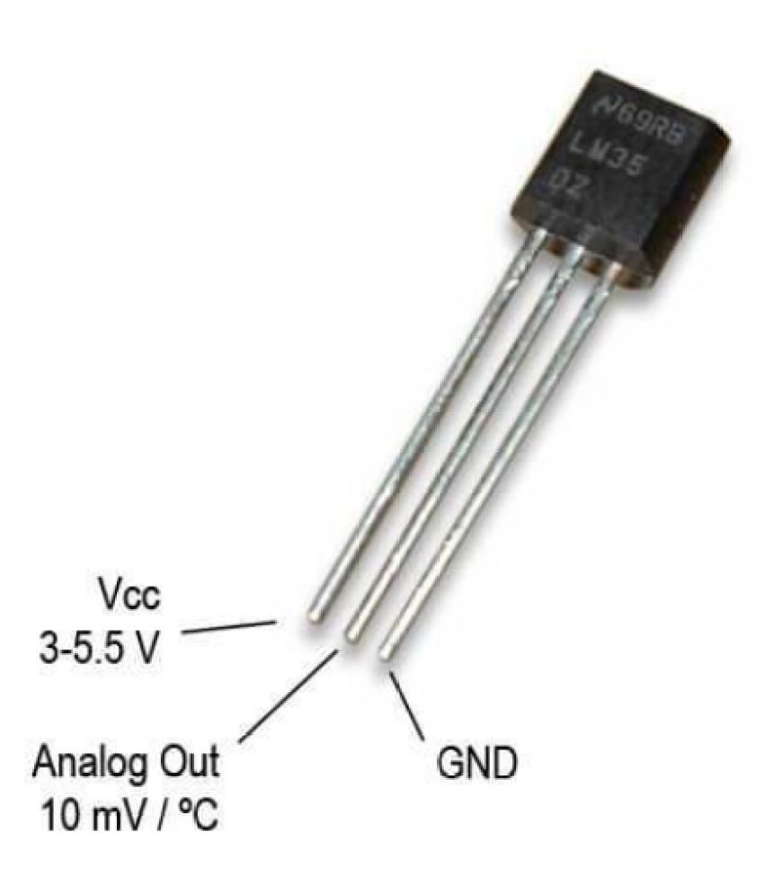
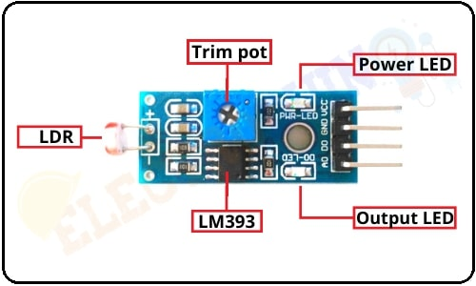
CIRCUIT DESIGN PROCESS
LM35 Temperature sensor
LM35 Temperature Sensor Connections:
First Pin to VCC (DC supply 3.3v)
Second pin to Channel 1 (CH1) pin of ADC module
Third Pin to Ground
TORCH_LDR Sensor Connections:
First pin to DC supply(3.3v)
Second part to 1k ohm analog resistor
Other end of resistor to ground
CH0 of ADC is connected to middle terminal of LDR and resistor

Slide 18
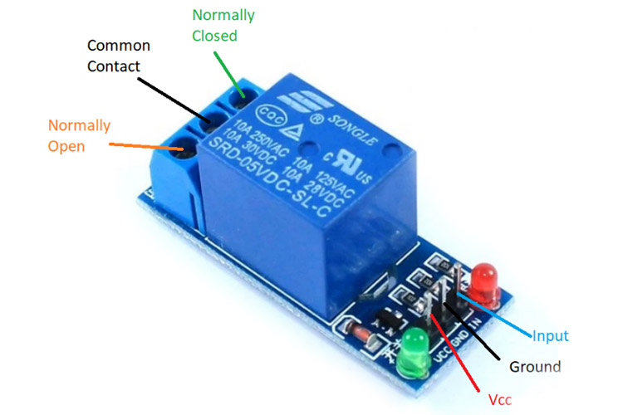
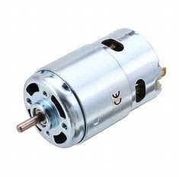
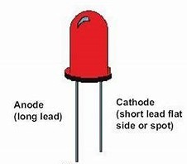
CIRCUIT DESIGN PROCESS
DC Motor and Relay Module Connections:
Output of relay to one terminal of DC motor
Other terminal of DC motor to ground
First terminal of relay connected to DC supply 12v
Second terminal to ground
Set the operating voltage to 5v
Relay default pin to GPIO24 pin of raspberry Pi
LED module(red LED) Connections:
One terminal is connected to GPIO12 of raspberry pi
The other terminal is connected to ground
one channel relay module
12v Dc motor
Red LED

Slide 19
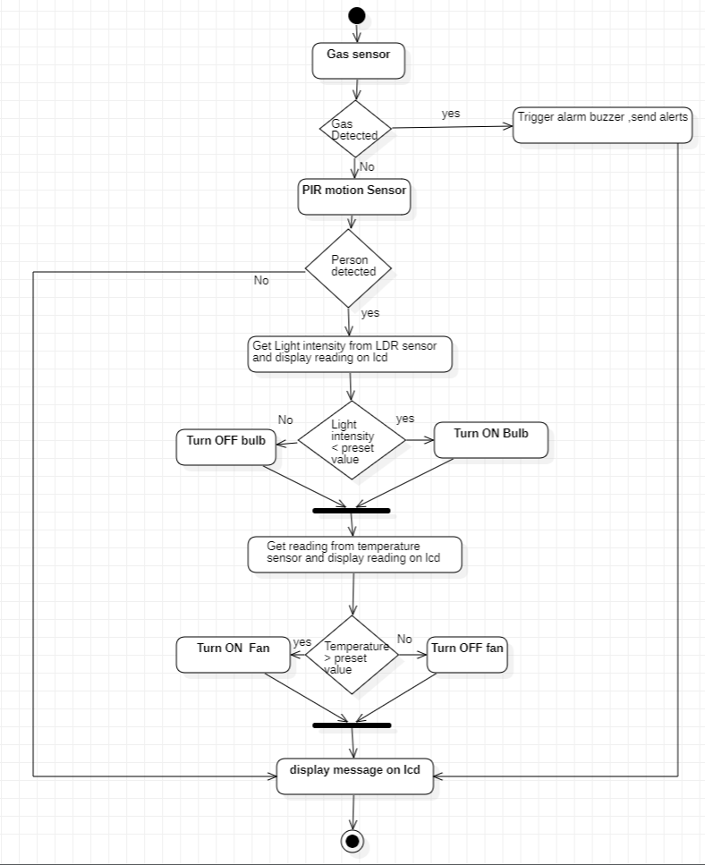
HOME AUTOMATION SYSTEM ACTIVITY DIAGRAM

Slide 20
HOME AUTOMATION SYSTEM SIMULATION
To start the simulation ,click on the run button at bottom left of the simulation software window.
Once the simulation starts, an initial message is displayed on the LCD.
In the case of Fire or gas leakage ,the Logic state of the gas sensor is set to 1.
The gas sensor sends a High Voltage pulse to the raspberry pi on detection of any smoke or gas.
On receiving the input from the gas sensor ,the alarm buzzer is set off and the raspberry pi sends an alert message using GSM module to the specified host number (This is displayed on the virtual terminal)
During this phase only a respective message is displayed on LCD and rest of the components are disabled irrespective of the person's presence.

Slide 21
HOME AUTOMATION SYSTEM SIMULATION
If PIR Motion sensor's logic state is set to 1 (person detected), it sends a high pulse to the Raspberry Pi . If Logic state is set to 0 then the default low pulse continues.
Once the person is detected , the light intensity reading of the room is taken using the LDR sensor. The analog signal from the sensor is sent as input to the ADC module and is converted to digital output and the digital pulse is sent to the raspberry pi .
The Intensity of light can be changed by adjusting the distance between the light source(lamp) and the LDR Sensor.

Slide 22
HOME AUTOMATION SYSTEM SIMULATION
After receiving the digital pulse ,the values are tallied with the preset values. If the Light intensity is less than the pre-set value then a high pulse(1.7-2.0v) is sent to the light bulb to turn it ON or else the bulb continues to stay in OFF mode.
The Light intensity reading and State of the Bulb are displayed on the LCD screen.
Similarly, the output voltage signal from the LM35 temperature sensor is converted to digital and sent to the raspberry pi.
The temperature value is tallied with the pre-set value of room temperature. If the reading is above the pre-set value , a high pulse(5v) is sent to relay switch and the DC motor circuit is completed and the Dc motor starts to rotate.

Slide 23
HOME AUTOMATION SYSTEM SIMULATION
If the temperature reading falls within pre-set value then, the relay disconnects resulting in an open circuit and the motor turns off.
The temperature readings can be changed using the virtual nobs of the sensor.
The temperature reading and the Motor status are displayed on the LCD screen.
In other case, if PIR sensor Logic state is set to 0(person not detected ), then the readings from the sensors (both LDR and LM35) are not read and the low pulse signal continues to LED ,DC motor keeping them in passive (off ) state.
Only a message of the case (person not detected) is displayed on the LCD screen.

Slide 24
CONCLUSION
The overall objective of the simulation is to develop a low-cost embedded home automation system that works efficiently depending on the specified conditions of home environment.
The simulated system is flexible and programmable, working efficiently under different circumstances and has wide range of applications and supports wide variety of peripherals and accessories to work with.

Slide 25
FUTURE ENHANCEMENTS
The proposed system can be improved and implemented by using physical components mentioned along with others such as camera module for surveillance , IR module to control and operate home appliances such as Television, Air conditioner etc.
As an extension ,this work can be carried forward by integrating relays to Raspberry pi board for controlling home appliances from a remote location in a real scenario using smart devices.

Slide 26
REFERENCES
A. Alheraish, “Design and Implementation of Home Automation System”, 2020, IEEE Transactions on Consumer Electronics ,Vol. 50(4) , pp. 1087-1092.
E. S. A. Ahmed, “Internet of things applications, challenges and related future technologies,” Internet of Things (IoT) Applications, vol. 67, no. 2, pp. 126–148, 2017,
https://www.internationaljournalssrg.org/
https://www.ijert.org/research/home-automation-system
https://www.researchgate.net/publication
http://www.elprocus.com/home-automation-system-applications
https://pypi.org/project/spidev/

Slide 27
THANK YOU

