Slide 1
Facial Emotion Detection using MultiBranch CNN
Using python and openCV along with tensorflow

Slide 2
Introduction to Facial Expression
In recent years, as computers have increasingly powerful computing power and huge data sets continue to emerge, machine learning algorithms have developed vigorously. Compared with traditional methods, the machine learning algorithm integrates the two processes of feature extraction and classification, reduces the operation process, and can automatically extract the internal features of the sample data, has powerful feature extraction capabilities, and is related to computer vision (CV)

Slide 3
Software Requirements
- IDE
PyCharm
- Operating System
Ubuntu
- Programming Languages Used
Python
- Packages, Models and Plugins Used
TensorFlow and keras
Keggle database
Pandas , Numpy and OpenCV

Slide 4
Hardware Requirements
- CPU
Minimum Intel i3 or Amd A4 and above
- Ram
Minimum 2GB
- Rom
Minimum 512GB

Slide 5
Working of FER
FER works on basing on Harcascade.xlm file which uses the greyscale image of the model for detecting the Expression of the images in real time or on Video Mode

Slide 6
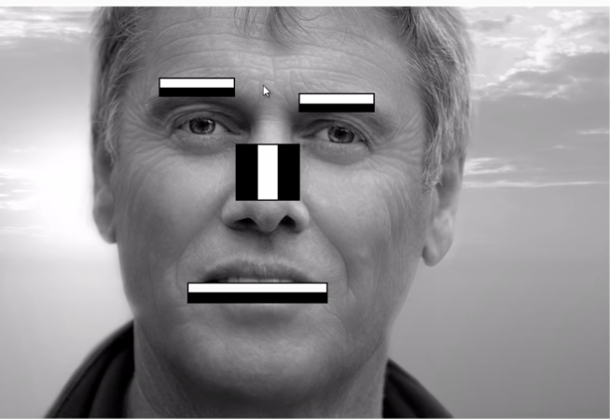
Working of Haarcascade
Haarcascade works on basis of using the reflective surface of the face . This xml file uses the light and dark surfaces of the face . Example the nose bridge is light in color and the eyebrows are dark in color by using this we can estimate the
Face

Slide 7

Working of OpenCV
OpenCV is a Python library used for facial detection and working with video purposes
OpenCV (Open Source Computer Vision Library) is an open source computer vision and machine learning software library.

Slide 8
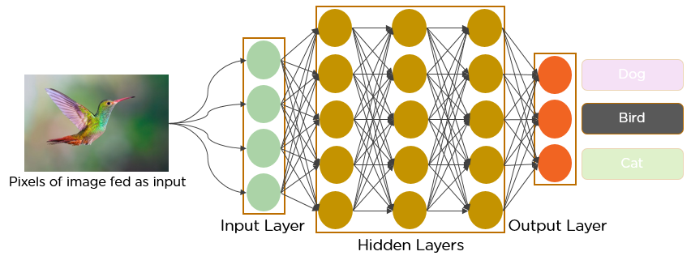
Brief Explanation on CNN
Convolutional Neural Networks (CNN)
convolutional neural network (CNN/ConvNet) is a class of deep neural networks, most commonly applied to analyze visual imagery

Slide 9
Thank You
By:-
Bharath S (1vj16cs015)
Rizwan (1vj15cs030)
Asif (1ac17cs002)
Hema (1ac18cs002)

