Slide 1
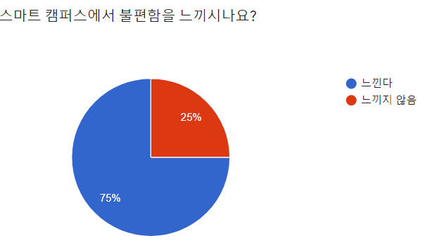
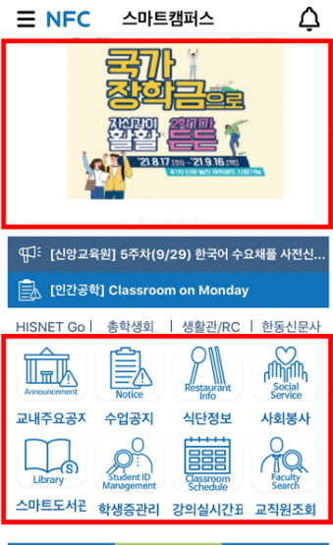
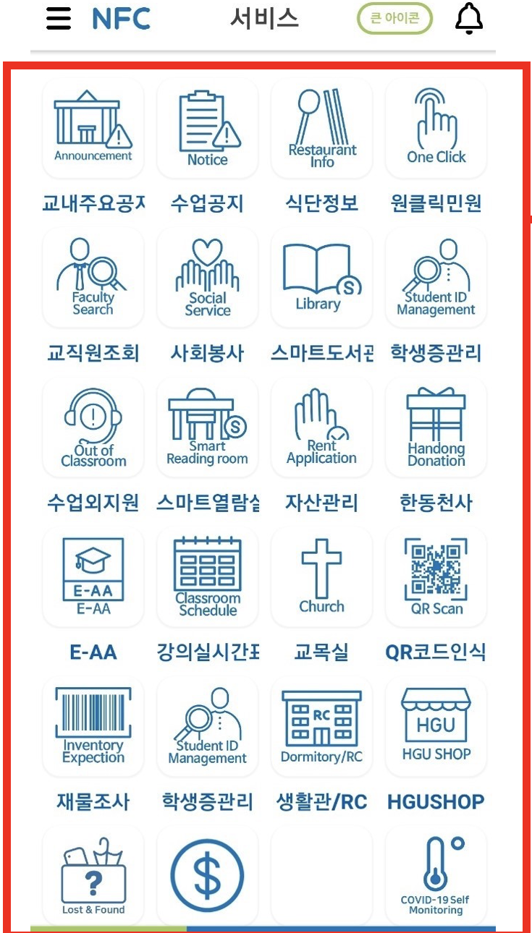
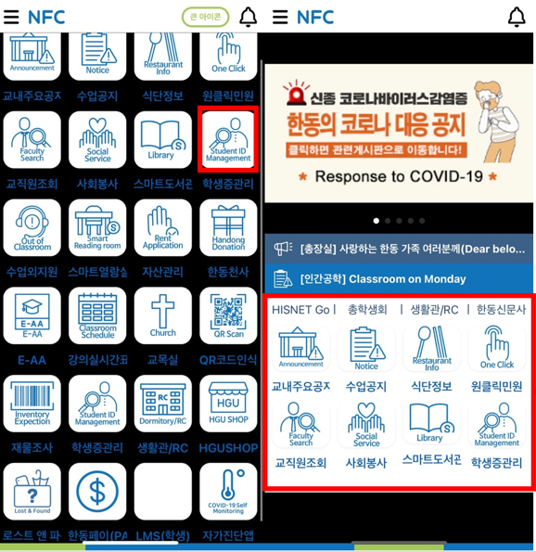
Background
Problem Cognition
Slow loading speed of the screen
login errors and server collisions
QR tagging not being on the main screen
complicated menu
configuration access multiple functions
Problem Definition
Main screen
Menu screen
Dark Mode
Large Banner
Unused function
Too many function
Unnecessary functions
Not User-friendly designed
Eye Fatigue
Solution

