Slide 1


Software Defined Networking and OpenFlow
Geddings Barrineau
Ryan Izard

Slide 2
What is Software Defined Networking and OpenFlow?

Slide 3
What is SDN?
Physical separation of network control plane from forwarding/data plane
Network control
Centrally managed
Directly programmable
Network infrastructure
Abstracted from applications

Slide 4
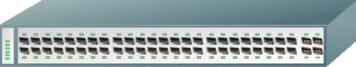



How does SDN work?
API Feature A
API Feature B
API Feature C
Network Operating System
Packet Forwarding
Packet Forwarding
Packet Forwarding
Packet Forwarding
Packet Forwarding
Notes:
Editorial Guidelines on Bullets:
1. Vertical lists are best introduced by a grammatically complete sentence followed by a colon. No periods
are required at the end of entries unless at least one entry is a complete sentence, in which case a period
is necessary at the end of each entry.
Example: A university can be judged by three measures:
· The quality of its students
· The quality of it faculty
· The quality of its infrastructure
2. If a list completes the sentence that introduces it, items begin with lowercase letters, commas or semicolons
(if individual items contain commas) are used to separate each item, and the last item ends with a period.
Note that the introductory clause does not end with a colon.
Example: A university can be judged by
· the quality of its students,
· the quality of its faculty,
· the quality of its infrastructure.
3. Avoid mixing sentence and nonsentence items in a bulleted list.
4

Slide 5

What is OpenFlow?
Link between SDN control and infrastructure layers
OF-enabled infrastructure communicates with an OF controller via the OF protocol

Slide 6

User Applications
How Does OF Work?
Network Services
Custom Services
APIs
OpenFlow Controller
Packet Forwarding
Packet Forwarding
Packet Forwarding
Packet Forwarding
Packet Forwarding
Notes:
Editorial Guidelines on Bullets:
1. Vertical lists are best introduced by a grammatically complete sentence followed by a colon. No periods
are required at the end of entries unless at least one entry is a complete sentence, in which case a period
is necessary at the end of each entry.
Example: A university can be judged by three measures:
· The quality of its students
· The quality of it faculty
· The quality of its infrastructure
2. If a list completes the sentence that introduces it, items begin with lowercase letters, commas or semicolons
(if individual items contain commas) are used to separate each item, and the last item ends with a period.
Note that the introductory clause does not end with a colon.
Example: A university can be judged by
· the quality of its students,
· the quality of its faculty,
· the quality of its infrastructure.
3. Avoid mixing sentence and nonsentence items in a bulleted list.
6

Slide 7
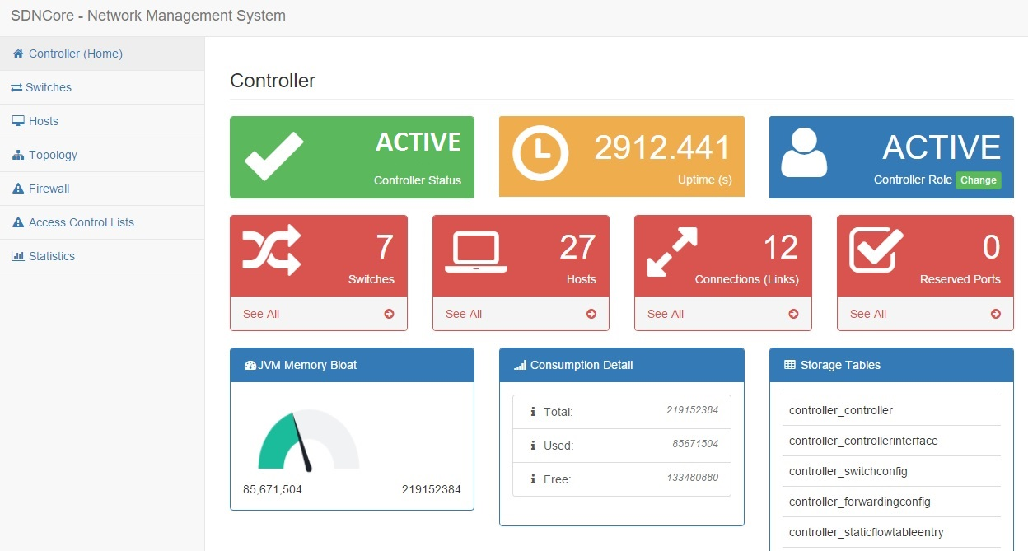
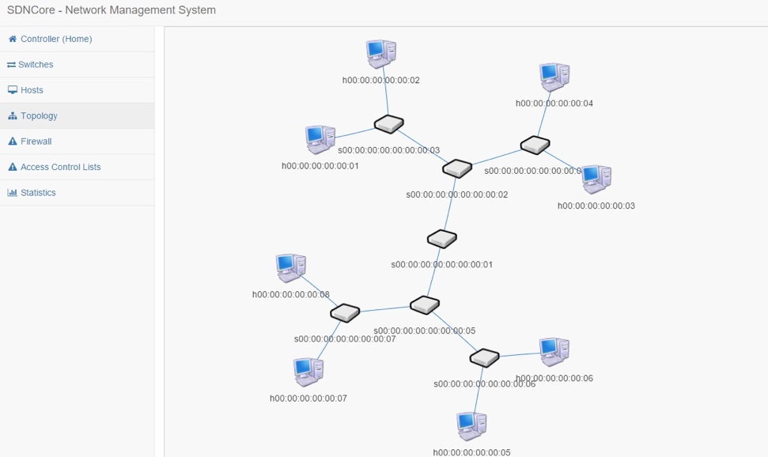
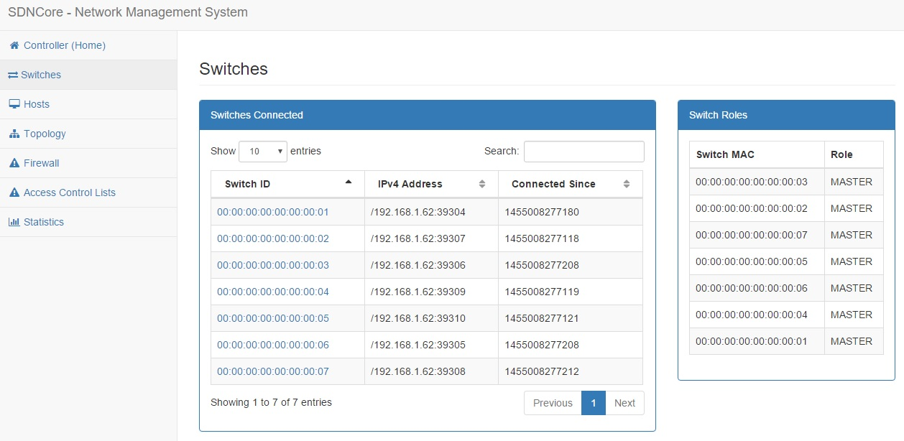
User Applications

Slide 8
OpenFLOW
Matches
Actions
Characteristics of a packet that must be true in order for a flow to apply to the packet
Header fields e.g. EtherType, VLAN, src/dst MAC, IP, and transport ports, ingress port
Applied for any packet that matches the flow
Tells a packet where to go or can even modify a packet

Slide 9


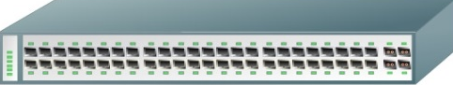

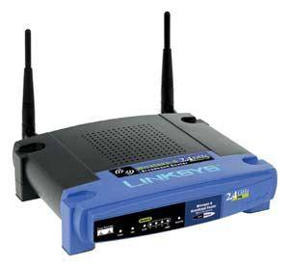


Basic SDN packet handling example
OpenFlow
Controller
Notes:
Editorial Guidelines on Bullets:
1. Vertical lists are best introduced by a grammatically complete sentence followed by a colon. No periods
are required at the end of entries unless at least one entry is a complete sentence, in which case a period
is necessary at the end of each entry.
Example: A university can be judged by three measures:
· The quality of its students
· The quality of it faculty
· The quality of its infrastructure
2. If a list completes the sentence that introduces it, items begin with lowercase letters, commas or semicolons
(if individual items contain commas) are used to separate each item, and the last item ends with a period.
Note that the introductory clause does not end with a colon.
Example: A university can be judged by
· the quality of its students,
· the quality of its faculty,
· the quality of its infrastructure.
3. Avoid mixing sentence and nonsentence items in a bulleted list.
9

Slide 10
Basic SDN packet handling example
OpenFlow
Controller
User 1
User 2
Notes:
Editorial Guidelines on Bullets:
1. Vertical lists are best introduced by a grammatically complete sentence followed by a colon. No periods
are required at the end of entries unless at least one entry is a complete sentence, in which case a period
is necessary at the end of each entry.
Example: A university can be judged by three measures:
· The quality of its students
· The quality of it faculty
· The quality of its infrastructure
2. If a list completes the sentence that introduces it, items begin with lowercase letters, commas or semicolons
(if individual items contain commas) are used to separate each item, and the last item ends with a period.
Note that the introductory clause does not end with a colon.
Example: A university can be judged by
· the quality of its students,
· the quality of its faculty,
· the quality of its infrastructure.
3. Avoid mixing sentence and nonsentence items in a bulleted list.
10

Slide 11
Basic SDN packet handling example
OpenFlow
Controller
User 1
User 2
Notes:
Editorial Guidelines on Bullets:
1. Vertical lists are best introduced by a grammatically complete sentence followed by a colon. No periods
are required at the end of entries unless at least one entry is a complete sentence, in which case a period
is necessary at the end of each entry.
Example: A university can be judged by three measures:
· The quality of its students
· The quality of it faculty
· The quality of its infrastructure
2. If a list completes the sentence that introduces it, items begin with lowercase letters, commas or semicolons
(if individual items contain commas) are used to separate each item, and the last item ends with a period.
Note that the introductory clause does not end with a colon.
Example: A university can be judged by
· the quality of its students,
· the quality of its faculty,
· the quality of its infrastructure.
3. Avoid mixing sentence and nonsentence items in a bulleted list.
11

Slide 12
Why SDN and OpenFlow?
Traditional networks
Static software architecture
Closed-source with limited customization
Vendor dependence
Decentralized control

Slide 13
Why SDN and OpenFlow?
SDN and OpenFlow
Dynamic software architecture
Open-source with vast customization
Allows large-scale network research
Supports integration of custom network services both transparent to and directly controlled by applications

Slide 14
How can Software Defined Networking and OpenFlow be Used?

Slide 15
High-Throughput Data Transfer
Steroid OpenFlow Service (SOS)
Enhance TCP connections
Large delay-bandwidth product networks
TCP windows
SOS provides
Transparent service improvement to user
Single and multipath support

Slide 16
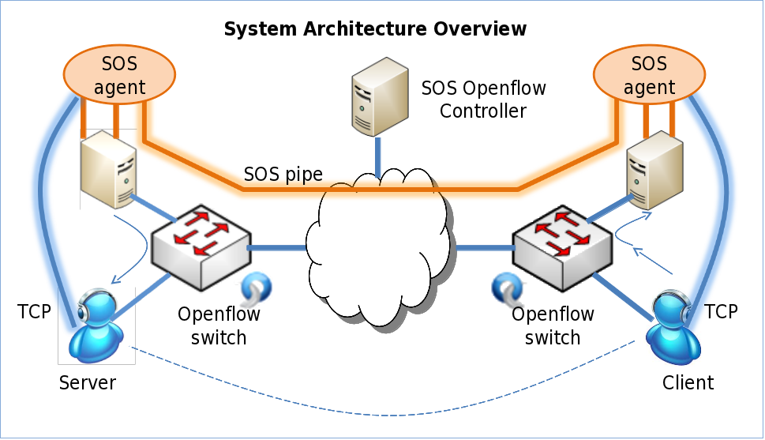
High-Throughput Data Transfer

Slide 17
Mobility over Heterogeneous Networks
Provide mobility for clients over IPv4
Entirely SDN and OF-based solution
Network-level
Migration detection
IP address assignment and management
Packet routing
Client-level
Packet routing
Interface switching
Transparent service to application

Slide 18
Mobility over Heterogeneous Networks
Network-Level, Mobile IP:
Home/Foreign Agents OpenFlow Controller
Mobile IP tunnels OpenFlow flows
DHCP server on OpenFlow controller
Client-Level, Vertical Handoff:
Change physical interface ➔ broken socket
Open vSwitch + Floodlight OF controller
Manage the physical interfaces via SDN
End-user sees “always-up” virtual interface

Slide 19
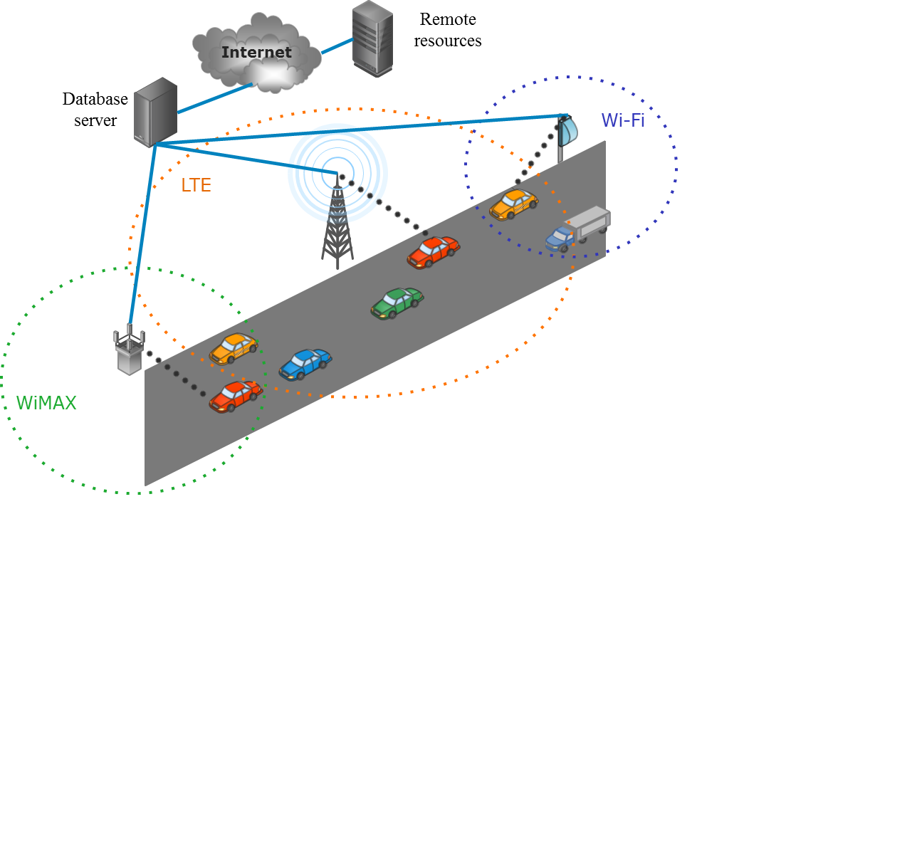
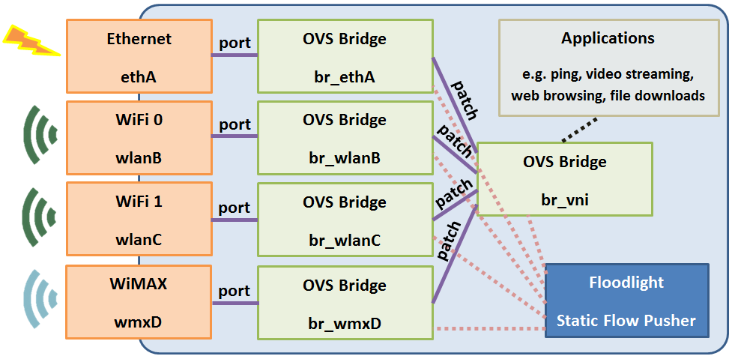
Mobility over Heterogeneous Networks
Client-Level

Slide 20
GENI Cinema
SDN and OF video streaming service
Chain of events
Client connects to public server and selects video of interest
Client receives address of nearby GENI Cinema gateway
OF controller (Floodlight) creates path between gateway and appropriate video server

Slide 21
GENI Cinema
OpenFlow
Controller
Public
Server
GENI
Cinema
Gateway
Video
Server 1
Video
Server 2
Notes:
Editorial Guidelines on Bullets:
1. Vertical lists are best introduced by a grammatically complete sentence followed by a colon. No periods
are required at the end of entries unless at least one entry is a complete sentence, in which case a period
is necessary at the end of each entry.
Example: A university can be judged by three measures:
· The quality of its students
· The quality of it faculty
· The quality of its infrastructure
2. If a list completes the sentence that introduces it, items begin with lowercase letters, commas or semicolons
(if individual items contain commas) are used to separate each item, and the last item ends with a period.
Note that the introductory clause does not end with a colon.
Example: A university can be judged by
· the quality of its students,
· the quality of its faculty,
· the quality of its infrastructure.
3. Avoid mixing sentence and nonsentence items in a bulleted list.
21

Slide 22
Software Components of an OpenFlow Software Defined Network

Slide 23
Basic SDN Network
API Feature A
API Feature B
API Feature C
Network Operating System
Packet Forwarding
Packet Forwarding
Packet Forwarding
Packet Forwarding
Packet Forwarding
Notes:
Editorial Guidelines on Bullets:
1. Vertical lists are best introduced by a grammatically complete sentence followed by a colon. No periods
are required at the end of entries unless at least one entry is a complete sentence, in which case a period
is necessary at the end of each entry.
Example: A university can be judged by three measures:
· The quality of its students
· The quality of it faculty
· The quality of its infrastructure
2. If a list completes the sentence that introduces it, items begin with lowercase letters, commas or semicolons
(if individual items contain commas) are used to separate each item, and the last item ends with a period.
Note that the introductory clause does not end with a colon.
Example: A university can be judged by
· the quality of its students,
· the quality of its faculty,
· the quality of its infrastructure.
3. Avoid mixing sentence and nonsentence items in a bulleted list.
23

Slide 24
User Applications
Basic OF Network
Network Services
Custom Services
APIs
OpenFlow Controller
Packet Forwarding
Packet Forwarding
Packet Forwarding
Packet Forwarding
Packet Forwarding
Notes:
Editorial Guidelines on Bullets:
1. Vertical lists are best introduced by a grammatically complete sentence followed by a colon. No periods
are required at the end of entries unless at least one entry is a complete sentence, in which case a period
is necessary at the end of each entry.
Example: A university can be judged by three measures:
· The quality of its students
· The quality of it faculty
· The quality of its infrastructure
2. If a list completes the sentence that introduces it, items begin with lowercase letters, commas or semicolons
(if individual items contain commas) are used to separate each item, and the last item ends with a period.
Note that the introductory clause does not end with a colon.
Example: A university can be judged by
· the quality of its students,
· the quality of its faculty,
· the quality of its infrastructure.
3. Avoid mixing sentence and nonsentence items in a bulleted list.
24

Slide 25
Bottom-Up: An OF-Enabled Switch
Power On
Bootloader
OF-Enabled OS
time
Control Path
OpenFlow
Data Path / Switching Hardware
Flow Table

Slide 26

OF Switch Connection to Controller
Network Services
Custom Services
APIs
OpenFlow Controller (e.g. Floodlight, NOX, etc.)
Controller
OS (e.g. Linux, Mac, Windows, etc.)
Hardware
Control Path
OpenFlow
Data Path / Switching Hardware
Flow Table

Slide 27
OF Switch Connection to Controller
Switch probes for controller
Configured with controller IP/port
Standalone or secure modes
Connection established via TCP/TLS
Controller learns topology
Packet-out LLDP
Devices and other participating OF switches discovered and mapped

Slide 28

Application Connection to Controller
Application Requesting Controller Service(s)
Interface to Controller (e.g. REST)
OS (e.g. Linux, Mac, Windows, etc.)
Hardware
Controller
Network Services
Custom Services
APIs
OpenFlow Controller (e.g. Floodlight, NOX, etc.)
OS (e.g. Linux, Mac, Windows, etc.)
Hardware

Slide 29
Application Connection to Controller
Controller-dependent
Floodlight provides REST API
JSON
Modify or query running configuration
Expandable with custom modules
Options are vast with open-source
Customize controller APIs and behavior
User-application-independent (e.g. a transparent network service like SOS)

Slide 30




The Floodlight OpenFlow Controller
Open-source OF controller
Sponsored and supported by Big Switch Networks
Written in Java and easily used with Eclipse
Modifiable and expandable to suit any application via modules
Large developer community and support group

Slide 31
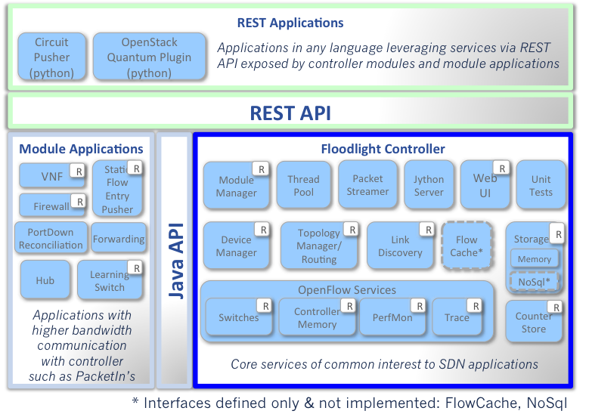
Floodlight Architecture

Slide 32
Software Defined Networking and OpenFlow
Geddings Barrineau
Ryan Izard

