Slide 1


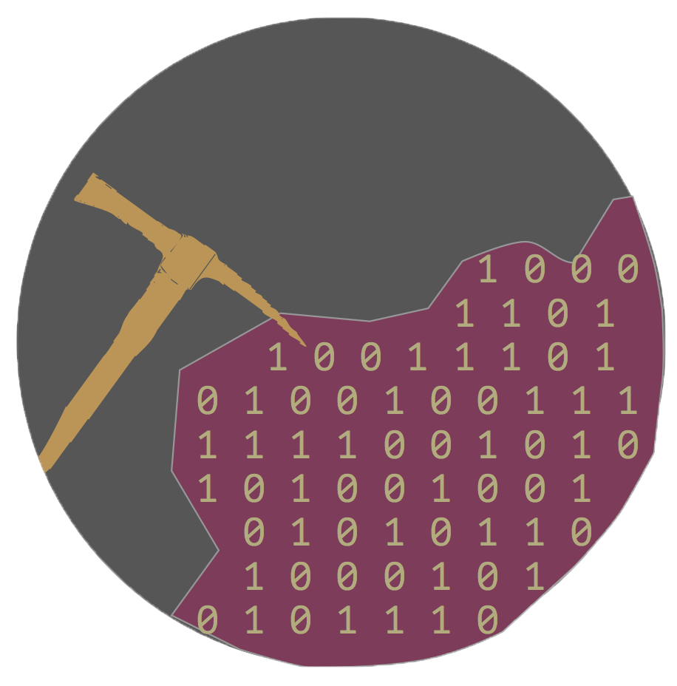


DataMiner Utility Tool
CodeDay Philly Fall 2014 entry by Dor Rondél, Renzhentaxi Baerde, Micah Weitzman, and Daniel Zabari.

Slide 2
So, what is the DataMiner Utility Tool?
The DataMiner Utility tool essentially gathers and organizes information regarding the user which you’re inquiring about that is available to the public domain.
Some of the social media outlets the tool attempts to access include: Facebook, Twitter, Reddit, Instagram, Github, and Soundcloud among others.
Aside from simply gathering the information from various outlets, using several sorting algorithms, the DataMiner tool enables the user to track the social media site from which the delivered information was obtained.

Slide 3
What the DataMiner Utility Tool is not!
Primarily, the DataMining Utility Tool is not in any way associated with the NSA!
Secondly, it’s not intended for stalking individuals.
It does not present information which the user it obtained it from did not agree to publicly share.
It will not display what would normally be considered highly confidential private information, such as a phone number or home address.
It does not store any of the information it acquires.

Slide 4
So, how does it work?
The DataMiner acquires it’s information from APIs and web scraping services.
In Python we used urllib2, requests, and BeautifulSoup4 modules to parse the html code.
We used APIs and their corresponding SDKs, such as the SoundCloud API and Python SDK.
We then used the flask micro-framework to extract out information and place it on our website.
Additionally, for our front-end side, we mainly used Bootstrap.
Finally, we used Jinja2 for Python templating.

Slide 5

DEMO!

Slide 6
About Creators
I
I
I
I
I
Name: Dor Rondél I Name: Micah Weitzman
E-mail: dor.rondel@gmail.com I Twitter: @mikachoow21
GitHub: DorRon I Github: mikachoow21
School: Murrow High School I Website: micahweitzman.com
Website: http://dorron.github.io/ I E-mail: mikachoow21@gmail.com
………………………………………....I………………………………………....
I
I
I
I
Name: Renzhentaxi Baerde I Name: Daniel Zabari
GitHub: renzhentaxibaerde I Facebook: Daniel Zabari
E-mail: I GitHub: Zabari
renzhentaxibaerde@gmail.com I E-mail: zabari.daniel@gmail.com
I

