Slide 1
Encoding…

Slide 2

What is it?!
“Encoding is the process of converting data into a format required for a number of information processing needs”.
In computer technology, encoding is the process of applying a specific code, such as letters, symbols and numbers, to data for conversion into an equivalent cipher

Slide 3
And Really..
Encoding in non formal speaking is
Lets take set of bits and define for each the equivalent character with known “scheme rules”.

Slide 4
A little bit of History
The first model to use encoding (non digital encodings) is the Bacon’s cipher – using only letters ‘a’ and ‘b’ in units of 5’s.
Examples:
aaaaa refers to the letter ‘a’.
aaaab refers to the letter ‘b.
And so on… So we can see that as a = 0, b = 1.
Also… Braille, Morse (first of digital use) and more…

Slide 5
Simple examples..
In ASCII – uses only 7 bits. Only 0 to 127 different values can be represent with 7 bits.
- letter ‘a’ decimal value is 97. We see ‘a’, computer sees 01100001, which is 97 in binary.
- letter ‘A’ decimal value is 65. We see ‘a’, computer sees 01000001, which is 65 in binary.
- letter ‘#’ decimal value is 35. We see ‘a’, computer sees 00100011, which is 97 in binary.
v O t i R o
118 79 116 105 82 111
01110110 01001111 01110100 01101001 01010010 01101111

Slide 6
Every text must have an Encoding next to it!
Q: The hypothetical document above contains this sequence of bits:
10000011 01000111 10000011 10010011 10000011 01010010 10000001 01011011 10000011 01100110 10000011 01000010 10000011 10010011 10000011 01001111 10000010 11001101 10010011 11101111 10000010 10110101 10000010 10101101 10000010 11001000 10000010 10100010
what encoding is the next sentence?

Slide 7
Every text must have an Encoding next to it!
A: We cannot know… In Ascii it’s not valid.. Not also in UTF-8..
In “Mac Roman” that is interpreted into "ÉGÉìÉRÅ[ÉfÉBÉìÉOÇÕìÔÇµÇ≠Ç»Ç¢“. That maybe be right.. Who knows that the writer wanted to write…
The correct encoding is Japanese Shift-JIS, and the text is
“エンコーディングは難しくない”.
But we cannot guess that without encoding definition.. Maybe the “Mac Roman” interpretation is the right one… maybe not..

Slide 8
But we have a little bit more than 127 characters…
We can use the MSB of the byte.. But that is not enough ☹.
What about risqué letter in French?
What about A Straßen­übergangs­änderungs­gesetz in German?
Multi-byte Encoding to the rescue!
One byte = 8 bits for 2^8 = 256 characters
Two bytes = 16 bits for 2^16 = 65536 characters.. Getting better..
3 bytes.. What? Sounds weird... Lets jump to 4 bytes.
4 bytes = 32 bits for 2^32 = 4 Billion.. We can stop here ☺

Slide 9
Multi-byte Encoding to the rescue!
Number of bytes | Bits number | Number of characters to cover
One byte | 8 | 2^8 = 256
Two bytes | 16 | 2^16 = 65536 (Getting better..)
Three bytes | Sounds weird..
Four bytes | 32 | 2^32 = 4 Bilion (We can stop here ☺)

Slide 10
1,114,112
The number of characters in Unicode
(Including un-official characters like Klingon!!)
So question – how many bits we need to encode all these characters in Unicode?

Slide 11
Unicode is not an Encoding
That my be confusing..
Why it is not an Encoding? But It so simple to have one encoding rule..!
Lets say it is encoding… so we need 3 bytes to hold for each character. 3 is awkward so lets use 4 bits. And now lets write “Votiro”.. It will require just for one letter 4 bytes. 6 letters are 24 bytes = 144 bits..
Instead of 48 bits we used earlier.. It is a waste of space.

Slide 12
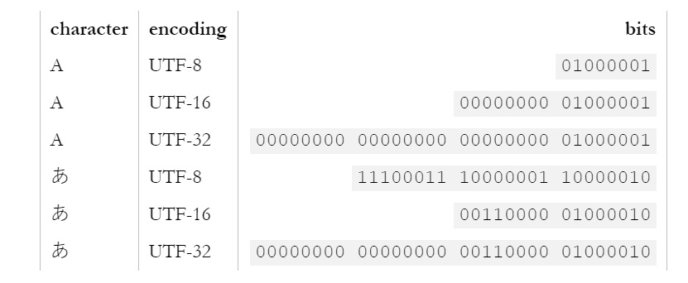
So lets optimize !
UTF-32 defines 32 bits per a character, as the “Unicode” encoding. Although it easy, that may be a waste of space in memory.
UTF-8 uses 1 to 4 bytes, UTF-16 uses 2 or 4 bytes. Therefore they are called “variable length encoding”.
Memory Space Efficiency
Efficient
Less Efficient
Not Efficient
Less Efficient
Efficient
Not Efficient

Slide 13
UTF8 Encoding
Character Unicode range | Value binary representation | UTF-8 binary representation
0-127 (0x0h – 0X7Fh) | 0zzzzzzz (Example: ‘a’ = 01100001) | 0zzzzzzz (01100001)
128 – 2047 (0x80h – 0x7FFh) | 00000yyy yyzzzzzz (Example: ‘©’ = 10101001) | 110yyyyy 10zzzzzz (11000010 10101001)
2048 – 65535 (0x800h – 0xFFFFh) | xxxxyyyy yyzzzzzz (Example: ‘∑’ = 00100010 00010001) | 1110xxxx 10yyyyyy 10zzzzzz (11100010 10001000 10010001)
65,536 – 1,141,111 (0x10000h – 0x10FFFFh) | 000wwwxx xxxxyyyy yyzzzzzz (Example: ‘🜼’ = 00000001 11110111 00111100) | 11110www 10xxxxxx 10yyyyyy 10zzzzzz (11110000 10011111 10011100 10111100)

Slide 14
Base64 Encoding
Character set has 2^6 = 64 characters = {A-Z, a-z, 0-9, ‘+’, ‘/’}.
Lets encode the Hebrew word "חתול".
‘ח’ – Unicdoe: 00000101 11010111. UTF8: 11010111 10010111
‘ת’ - 00000101 11101010. UTF8: 11010111 10101010
‘ו’ - 00000101 11010101. UTF8: 11010111 10010101
‘ל’ - 00000101 11011100. UTF8: 11010111 10011100
11010111 10010111 11010111 10101010 11010111 10010101 11010111 10011100 00000000
1 d f X q t e V 1 5 w =
‘=‘ is padding character. It has value of 000000.

Slide 15
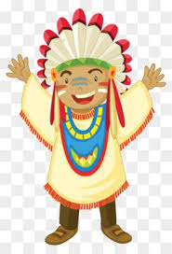
Little Endian – Big Endian
The order bytes are saved on memory.
Intel – Little Endien, Motorolla – Big Endien.
Actual meanings:
Little endian – we save the least significant bytes to memory.
Big endian – we save the most significant bytes to memory.

Slide 16
Little Endian – Big Endian
Actual meanings:
Little endian – we save the least significant bytes to memory.
Big endian – we save the most significant bytes to memory.
Note: Every byte will be saved as it is.. We do not change the order of bits within a byte!
One byte – will be saved as it is.
More then one bytes: xxxxxxxx yyyyyyyy (‘∑’ = 00100010 00010001)
Big endian - 00100010 00010001.
Little endian – 00010001 00100010.

Slide 17
What about files created with different byte order?
BOM – Byte Order Mark – declares the encoding as well as the endianness of the bytes in the file.
UTF-8: EF BB BF – not mendatory since UTF-8 we read byte by byte.
UTF-16: Big endian for FE FF, little endian for FF FE.
So back to ‘∑’ :
Big endian with BOM: 11111110 11111111 00100010 00010001
Little endian with BOM: 11111111 11111110 00010001 00100010

Slide 18
THANKS!
Any questions?

Slide 19
SlidesCarnival icons are editable shapes.
This means that you can:
Resize them without losing quality.
Change fill color and opacity.
Change line color, width and style.
Isn’t that nice? :)
Examples:

Slide 20
Now you can use any emoji as an icon!
And of course it resizes without losing quality and you can change the color.
How? Follow Google instructions https://twitter.com/googledocs/status/730087240156643328
😉
✋👆👉👍👤👦👧👨👩👪💃🏃💑❤😂😉😋😒😭👶😸🐟🍒🍔💣📌📖🔨🎃🎈🎨🏈🏰🌏🔌🔑 and many more...

