Slide 1
Virtual HPC with Virtualbox with Vagrant
CITS5507

Slide 2
Software requirements
You will need to install a few open source tools.
These are Virtualbox, Vagrant and Git.
https://www.virtualbox.org/
https://www.vagrantup.com/downloads.html
Macbooks typically have git installed.
Windows may or may not have git installed if not here is a link.
https://gitforwindows.org/

Slide 3
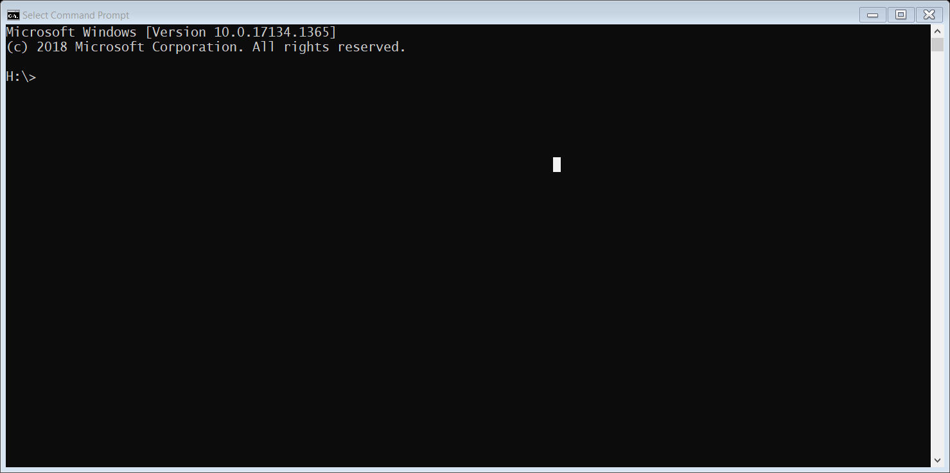
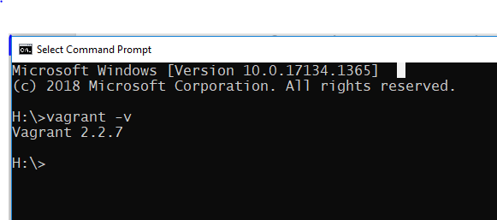
How to test if you have correctly installed virtualbox and vagrant.
On windows laptop open a “Command Prompt Terminal window”
On a macbook open the “terminal” window
Enter the command “vagrant –v”
If it returns the version number as shown above you are good to go!
NOTE 2.2.9 is the latest and everything will work with it as well.

Slide 4
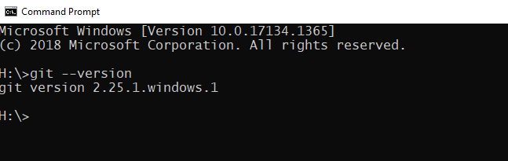
Test git on Windows
Windows may or may not have git installed if not here is a link.
https://gitforwindows.org/

Slide 5
Setup VM
Once Vagrant VirtualBox and Git are installed and working, you can then begin setting
up a Virtual Machine or VM that will run locally on your laptop.
Step 1 – create the directory structure for this project.
For Windows using the Command Prompt terminal the command is:
% mkdir cits5507
For MacOS and linux the command is:
% mkdir cits5507
To make cits5507 directory the working directory, use the command “cd”
it is the same for Windows and MacOS
% cd cits5507
NOTE the % is the prompt and not part of the command!!

Slide 6
Setup VM - continued
Step 2: clone the vagrant file repository from github
For Windows and Macs this step the command is identical.
% git clone https://github.com/chrisbpawsey/HPC.git
Verify the command worked
On Windows:
dir --- this shows all the files and sub-directories in the current folder
On Macbooks/Linux
ls -- LIST so that is lower case L not capital I

Slide 7

Setup VM - continued
Step 3: change director into the cits5507/HPC directory
% cd HPC
You can check that it worked using the “ls” or “dir” command and you should see a file named
“Vagrantfile” it contains the instructions to setup the Virtual Machine. You don’t need to make
changes to it.
Launch the VM, you should still be in the HPC directory and you MUST be in the HPC directory as that is where the Vagrantfile is.
To start the VM the Vagrant command is
% vagrant up
Coffee Break:
This can take up to 30 minutes as it automatically downloading and configuring the base Ubuntu OS image that is used for your VM. It is dependent on your internet connection and laptop.

Slide 8
Install the HPC environment in the VM
Step 4: Log in to the VM using ssh once it finished the command prompt will return
% vagrant ssh
Step 4a: Run the install script “setup.sh” that has been copied into your home directory of your Virtual Machine!
% ./setup.sh
COFFEE BREAK:
This can take up to 30 minutes to complete! Depending on your laptop processor speed.
Go get a coffee! If you do work on your laptop or surf the net it will just take longer!
Good news is you only need to do this ONCE when you first create the VM.
Step 4b: To ensure that you correctly pickup all the changes to your environment the simplest thing to do is log out and log back in to the VM
% exit
Log back in to the VM.
% vagrant ssh

Slide 9
Summary of commands
Step 1 - Create the project directory
mkdir cits5507
cd cits5507
Step 2 - Clone the repository with the HPC Vagrantfile
git clone https://github.com/chrisbpawsey/HPC.git
Step 3 - launch the Virtual machine
cd HPC
vagrant up ---- note this can take up to 30 minutes
Step 4 - login to the virtual machine
vagrant ssh
Step 4a - run the setup command
./setup.sh ---- note this can take up to 30 minutes
Step 4b – initialize the environment permanently.
Exit (or ctrl-d)
vagrant ssh

Slide 10
VAGRANT BASIC COMMANDS
The basics vagrant commands to manage your virtual instance.
Command: vagrant up
This command creates and configures guest machines according to your Vagrantfile.
This is the single most important command in Vagrant, since it is how any Vagrant machine is created. Anyone using Vagrant must use this command on a day-to-day basis.
Command: vagrant ssh
This will SSH (Secure SHell) into a running Vagrant machine and give you access to a shell.
Command: vagrant status
This will tell you the state of the machines Vagrant is managing. (running, suspended, not created, etc. This command tells you the state of the underlying guest machine.

Slide 11
Vagrant Basic Commands
The vagrant commands for shutting down your Vagrant machine and destroying
your Vagrant machine. It is important to understand the differences.
Command: vagrant halt
This command shuts down the running machine Vagrant is managing. This frees up
the resources (CPU cores and RAM) allocated to the Virtual machine. It saves the environment
and files. Vagrant will effectively just shut off power to the machine. The Vagrant command
“vagrant up” will restart the Vagrant machine to it’s previous state.
Command: vagrant destroy
This command stops the running machine Vagrant is managing and destroys all resources
(CPU cores, RAM, and diskspace) that were allocated during the machine creation process.
After running this command, your computer should be left at a clean state, as if you never
created the guest machine in the first place. The FILES in your SHARED directories
are not deleted!!

