Slide 1

Team 3:
Jiayu Zhuo,Shengyuan Gao,Yanyan Deng

Slide 2
Abstract
With the abnormal change of weather and the increase of haze, the pm2.5 index has attracted more and more people's attention. In the study, we use the dataset collecting from the city of Beijing to analyze the relationships between pm2.5 values and environmental indicators and to predict what factor would cause PM values. We use 52874 data from the dataset, including 19 attributes. By using the algorithm result, we are looking forward to finding the relationship between the data by the analysis of the result. Hopefully, this research result could help us to find out the incidence of air pollution, thereby find an effective method to control and reduce the incidence rate. Finally, a good environment will benefit hundreds of millions of people.

Slide 3
Introduction
•Our study is to study which factors are significantly related to the pm2.5 in Beijing, such as temperature, humidity and season.
•Background
Due to rapid economic development, industrial expansion, and urbanization during the last few decades in China, the increasing occurrence of haze or smog episodes characterized by the high fine particulate matter levels and reduced visibility has been reported in national-scale China, especially in the most developed and high-populated city. Besides, the global climate is warmer and warmer, which is affecting our life all the time. For example, there are fewer glaciers, less water, animal extinction, weather changes, and so on. Climate is closely related to our life. The haze in the Beijing area is a severe problem in the world.
•Meaning
Studying this area can deepen our understanding of relation between urban climate and PM2.5’s detection value. High occurrence of extreme haze episodes in recent years not only leads to a global concern due to its adverse health effects but also triggers the Chinese government to tackle the severe air quality problem, especially PM2.5 pollution. Our purpose is also to hope that people pay more attention to environmental protection.

Slide 4
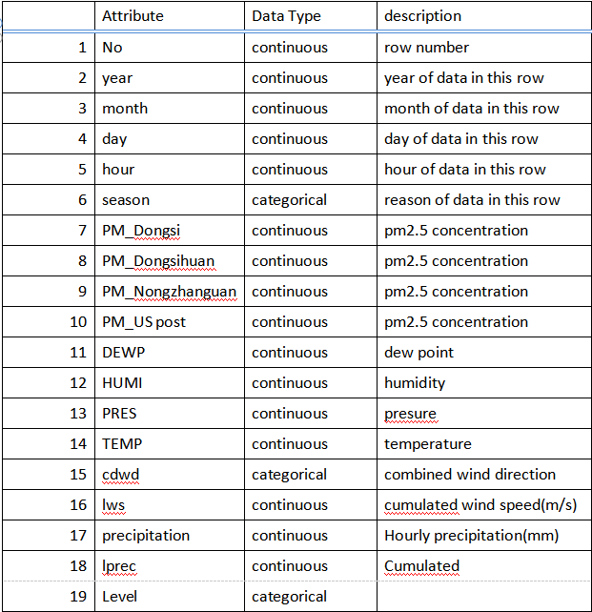
Data Description
•Data source: UCI datamining Archivehttps://archive.ics.uci.edu/ml/datasets/PM2.5+Data+of+Five+Chinese+Cities#
•Number of records in the dataset: 52874 (Beijing)
•No of features: 17 (excluding the 1 No field)
•Brief Description of the dataset: PM 2.5 refers to atmospheric particulate matter that have a diameter less than 2.5 micrometers. The dataset contains 52874 records in Beijing.
•Target: us_post and level of PM2.5, Level
• Processing: Delete invalid data, and divide into six grades depend on pm2.5 index.
Partition: 60% Training Sample and 40% Testing Sample.
Three Algorithm models: MLR, DT and ANN.

Slide 5
Problem Statement:
•Data mining task:
In this case, we choose the dataset, include 50389 history records, from Beijing. By using three algorithm models, we are trying to find relationship between PM2.5 value and climatic characteristics (mainly on whether).
Using classification and regression to find the relationship between element of climate and the rate of PM2.5. How does it impact the PM2.5 pollution in the urban area.

Slide 6
Methodology
•Data collect from Kaggle, delete the ‘N/A’ raw in target and attributes column. Add a column to classified the value of target:Define 0-50 as good,51-100 moderate. 100-150 unhealthy for sensitive group,151-200:unhealthy,201-300 very unhealthy,over 301:hazardous
•Model:
Regression: Ann, MLR
Classification: Ann, Decision tree
For us_post: regression, ANN.
Level: Ann, Decision tree
choose 60% samples go to training and 40% go to the testing.

Slide 7
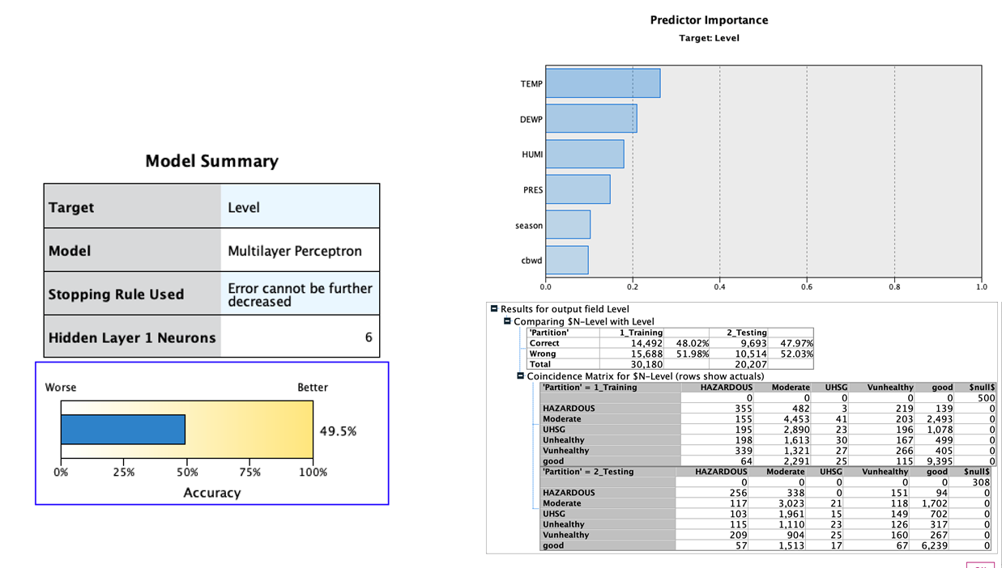
ANN Model

Slide 8
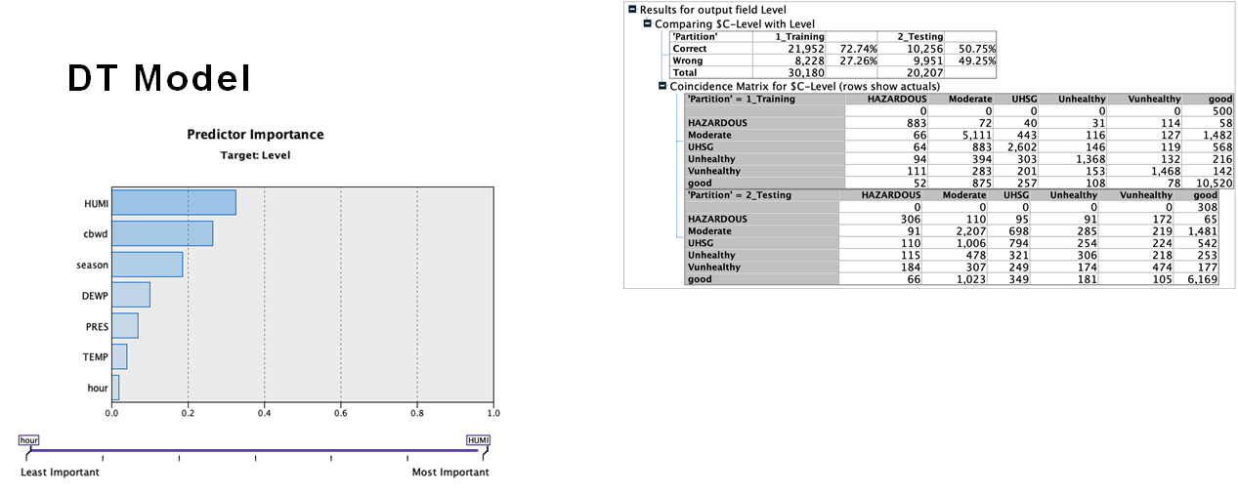
DT Model

Slide 9
Expected results & conclusions
•The Ann model
The accuracy of the model is 50%. In the predicted importance, temperature is the most significant influence, then followed by DEWP, HUMI, PRES,season and other factors. The accuracy of Training data and Test data are 48.02% and 47.97% respectively. As the result, the Ann model is relatively stable.
•Decision Tree
Among all factors, temperature is the most significant influence, then followed by pressure, season and other factors.The accuracy of training data and test data were 72.74% and 50.75%, values between DT and ANN are quite different.
Comparing two models, Dew point and Humidity are relatively more important compare with other inputs.
Due to low accuracy, we are not going to talk about regression part here.
Research result: In high humidity environment(Normally over 60%), which always has mist in the air, the measurement equipment would mistakenly measure the mist as PM2.5, too. Because Pm2.5 and mist both have a diameter of less than 2.5 micrometers. Besides, the mist and PM2.5 in environment would combined with each other, which increased the difficulty of detection.

Slide 10
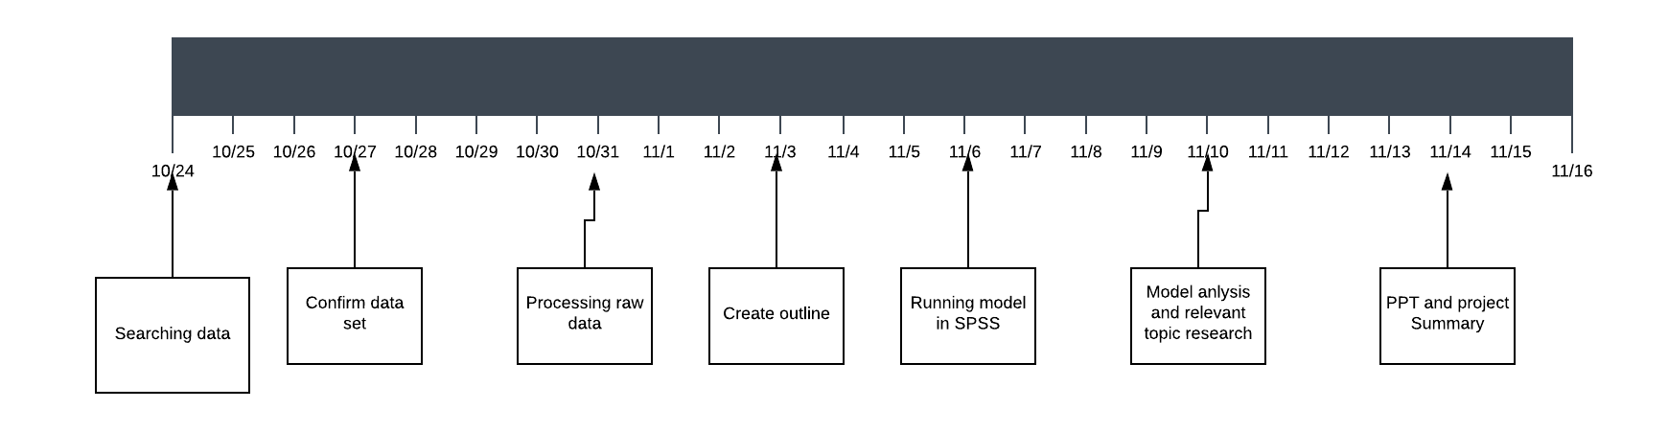
Time Line

Slide 11
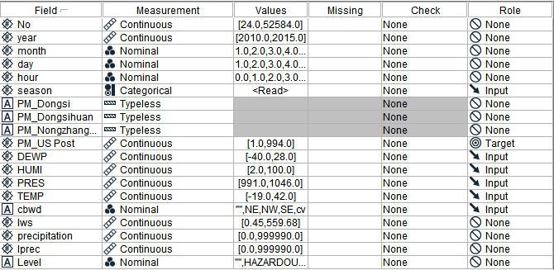
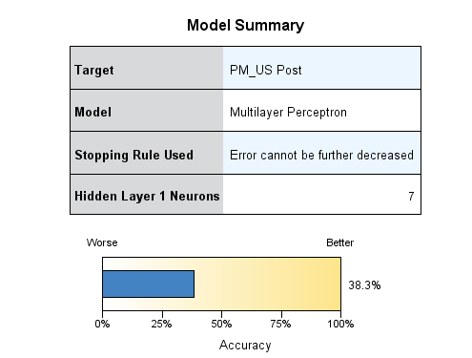
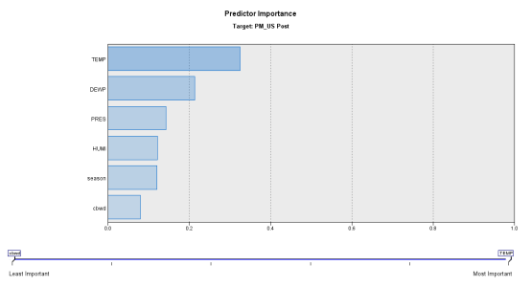
Reference: regression

Slide 12
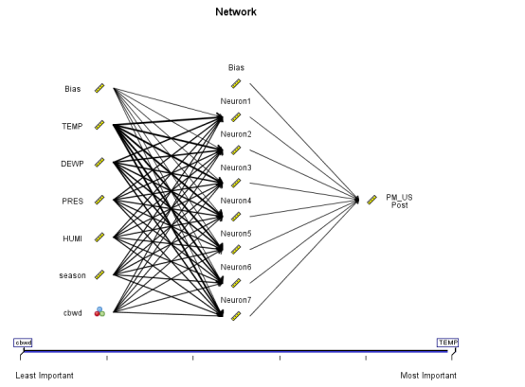
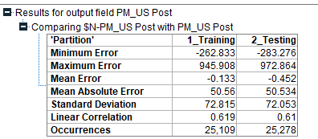

Slide 13
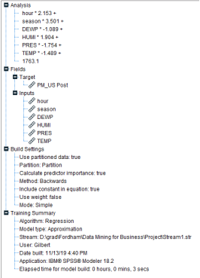
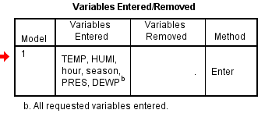
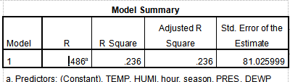
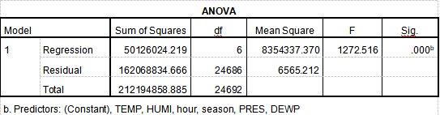

Slide 14
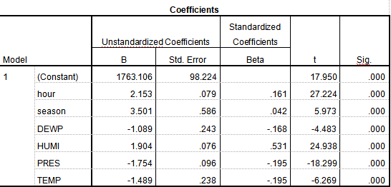
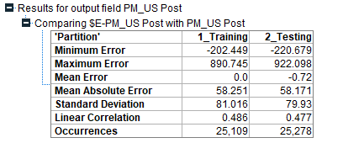

Slide 15
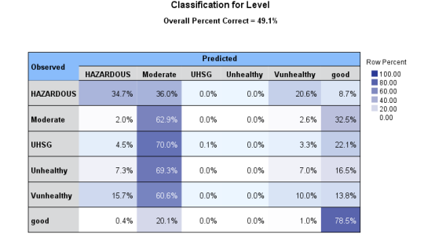
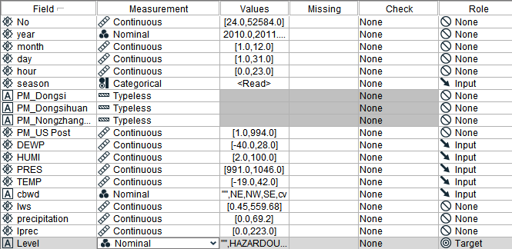
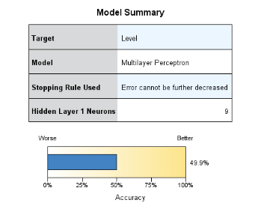
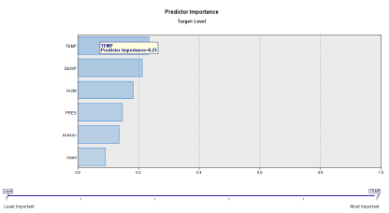
Classification ANN

Slide 16
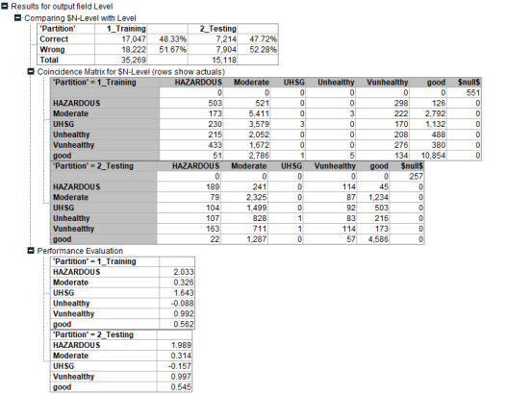
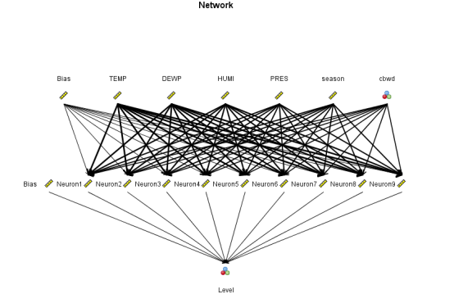
ANN

Slide 17
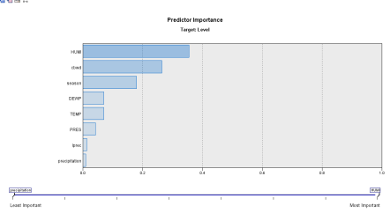
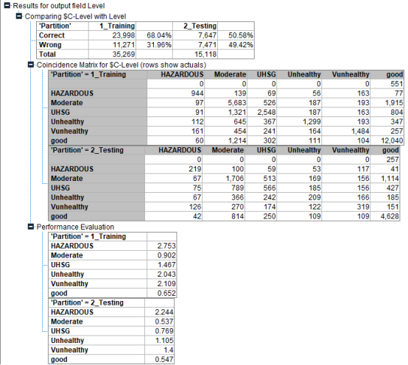
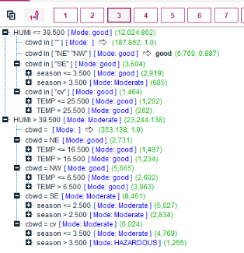
Decision Tree

