Slide 1



KATHLEEN 100 5th INTERNATIONAL CONFERENCE ON COMPUTING SCIENCES (ICCS-2021)
(ICRITO-2021)
3th – 4th December 2021
Paper Title: Vehicle Detection And Accident Prediction In Sand/Dust Storms
Paper ID: ICCS(2021) - 51
Presentation Date: 04 December 2021
Presented By: Arun Singh
Full Affiliation:
School of Computer Science
and Engineering,
Lovely Professional University
Jalandhar - Delhi, Grand Trunk Rd, Phagwara, Punjab 144001

Slide 2
Abstract
In this modern world that is designed by progressing technology, automated vehicles would become a precious part of it. The first thing that strikes in our minds talking about vehicles is traffic and accidents. Accidents could take place because of several reasons: dense traffic, unfavorable weather conditions, sudden braking, change in speed, etc, and the solution to this is machine learning, computer vision, and deep learning. Our focus is to improve the vision in areas of low visibility and predict the future by analyzing the present.
We introduce a model which would help in dehazing and improving the visibility for a better driving experience in adverse weather especially targeting sandstorms and dust storms which would be quite common in the future because of the afforestation.

Slide 3
Methodology used
Our project is divided into 2 parts
Dehazing and improving the quality of the blurred video.
Detecting the vehicle calculating the traffic density and predicting if there could be a accident or fire.
Notes:
First step involved selecting the most common methodologies that are used to predict the data. ARIMA, LSTM, and MLP were found to be the mostly used models for data prediction.
There was also a need to find a suitable and consistent method to have access to NSE database for data collection and processing. Python libraries nsepy and nsetools come in handy in this scenario. Once the data was fetched, it had to be scaled and divided into two sets for training and testing respectively.
The next step involves creating a model for each of the selected methodology, training it on the data fetched from NSE, and the use the trained models on a common stock to predict the value and compare the results for each of them.

Slide 4
Dehazing the Video
The dehazing consists of 3 parts i.e. image/video manipulation, masking and, the threshold.
Calculates each pixel of the image according to the matrix we have created and this makes it easy for us to manipulate according to our needs. As we have done here is to dehaze, we can simply say it adds a filter to the image.
Then a threshold value is assigned if the pixel value is greater than the threshold value then an imaginary value is assigned for example 1 if not then 0 is assigned to it, this helps in converting the image to a black and white format for easy modifications on the image. It analyzes the Atmospheric lighting in the image and then gives us a refined and improved image in the output frame.
If a video is given as input then as we know that a video is a collection of several frames played one after the other in a sorted manner. So, what is done here is segregate the video at 25 fps (frames per second) and apply the same process which we have done for the image dehazing, and then all the frames one after the other in a queue and giving us a new refined video as output.
Notes:
The Autoregressive Integrated Moving Average (ARIMA) is a standard time series analysis and forecasting model that has its roots from Autoregressive Moving Average (ARMA). For an accurate prediction through this model, three values namely p, q, and d should be calculated. The p value defines the lag order i.e., a delay that must be considered in time so that the series could be made stationary. The d value defines the number of times the differencing in the data will be carried out which is called its degree of differencing. The q value defines the window for which the moving average will be calculated in the dataset which can be referred to as the moving average window. Since the data from NSE is always stationary p can be set to 0 and d can be set to 1 and q can be set to 15 to calculate moving average for every fifteen points in the dataset.

Slide 5
Flow chart for Image/ Video dehaze

Slide 6
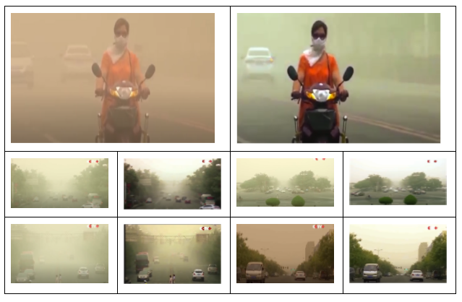
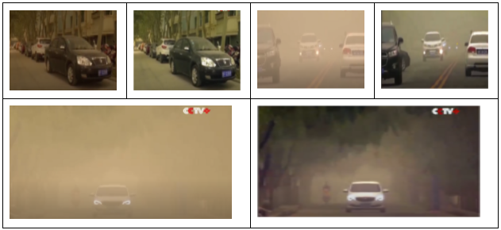
results
Before & after dehazing

Slide 7
vehicle detection, calculating traffic density, forecast of accidents and fire
First, we input the dehazed video which we got as output from the above flow diagram. Then do preprocess on the video and make it adjustable according to our need and size
Contour the image which gives us a black and white binary video; these continuous and sharp lines joining all the boundaries help to recognize and identify the moving vehicles in the video.
To count the number of vehicles in the video we have used the method of reference line passing objects; a highlighted reference line is brought up on the screen which help helps us to count the number of vehicles that pass from it and a tracker mechanism is used so that the same vehicle is not detected many times in the continuous ongoing frames of the video
To implement the traffic density and prediction of accidents we need to train the model on several photos and videos first to meet our needs to predict and calculate the traffic as it would save the weights for giving accurate values in the future.
Notes:
The Long Short-Term Memory (LSTM) is a special type of Recurrent Neural Network (RNN) that has the capacity to learn from long term dependencies in the data through blocks . For any LSTM, the number of neurons, the number of layers, and the density of the neural network play a vital role in the learning process of the neural network. There is no such formula to calculate the exact number of neurons that would be sufficient for the data. It must be adjusted manually to get the optimal result meanwhile keeping in mind the time taken by the machine to learn from dataset. For our observations, we have taken two LSTM input layers, one with 270 neurons and the other with 170 neurons, and a simple LSTM layer with 155 neurons [1]. Furthermore, one simple dense layer of 25 neurons and an output dense layer of 1 neuron has also been added to the model.

Slide 8
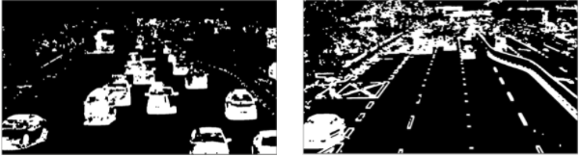
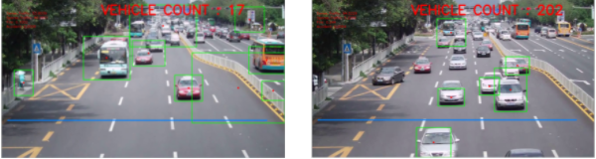
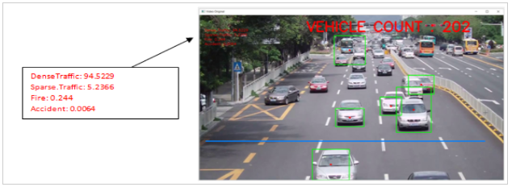
results
Notes:
The Multilayer Perceptron is a special type of feed-forward Artificial Neural Network (ANN) which uses backpropagation training algorithm to learn from the input dataset. It is divided into three layers namely the input layer which deals with the input signals, the hidden layer which is used for nonlinear transformation of inputs, and the output layer that predicts and classifies the values based upon the inputs. For our observation, we used 1987 hidden layers with the maximum iteration of 300 and three dense layers having 2200, 2570, and 2800 neurons, respectively.

Slide 9
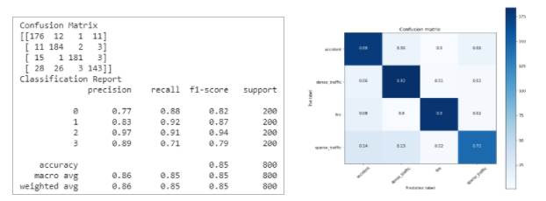
Model accuracy & results
The proposed model gave us a accuracy of 85-90%
Notes:
We observed that predictions from ARIMA model are close to the actual value whereas LSTM shows a significant deviation from actual value as compared to MLP though the rmse value for latter is more than that of the prior. When the number of neurons for LSTM and MLP are changed, notable comparative change in the deviation in MLP and LSTM can be observed even though the rmse value for both remains close enough to the one stated in Table. For ARIMA, increasing the window size of the model increases the rmse value in turn increasing the deviation from the actual value but the predicted result remains considerably closer to the actual result.

Slide 10
THANK YOU

