Slide 1
Improve the predictability of SmartFund
Yiwei Dong
dongyiwei@stu.scu.edu.cn
Instructors: Meng Jiang, Qingkai Zeng
{mjiang2, qzeng}@nd.edu

Slide 2
Introduction
This project aims at improving the predictability of SmartFund, which is a model used for research outcomes prediction developed by Alvin Alaphat and Dr. Jiang. SmartFund leverages the past project data (award amount, investigators, university, and abstract) from the National Science Foundation (NSF) website, to predict the number of papers and corresponding citations a new project might produce, and thus it is expected to help NSF fund projects efficiently and cost-effectively. However, the performance of SmartFund model is not so satisfying, with coefficient of determination 0.348 for #papers prediction and 0.188 for #citations prediction. Therefore, it is important to enhance the predictability of SmartFund to make it useful in the real sense.

Slide 3
Motivitions
Textual features can be better extracted by SciBERT model
Textual features hidden in the abstract can be extracted more amply by SciBERT, the state-of-the-art natural language processing model.

Slide 4
Work of Alvin Alaphat and Dr. Jiang: LDA + regression Models
Extract data from NSF¹ and Open Academic Data²
Feature extraction
Bag-of-Words model
Latent Dirichlet Allocation (LDA)
Term Frequency-Inverse Document Frequency (TF-IDF)
AutoPhrase model: upgrading vocabulary from words only to words and phrases
Feature selection
Regression models
¹NSF Award Search: https://www.nsf.gov/awardsearch/download.jsp
²Open Academic Graph: https://www.openacademic.ai/oag/

Slide 5
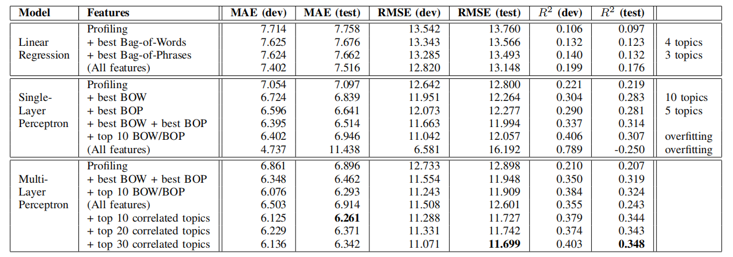
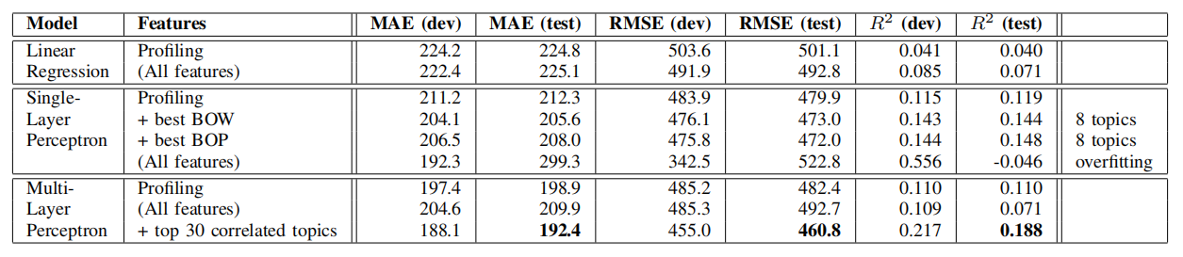
Results of Topic Modeling + Regression Models
Table 1: Performance on predicting the number of papers produced by an unseen project¹
Table 2: Performance on predicting the number of citations the produced papers can have²
^{1,2} from Alvin and Dr. Jiang

Slide 6
SciBERT Model + Regression Models
Using SciBERT Model to get sentence embeddings of abstracts
Feed the sentence embeddings to regression models
Embedding
SciBERT
Regression Models
#paper
#citation
Abstract

Slide 7
Data Processing
Delete items with none abstract
Tokenize abstract & Cut to 490 tokens (BERT model can tackle at most 512 tokens at one time. Here, we regard each abstract as one sentence, and take the sentence embedding as its feature)
Split train, dev, and test

Slide 8
Use SciBERT to Embed All The Abstracts
Sentence embeddings
ID
Abstract
#paper #citation
0 1 ... 767
This is a workshop on the use of mathematical and computer models in biological resource conservation. It is designed to... | 0 | 0
The distribution of Ba in the ocean is similar to the refractory components, silica and alkalinity. Therefore reconstructions of Ba in ancient... | 1 | 90
The research objective of this project is to investigate how performance can be made comparable across a wide range of construction project sizes and types. Performance... | 0 | 0
... | ... | ...
-0.6507 | 0.0876 | ... | -0.8717
-0.6902 | -0.3954 | ... | -0.8150
0.1398 | -0.3006 | ... | -0.5552
... | ... | ... | ...
8854199
9012033
1536005

Slide 9
Feedforward Neural Network
Pass the obtained sentence embedding as the input to the feedforward neural network
Train & Save the model with the least MSE on validation set

Slide 10
Future Work
Optimize the SciBERT + Feedforward neural network model
Test the reasonability of each step(e.g. If it is reasonable to cut each long abstract to 490 words? If it is better to cut those abstracts backward so that we can get a better result?)

Slide 11
Conclusion
In this project:
We propose to improve the predictability of SmartFund, to make it function better
We propose to use SciBERT to extract the information contained in abstracts
Feel free to contact me at dongyiwei@stu.scu.edu.cn should you have any questions!

