Slide 1

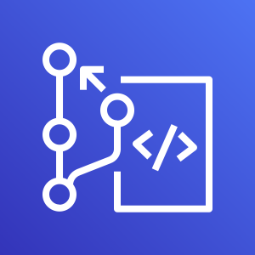
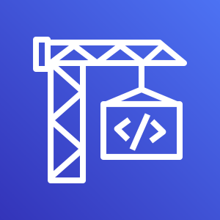







Workshop Scope
DevOps
AWS CodeCommit
AWS CodeBuild
create ML container
Machine Learning Containers
Amazon Elastic Container Registry
AWS CodeBuild
Version_Set
AWS CodeBuild
Trigger_QA_Training
AWS CodeBuild
Pull_QA_Model
AWS CodeBuild
Deploy_PRD_Model
AWS CodeBuild
Deploy_PRD_EndPoint
Models
Repositories
Push and Pull Source Codes
Trigger remote model training
Pull models
Deploy Models
Dev
Beta
Prod
AWS Cloud9
Amazon SageMaker
Train new
Models
Re-train
models
Amazon Simple Storage Service
Amazon SageMaker
Models
Inference
Batch Transform

Slide 2

AWS CodeCommit
AWS CodeCommit
Amazon Elastic Container Registry
AWS CodeBuild
Version Set
AWS CodePipeline
AWS CodeBuild
create ML container
Machine Learning Containers
AWS CodePipeline
Pull QA
model
AWS CodeBuild
Pull_QA_Model
AWS CodeBuild
Trigger_QA_Training
Amazon SageMaker
Train new
Models
Approve
Trigger QA
model training
Deploy PRD
Model
AWS CodeBuild
Deploy_PRD_Model

