Slide 1

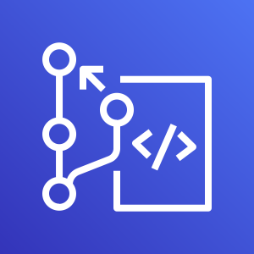
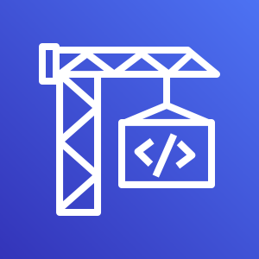







Workshop Scope
DevOps
AWS CodeCommit
AWS CodeBuild
create ML container
Machine Learning Containers
Amazon Elastic Container Registry
AWS CodeBuild
Trigger_QA_Training
AWS CodeBuild
Pull_QA_Model
AWS CodeBuild
Deploy_PRD_Model
Models
Repositories
Push and Pull Source Codes
Trigger remote model training
Pull models
Deploy Models
Dev
Beta
Prod
AWS Cloud9
Amazon SageMaker
Train new
Models
Re-train
models
Amazon Simple Storage Service
Amazon SageMaker
Models
Inference
Batch Transform

