Slide 1
Saturn IDE
GitHub: https://github.com/Doraemon012/Saturn
A code editor developed in JAVA
By: Neyati

Slide 2
Contents
Introduction
Tech Stack & Concepts used
Features
Code Samples

Slide 3
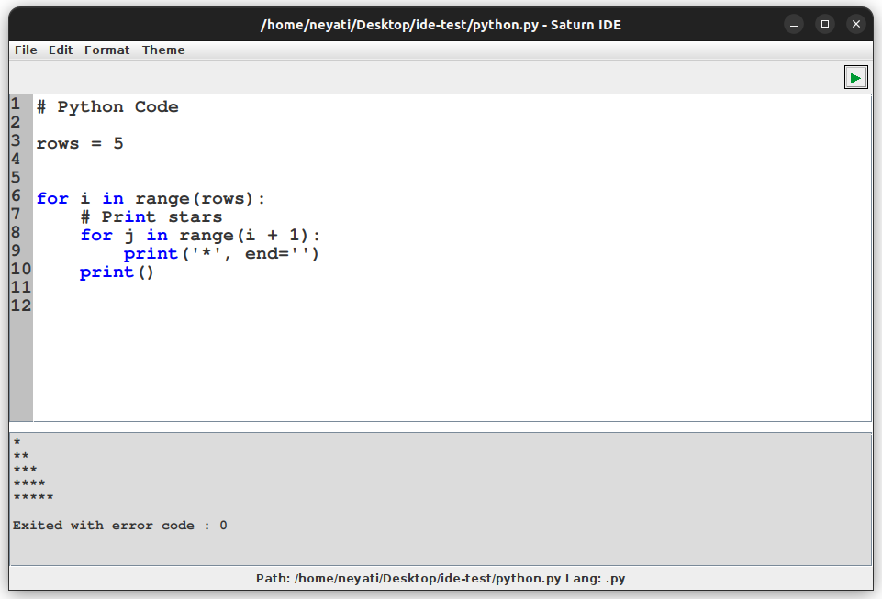

Slide 4
Introduction
Welcome to Saturn IDE, a versatile code editor designed to empower your coding journey with simplicity and efficiency.
Developed entirely in Java, Saturn IDE boasts a clean and minimalist user interface, making it the perfect tool for developers of all levels.
Whether you're coding in C++, C, Python, or Java, Saturn IDE provides a seamless and enjoyable coding experience, tailored to meet your needs.
Works on Windows, Linux

Slide 5
Tech Stack
Concepts
Java
Java Swing
File Handling
Java Awt
OOPs Concepts
Exception Handling

Slide 6
Features
Syntax Highlighting 🎨
Enhance code readability with vibrant syntax highlighting for languages like C++, C, Python, and Java.
Dark and Light Modes 🌓
Personalize your coding environment with both dark and light modes, ensuring comfort and visual appeal.
Basic Editing Functions ✂️📋
Perform essential code manipulations effortlessly with cut, copy, paste, and select all functionalities.
Print Code with a Click 🖨️
Streamline the process of printing your code with a single click, making documentation and reference easier.
Automatic Interpreter/Compiler Detection 🚀
Saturn IDE intelligently identifies the required interpreter or compiler for your code, removing the need for manual selection.

Slide 7
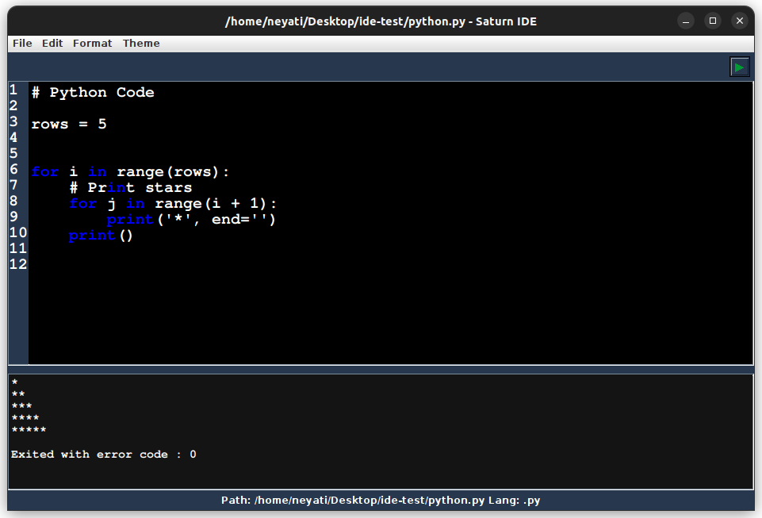
Multiple Themes
Syntax Highlighting

Slide 8
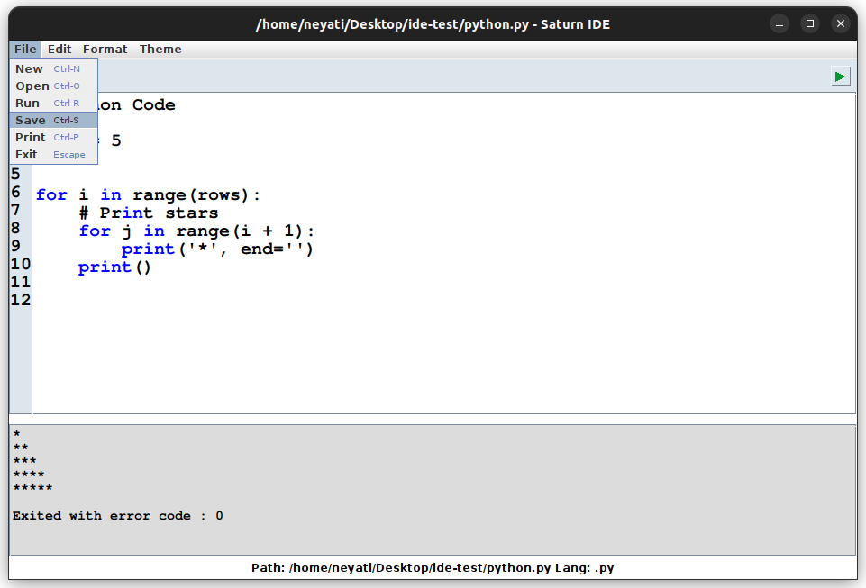
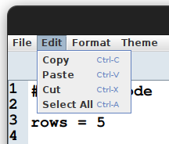
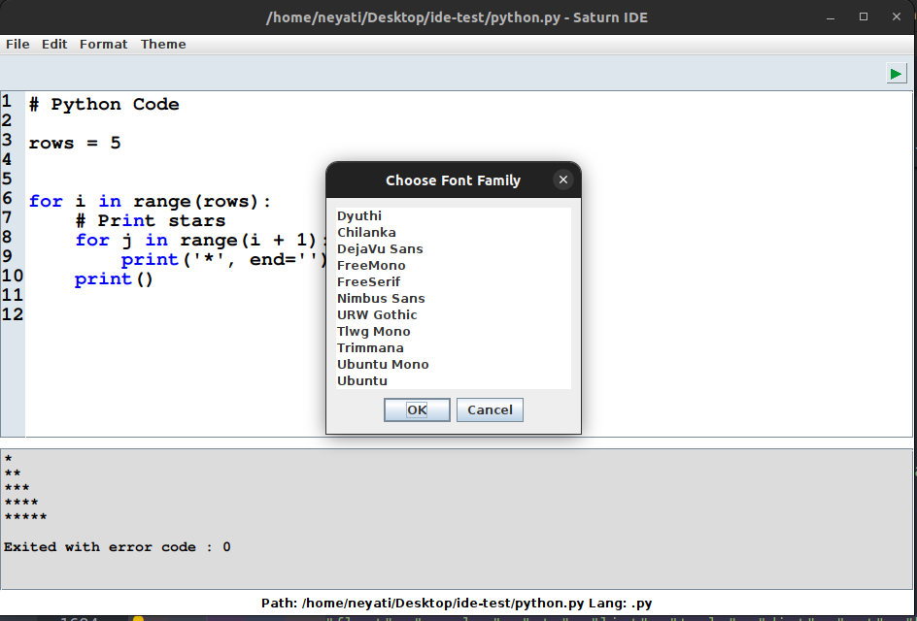
Print Code
Editing Features
Auto Compiler/Interpreter Detection

Slide 9
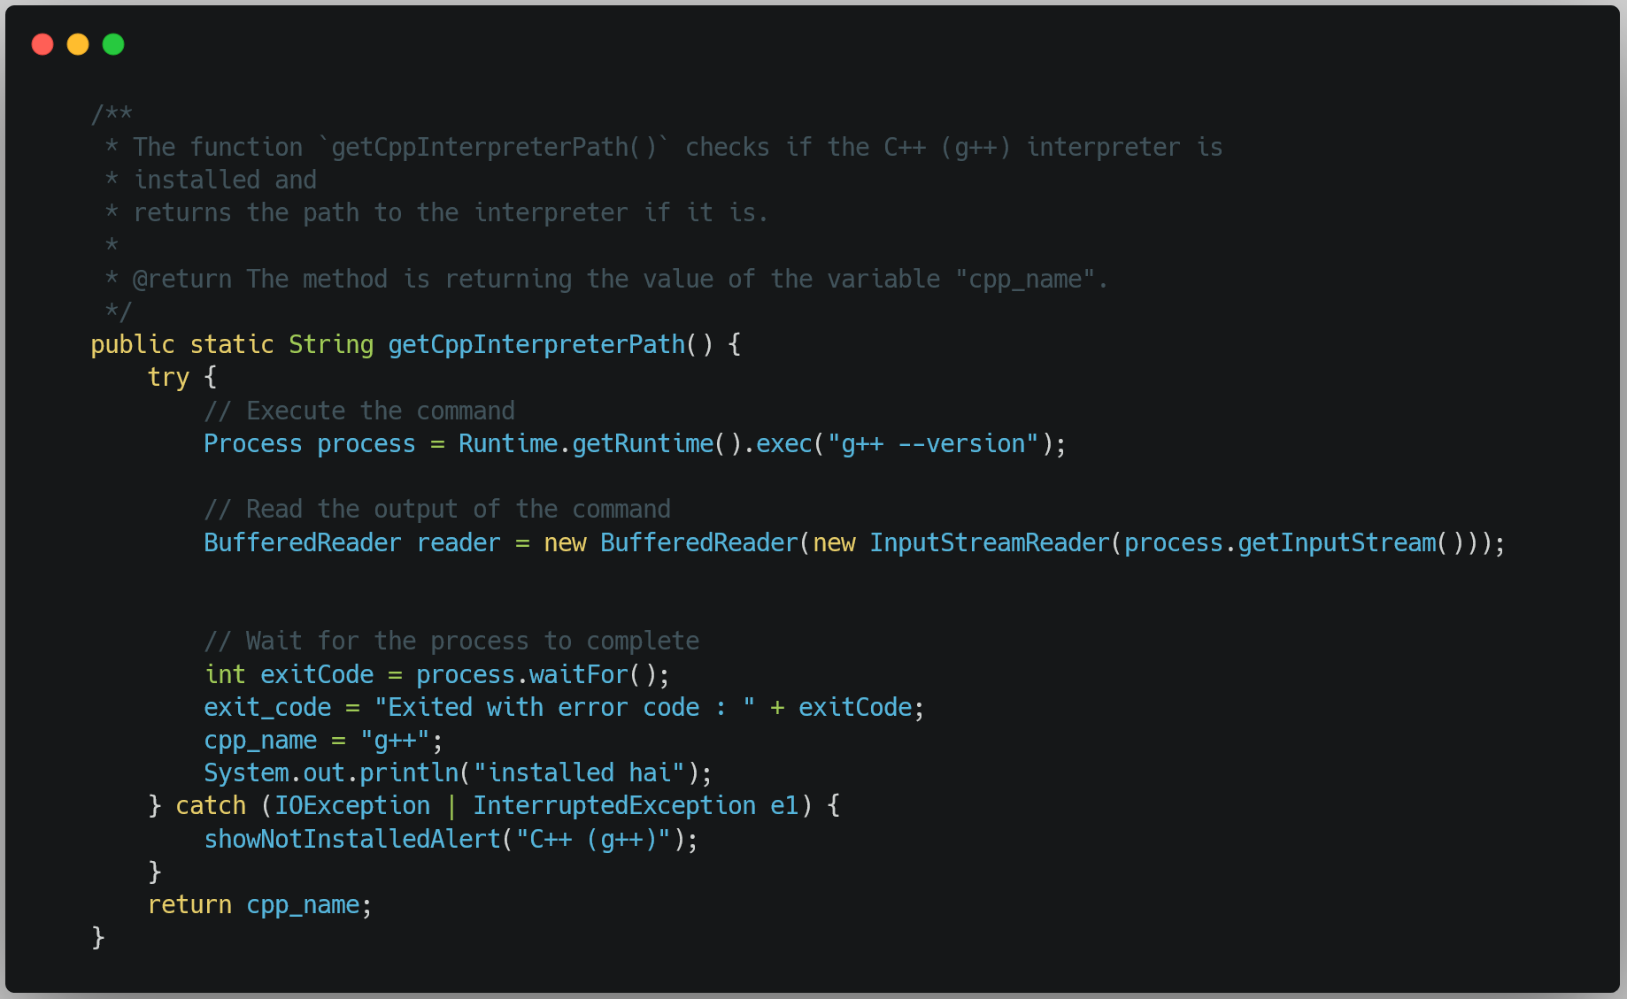
Auto Compiler/Interpreter Detection
Code Example: Detecting C++ Compiler

Slide 10
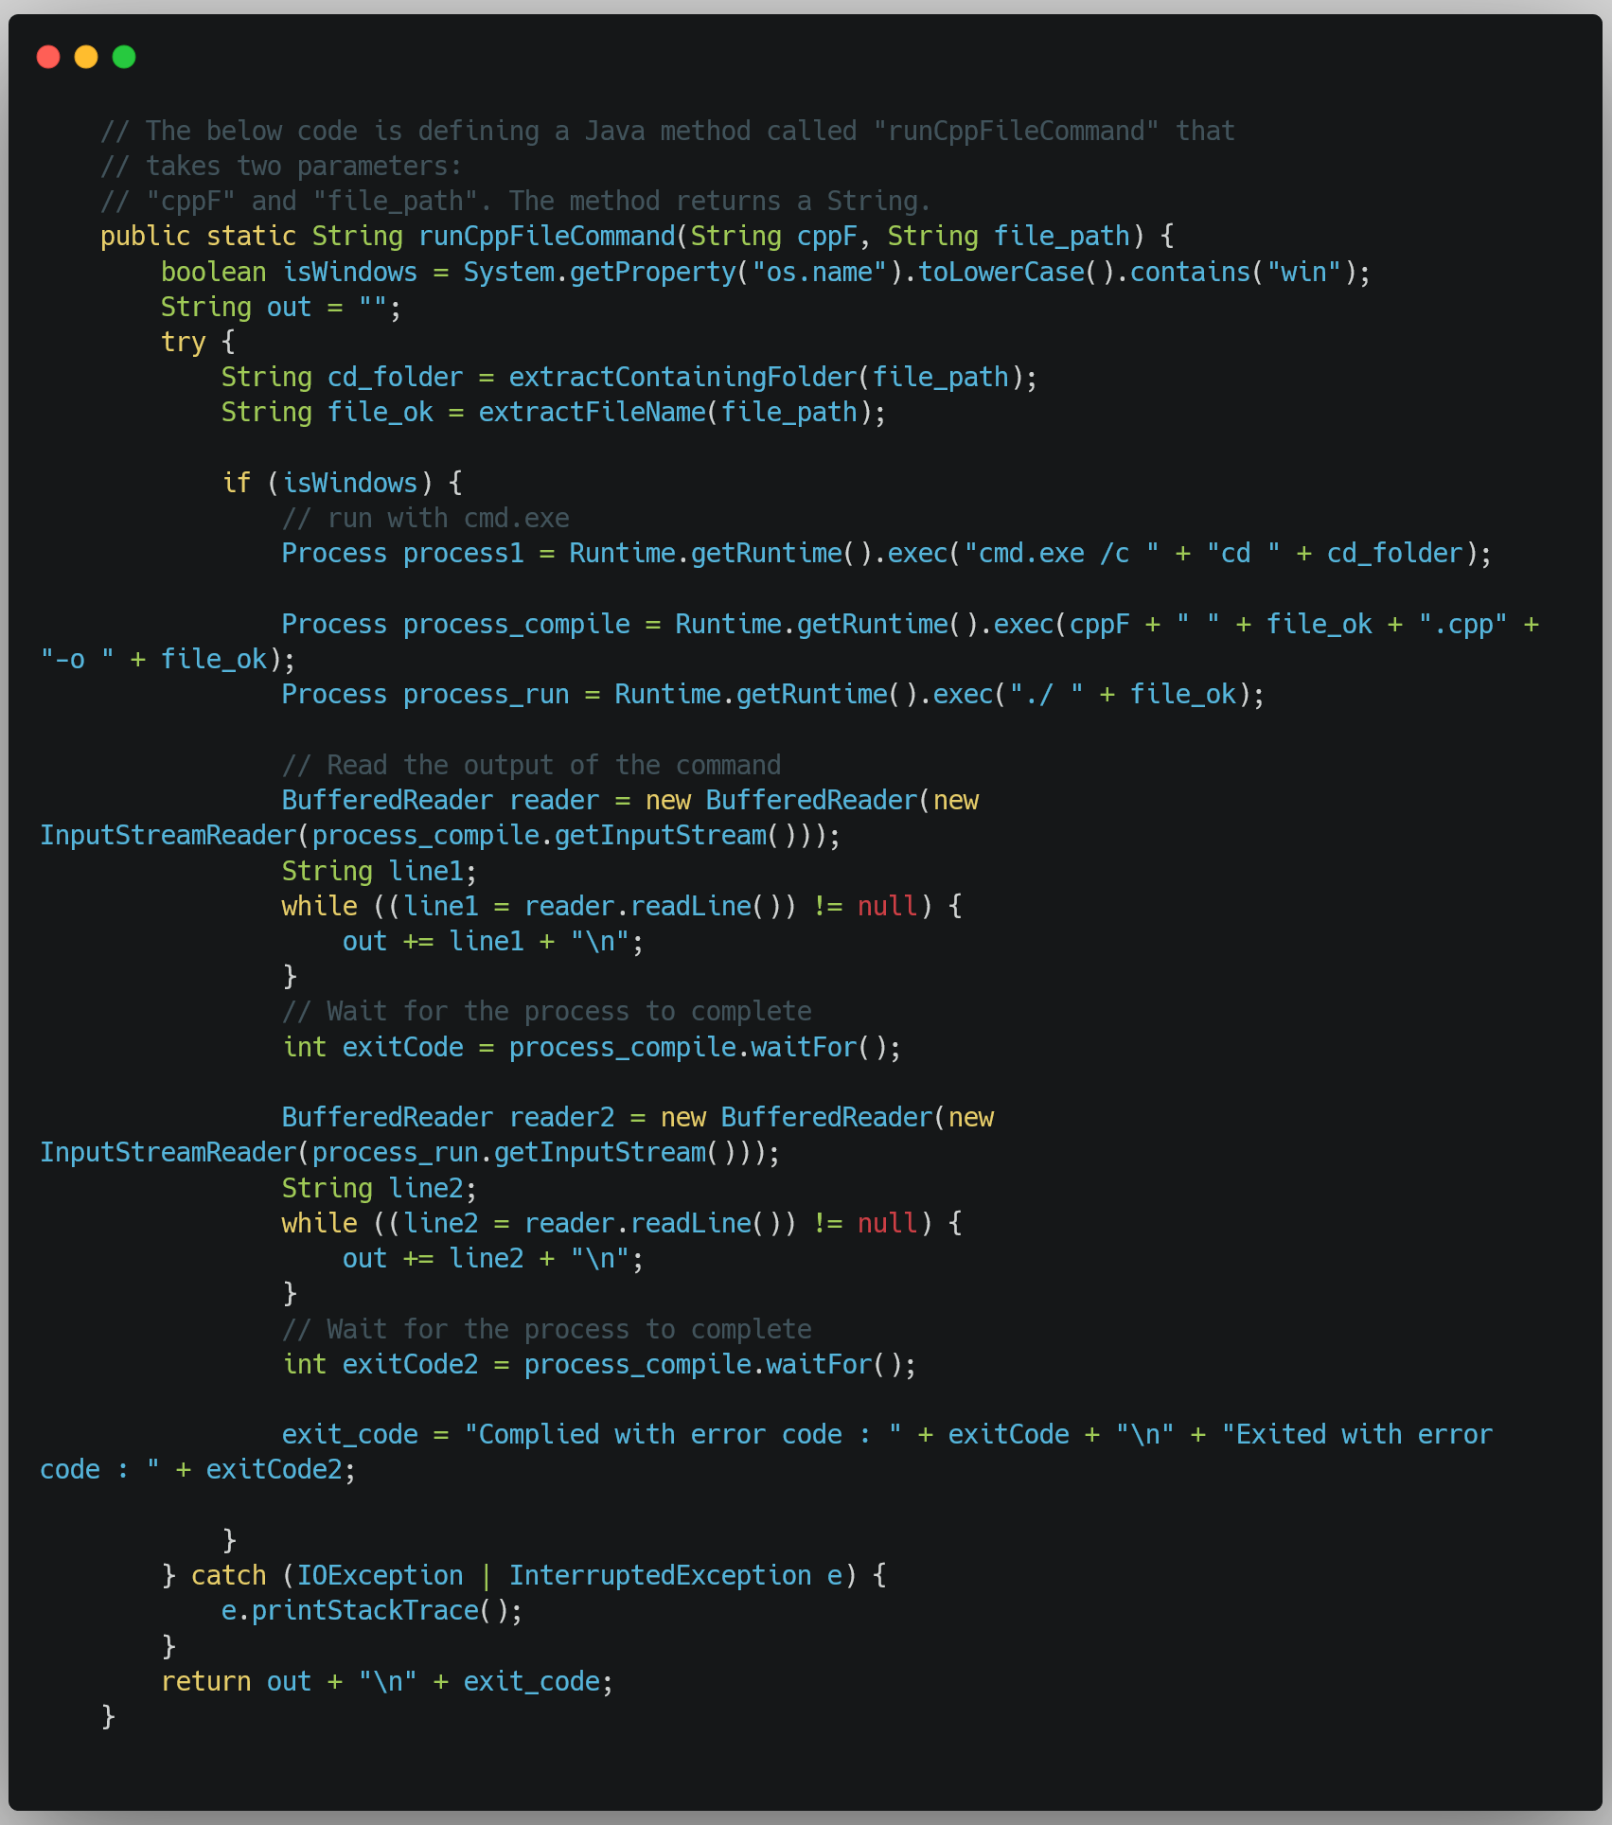
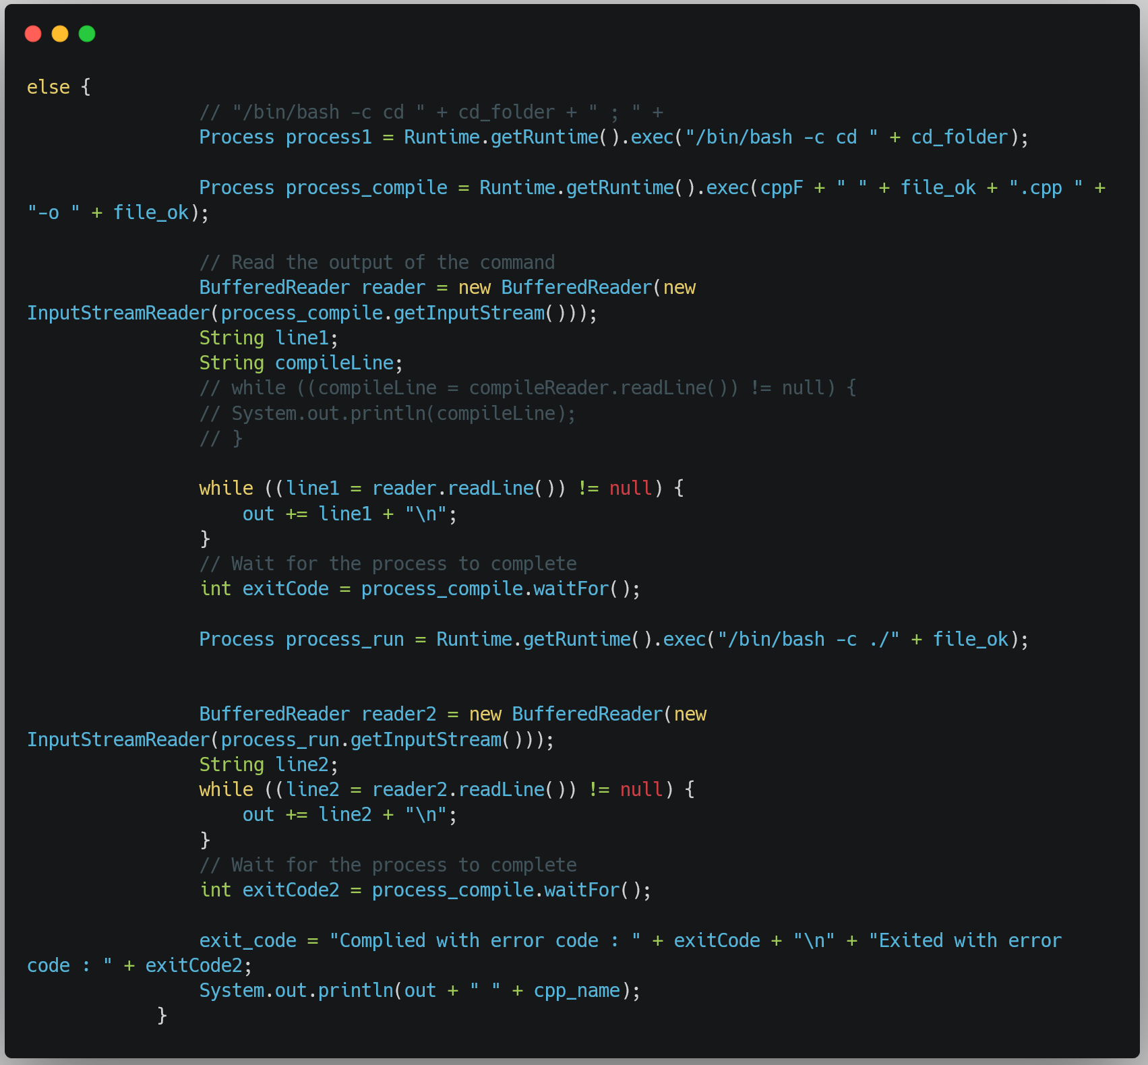
Executing Code
On Windows
Code Example: Executing C++ Code
On other OS

Slide 11
Supported languages
Java
Supported Operating Systems
Python
C++
Windows
C
Linux

Slide 12
Thank you!
By: Neyati
GitHub: https://github.com/Doraemon012/Saturn

