Slide 1
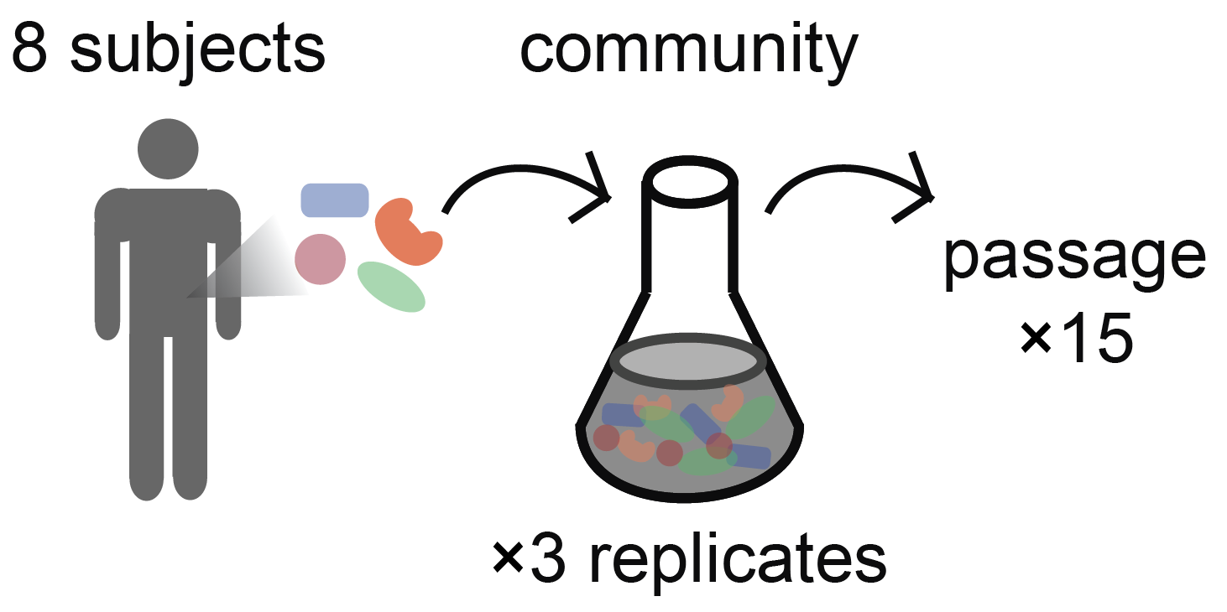
Basic Microbiome Data Analysis in R
Doran Goldman
Stanford Splash Spring 2024

Slide 2
Overview of today’s class
Brief introduction to R
Introduction to the human gut microbiome
Experimental setup: testing the effect of antibiotics on gut communities
Goals for today

Slide 3

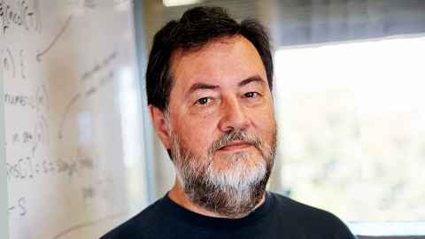
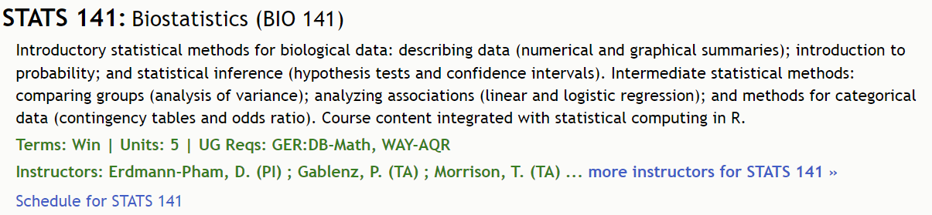
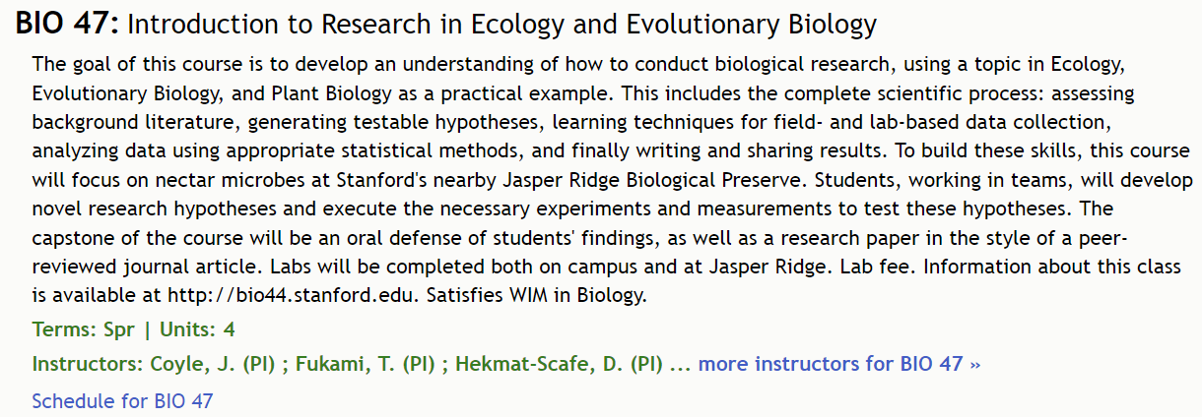

R as a programming language
First developed in 1993 by Ross Ihaka and Robert Gentleman at the University of Auckland.
Popular in biology for data analysis, visualization, and statistical computing.
Used in many statistics, bio courses – but often not the primary teaching focus.

Slide 4
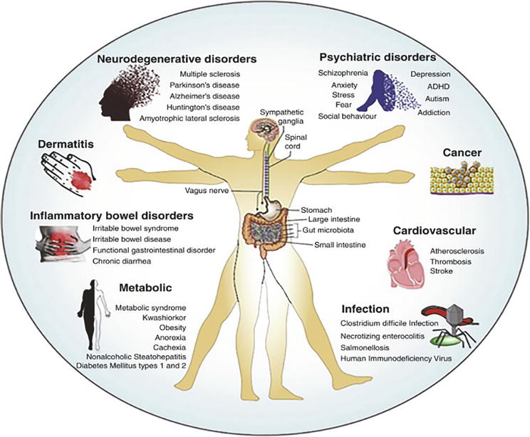
The gut microbiome plays a key role in health and disease
M., Basavaraju, et al. ‘Microbiome - The Power House of Health and Disease’.

Slide 5

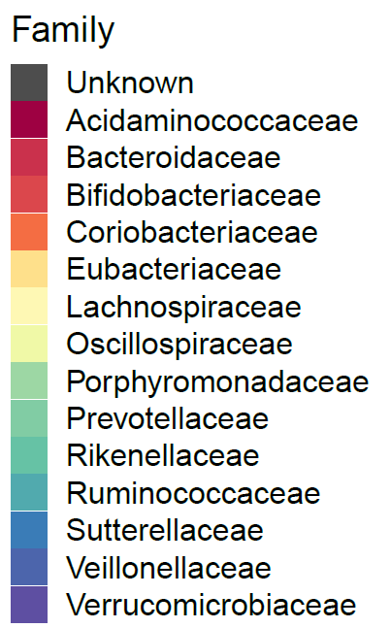
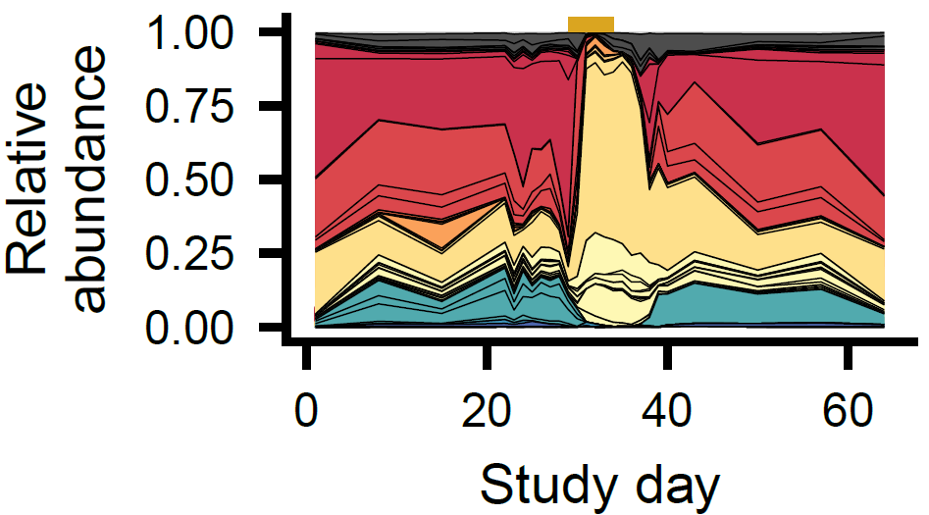
The microbiome is typically diverse and stable in adult life.
Up to ~100 trillion microbes are thought to be present in the human gut.
Hundreds of different species are present.
The composition of the adult gut is generally stable, but can be affected by perturbations like antibiotics.
An example microbiome composition:
antibiotics
Xue et al. 2023

Slide 6
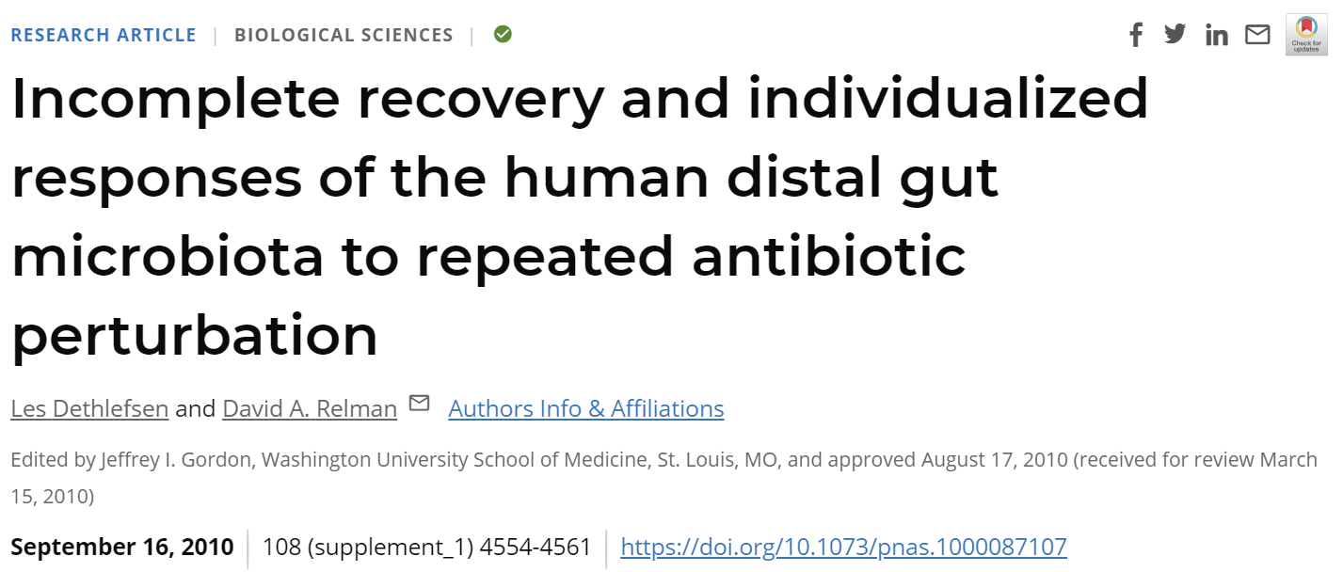
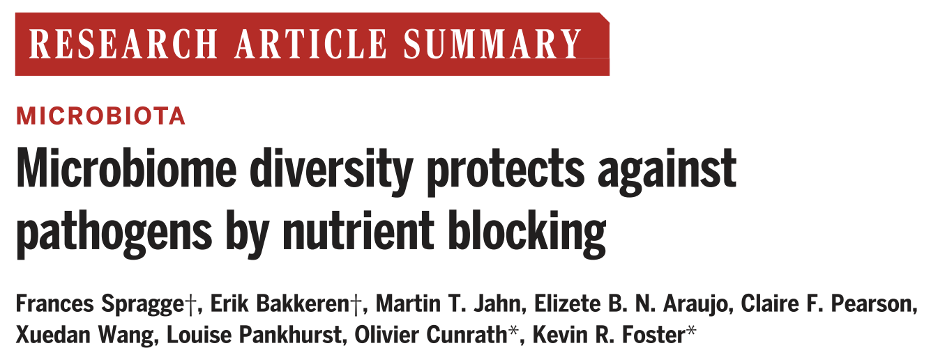
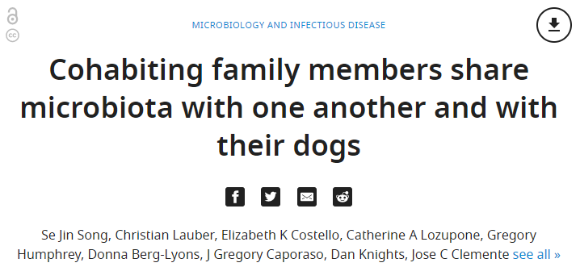
Open questions in microbiome ecological research.
How do different perturbations affect microbiome composition?
What factors maintain microbiome stability?
How often does transmission between individuals occur?

Slide 7
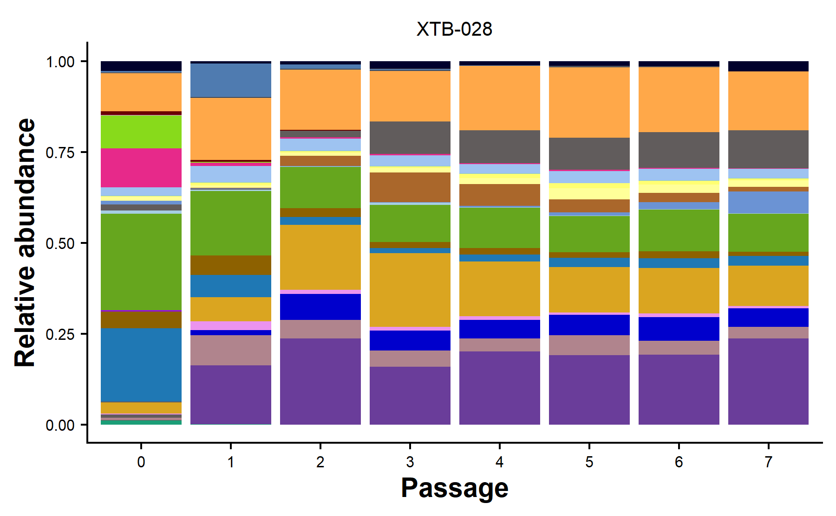




In vitro communities can be used to study microbiome ecology.
human subject
(stool sample)
in vitro community
×7
1:200, every 48 hr
Passage communities 7 times to stabilize composition.
KC
Huang
David Relman
Katherine
Xue

Slide 8
We tested how antibiotic perturbation impacts communities.
DNA extraction
antibiotic
in vitro community
16S sequencing
0 ug/ml
(control)
×5
2 ug/ml
×5
Q: how do antibiotic responses differ across communities and doses?
×5
8 ug/ml
passage:
1
2
3-7

Slide 9
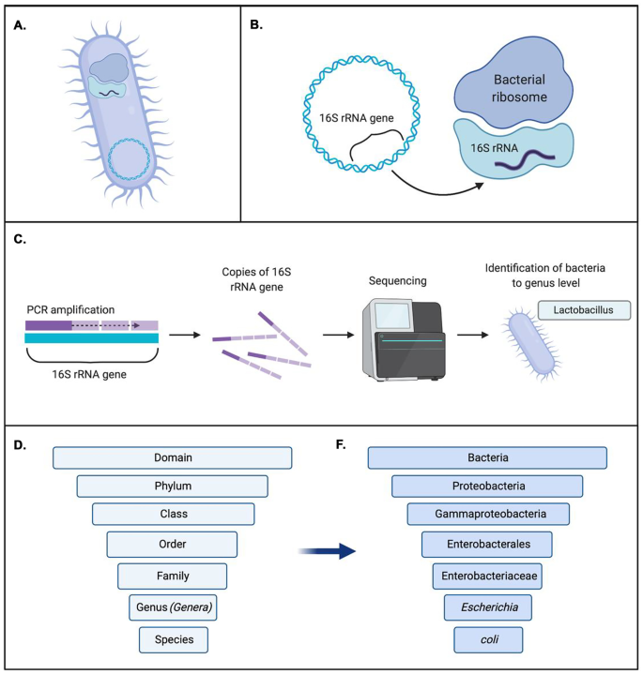
We used 16S sequencing to characterize community composition.
The 16S rRNA gene is highly conserved across all bacteria.
Gene sequences are algorithmically matched to a reference database.
Sequences with >~97% similarity are classified as the same “operational taxonomic unit” (OTU) – a rough equivalent to species.
Sequencing this gene provides a readout of the relative proportion of each species in each community.
Patel et al. 2022

Slide 10
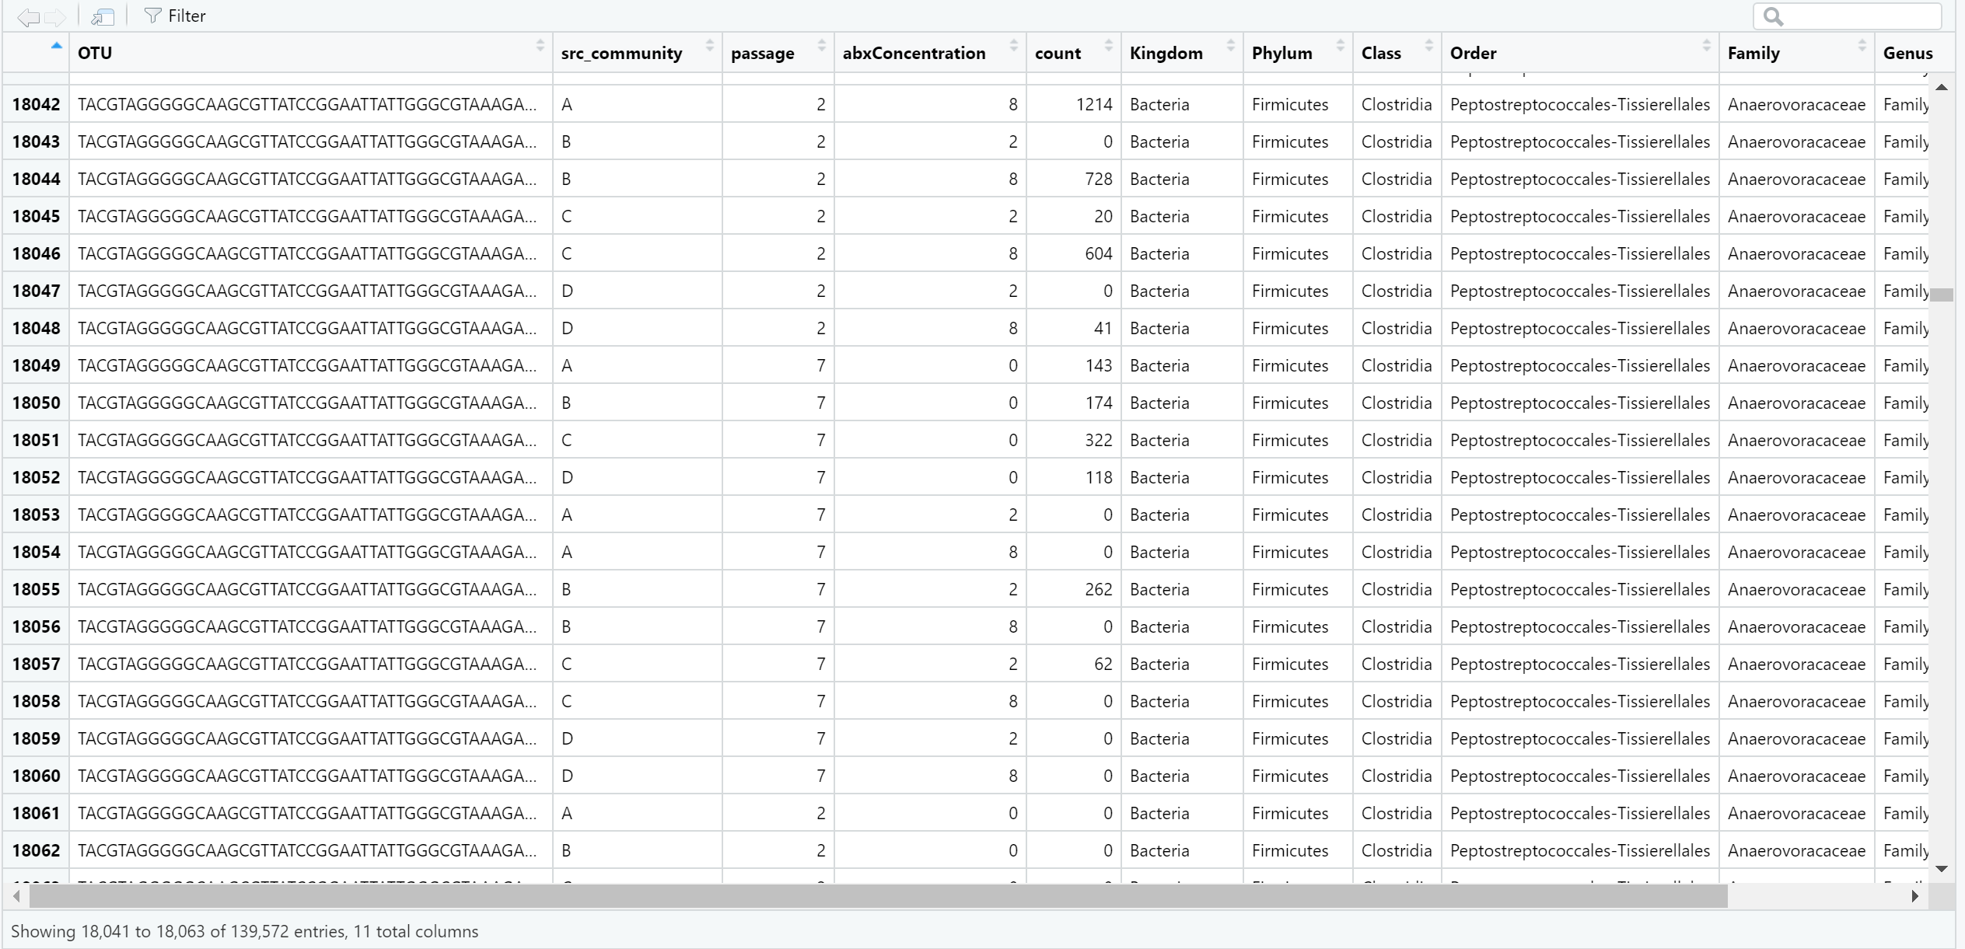
What will the 16S data look like?
Each column is a sample variable.
Each row is a unique observation
This data format is called “long data.”
4 source communities × 3 passages × 3 antibiotic doses = 36 unique communities.
So each OTU appears in 36 rows.

Slide 11
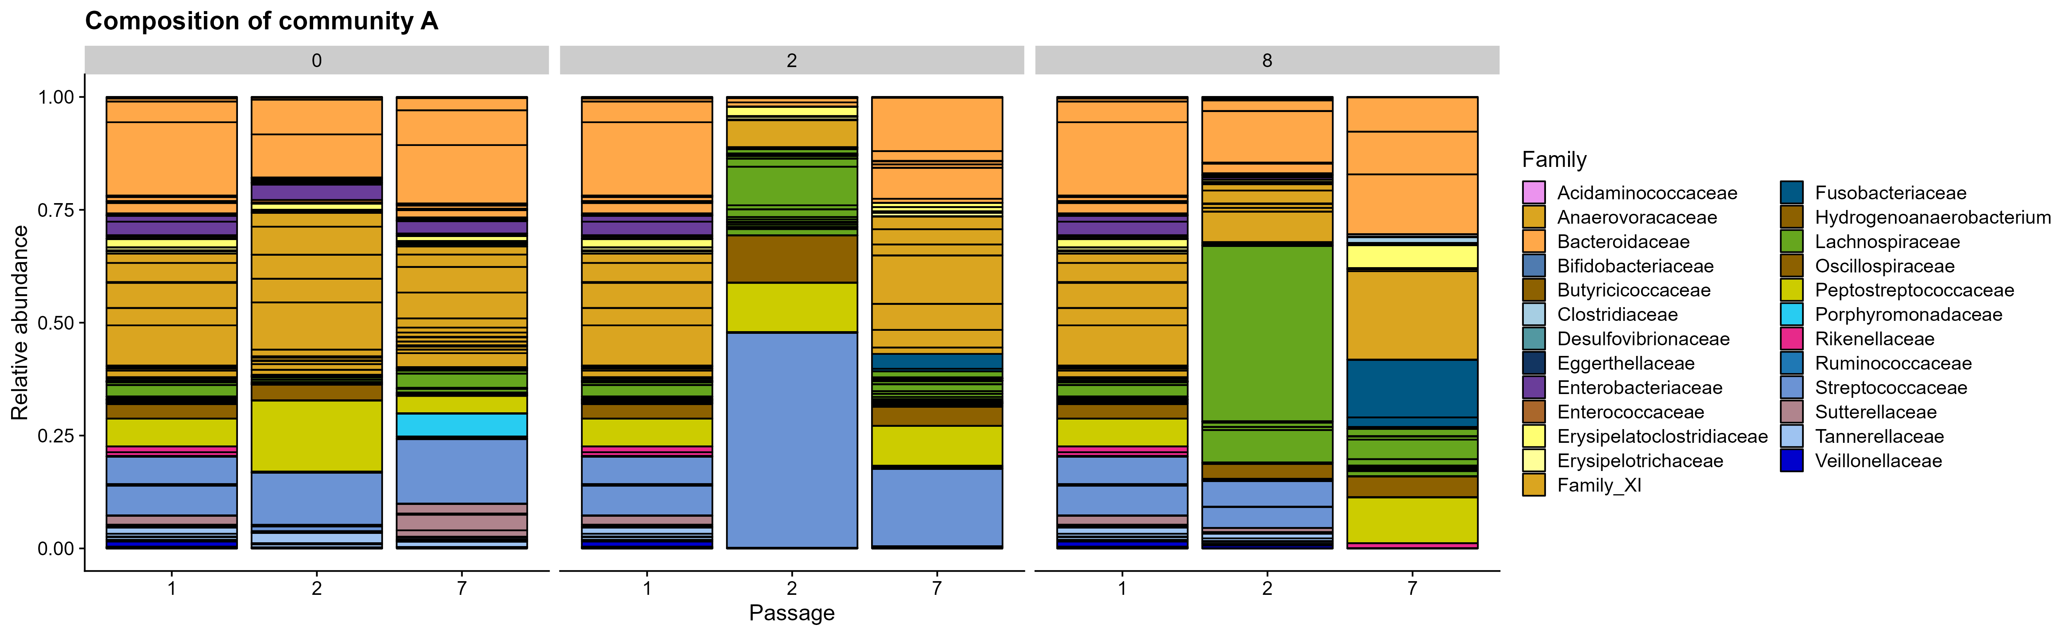
What plots will you learn to make today?
Community composition stacked bar plots.
Interpretive Q: are there certain families that seem to systematically survive better or worse during antibiotics? What are some biological reasons this might be the case?

Slide 12
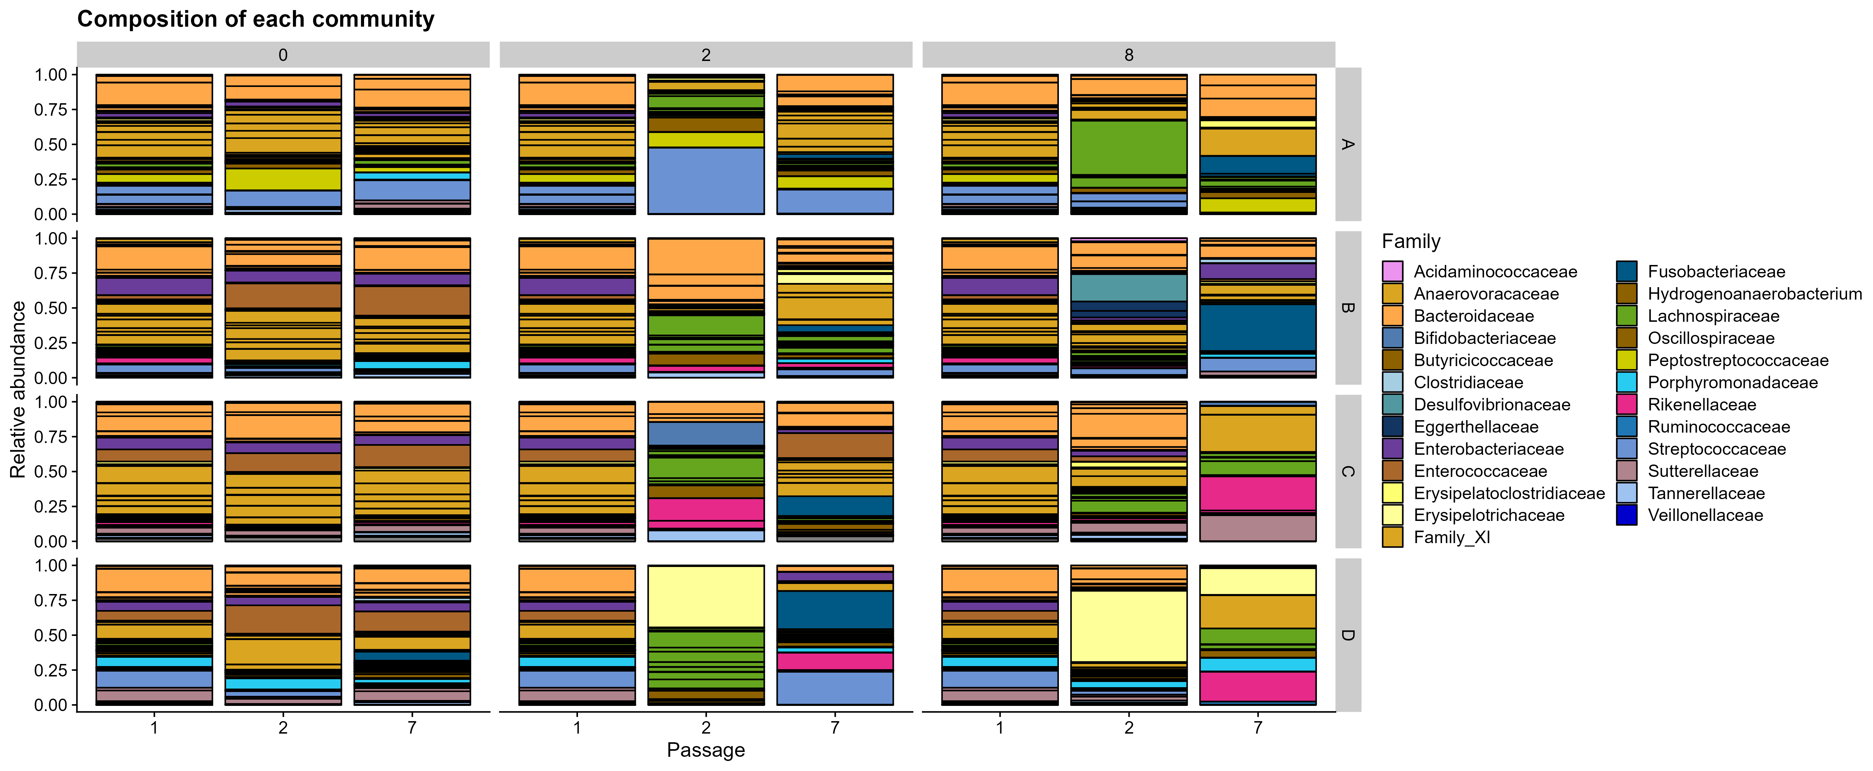
Community composition of all communities.
Interpretive Q: which communities show more recovery to their initial state? Which ones don’t? Why might some communities show more recovery than others?

Slide 13
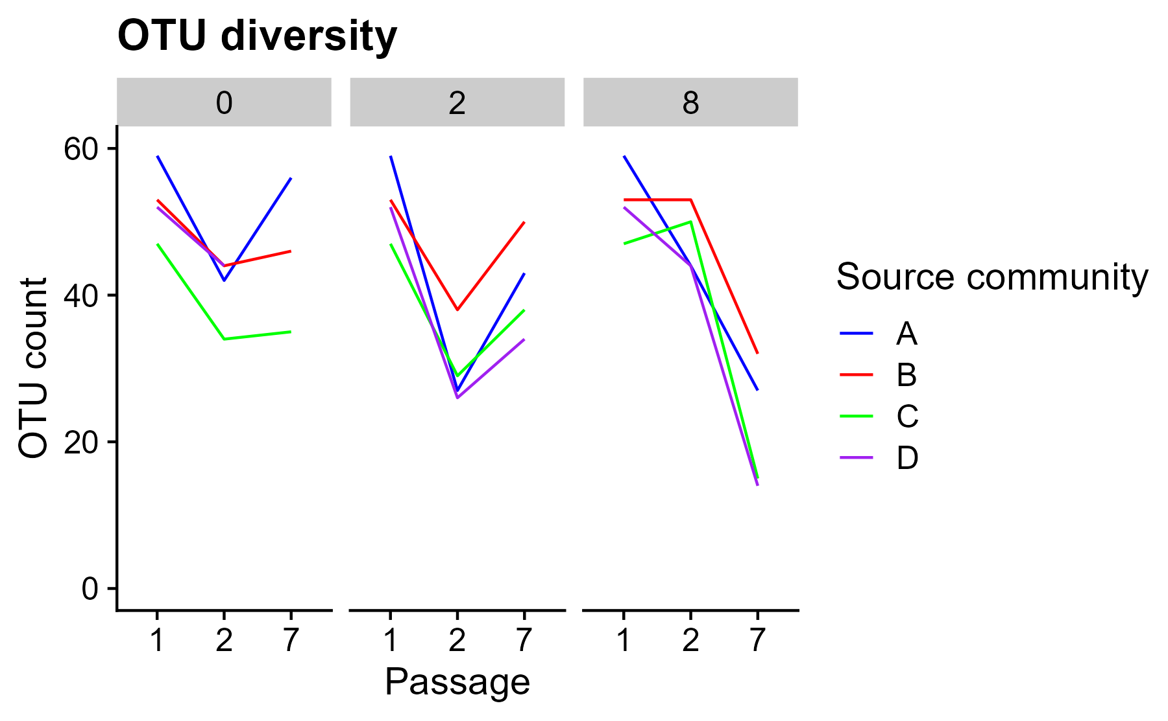
OTU diversity of each community
Interpretive Q: which communities recover in diversity at which doses?
What are some potential drawbacks of considering only OTU presence/absence and not abundance?

Slide 14
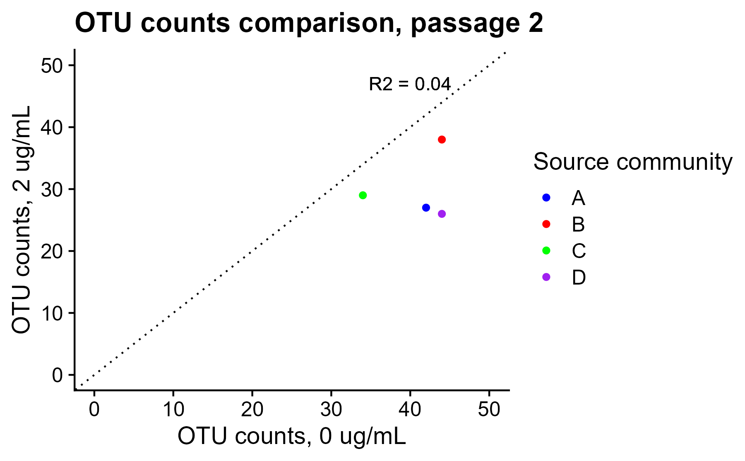
Correlation of OTU diversity across antibiotic doses.
Interpretive Q: which communities look more similar in OTU diversity across doses?
From a technical perspective, considering how 16S sequencing works, why would plotting the raw sequencing counts for each OTU in each community be an unsound analysis?

Slide 15
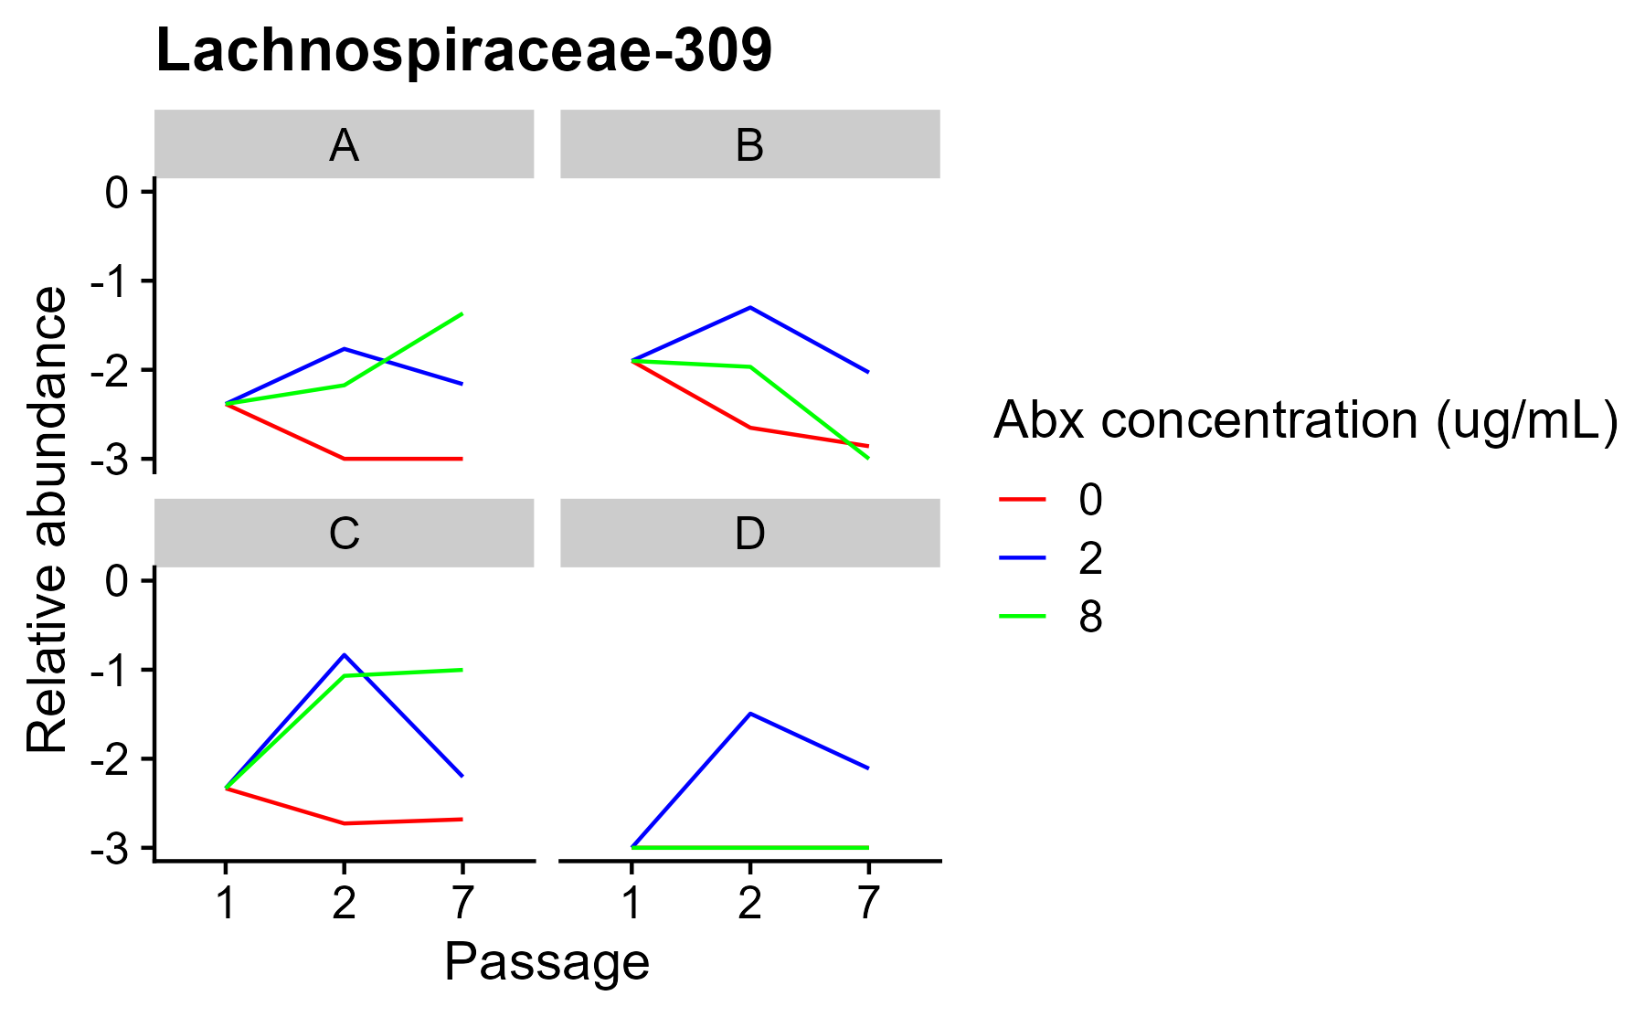
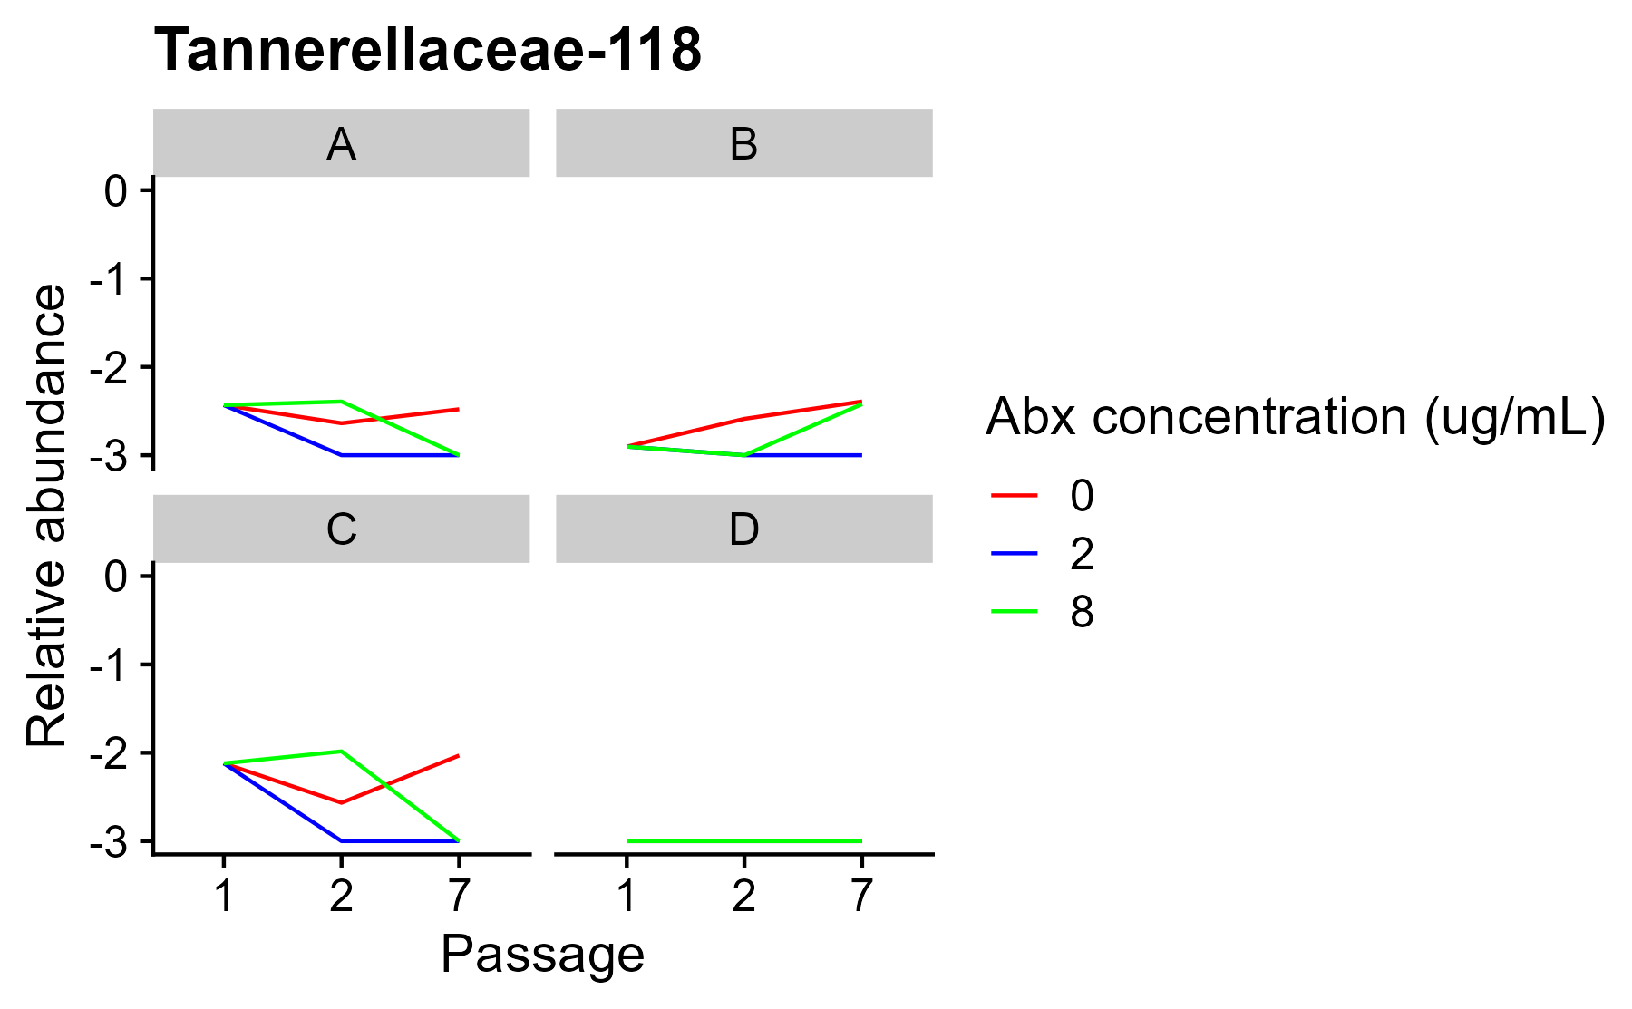
Relative abundance of example OTUs across communities.
Interpretive Q: why might OTUs exhibit different behaviors across communities? In particular, why might their relative abundances sometimes increase during antibiotics?

Slide 16
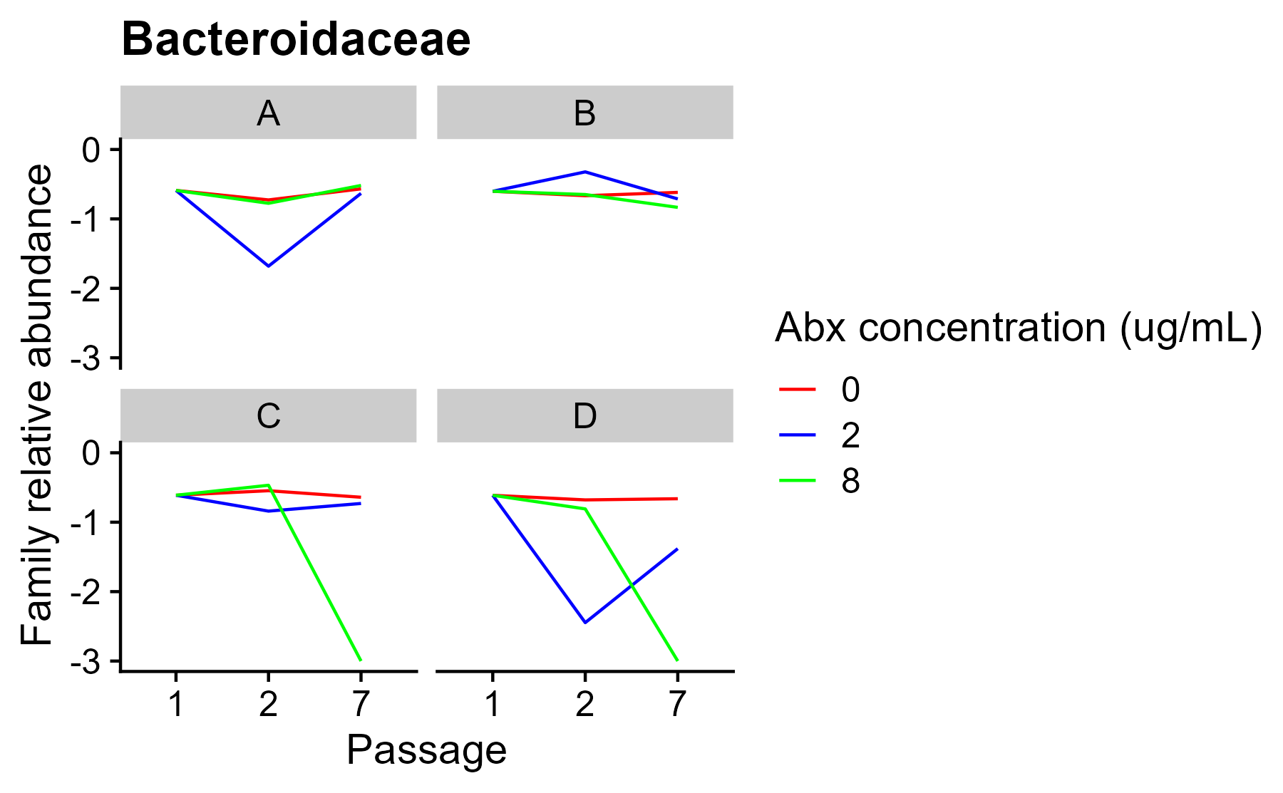
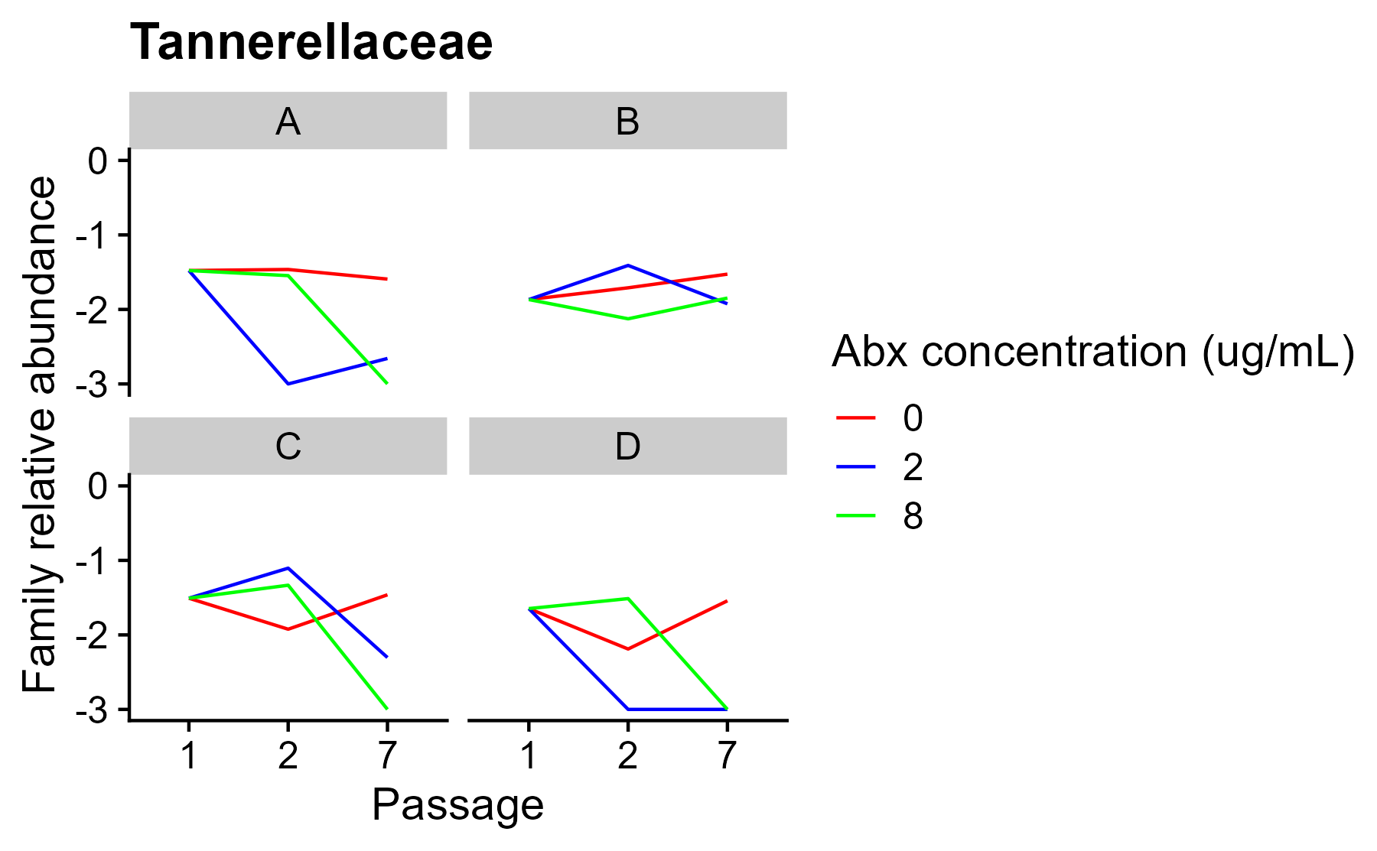
Relative abundance of example families across communities.
Interpretive Q: the relative abundance of Tannerellaceae remains high in the B community at passage 7, even at the highest antibiotic concentration. How many individual OTUs are present from this family at high abundance in this community?

Slide 17
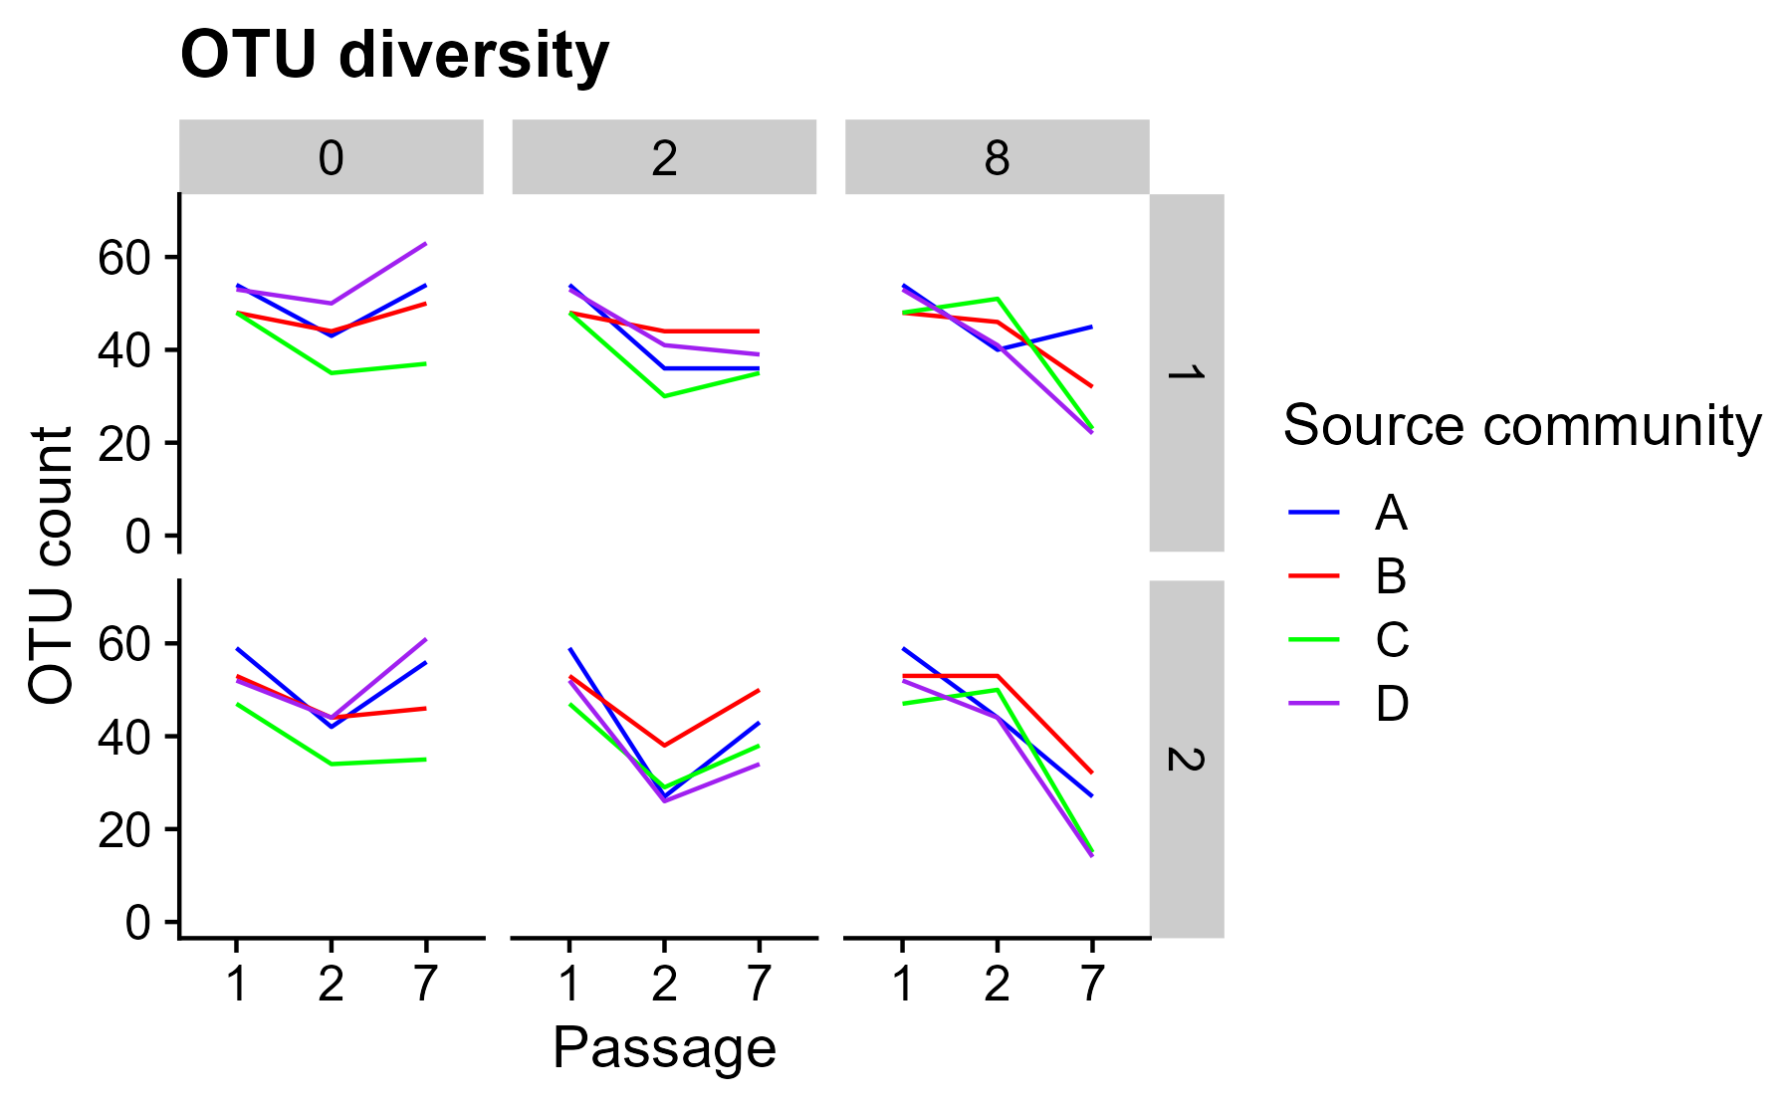
OTU diversity of each community, with two replicates.
Interpretive Q: which communities show the greatest divergence in replicate OTU diversity? What are some potential biological explanations for this divergence? What about technical explanations?

Slide 18
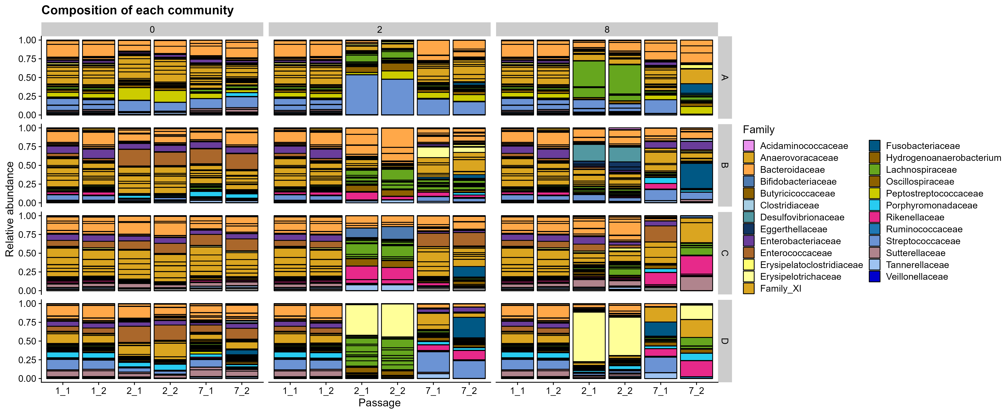
Community composition of all communities, two replicates.
Interpretive Q: which communities show the most divergence in replicate composition? Are there families that seem to be more frequently different between replicates?

Slide 19
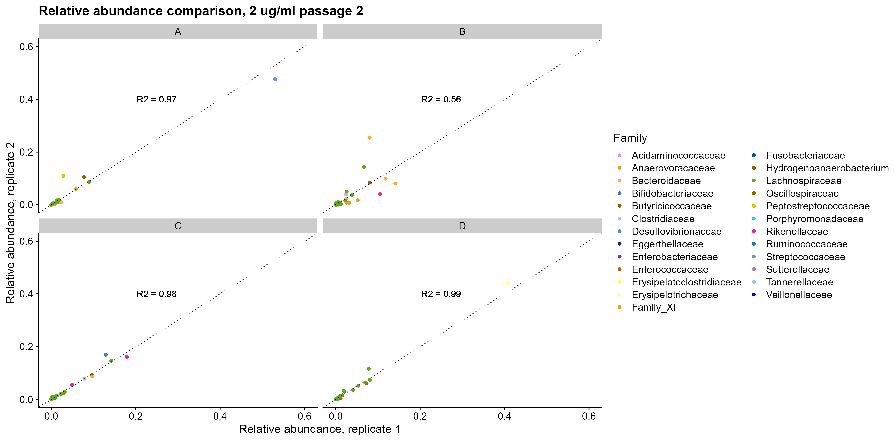
Correlation of OTU relative abundances across replicates.
Interpretive Q: which OTUs drive the greatest divergence between replicates?
Is the family-level relative abundance of the families to which these OTUs belong conserved?

Slide 20
Happy coding!!

