Slide 1
Bulambuli Q1 2025 Health Layering Report
Prepared by Spark M&E Team

Slide 2
REPORT OUTLINE
Background
Objectives of the Health Layering Project
Methodology
Study Population
Sample Size
Data Collection
Definition of Study Variables
Findings
Summary table of Indicator Performance
Functional Latrine Coverage
Hand Washing Facility Coverage
Dish Drying Rack
Conclusions and Recommendations

Slide 3
BACKGROUND
Bulambuli district in Eastern Uganda is home to 108 villages where Spark Microgrants is working to improve livelihoods. To support these efforts, we recently collected data from 53 of our implementation on key health indicators related to water, sanitation, and hygiene (WASH). This data is critical for understanding the current state of health and hygiene in the district, which directly impacts the well-being of the community.
The indicators we focused on include the percentage of households with functional latrines, hand washing facilities, access to safe drinking water, safe water storage, and dish drying racks. We also compared the latrine and hand washing coverage in each village to the district-wide averages. According to the district health office, Bulambuli currently has a 77% coverage of functional latrines, which falls short of the 100% needed to declare the district open defecation free (ODF). Additionally, only 45% of households have hand washing facilities.
These statistics highlight the need for focused interventions to improve WASH in Bulambuli. The data from our survey will help us identify specific areas for improvement in each village, guiding our efforts to ensure better health and hygiene for the communities we serve.

Slide 4
OBJECTIVES OF HEALTH LAYERING INTO THE FCAP
Overall Objective:
To improve overall health and hygiene practices among FCAP Communities.
Specific Objectives:
To raise the coverage of pit latrines from the current 78% by ensuring that every household has access to a well-maintained pit latrine.
To increase the availability of handwashing facilities from 45% by promoting the installation of proper handwashing stations in all households.
To enhance the adoption of drying racks by encouraging clean and sanitary kitchen practices
To introduce regular health sensitization sessions led by Bulambuli Health Assistants during FCAP meetings, focusing on hygiene, sanitation, and disease prevention.

Slide 5
METHODOLOGY
STUDY POPULATION
This study was conducted across the FCAP communities in Bulambuli District, involving all 53 communities from the 2023 FCAP cohort, where data was collected.
Sample size
The Community Based Facilitator was tasked to provide a list of all households in the communities involved in the FCAP project. This Households list was collected within a month and was verified by the respective Spark Trainers.
In total, 2,998 Households were involved in the exercise.

Slide 6
SAMPLED HOUSEHOLDS PER SUB-COUNTY
Subcounty | surveyed_households | total_households | percent_surveyed
bukhalu | 169 | 182 | 93
bulegeni | 139 | 196 | 71
buluganya | 169 | 184 | 92
bumufuni | 310 | 396 | 78
bumugibole | 176 | 169 | 100
bunambutye | 131 | 128 | 100
bwikhonge | 156 | 163 | 96
kamu | 158 | 185 | 85
lusha | 167 | 192 | 87
muyembe | 180 | 185 | 97
nabongo | 185 | 182 | 100
namisuni | 165 | 172 | 96
simu | 225 | 229 | 98
sisiyi | 303 | 349 | 87
sotti | 365 | 375 | 97
As can be seen in the table, majority of FCAP members participated in the data collection.
The number of households surveyed in Bumugibole, Bunambutye and Nabongo were above the total number of FCAP households recorded on Commcare

Slide 7
DATA COLLECTION
For data collection, Community Based Facilitators (CBFs) were availed with templates which consisted of all Household Head names and the health indicators of interest such as Functional Latrine, Hand Washing Facility and Drying racks coverage. The CBF indicated a ‘yes’ if the H/H had the item available and a ‘No’ if the item didn’t exist.
The Community Based Facilitators (CBFs) visited Households/homes, asked the Household Heads if they had the facilities of interest but also confirmed through observation. The completed template was returned to the Spark offices.
The Spark Trainers then made summaries from the templates and entered these summaries onto the Health Layering Form on Commcare from where the data was extracted for analysis.

Slide 8
VARIABLE DEFINATIONS
A functional Latrine: A functional latrine is a facility which is found providing service to households during data collection even if it needs maintenance (Woyessa et al., 2022).
Hand Washing Facility: A facility providing either a basin, container, or outlet with an adequate supply of potable water and soap. It is a designated setup or station where individuals can clean their hands with soap/ash and water to remove dirt, germs, and contaminants
Dish Drying Rack: Is any kitchen structure designed to hold dishes, utensils, and cookware after they have been washed, allowing them to air dry.

Slide 9
DEFINATION OF INDICATORS
Variable/indicator | Indicator Definition
Functional Latrine Coverage | The percentage of households within the FCAP communities with functional latrines.
Hand Washing Facility Coverage | The percentage of households within the FCAP communities with functional handwashing facilities (HHs that practice hand washing).
Dish Drying Rack | The percentage of households within the FCAP communities with dish drying racks.
::: ::

Slide 10
FINDINGS

Slide 11
SUMMARY OF INDICATORS’ PERFORMANCE IN Q1 2025
Q1_Latrine_Coverage | Q1_Hand_Washing_Fac | Q1_Drying_Rack
88 | 53 | 72
In Q1 2025, latrine coverage among FCAP Households was highest at 88% compared to the other indicators.
Only about half (53%) of Households have Hand washing facilities stationed for use near Latrines

Slide 12
INDICATOR PERFORMANCE COMPARISON
Variable/indicator | Q2-2024 | Q1-2025
Functional Latrine Coverage | 83% | 88%
Hand Washing Facility Coverage | 49% | 53%
Dish Drying Rack | 65% | 72%
Overall, there’s an improvement in performance on the 3 indicators when compared to Q2 2024
However more needs to be done to ensure households adopt hand washing practices after Latrine use to prevent diseases.

Slide 13
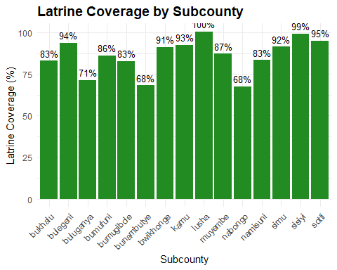
LATRINE COVERAGE BY SUBCOUNTY
All households in FCAP communities in Lusha subcounty have functional Latrines
More support/sensitization need to be given to communities in Bunambutye, Nabongo and Buluganya

Slide 14
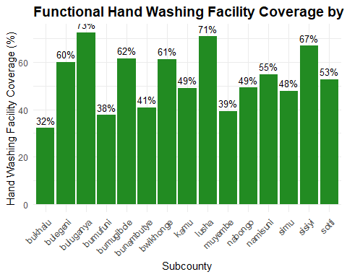
HAND WASHING FACILITY COVERAGE BY SUBCOUNTY
FCAP Communities in majority of the subcounties require intensive sensitization on importance of having hand washing facilities near Latrines. Spark can continue to leaverage the existing Local Government Health Assistants for this sensitization exercise

Slide 15
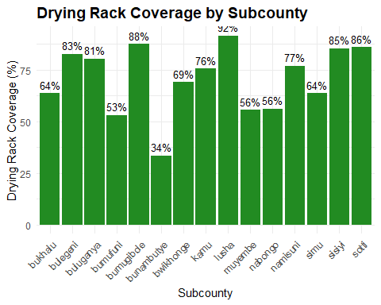
DRYING RACKS COVERAGE
Many communities haven’t adopted the use of dish drying racks as seen from the table.
Marjority of these communities performed below 80%, and communities in Bunambutye have the lowest performance of 34%

Slide 16
CONCLUSIONS AND RECOMMENDATIONS

Slide 17
CONCLUSION
In certain subcounties, the number of households surveyed exceeded the total number of households recorded in CommCare.
Given the period under review (Q2 2024 to Q1 2025), the level of improvement across the indicators appears lower than expected. Considering the program implementation timelines and efforts, performance should ideally have been higher than what is reflected in this report.
Functional Latrine Coverage - ↑ 5% Improvement
Hand Washing Facility Coverage - ↑ 4% Increase
Dish Drying Rack Coverage - ↑ 7% Increase

Slide 18
RECOMMENDATION
The Program team needs to review and reconcile household size records to ensure consistency and accuracy.
The Impact and Product team should devise ways of ensuring quality during data collection.
Spark should strengthen partnership with Health Department at the Bulambuli LG to enable consistent visits to communities by the Health Assistants
CBFs need to be trained on the Health Layering model which can then be incoperated during weekly community meetings
Every quarter, the Spark team, together with LG needs to conduct monitoring visits to sampled Households to ensure the 3 items are in place
Community Exchange Visits is a good way for communities to be motivated and learn from each other.

