Slide 1
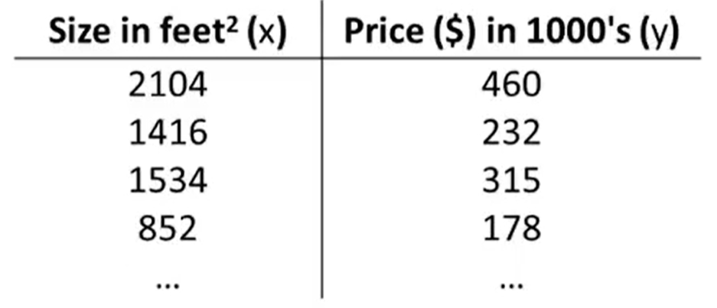
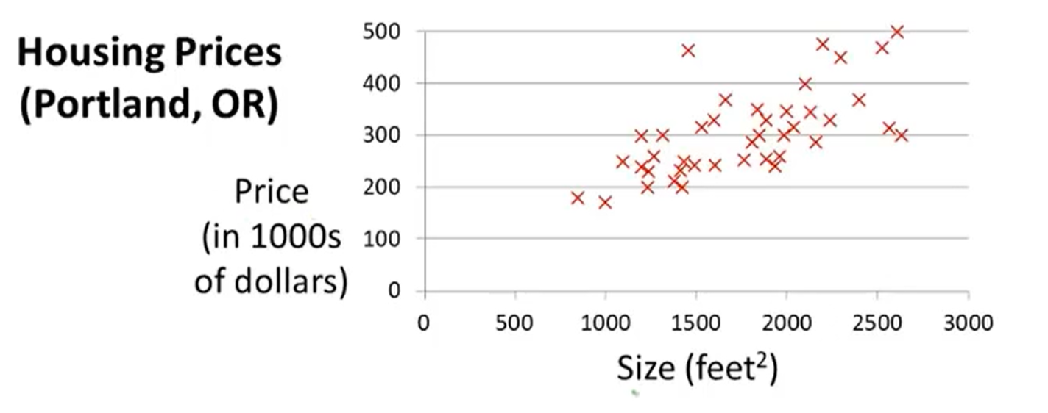

Slide 2
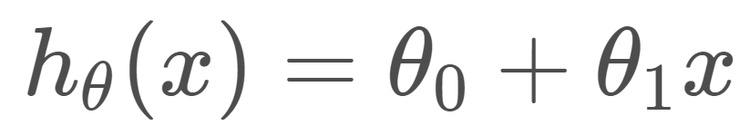
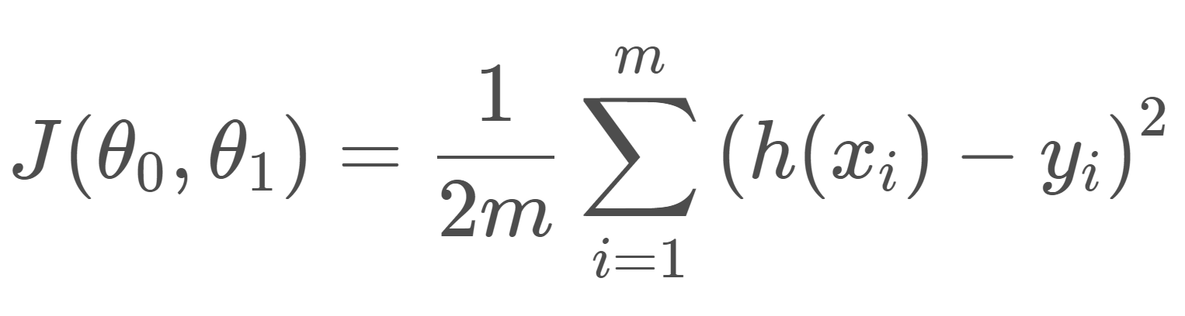
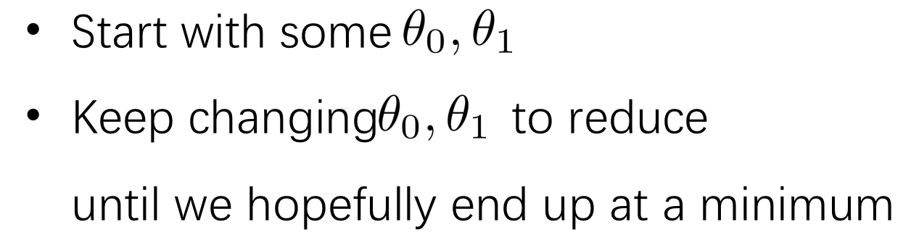
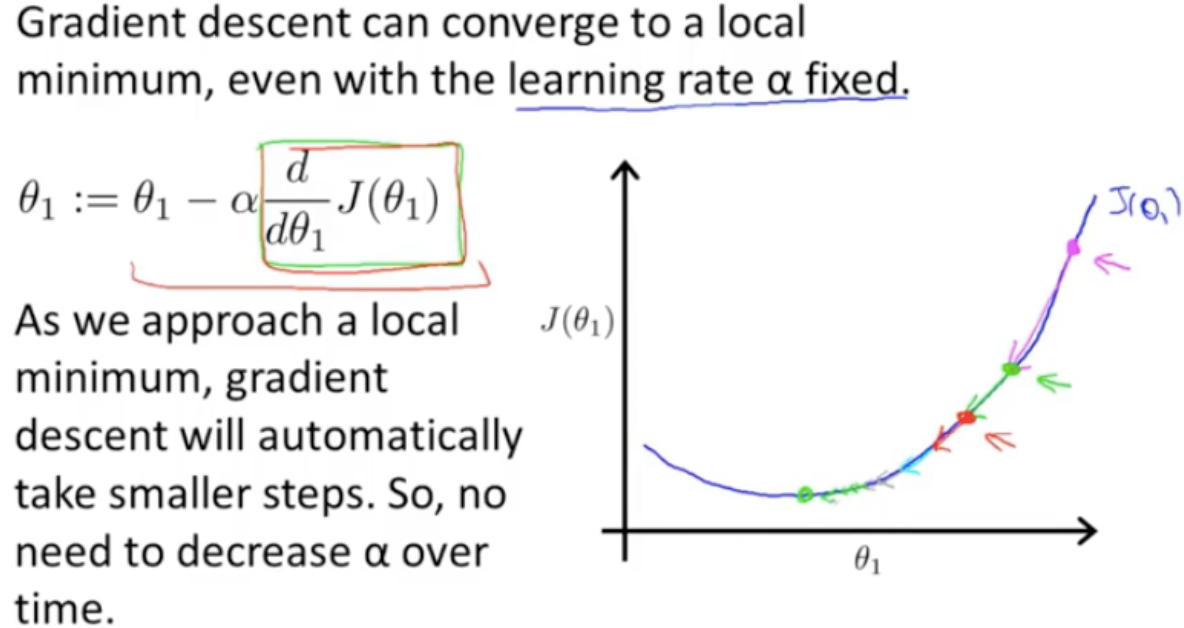
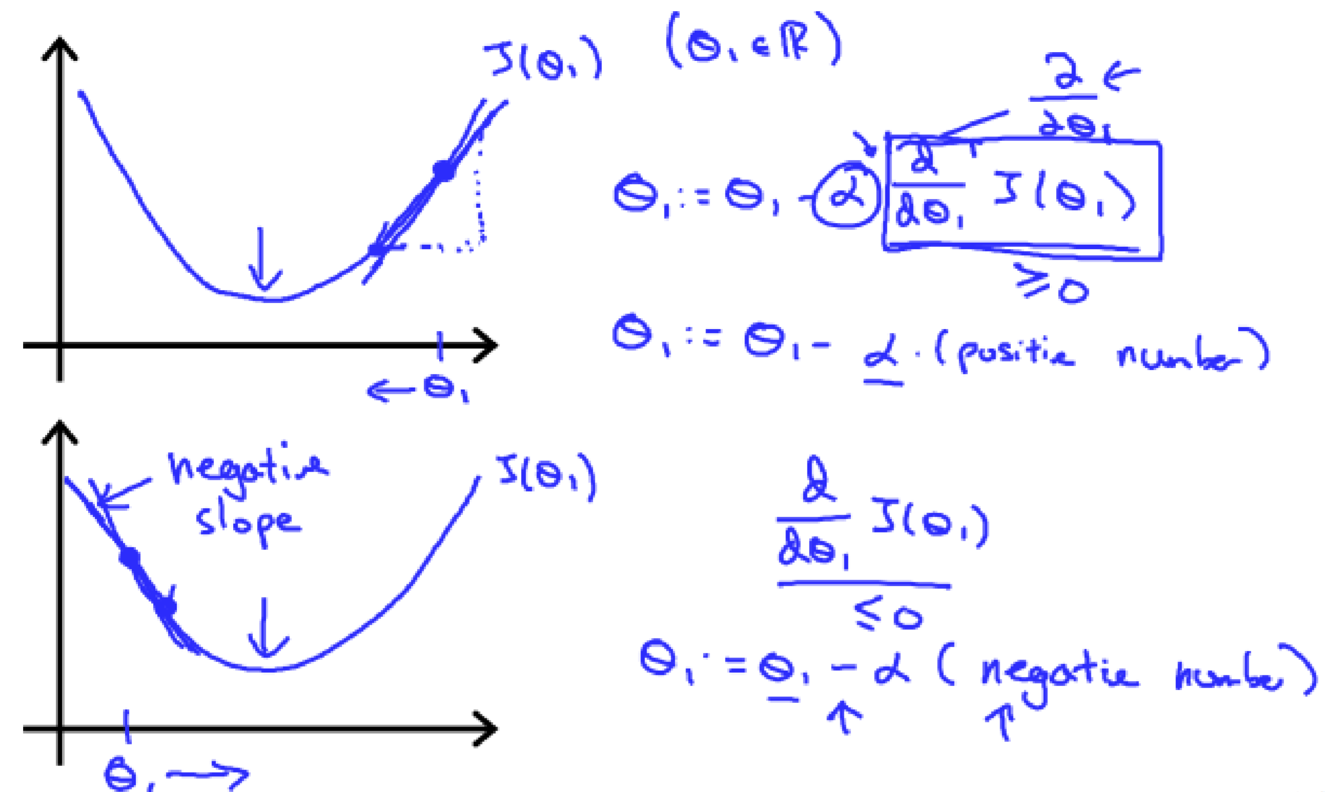
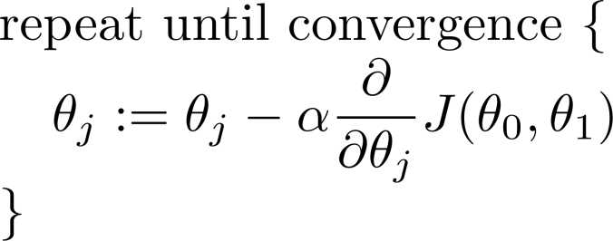
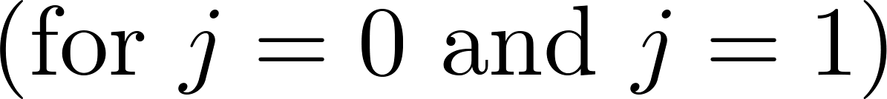


x | y
1 | 1
2 | 3
4 | 4
4
3
2
1
0
$J$($θ_{0} ,θ_{1}$) = $\frac{1}{6}$ (($θ_{0}{ + θ}_{1}χ1$– y₁)² + ($θ_{0}{ + θ}_{1}χ$₂– y₂)² + ($θ_{0}{ + θ}_{1}χ$₃– y₃)²)
1 2 3 4
$J$($θ_{1}$) = $\frac{1}{6}$ ((${ θ}_{1}χ1$– y₁)² + ($θ_{1}χ$₂– y₂)² + ($θ_{1}χ$₃– y₃)²)
Gradient descent algorithm
$$J_{\left(θ_{1}\right)}^{′}=\frac{1}{3}\left(θ_{1}\left(x_{1}^{2}+x_{2}^{2}+x_{3}^{2}\right)−\left(x_{1}y,+x_{2}y_{2}+x_{3}y_{3}\right)\right)$$

Slide 3
