Slide 1

Personal Finance Manager
TEAM 11
ZHANG Lifan, ZHANG Mingwei, XIAO Shan, YU Wenlin
Tutor: Henry Neo
Notes:
Hello everyone, we are team 11. We developed an application of personal finance manager. Our group members are...
Today we will go through this powerpoint to introduce this application.

Slide 2
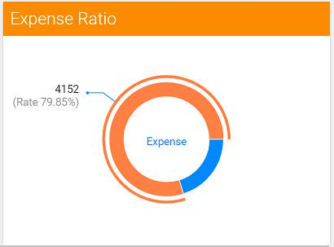

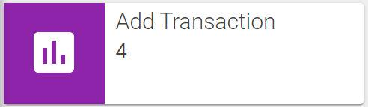
Requirements
NEEDS
add / remove or change categories
add transactions
visualize the budget and current expenditure
PRODUCT
Hackathon – TEAM 11 - Lifan ZHANG, Mingwei ZHANG, Shan XIAO, Wenlin YU
Notes:
Object User: Anyone who has a desire to manage their expenditures.
Main purpose: Users track their spending by allocating transactions into individual categories
This personal finance manager software is designed to help individual users track their spending by allocating transactions into individual categories and visualizing their budget.
Users can use the software to add/remove or change categories,such as travel、drinks、cell phone.They can add transactions from their accounts.Users are able to set monthly budgets for each category and visualize the budget and current expenditure.
提出问题用户需求
基本功能
根据功能我需要做什么：前端加后端
不要讲tech的东西，只要business就行了帮用户解决问题
➕图片，只截图重要的东西

Slide 3
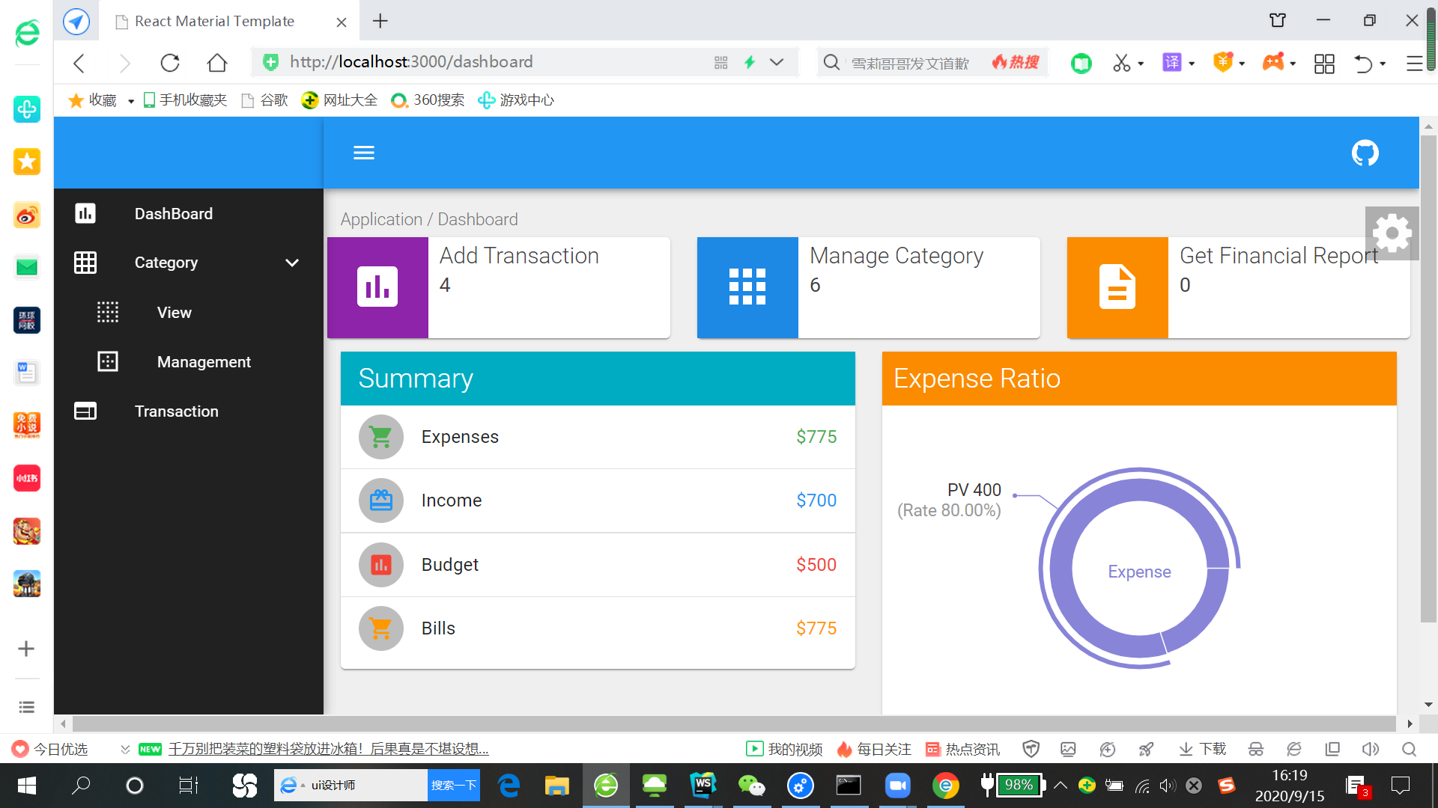
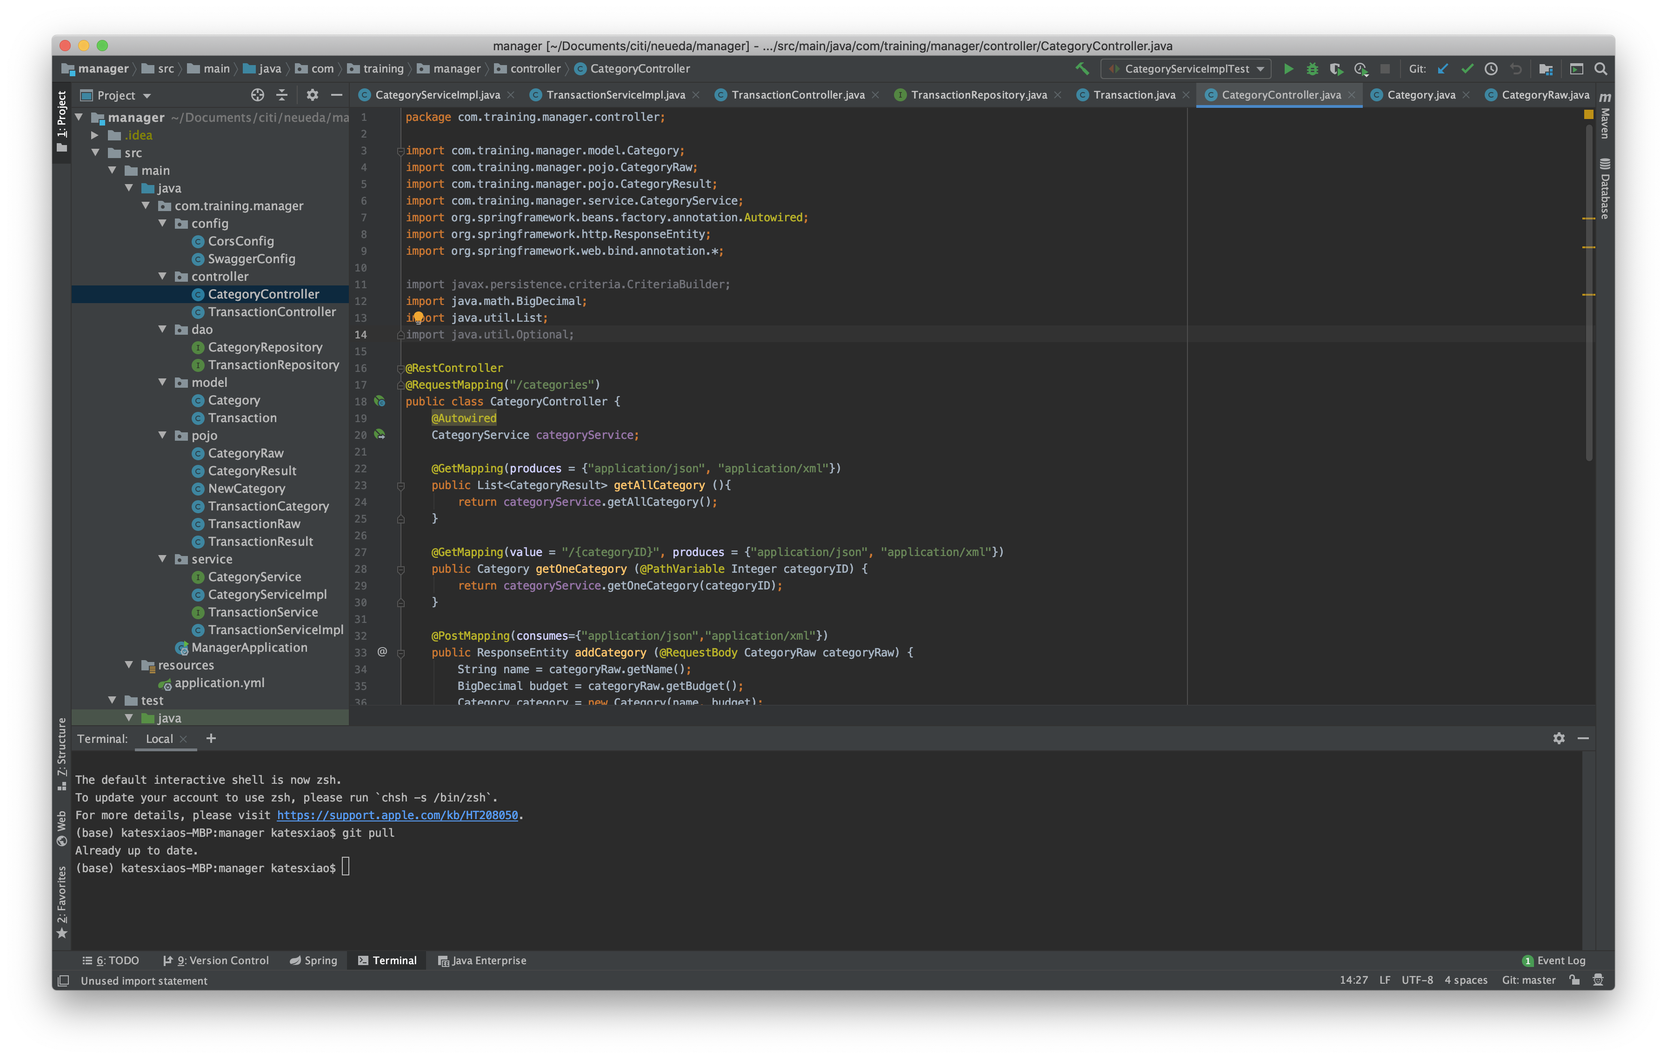
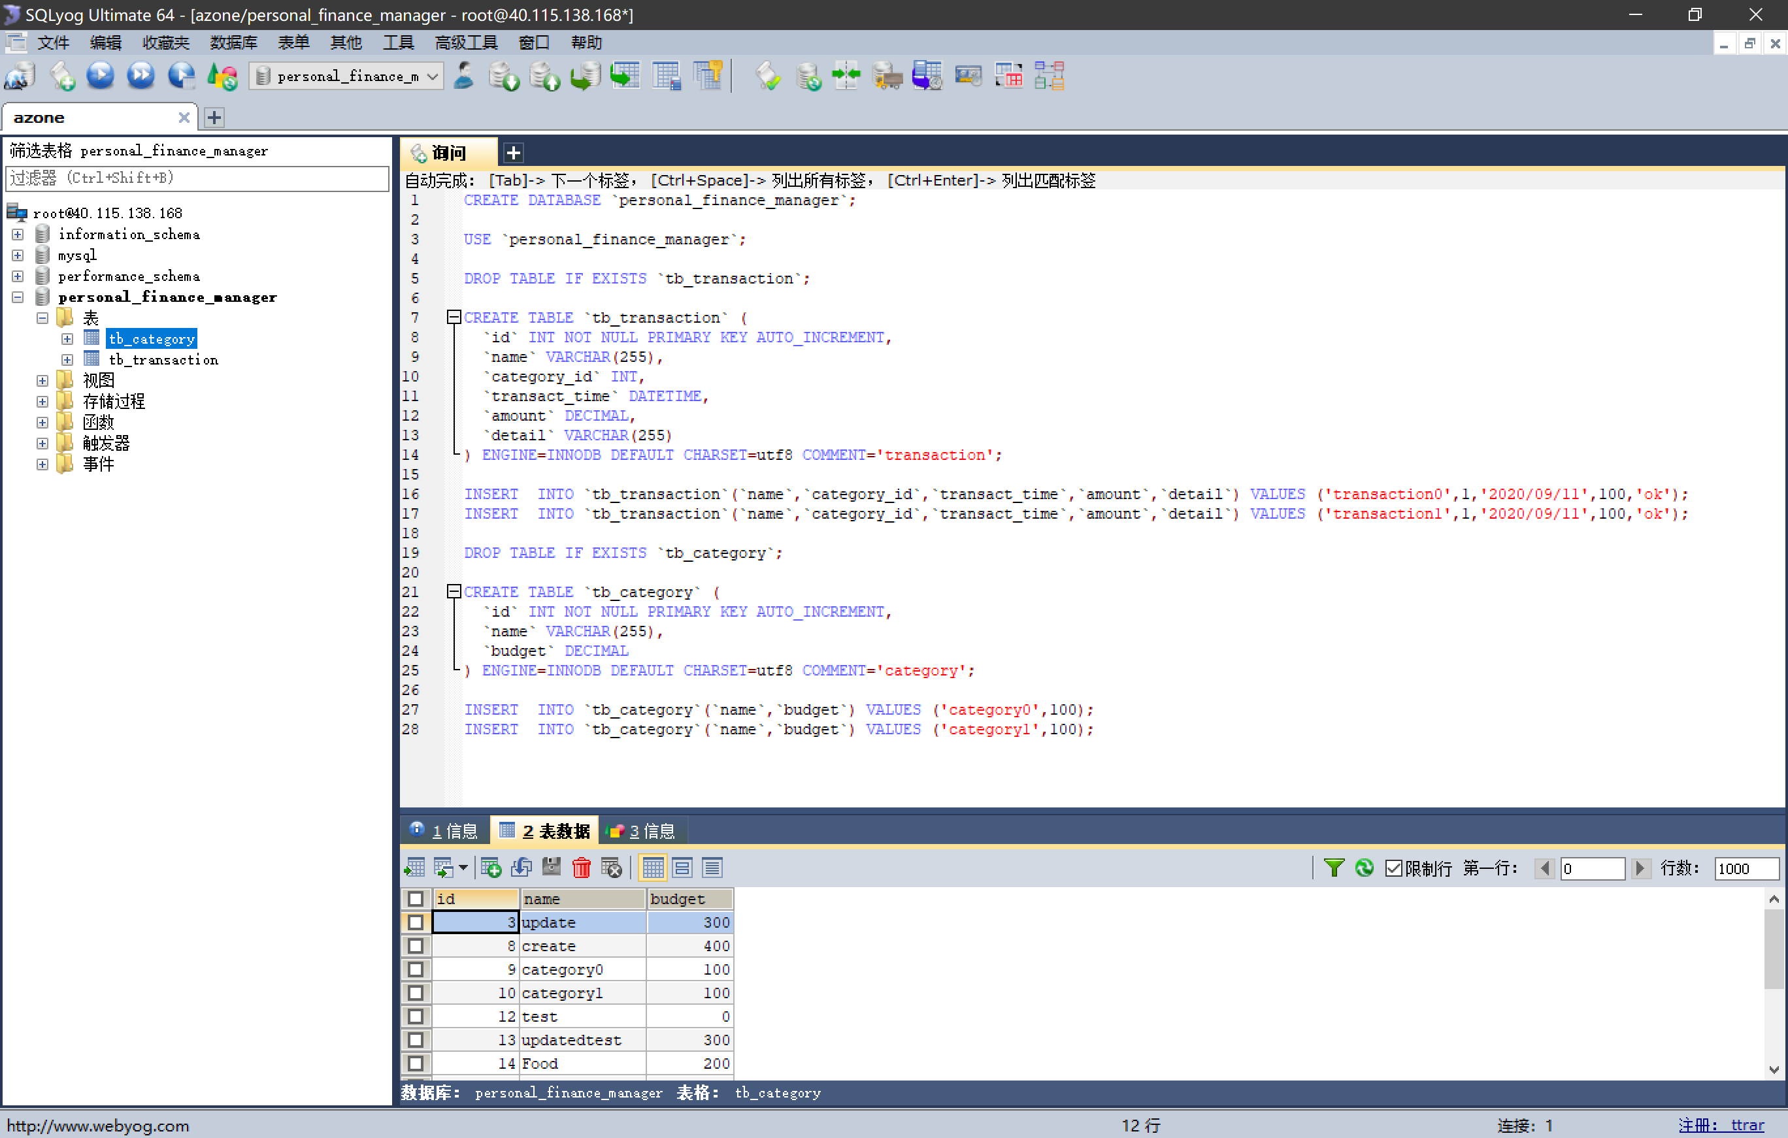



Architecture
UI - interact with users
Backend - handles logic of transaction and category
Database - stores data
PART
TECH
facilitates the overall process of writing component
boosts productivity and furture maintenance
embeded tomcat (no need to deploy wara files)
no required for XML config
perfect tool for microservices
relational DB fits in our system
easy, cheap, and secure
Hackathon – TEAM 11 - Lifan ZHANG, Mingwei ZHANG, Shan XIAO, Wenlin YU
Notes:
//xiao shan
React:
SpringBoot:
MySQL:

Slide 4



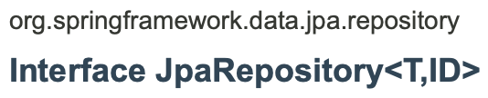


Technology Used
Spring Boot
Git
Swagger
MySQL
JPA
Maven
Mockito
Hackathon – TEAM 11 - Lifan ZHANG, Mingwei ZHANG, Shan XIAO, Wenlin YU
Notes:
可以最后讲docker这样讲的时候我们的海豚能飞出来

Slide 5
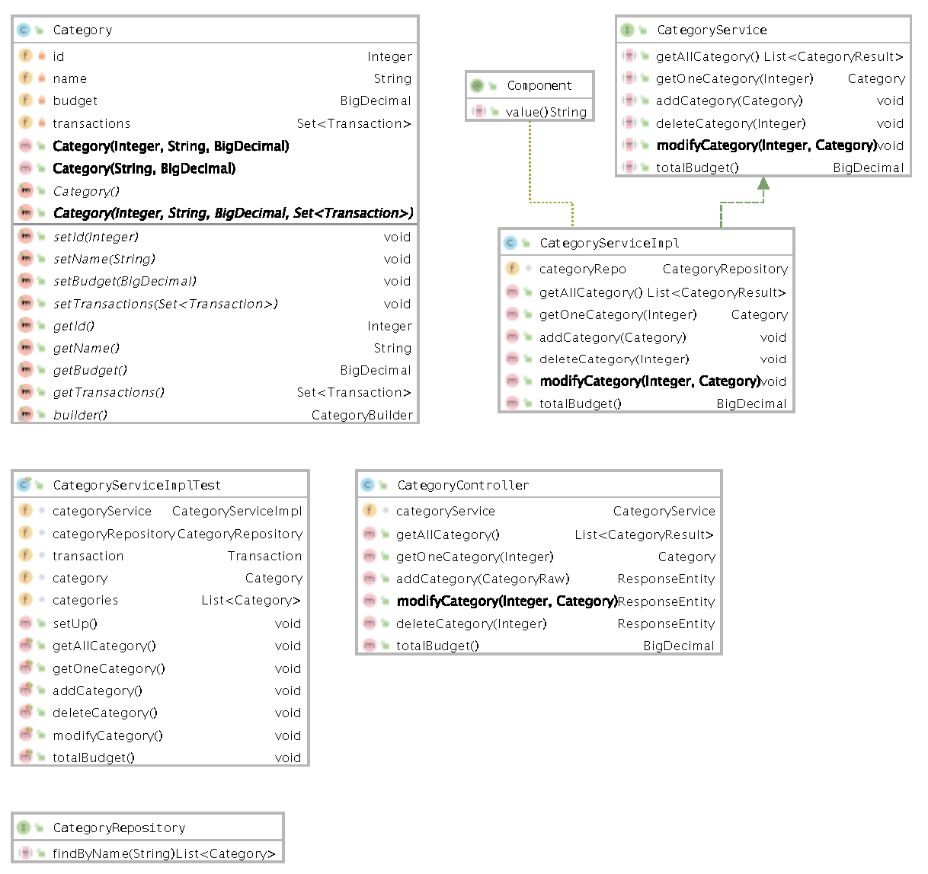
Backend Design
Demo & Code Review
Hackathon – TEAM 11 - Lifan ZHANG, Mingwei ZHANG, Shan XIAO, Wenlin YU
Notes:
we use category as an example to show you the backend design
transaction is usnig the same structure.
blue box --> model
red box --> service
yellow box --> controller --> talk to ui
green box --> repository --> talk to db

Slide 6

Front End
Demo
Hackathon – TEAM 11 - Lifan ZHANG, Mingwei ZHANG, Shan XIAO, Wenlin YU
Notes:
//zhang lifan

Slide 7

Challenges and Improvements
Challenges
Improvements
Communication
Logs, Exception handling
Hackathon – TEAM 11 - Lifan ZHANG, Mingwei ZHANG, Shan XIAO, Wenlin YU

Slide 8
Q&A

