Slide 1
Beautified Is Not Forged
A face detector that tells beautification from forgery, with checkable evidence
Capstone project results · 3 November 2026
林沁瑩 陳柏融 游宸山
Advisor: Prof. Shang-Hong Lai
1
Notes:
老師好，這是我們專題的成果報告。主題是：美顏過的照片不是偽造。我們依序講問題、成因、方法，然後是各種測試的成績：三類測試、各種修圖類型、沒見過的修圖服務、不同資料集，最後是可解釋性和手機上的系統。

Slide 2
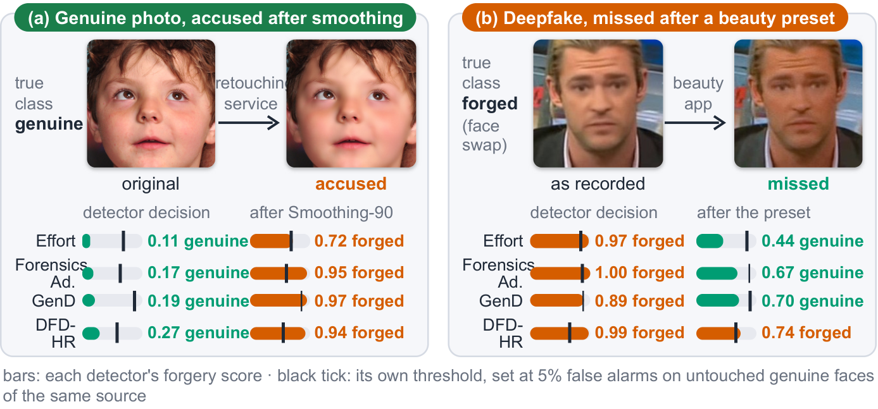
[Problem]
A beautified photo is neither real nor fake for a binary detector
False alarm
After commercial skin smoothing, four 2025 detectors all flip a genuine photo from real to forged
Miss
After an app beauty preset, three of the same four detectors let a face-swap video through
Detectors serve content moderation, remote identity checks and fact-checking; photos are often beautified before upload.
(a) FFHQ original vs Alibaba Smoothing-90; (b) Celeb-DF face swap vs app beauty preset (Celeb-DF-B). Black ticks: each detector's threshold at 5% false alarms.
One edit, two errors: a binary detector has no “beautified” answer, so it must force the photo into real or fake.
2
Notes:
問題是這樣：偽造偵測器被用在內容審核、遠端身分驗證和事實查核，但照片上傳前常常先經過美顏。左邊是一張真人照片，經過商用修圖的最強磨皮後，四個 2025 年的偵測器全部從真變偽造，這是冤枉。右邊是一支換臉影片，套上手機 app 的美顏後，同樣四個偵測器裡有三個讓它通過，這是漏抓。原因是二分類偵測器只有 real 和 fake，美顏過的真人兩者都不是。

Slide 3
[Related work]
What prior work found, what it left open, and what we do
Prior work | Finding | Left open
Libourel et al., IWBF 2024 (Celeb-DF-B) | App beautification lowers video AUC: CADDM 0.91→0.76, RECCE 0.81→0.66, FTCN 0.80→0.64 | “Strongly recommends” dedicated filter detection, but does not build or test it
Saeed et al., BMVC-W 2025 | Facial enhancement lets face swaps evade detection; adversarial training on one enhancement fails on another | Measures misses only, not false alarms
Concas et al., MetroXRAINE 2025 | One beauty filter raises EER on CelebDF (AlexNet 22.3→28.1%, VGG19 30.2→35.2%) | One filter, two CNNs
RetouchingFFHQ, ACM MM 2023 | Large-scale retouching data; detects retouching operations on genuine photos | No forgery class: cannot say whether a retouched face is also forged
ForgeryNet, CVPR 2021 | Multi-class forgery analysis benchmark | Identity-preserving edits still labelled fake
Grad-CAM; FakeVLM 2025 | Post-hoc heat maps; vision-language models write free-text explanations | Heat maps are not trained to mark the edit; the text is not tested
1 Measure both directions
17 detectors, pixel-aligned pairs
2 Find the cause
Controlled experiment: change only which class sees smoothing
3 Build the beautified class
Three-class model + evidence head + checked sentences
3
Notes:
別人怎麼處理這個問題？Libourel 等人 2024 年做了 Celeb-DF-B，發現 app 美顏讓偵測器的 AUC 掉 0.15 左右，結論是強烈建議要有專門的濾鏡偵測，但他們沒有做。Saeed 等人只量了換臉逃過偵測這一邊，而且發現對一種美顏做對抗訓練，換一種就沒用。Concas 等人只用一個濾鏡、兩個 CNN。RetouchingFFHQ 這類修圖偵測沒有偽造類；ForgeryNet 有多類別，但保留身分的編輯還是算 fake。解釋方面，熱圖是事後算的，VLM 的文字沒有被檢驗。所以我們做三件事：第一，在像素對齊的配對上同時量兩個方向；第二，用控制實驗找成因；第三，把 Libourel 建議的美顏類別真的做出來，而且證據和句子都經過檢驗。

Slide 4
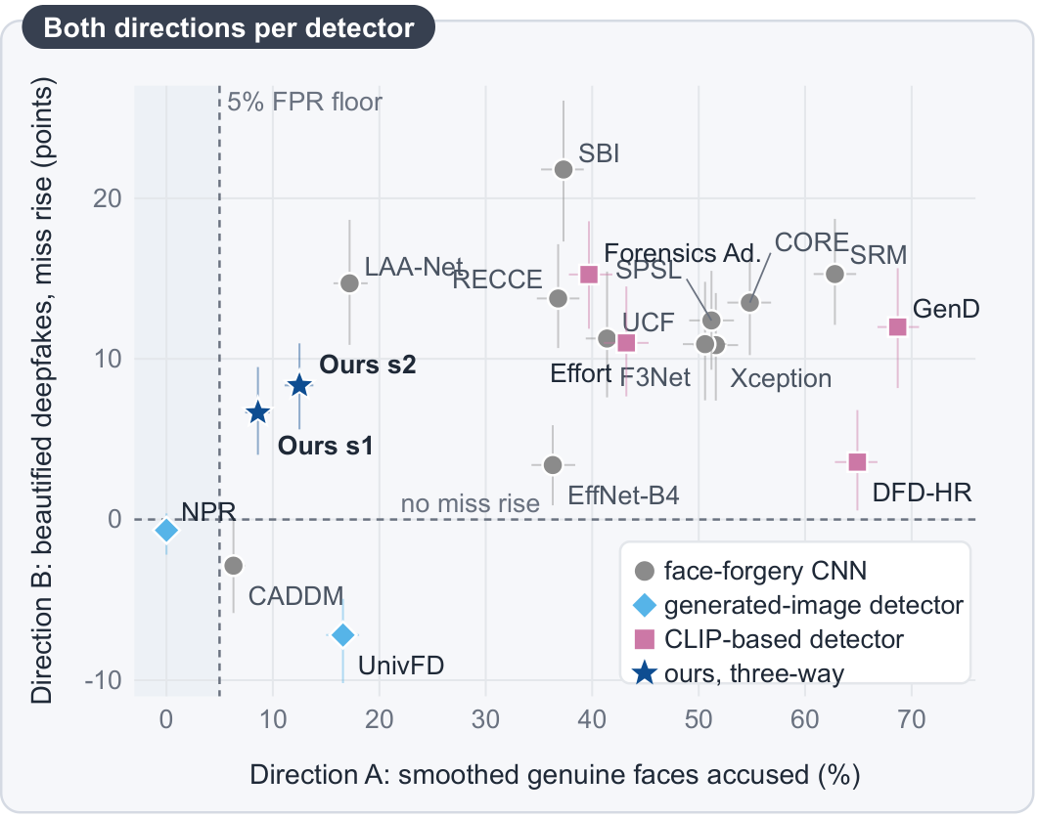
[Audit]
16 of 17 published detectors accuse a smoothed genuine face
15 / 17
score the smoothed genuine face as more fake than its original in 89–99% of pairs
13 / 17
call 36–69% of smoothed genuine faces fake at their own threshold
14 / 17
miss 3–22 points more face-swap videos after app beautification (re-encoding removed)
Our model (star) sits in the lower left: no published detector is lower on both axes.
4
Notes:
我們把 17 個已發表的偵測器用各自的官方權重和前處理重跑。左圖橫軸是冤枉、縱軸是漏抓，越靠左下越好。15 個在 89 到 99% 的配對裡把磨皮的真人判得比原圖更假，13 個在自己的門檻下把三到七成的磨皮真人判成 fake，影片上 14 個的漏抓增加 3 到 22 點。我們的模型是星號，兩個方向都在左下角。

Slide 5
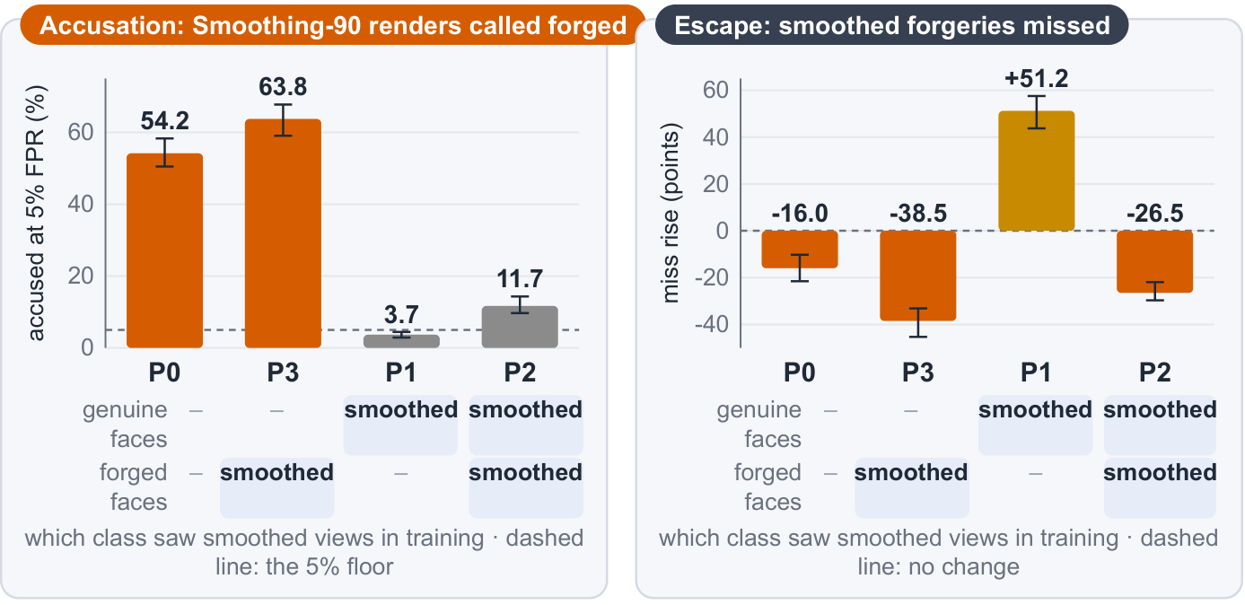
[Cause]
Which class saw smoothing in training decides the error
P0
No beautification
accused 43.5–56.1%
P3
Forged class only
accused 63.8%
P1
Real class only
accused ≈ 1%, misses +51–63
P2
Both classes
accused 6.9–11.7%
Finding
With architecture, data and recipe fixed, which class saw smoothing decides the false alarms: the fix is the training recipe.
5
Notes:
這是找原因的控制實驗。同一個 CLIP 模型、同一份 FF++ 資料、同一個配方，只改訓練時哪一類看過磨皮。只給偽造類看，冤枉衝到 64%；只給真人類看，冤枉降到 1%，可是磨皮過的換臉就漏抓多五六十點；兩類都看，冤枉降到 7 到 12%。所以問題出在訓練曝露，解法就是訓練配方。

Slide 6
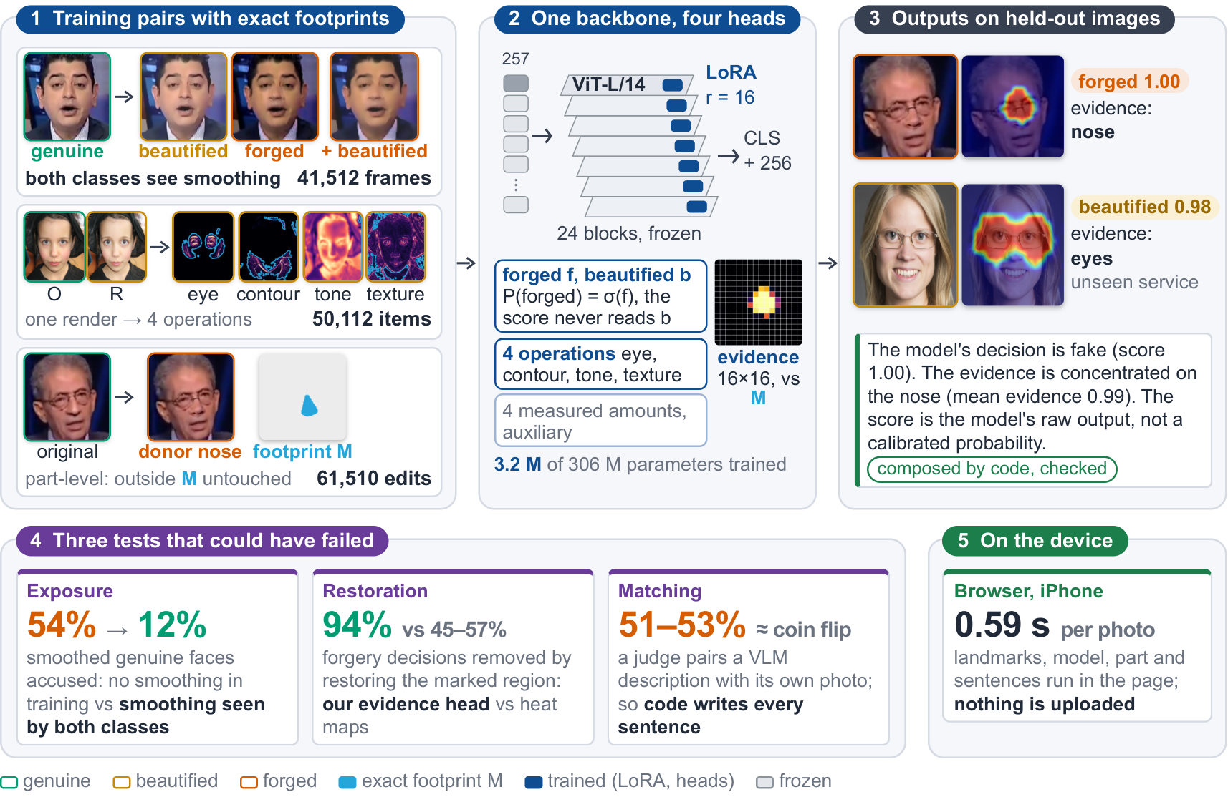
[Method]
Paired edits with exact footprints, one backbone, four heads
Exact footprints
Every edited image has a pixel-aligned original, so the edit region M is known
Both classes see beauty
Half of the forged samples are also beautified, so smoothing is not a forgery cue
Evidence head is tested
The classifier does not read the map; a restoration test checks it is the reason
6
Notes:
這頁是整個方法的總覽，後面兩頁再分別放大資料和模型。第一區是訓練資料，共三種，共同點是每一張編輯過的圖都有像素對齊的原圖，所以改了哪些像素是確定的，我們叫它 footprint M。第一列是 FF++ 的真人和換臉影格，兩類都會被套上美顏，共 41,512 張，這就是上一頁實驗裡兩類都看過磨皮的做法。第二列是商用修圖：一張騰訊或曠視的修圖被拆成大眼、輪廓、色調、紋理四個單一操作，共 50,112 筆，下一頁會講怎麼拆。第三列是部位偽造：只把鼻子這類部位換成別人的，其餘像素完全不動，所以藍色的 footprint就是被改的地方，共 61,510 張。第二區是模型：一個凍結的 CLIP ViT-L/14，只在 24 層加 LoRA，總共 3 億多參數裡只訓練 320 萬。上面接四個 head：classification head 給 forged 和 beautified 兩個分數，forged 的判定只看 forged 分數，美顏分數再高也搶不走，所以美顏過的換臉還是會被判偽造；operation head 給四個操作分數；quantity head 輸出四個修圖量做輔助；evidence head 輸出 16×16 的 evidence map，用 footprint M 直接監督。第三區是在沒看過的圖上的實際輸出：上面是鼻子被換掉的偽造，判 forged 1.00，證據落在鼻子；下面是訓練沒用過的修圖服務做的大眼，判 beautified 0.98，證據落在眼睛。最下面那段文字是程式根據模型輸出組出來、檢查過才顯示的解釋。第四區是三個可能推翻我們的測試，及格標準都是事先寫好的：訓練曝露讓冤枉從 54% 降到 12%；把證據標出的區域還原，94% 的偽造判定消失，熱圖只有 45 到 57%；視覺語言模型的自由描述盲配對只有 51 到 53%，跟擲硬幣一樣，所以每一句都改由程式寫。第五區是部署：在 iPhone 瀏覽器上一張 0.59 秒，照片不上傳。右邊三個重點：footprint 是精確的、兩類都看美顏、evidence head 有被檢驗。

Slide 7
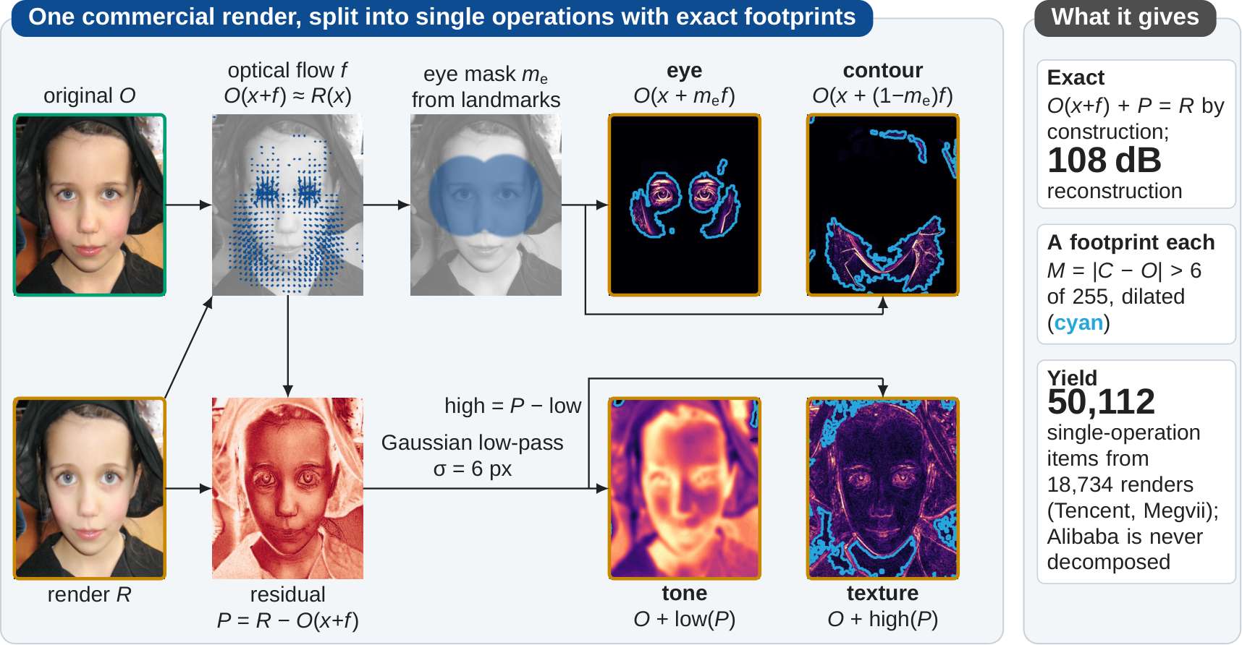
[Method · data]
A commercial render, split into single operations with exact footprints
Tencent render (FFHQ 60002; whitening, smoothing, slimming and eye enlarging in one pass): optical flow f splits the geometry, the residual P splits tone and texture. 18,734 renders → 50,112 single operations.
7
Notes:
這是資料引擎，是我們最原創的部分。商用 app 一次套好幾種美顏，也不告訴你改了哪裡。我們用光流把形狀的變化拆成眼睛和輪廓，光流解釋不了的殘差再用低通拆成色調和紋理。四個分量合起來重建誤差 108 dB，每個分量都有自己的 footprint。騰訊和曠視 18,734 張修圖變成 50,112 筆單一操作的訓練資料；阿里完全不拆，只拿來測試。

Slide 8
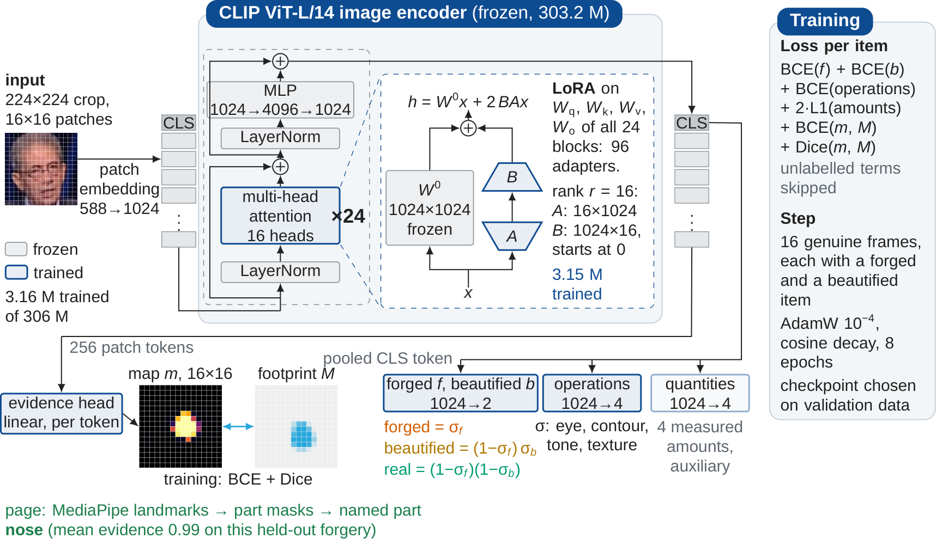
[Method · model]
CLIP ViT-L/14 with LoRA; the evidence head learns the exact footprint
303.2 M frozen, 3.16 M trained (96 LoRA adapters + four heads); P(forged) = σ(f): the forgery score does not read the beauty score b.
8
Notes:
這頁放大模型。Backbone 是 CLIP ViT-L/14，24 個 Transformer block 全部凍結，只在每層 attention 加 rank 16 的 LoRA，總共只訓練 316 萬個參數，大約是全部的 1%。輸出分兩路。CLS token 接三個 head：classification head 給 forged 和 beautified 兩個分數，forged 的判定只看 forged 分數，美顏分數再高也搶不走；operation head 給四個操作分數；quantity head 只用來輔助訓練。256 個 patch token 接 evidence head，輸出 16×16 的 evidence map，直接用 footprint M 監督。網頁再把 evidence map 對到臉部部位，點名最強的那一個，這個例子是 nose。

Slide 9
[Results · three-class]
Three-class test on FF++: 82.7 / 90.9 / 86.7% recall
predicted
Share called forged per face-swap method (%)
real
forged
beautified
real
82.7%
(1,088)
5.9%
(78)
11.4%
(150)
forged
6.6%
(352)
90.9%
(4,819)
2.5%
(133)
Where the errors go
real → beautified 11.4%, real → forged 5.9%
beautified → real 9.0%, beautified → forged 4.3%
Most errors fall between real and beautified; beautified is rarely called forged
beautified
9.0%
(118)
4.3%
(57)
86.7%
(1,141)
FF++ c23 test: 7,936 frames, 140 videos, unused in training and selection; main model, seed 1.
9
Notes:
三類測試的成績：FF++ 測試集 7,936 張，訓練和挑模型都沒用過。真實 82.7%、偽造 90.9%、美顏 86.7%。右邊是四種換臉方法：Deepfakes 98.6%、FaceSwap 96.2%、Face2Face 93.5%，NeuralTextures 只改嘴部紋理，比較難，75%。錯誤的方向多半是真人和美顏互相混淆，美顏被判成偽造只有 4.3%。

Slide 10
[Results · filter types]
Each beauty operation and filter type is called “beautified”, not “forged”
Share called beautified (%)
■ 4 beauty operations (smoothing, slimming, whitening, eyes)
■ 14 Instagram-style filters
≤ 10.7%
called forged, for any type (highest: whitening)
86–100%
of each Instagram filter called beautified
Applied to FF++ test videos (unseen in training); eye enlarging is hardest (49.3%, most of the rest called real). Unseen filters: slides 12–13.
10
Notes:
各種修圖類型的成績：在 FF++ 測試影片上套用四種美顏操作和 14 種 Instagram 風格濾鏡。磨皮 94%、瘦臉 86%、美白 82% 判成美顏；大眼最難，一半判美顏、其餘多判真實。14 種濾鏡 86 到 100% 判美顏。任何一種被判成偽造的比例都不超過 11%。

Slide 11
[Results · unseen service]
Alibaba, a retouching service never used in training
Operation | beautified, 30 | 60 | 90 | forged (max) | above own original
Skin smoothing | 90.5 | 99.0 | 98.8 | 0.8 | 97.6–99.4
Whitening | 51.5 | 63.6 | 72.3 | 0.8 | 85.4–92.2
Eye enlarging | 46.5 | 59.8 | 69.7 | 0.5 | 92.4–97.6
Face slimming | 46.1 | 53.7 | 61.3 | 0.4 | 84.1–93.7
Untouched original | 20.8 |  |  | 0.8 | real 78.4
98.8%
commercial smoothing called beautified
≤ 0.8%
called forged, any operation and strength
84–99%
2,210 pairs of FFHQ originals and Alibaba renders at strength 30 / 60 / 90 (%). Above own original: share of pairs in which the render's beautified score exceeds that of its own original.
of pairs: each operation scores above its own original
11
Notes:
這是訓練完全沒見過的修圖服務阿里，四種操作、三種強度各 2,210 對。磨皮強度 60 以上 99% 判美顏；美白、大眼、瘦臉強度越高越容易判美顏。關鍵是任何操作、任何強度被判成偽造都不超過 0.8%。而且和自己的原圖比，修過的那張美顏分數比較高的比例是 84 到 99%，也就是模型看得出改變，只是弱的修圖在絕對門檻上會判成真實。

Slide 12
[Results · cross-dataset]
Across datasets and filters, with the same training data as the baselines
Test set | Filter source | Ours, FF++ only | Ours, full data | Best published
Celeb-DF-B | 4 app beauty presets | 0.872 / 0.870 | 0.866 / 0.883 | 0.838 DFD-HR
Celeb-DF-v2 | 11 held-out filters | 0.851 | 0.873 / 0.875 | 0.856 GenD
DFD | 16 fresh filters | 0.932 | 0.931 / 0.931 | 0.928 DFD-HR
Celeb-DF-v2 | GPUPixel engine, accused % | -- | 13.7 / 13.1 | 14 of 15 > 15
FFHQ pairs | Alibaba S-90, accused % | -- | 8.6 / 12.5 | 6.3 CADDM
Celeb-DF-B decisions (%)
Top three rows: AUC after beautification or filtering (higher is better); bottom two: accusation rate (lower is better). Bold = best in the row. FF++ only: the FF++ c23 training videos of Effort, Forensics Adapter, GenD and DFD-HR, no commercial renders or part edits (--: no such training data, not reported).
Fair comparison (same training data)
Trained on FF++ only: Celeb-DF-B AUC 0.872 after beautification, above every published detector; paired 95% intervals against Effort, Forensics Adapter and SBI all above 0. With the full data, the paired intervals against the six strongest detectors are also all above 0.
12
Notes:
這頁是公平比較。第三欄是只用 FF++ 訓練的版本，訓練影片跟 Effort、Forensics Adapter、GenD、DFD-HR 完全一樣，沒有用商用修圖和部位偽造。它在 Celeb-DF-B 美顏後 AUC 0.872，高於所有已發表偵測器，而且跟 Effort、Forensics Adapter、SBI 的配對信賴區間都大於 0；DFD 加 16 種新濾鏡也是最高。所以優勢來自配方，不是資料量。第四欄是完整資料的系統版本，當成系統能做到多好的參考。右邊是 Celeb-DF-B 上的三類判定。

Slide 13
[Results · per filter]
Each held-out filter: AUC after filtering
Celeb-DF-v2 + 11 held-out filters
DFD + 16 fresh filters
Filter | Ours s1 | Ours s2 | Effort | FA | GenD | DFD-HR
brooklyn | 0.939 | 0.946 | 0.850 | 0.874 | 0.937 | 0.877
clarendon | 0.870 | 0.884 | 0.804 | 0.902 | 0.874 | 0.894
earlybird | 0.874 | 0.893 | 0.802 | 0.811 | 0.802 | 0.811
inkwell | 0.783 | 0.771 | 0.767 | 0.826 | 0.816 | 0.725
kelvin | 0.802 | 0.791 | 0.732 | 0.846 | 0.833 | 0.818
lofi | 0.895 | 0.914 | 0.833 | 0.831 | 0.920 | 0.836
mayfair | 0.917 | 0.932 | 0.908 | 0.874 | 0.921 | 0.896
moon | 0.789 | 0.780 | 0.747 | 0.822 | 0.823 | 0.805
perpetua | 0.908 | 0.897 | 0.935 | 0.906 | 0.941 | 0.906
reyes | 0.910 | 0.911 | 0.799 | 0.838 | 0.927 | 0.918
slumber | 0.928 | 0.893 | 0.793 | 0.866 | 0.831 | 0.824
pooled | 0.873 | 0.875 | 0.813 | 0.814 | 0.856 | 0.824
Filter | Ours s1 | Ours s2 | Effort | FA | GenD | DFD-HR
amaro | 0.955 | 0.974 | 0.964 | 0.975 | 0.968 | 0.968
ashby | 0.874 | 0.884 | 0.883 | 0.909 | 0.935 | 0.918
charmes | 0.878 | 0.898 | 0.778 | 0.847 | 0.829 | 0.822
crema | 0.990 | 0.990 | 0.915 | 0.974 | 0.959 | 0.982
dogpatch | 0.974 | 0.977 | 0.966 | 0.966 | 0.961 | 0.978
ginza | 0.967 | 0.971 | 0.971 | 0.962 | 0.983 | 0.982
grayscale | 0.896 | 0.888 | 0.909 | 0.899 | 0.946 | 0.921
hefe | 0.844 | 0.837 | 0.808 | 0.888 | 0.880 | 0.809
helena | 0.903 | 0.914 | 0.897 | 0.932 | 0.891 | 0.883
juno | 0.918 | 0.944 | 0.889 | 0.909 | 0.888 | 0.893
ludwig | 0.894 | 0.942 | 0.847 | 0.924 | 0.884 | 0.899
poprocket | 0.929 | 0.929 | 0.869 | 0.912 | 0.872 | 0.948
sepia | 0.956 | 0.939 | 0.920 | 0.828 | 0.934 | 0.913
sierra | 0.936 | 0.939 | 0.930 | 0.977 | 0.948 | 0.948
skyline | 0.994 | 0.992 | 0.981 | 0.976 | 0.981 | 0.992
sutro | 0.991 | 0.985 | 0.961 | 0.957 | 0.972 | 0.980
pooled | 0.931 | 0.931 | 0.905 | 0.924 | 0.925 | 0.928
Bold = highest in the row. Pooled, ours is highest; filter by filter we win 4/11 (Celeb-DF-v2) and 7/16 (DFD). Red = monochrome filters (inkwell, moon, grayscale), our weakest group. Frame AUC per filter, from existing scores.
13
Notes:
這頁把上一頁合併的濾鏡成績拆開來看，每一列是一種訓練沒見過的濾鏡，數字是套上濾鏡後的 AUC，粗體是該列最高。合併起來我們最高，但逐一看並不是每一種都贏：Celeb-DF-v2 的 11 種贏 4 種，DFD 的 16 種贏 7 種。最明顯的弱點是黑白濾鏡，inkwell、moon、grayscale 三種我們都輸，這是目前看到最一致的弱點，原因還沒有做實驗分析。

Slide 14
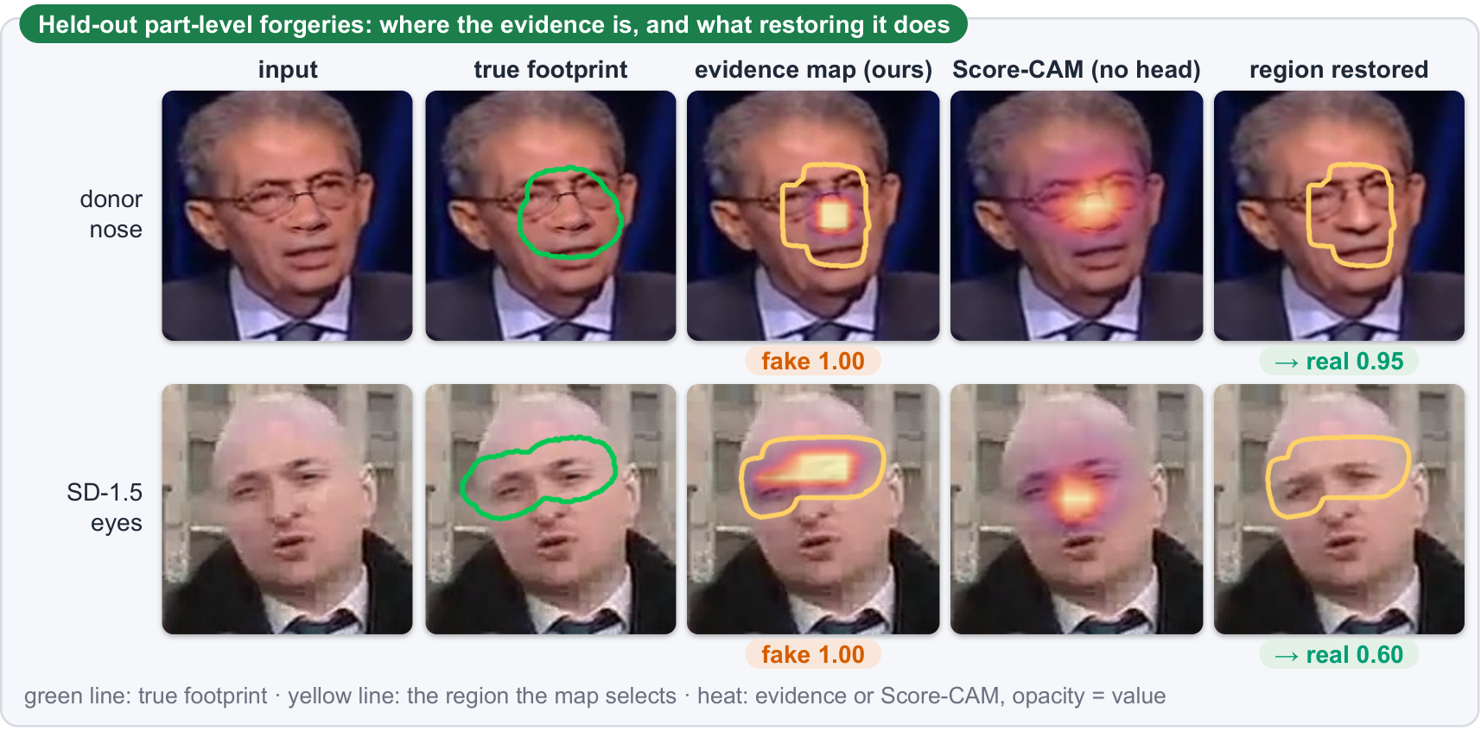
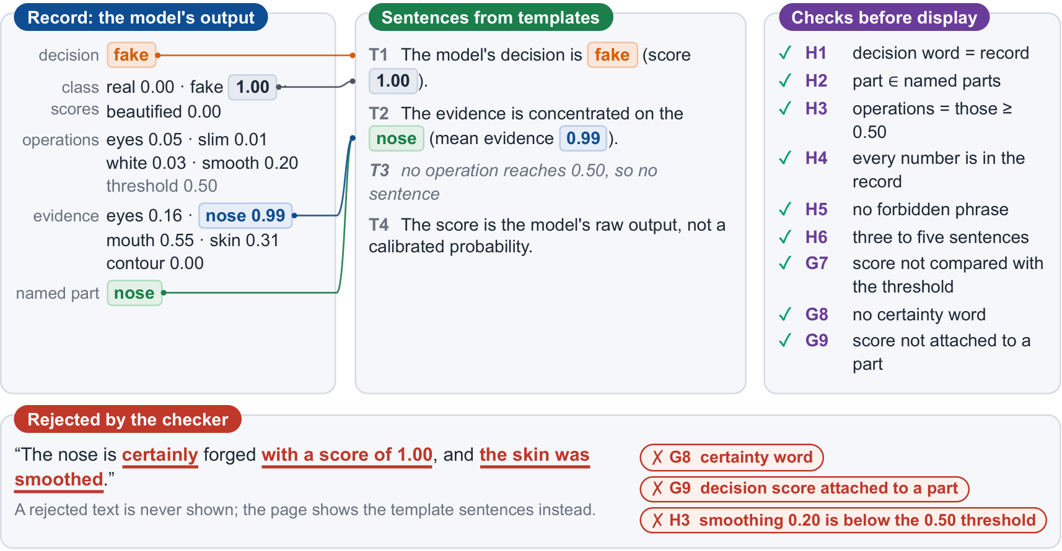
[Explainability]
The marked region is the reason, and code writes every sentence
94%
51%
51–53%
361 / 361
of forged decisions removed by restoring the marked part (ceiling 94.1%)
with Grad-CAM (Score-CAM 57%)
blind matching of VLM free-text descriptions (chance 50%)
code-composed sentences on the holdout pass six rules
14
Notes:
可解釋性有兩個測試。左邊：把 evidence head 標的區域換回原圖，94% 的偽造判定消失，跟上限只差 0.1；熱圖只有一半左右，所以 evidence head 標的就是理由。右邊：視覺語言模型的自由描述，盲配對回原照片只有 51 到 53%，跟擲硬幣一樣，所以我們讓程式根據模型輸出組句，每一句出貨前都由規則檢查器對照，361 張 holdout 全部通過。

Slide 15
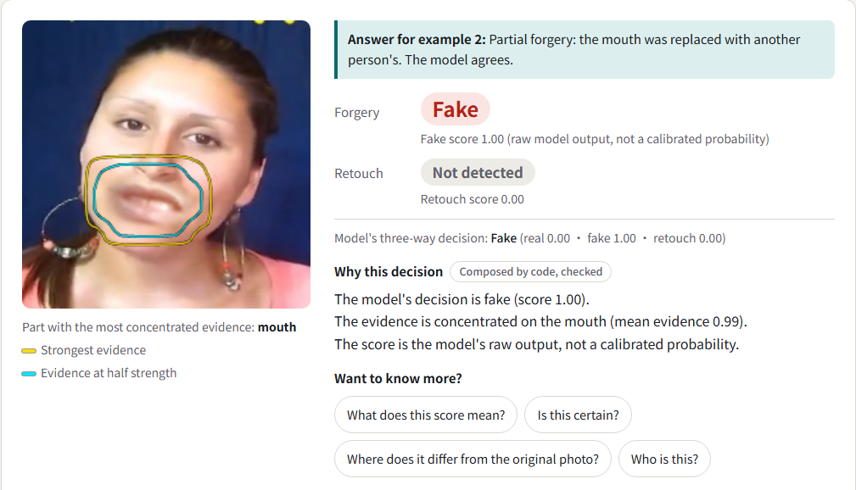
[System]
The browser page: 0.59 s per photo on an iPhone, nothing uploaded
0.59 s
iPhone Safari median (P90 0.79 s)
0.51 s
desktop (one WebAssembly thread)
95.7%
everyday photos (FairFace) called real
MediaPipe finds the face → ONNX Runtime Web runs EfficientNet-B4 (67 MB) → code draws the outline, names the part, composes and checks the sentences
Example: FF++ test frame with the mouth replaced by another person's (part-level forgery). Yellow = strongest 12% of the evidence; cyan = evidence score 0.5 or more; named part: mouth.
15
Notes:
系統：整條流程在瀏覽器裡跑，MediaPipe 找臉、ONNX Runtime 跑 67 MB 的 EfficientNet-B4、程式畫出證據輪廓並組句，照片不上傳。iPhone 上一張 0.59 秒，桌機 0.51 秒；一般網路照片 FairFace 有 95.7% 判真實。截圖是網頁內建的範例 2：FF++ 測試影格只把嘴巴換成別人的，證據輪廓和點名部位都落在嘴巴上。這是挑來展示輪廓的例子，整體效果看上一頁還原測試的 94%。

Slide 16
[Conclusion]
Results and limitations
16 / 17
54% → 12%
94% vs 51%
0.59 s
published detectors score a smoothed genuine face as more fake
false alarms: the cause is which class saw smoothing
restoring the marked part removes the forged decision
per photo in an iPhone browser
both directions, 17 detectors
controlled, same model and data
Grad-CAM heat map: 51%
nothing uploaded
Limitations
Reenactment DF40 reenactment AUC 0.50 / 0.56, outside the training coverage
Originals 20.8% / 19.6% of untouched FFHQ originals called beautified
Beauty + swap 10.9 / 9.8 points of face-swap videos land in beautified; the page always shows the fake score
Named operations across services only smoothing is reliable (AUROC 0.999), others 0.69–0.72; monochrome filters are weakest
16
Notes:
總結：第一，16/17 個已發表偵測器會冤枉磨皮的真人；第二，我們找出成因是訓練曝露，只改哪一類看過磨皮，冤枉從 54% 降到 12%；第三，evidence head 標的區域是判定的真正理由；第四，整套在 iPhone 瀏覽器 0.59 秒跑完。限制是重演類偽造不在涵蓋內、兩成原圖會被判美顏、一部分美顏換臉會落到美顏類所以頁面一律顯示偽造分數、跨廠牌只有磨皮能可靠點名。以上是我們的成果，謝謝老師。

