Slide 1
Contagion Risk in Interconnected Banking Ecosystems
Arno Bargerbos, Erasmus Elsner and Dorela Kozmai

Slide 2
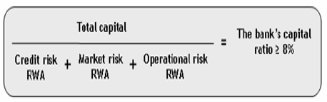
Introduction
Financial regulation before global financial crisis (GFC) of 2007-2008: microprudential supervision
Basel II Capital Accord:
Narrow focus on balance sheet structure of individual bank, i.e. capital adequacy
Ignores systemic risk through interconnectivity and contagion risk

Slide 3
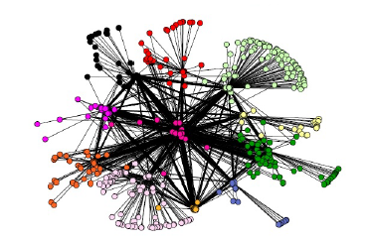
Introduction
Since the GFC:
Shift from microprudential to macroprudential regulation
Push by systemic surveillance bodies (IMF, FSB, BIS) to extend focus beyond bank capitalization to interconnetedness
“[T]he risk of failure of large, interconnected firms must be reduced,
whether by reducing their size, curtailing their interconnections, or limiting
their activities.” – Paul Volcker, 2012

Slide 4
Basic Model (1/3)
Model developed by Nier et al. (2007)
The Bank‘s Balance Sheets
ASSETS LIABILITIES
Interbank Loans
Interbank Debt
Depositors
External Assets
Equity

Slide 5
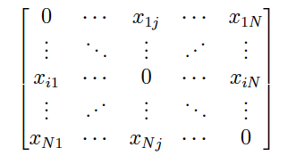
Basic Model (2/3)
Interbank loan network: NxN adjacency matrix
Bank 1
Bank 2
Bank 4
Bank 3
Bank 5
Bank 6

Slide 6
Basic Model (3/3)
Shock initialization via external assets
Shock propagation through interbank lenders
(3)
ASSETS LIABILITIES
PARTIAL WIPEOUT IB LENDERS
PARTIAL WIPEOUT IB LENDERS
Interbank Loans
External Assets
Depositors
(1)
EXOGENOUS SHOCK
FULL WIPEOUT EQUITY HOLDERS
(2)

Slide 7
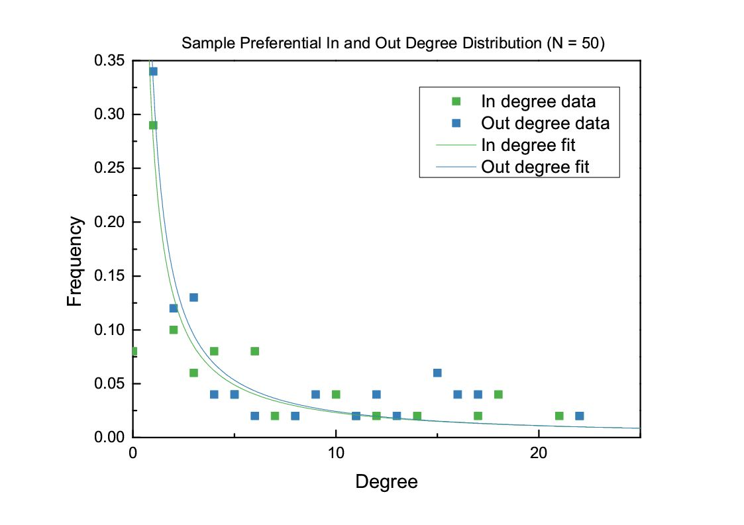
Adjustments
Implemented a directed scale free network algorithm¹
1: Fan Chung and Linyuan Lu. Complex graphs and networks. 2006.

Slide 8
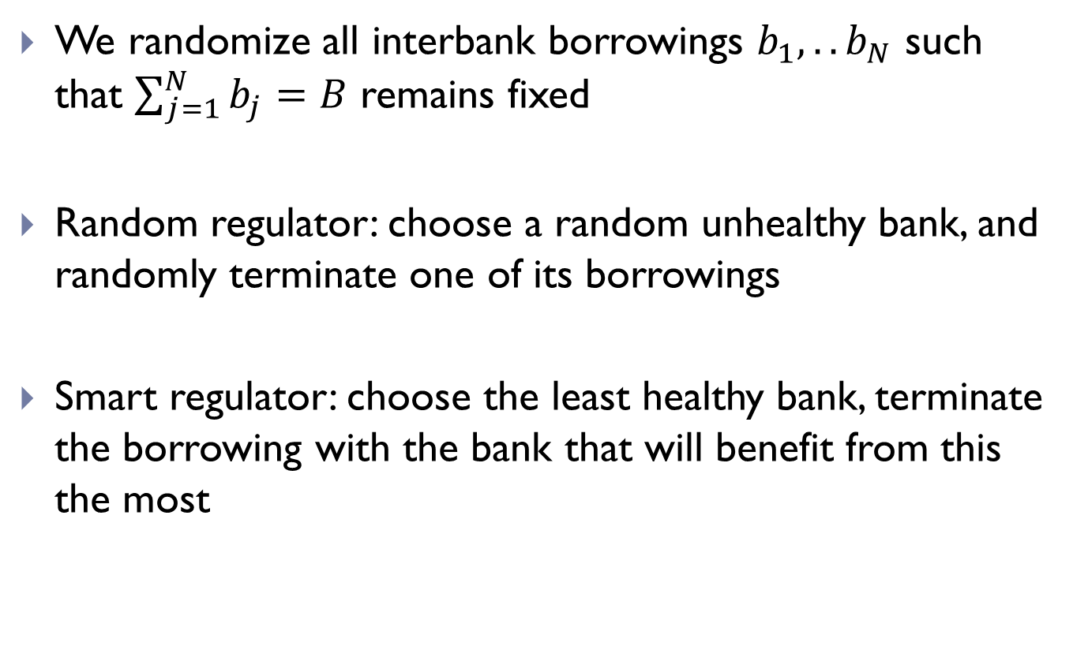
Adjustments
We randomize all interbank borrowings $b_{1},..b_{N}$ such that $\sum_{j=1}^{N}{b_{j}}=B$ remains fixed
Random regulator: choose a random unhealthy bank, and randomly terminate one of its borrowings
Smart regulator: choose the least healthy bank, terminate the borrowing with the bank that will benefit from this the most

Slide 9
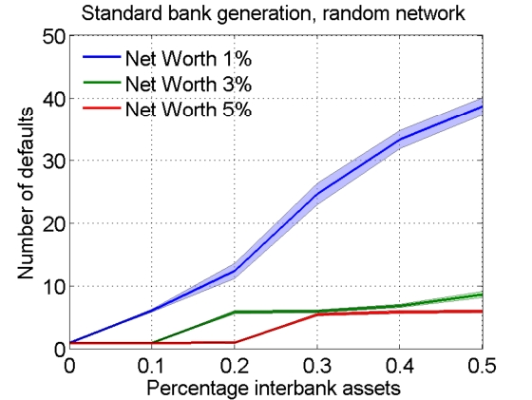
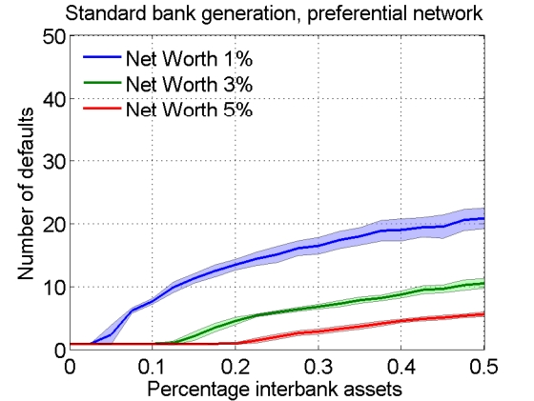
Results: random vs scale free (standard balance sheet)

Slide 10
Results: random vs scale free (standard balance sheet)
Random networks:
Binomially distributed; every bank has a similar amount of connections
Scale free networks
Power law distribution, many banks with few connections, a few banks with many connections

Slide 11
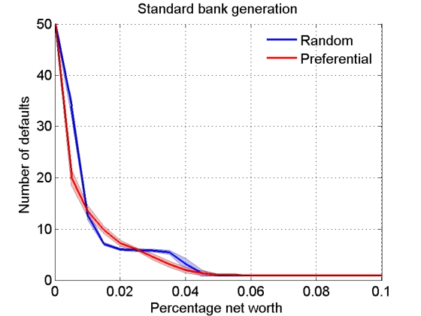
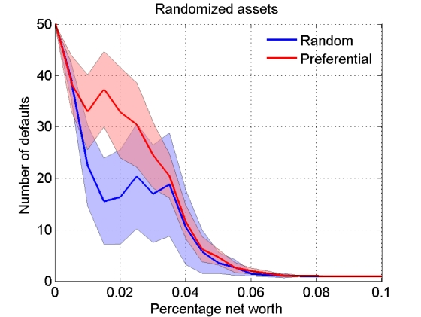
Results: random vs scale free (randomized)
Declination in resilience for both types of networks

Slide 12
Results: random vs scale free (randomized)
Random networks:
Some of the typical banks borrowing more than they should
Scale free networks
Some of the highly connected banks borrowing more than they should

Slide 13
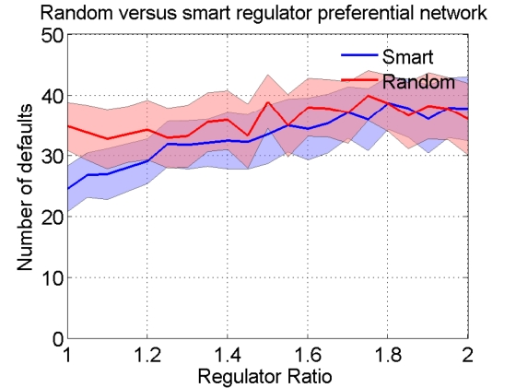
Results: Random vs Smart Regulator (Scale free network)
Smart Regulator works better than random regulator
Reducing interconnectivity is not the only factor in the increased stability

Slide 14
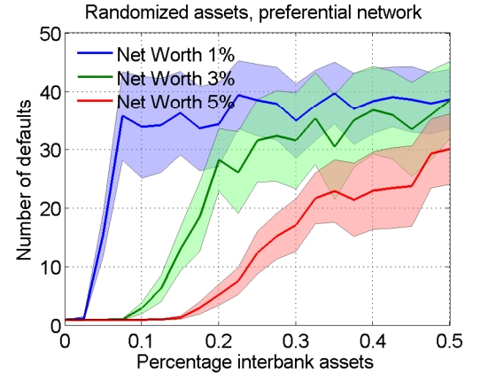
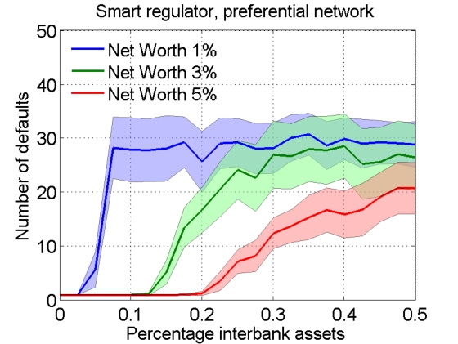
Results: Smart Regulator in Scale Free network

Slide 15
Conclusion
Random vs Scale free (standard balance sheet)
Scale free networks are more resilient
Randomized interbank assets
Both networks less resillient, moreso for the scale free network
System more realistic, not all loans are equal
Regulation
Smart regulator better than random regulator
Smart regulator more effective in the scale free network than in random

