Slide 1
Business Questions: Understanding Clients

Slide 2
Understanding Clients: Focal Business Questions
Goal: examine the clients of a business
Focal questions:
What are the characteristics of the clients?
What can we say about different types of clients relative to each other?

Slide 3
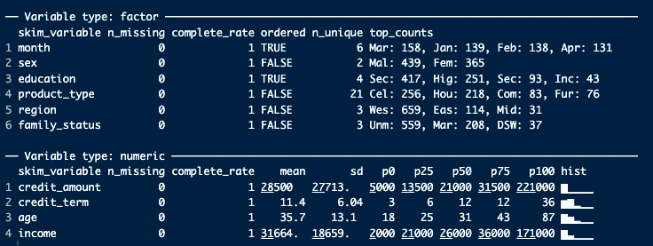
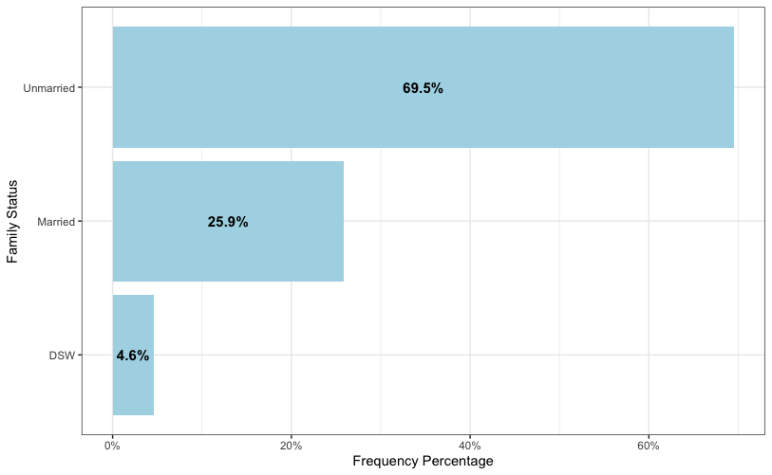
Client Characteristics
We see the average, standard deviation, and percentiles for numeric variables
These clients on average have credit amounts almost as big as their incomes
We see the counts for factor variables
Most clients buy cell phones
Visualization indicates most of the clients are unmarried

Slide 4
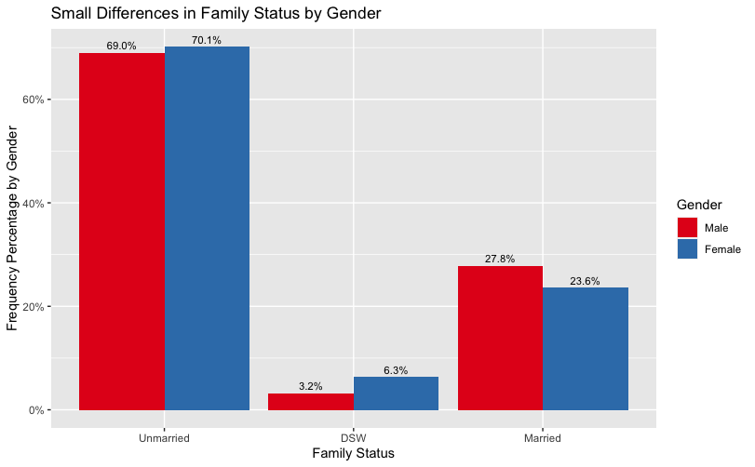
Comparing Clients to Each Other
Women and men tend to have similar family statuses

