Slide 1
Data Queries: Concepts and Practice

Slide 2
Overview
Data Queries: Concepts
Analytic workflows
Data files
Cleaning data
Querying data
Summarizing data
Visualizing data
Data Queries: Practice
R, RStudio
R Markdown scripts
Importing, cleaning, querying, summarizing, visualizing data

Slide 3
Data Queries: Concepts

Slide 4
Motivations for Business Analytics
Business analytics are motivated by questions of interest for the business
Who are our customers?
What kinds of products do our customers buy?
How can we retain our customers?
Where should we invest our funds?
How can we improve our work processes?
How do we attract top talent to the business?
In what areas do our competitors perform better than us?
Effective businesses, institutions, and non-profit organizations collect and analyze data on their various questions of interest

Slide 5
Investigative Process
Ask a Business Question
Determine Expectations
Operationalize Variables
Design Data Collection
Collect Data
Summarize, Visualize, Analyze Data
Report

Slide 6
Analytic Workflows
Typical analytical workflow involves the following steps:
Importing data
Cleaning data
Querying data
Transforming data
Summarizing data
Visualizing data
Modeling data
Exporting data
Creating reports, presentations, and/or dashboards

Slide 7
Components of Data
Data consists of two components
What units are measured?
Employees
Products
What variables are measured?
Personality of employees
Features of products
Units might be defined by multiple identifying variables
Performance of employees across many weeks who work on different teams
An observation consists of measuring an employee (first identifying variable) during a week (second identifying variable) on a team (third identifying variable)
Variables might be functions of each other or exist at different levels of aggregations
Five survey items measuring conscientiousness might be averaged for a single conscientiousness score
Individual performance of a team of employees might be averaged for a single team performance score

Slide 8
Data Example
emp_id | team_id | perf | consc_1 | consc_2 | consc_3 | consc_avg
1 | 1 | 75 | 5 | 3 | 7 | 5.00
2 | 1 | 64 | 4 | 2 | 1 | 2.33
3 | 1 | 66 | 3 | 4 | 3 | 3.33
4 | 2 | 45 | 1 | 2 | 1 | 1.33
5 | 2 | 87 | 6 | 7 | 7 | 6.67
6 | 2 | 56 | 4 | 5 | 4 | 4.33
7 | 3 | 90 | 7 | 7 | 7 | 7.00
8 | 3 | 87 | 7 | 7 | 5 | 6.33
9 | 3 | 34 | 1 | 1 | 1 | 1.00

Slide 9
Types of Variables
We can define variables in four ways
By their investigative purpose
A variable whose scores we want to explain or predict
Dependent variable, outcome variable, endogenous variable
A variable whose scores we use to explain or predict other variables
Independent variable, predictor variable, exogenous variable
By measurement properties
Nominal variables
Gender, training intervention
Values represent categories
Ordinal variables
Order of finishing assignments
Values reflect order
Interval variables
Temperature, potentially intelligence tests
Equal intervals anywhere on scale (i.e., equidistance)
Difference in Fahrenheit temperature of 120 and 80 equals the difference in Fahrenheit temperature of 150 and 110
Ratio variables
Productivity
Equidistance plus a true zero value
An employee finished twice as many tasks as the average employee
By continuum
Continuous variables
Measured along an infinitesimal continuum
Age
Discrete variables
Measured in whole units
Number of absences
By numeric representation
Quantitative variables
Uses numbers to reflect values
Rank ordering performance with numbers (e.g., 1st, 2nd, 3rd, etc.)
Qualitative variables
Uses labels to reflects values
Rank ordering performance with labels (e.g., A, B, C, D, etc.)

Slide 10
Properties of Measurement Scales
 | Nominal | Ordinal | Interval | Ratio
Order | No | Yes | Yes | Yes
Equidistance | No | No | Yes | Yes
True Zero | No | No | No | Yes

Slide 11
Data Files
Data may be stored in various formats
Spreadsheet formats
Excel
Numbers
Google Sheets
Delimited formats
Comma separated values
Tab separated values
Software specific
SPSS, SAS, Stata, R
Application specific
JavaScript Object Notation (JSON)
Extensible Markup Language (XML)
Databases
SQLite
PostgreSQL
Unstructured data
Text files
Portable Document Format (PDF)
Software must read various formats with different procedures
R can read various data formats

Slide 12
Data Cleaning
Data cleaning consists of making data ready to facilitate analytical work tasks
Typical data cleaning tasks include:
Renaming variables to following a consistent naming convention (e.g., snake_case)
Converting character variables to nominal and ordinal factors
Changing the order of the levels of factor variables in preparation for summary computations and visualizations
Changing the labels of factor variables in preparation for visualization
Converting date information into an appropriate date format

Slide 13
Data Querying
Data querying consists of examining data to better understand it for summary computations, modeling, and reporting
Typical data querying tasks include:
Examining the values of any given set of variables
Examining the values of any given set of units
Examining the plausibility of values for any given variable
Examining which units meet specified filtering conditions
Examining top and bottom scores on numeric variables

Slide 14
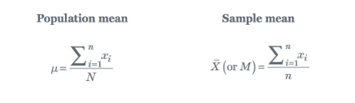
Summarizing Data: Central Tendency
Value | Count
5 | 3
12 | 4
13 | 3
14 | 1
17 | 1
18 | 1
20 | 1
Measures of central tendency: calculate a single value most representative of all values for a variable
Mode: the most frequently occurring value for a variable
5, 5, 5, 12, 12, 12, 12, 13, 13, 13, 14, 17, 18, 20
Median: the value of a variable where 50% of other values are below and 50% of other values are above
5, 5, 5, 12, 12, 12, 12, 13, 13, 13, 14, 17, 18, 20
Average two middle values due to even number of values
Average the two middle values: (12 + 13)/2 = 12.5
Mean: the sum of all the values divided by the number of values
5, 5, 5, 12, 12, 12, 12, 13, 13, 13, 14, 17, 18, 20
Sum: 5 + 5 + … + 18 + 20 = 171
Mean: 171/14 = 12.21

Slide 15
Summarizing Data: Properties of Central Tendencies
Mode
Multiple modes may occur (bimodal, trimodal, etc.) or all scores may have the same frequency (rectangular distribution)
The only measure of central tendency appropriate for nominal data, and it can be used for all measurement scales
Median
Less sensitive to extreme scores than the mean
A single unusual value does not change the median
Good measure for skewed distributions
Best measure for ordinal data, and it can be used for ordinal, interval, and ratio scales
Mean
Sensitive to extreme scores
A single unusual value may drastically change the mean, especially in small samples
Generally, most stable measure from sample to sample
Preferred measure if data is continuous and normally distributed, and it can be used for interval and ratio scales

Slide 16


Summarizing Data: Variability
Measures of variability: how far do scores fall from the center
Variance: squared deviation of scores from the mean
Measures variability in squared units
Affected by outliers
Standard Deviation: square root of the variance
Measures variability in original units
Affected by outliers
Range: difference between minimum and maximum values
Informative if no outliers
Interquartile Range (IQR): difference between 25th and 75th percentiles
Useful in the presence of outliers
Population Standard Deviation
Sample Standard Deviation

Slide 17
Summarizing Data: Percentiles
Percentiles: measures the proportion of variable values that equal or fall below a particular value
Example: 5, 6, 7, 8, 9, 14, 17, 18, 19, 24
60th percentile of a variable is 15.2
This implies 60% of the values of the variable equal or fall below the value of 15.2
Common percentiles:
25th percentile (first quartile): 25% of values equal or fall below the value
50th percentile (second quartile; median): 50% of values equal or fall below the value
75th percentile (third quartile): 75% of values equal or fall below the value
Common uses
Interquartile Range (IQR)
Boxplot

Slide 18
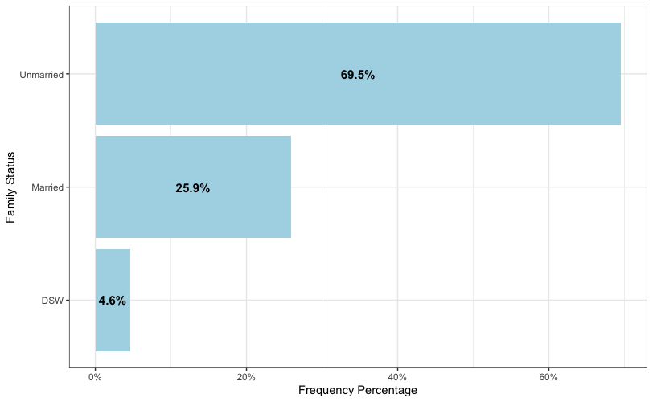
Visualizing Data: Plotting for Discrete/Categorical Variables
Bar charts: calculates and visualizes the frequency or proportion of occurrence for each value of a discrete variable with vertical or horizontal bars
Pie charts: calculates and visualizes the frequency or proportion of occurrence for each value of a discrete variable in a divided circle
Research on human interpretation of charts suggests people make more accurate assessments with bar than pie charts

Slide 19
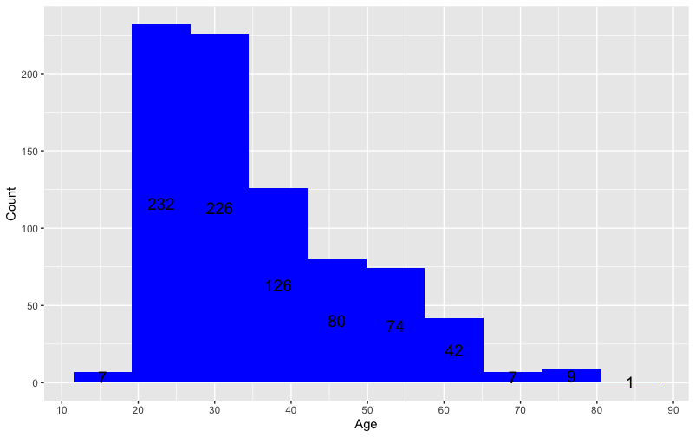
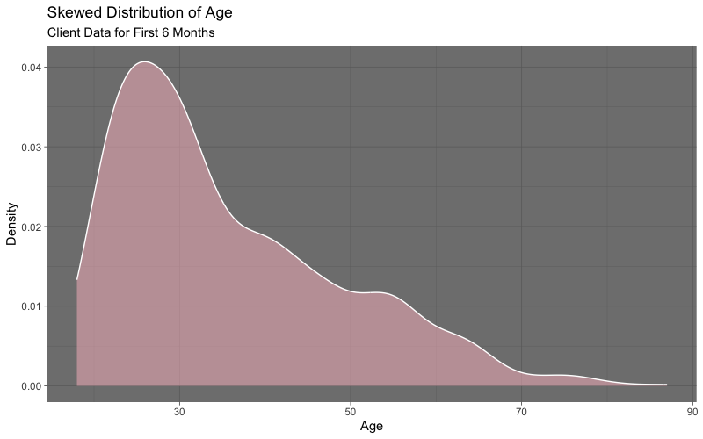
Visualizing Data: Plotting for Continuous/Numeric Variables
Histograms: calculates and visualizes the frequency or proportion of occurrence for bins of values of a continuous variable with vertical or horizontal bars
Density plots: calculates and visualizes the density of occurrence for each value of a continuous variable

Slide 20
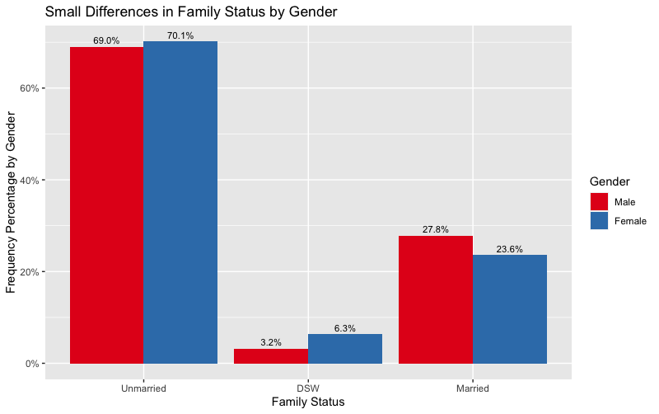
Visualizing Data: Plotting for Two Discrete Variables
Dodged bar charts: calculates and visualizes the frequency or proportion of occurrence for values of one level of one discrete variable across levels of another discrete variable

Slide 21
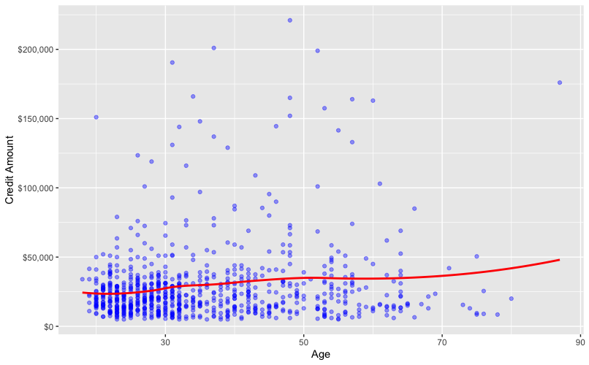
Visualizing Data: Plotting for Two Continuous Variables
Scatterplots: visualizes the pairing of values across two continuous variables

Slide 22
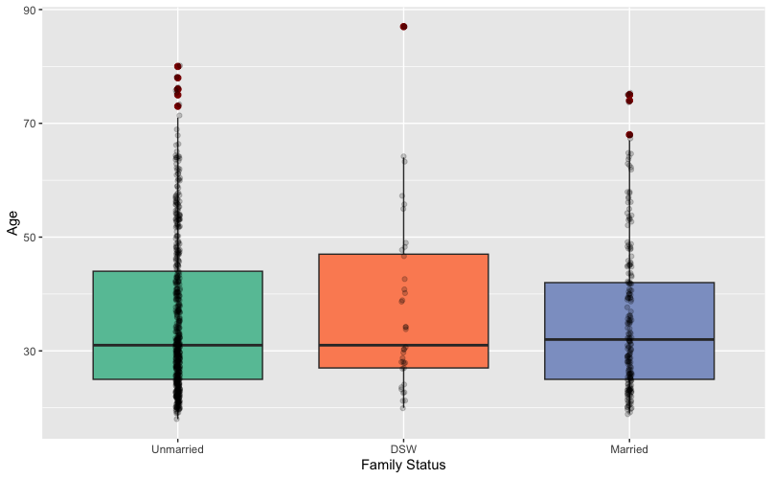
Visualizing Data: Plotting When Combining Discrete and Continuous Variables
Boxplot: visualizes the distribution of continuous variable across levels of discrete variable
Box reflects first, second, and third quartiles of continuous variable
End of whiskers reflect the smallest and largest value of continuous variable within:
Q1 - 1.5*IQR
Q3 + 1.5*IQR

Slide 23
Data Queries: Practice

Slide 24
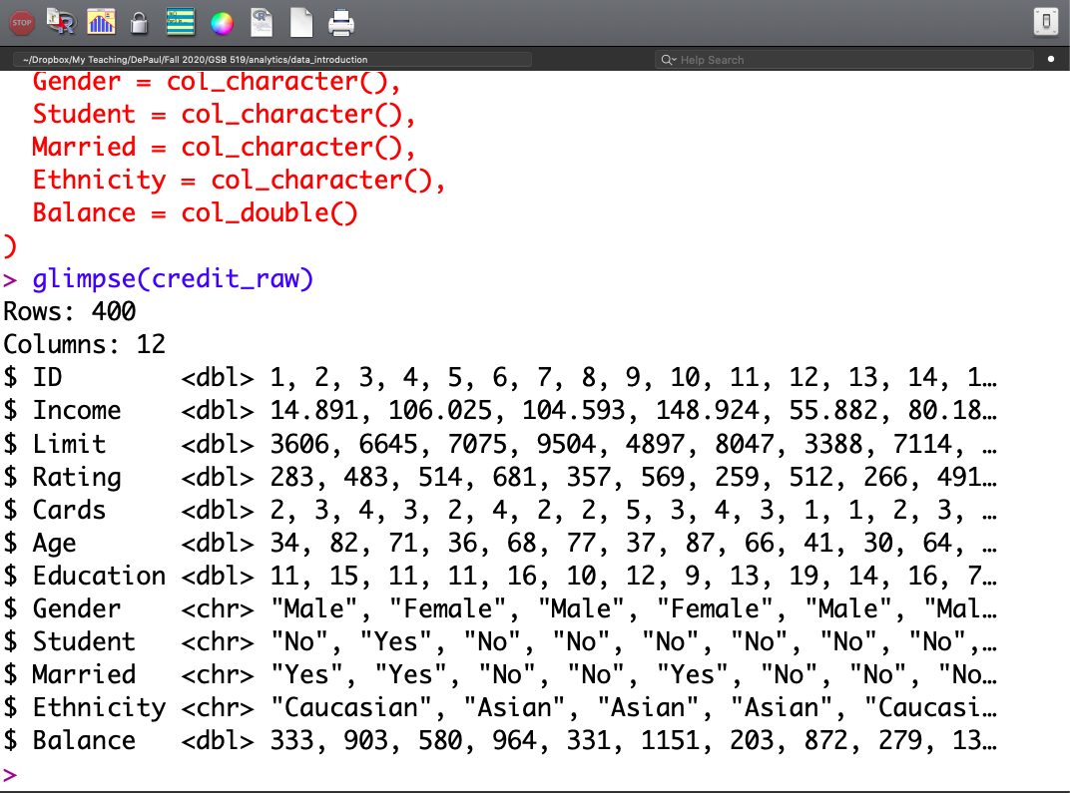
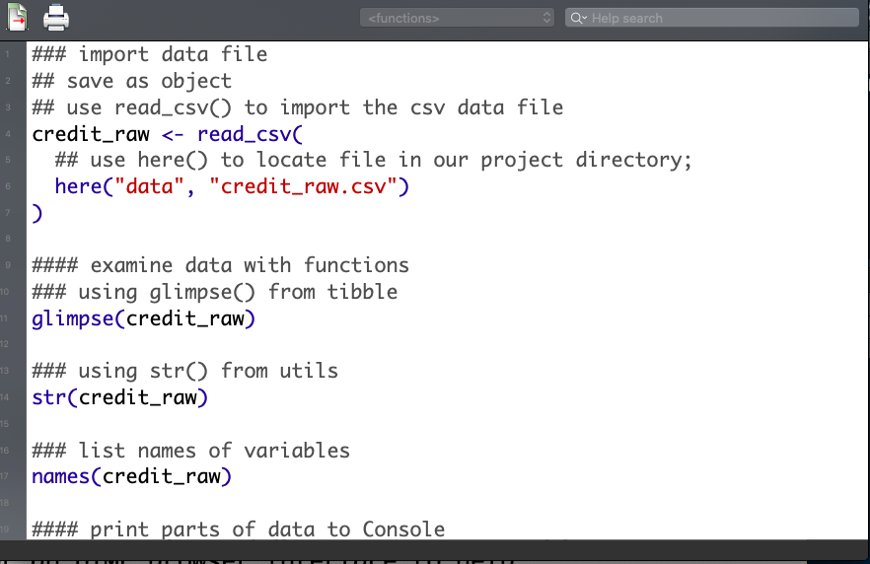
R Graphical User Interface (GUI)

Slide 25
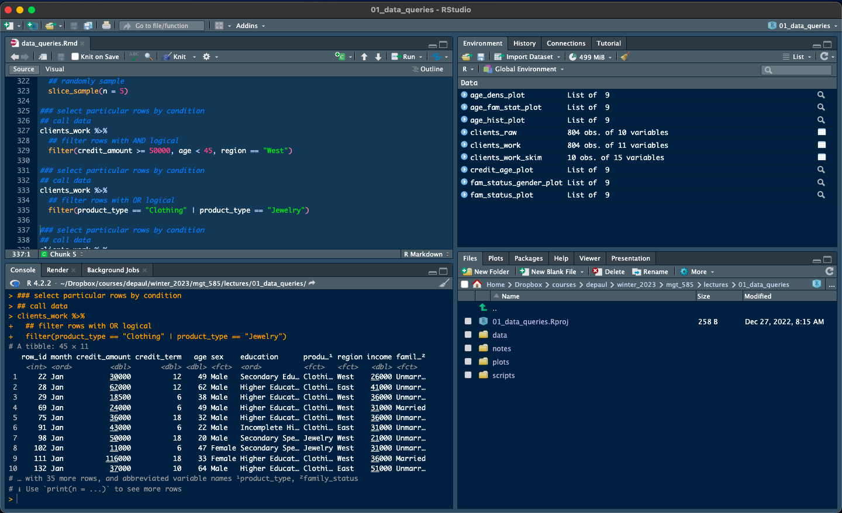
RStudio GUI

Slide 26
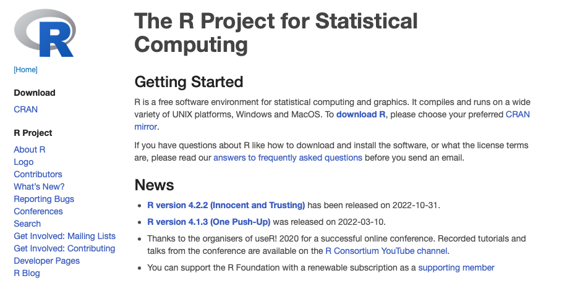
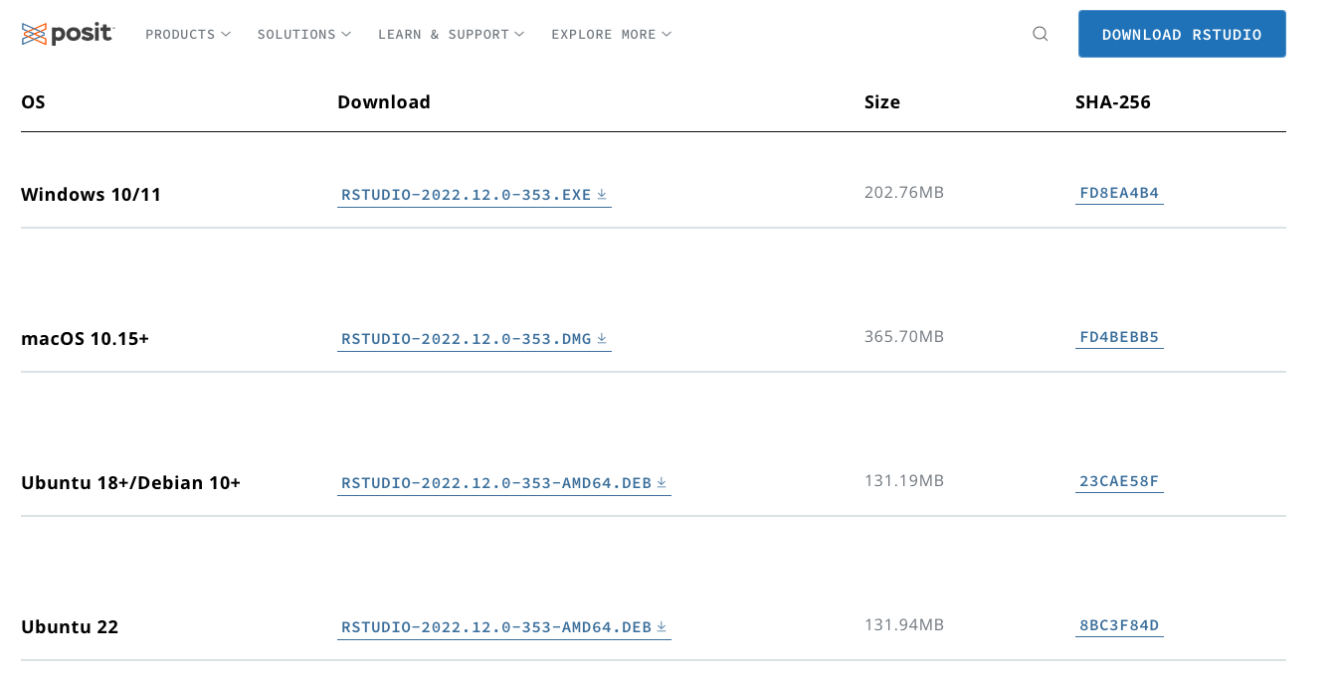
Downloading Software and Packages
Download R from https://www.r-project.org
Download RStudio from https://posit.co/download/rstudio-desktop/
Generally, R functions are contained in packages
Initial download of R comes with foundational packages that provide basic functionality
base, utils, stats
Additional packages require separate downloads from within RStudio
here, tidyverse, readxl , lubridate, skimr, scales
Download these additional packages by using the install.packages() function in the Console window
install.packages(“tidyverse”)

Slide 27
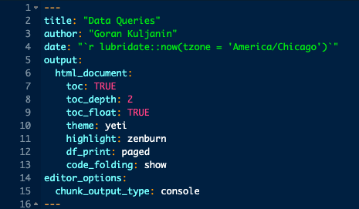
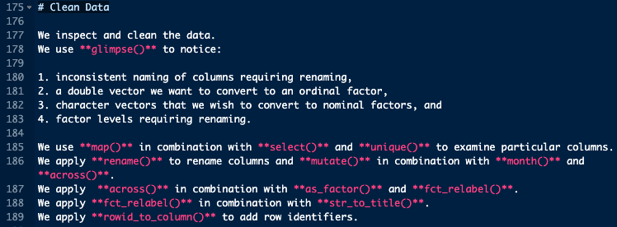
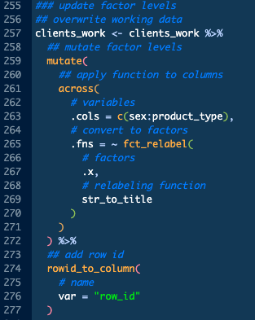
R Markdown Script
R Markdown scripts are useful for producing reproducible reports consisting of three parts
YAML section to set-up a report
R Markdown sections to describe analytical work
Code chunks to perform analytical work
Reports output to HTML, PDF, and Word
Can control what outputs
Descriptions plus code plus results, just descriptions and code, just descriptions and results

Slide 28
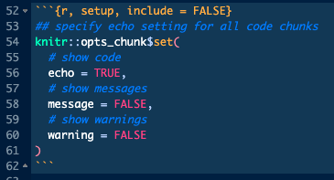
Code Chunk Options
Code chunks begin and end with three backticks (```)
Code chunks require a specification of the type of code that will be written
Indicated by the first statement inside the curly ({ }) braces
The letter r indicates we will write R code
RStudio supports other languages like Python and SQL
The other specifications are optional
The second slot is reserved for naming the code chunk
In this example, the name of the code chunk is setup
include option prohibits the code and results from appearing in the knitted report
Code is still executed and results can be used by other code chunks
This code chunk sets the default options for the other code chunks
echo option indicates whether code will appear in the knitted report
message option indicates whether messages will appear in the knitted report
warning option indicates whether warnings will appear in the knitted report

Slide 29
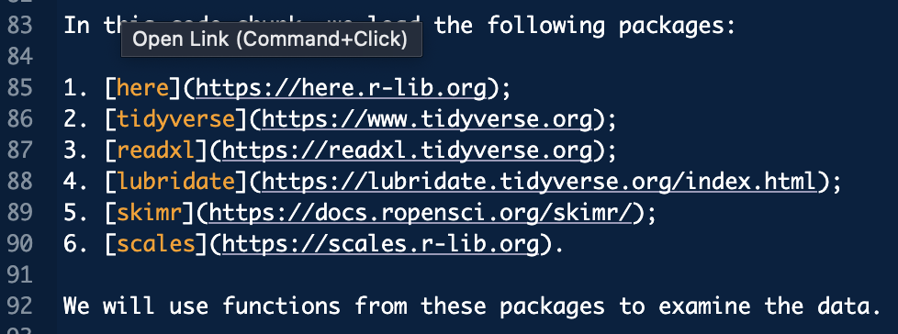
R Markdown Language
This report includes section headings indicated by ##
# is a level 1 heading
## a level 2 heading
### a level 3 heading and so on
Asterisks (*) and underbars (_) make words italics and/or bold
A single asterisk or underbar makes words italic
A double asterisk or underbar makes words bold
Mixing asterisks and underbars allows the possibility to make words bold and italic
Ordered lists can be created with numbers as shown in the graphic
Square brackets with text followed by parentheses with a web address create text links

Slide 30
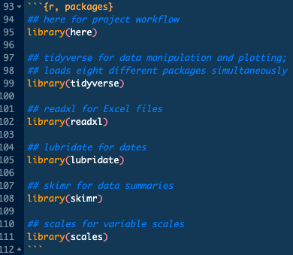
Activating Packages
Downloaded packages must be activated in a given working session with the library() function
This example loads six different packages

Slide 31
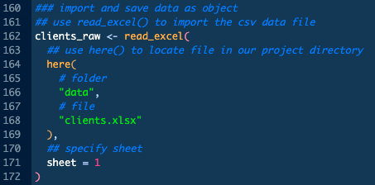
Importing Data
Import Excel files from the project directory using the here() and read_excel() functions
This code navigates to the data folder to find the clients.xlsx data file
The first sheet is of the Excel file is imported

Slide 32
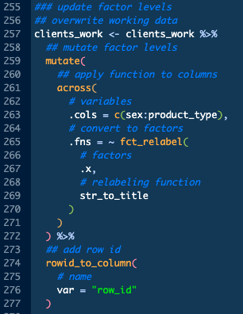
Cleaning Data
Cleaning data includes tasks such as:
Changing variable types
From characters to factors
Changing the labels of factors
Making the labels a consistent case for visualizations and summaries
Adding identifying variables for clarification
Example uses combination of mutate() and across() functions for this cleaning task plus rowid_to_column() to add an identifying variable

Slide 33
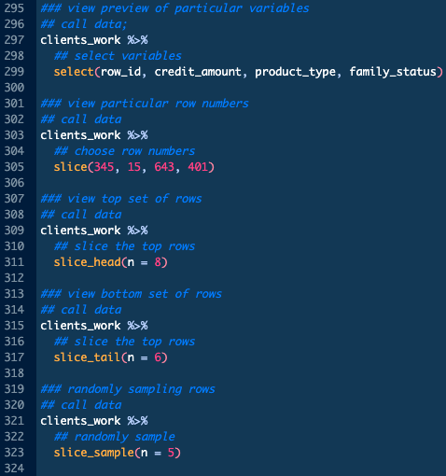
Querying Data
Querying data includes task such as:
Examining overall properties
Number of observations
Number of variables
Considering the types of variables
Double/numeric, character, factor, integer
Viewing different parts of the data
Filtering for top and bottom rows
Looking at values of specific variables or units

Slide 34
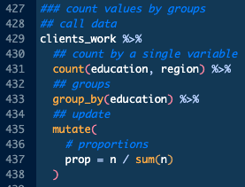
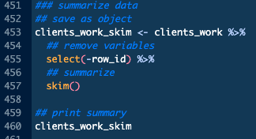
Summarizing Data
Summarizing data includes task such as:
Counting the number of values of discrete variables
Number of observations
Number of variables
Computing the average, standard deviation, and percentiles of continuous variables

Slide 35
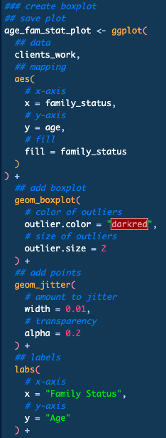
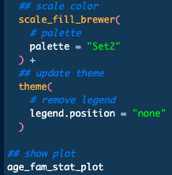
Visualizing Data
Data visualization involves understanding what kinds of geometries can effectively present data
ggplot2 package and other supporting packages offer the capability to create different types of visualizations including:
Single discrete variables
Single continuous variables
Multiple variables consisting of any combination of discrete and continuous variables

Slide 36
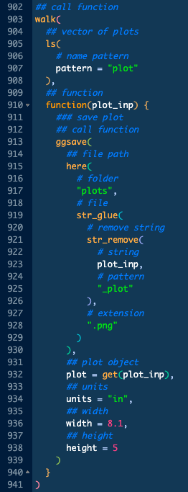
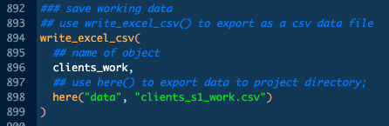
Saving Objects
We can save any created objects in an RStudio session to the project directory
Export data tables as comma separated values prepared for Excel using the here() and write_excel_csv() functions
Save plots created with the ggplot2 functions using ggsave()
Example code below navigates to the data folder of the project directory to save the data object clients_work as a data file named clients_s1_work.csv
Example code to the right saves multiple plots using walk()

