Slide 1
Clustering Units: Concepts and Practice

Slide 2
Overview
Clustering Units: Concepts
Cluster analyses
Hierarchical cluster analyses
Partitional cluster analyses
Cluster analyses on mixed variables
Clustering Units: Practice
Importing, cleaning data
Agglomerative hierarchical cluster analysis
K-means cluster analysis
K-medoids cluster analysis

Slide 3
Clustering Units: Concepts

Slide 4
Supervised vs. Unsupervised Learning
Supervised learning consists of finding patterns in data with target values
Classification
Consists of predicting categorical targets
Regression
Consists of predicting continuous targets
Unsupervised learning consists of finding patterns in data without target values
Dimensionality reduction
Consists of reducing the variables (columns) of a data table to a subset of more distinguishable variables
Clustering
Consists of reducing the units (rows) of a data table to a fewer subset of more distinguishable groupings of units

Slide 5
Clustering
Clustering has the general goal of finding similar groupings of units as a function of distances between units on a set of measured variables
Commonly applied clustering algorithms include:
Hierarchical clustering algorithms
Agglomerative (bottom-up) hierarchical clustering
Divisive (top-down) hierarchical clustering
Partitional clustering algorithms
K-means clustering
K-medoids clustering (a.k.a., PAM = partitioning around medoids)
Model-based (soft/probabilistic) clustering
Finite mixture models

Slide 6
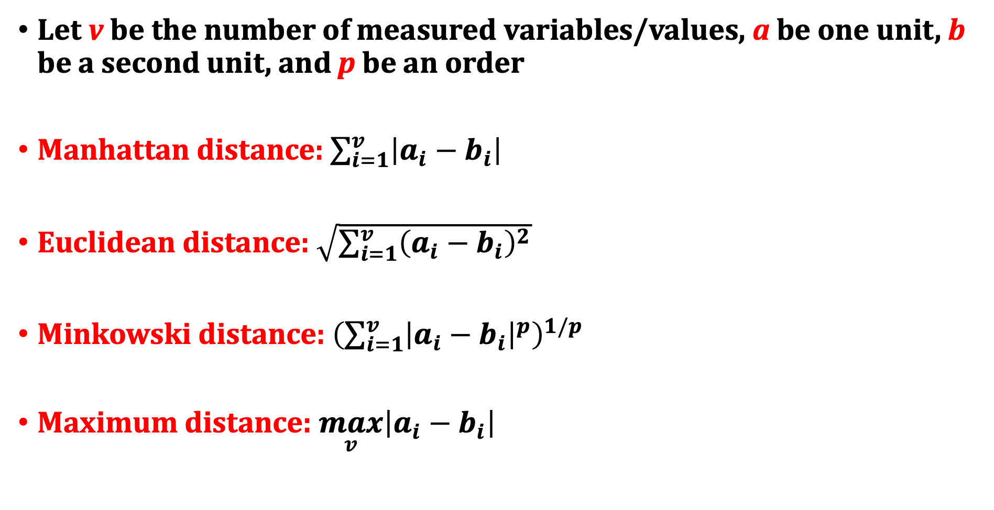
Unit Distance Metrics for Numerical Variables
Let v be the number of measured variables/values, a be one unit, b be a second unit, and p be an order
Manhattan distance: $\sum_{i=1}^{v}{\left|a_{i}−b_{i}\right|}$
Euclidean distance: $\sqrt{\sum_{i=1}^{v}{{\left(a_{i}−b_{i}\right)}^{2}}}$
Minkowski distance: ${\left(\sum_{i=1}^{v}{{\left|a_{i}−b_{i}\right|}^{p}}\right)}^{1/p}$
Maximum distance: $\max_{v}\left|a_{i}−b_{i}\right|$

Slide 7
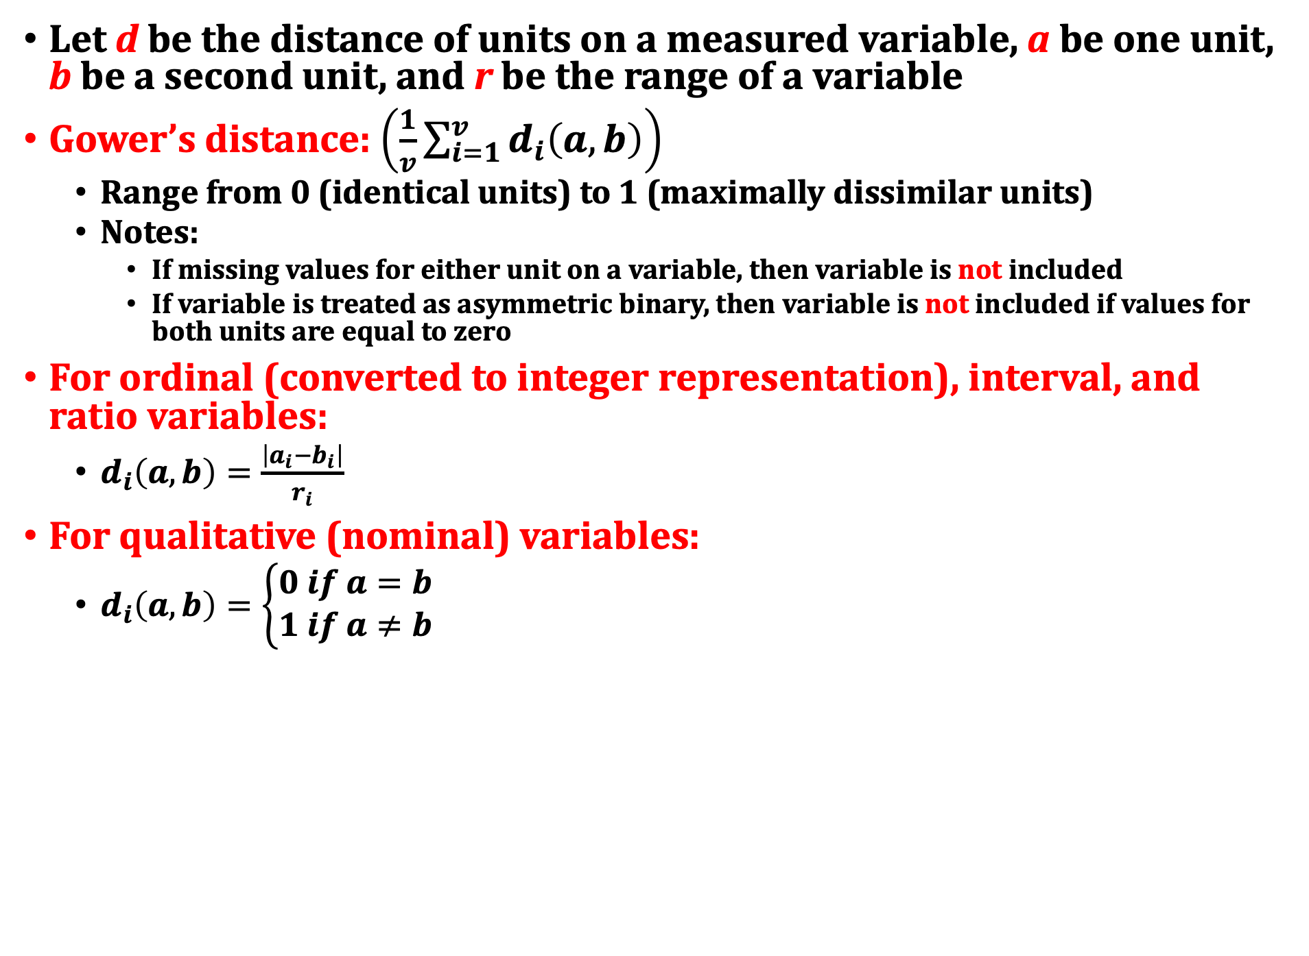
Gower’s Unit Distance Metric for Mixed Variables
Let d be the distance of units on a measured variable, a be one unit, b be a second unit, and r be the range of a variable
Gower’s distance: $\left(\frac{1}{v}\sum_{i=1}^{v}{d_{i}\left(a,b\right)}\right)$
Range from 0 (identical units) to 1 (maximally dissimilar units)
Notes:
If missing values for either unit on a variable, then variable is not included
If variable is treated as asymmetric binary, then variable is not included if values for both units are equal to zero
For ordinal (converted to integer representation), interval, and ratio variables:
$d_{i}\left(a,b\right)=\frac{\left|a_{i}−b_{i}\right|}{r_{i}}$
For qualitative (nominal) variables:
$d_{i}\left(a,b\right)=\left\{\begin{aligned}0 if a=b \\ 1 if a≠b\end{aligned}\right.$

Slide 8
Agglomerative Hierarchical Clustering
Data preparation:
Include only numeric variables
No non-numeric nominal or ordinal variables
Standardize all variables
Otherwise, variables with large variance will dominate the clustering
Compute distances between all pairs of units
Choose distance metric of choice
Algorithm includes the following steps:
Step 1: Begin with each unit in its own cluster
For n units, we have n clusters at the start
Step 2: Find the nearest pair of distinct clusters and merge using the specified cluster linkage method (i.e., cluster distance metric)
Step 3: Repeat the second step until all units belong to a single cluster
Output:
Specify a cluster distance height or number of clusters to create clusters
Visualize formation of clusters with dendrogram
Visualize clusters with principal components plot

Slide 9
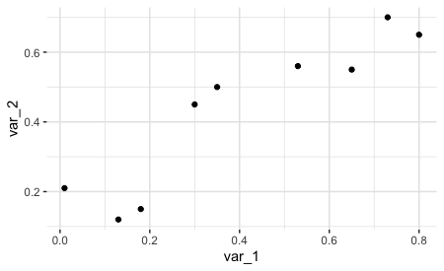
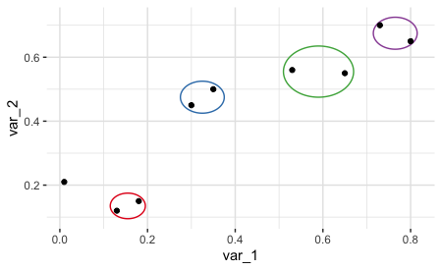
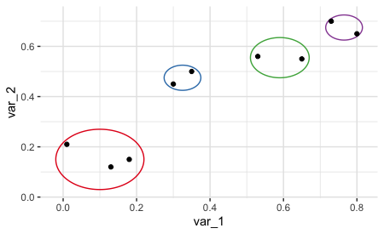
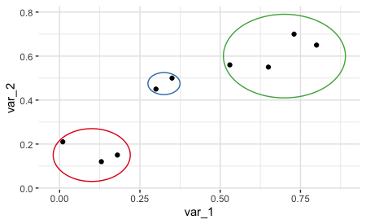
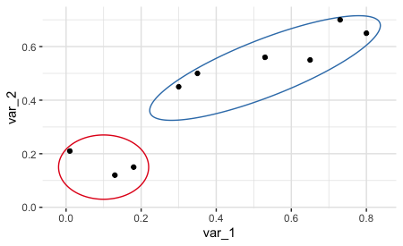
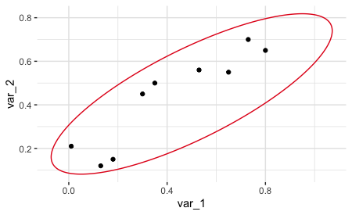
Initial
Iterations 1-4
Iteration 5
Iteration 6
Iteration 7
Iteration 8

Slide 10
Cluster Distance Metrics (Cluster Linkage Method)
Single linkage: the distance between two clusters is the distance between the two closest observations
Average linkage: the distance between two clusters is the average of all distances between the units in the two clusters
Complete linkage: the distance between two clusters is the distance between the two furthest observations
Centroid linkage: the distance between two clusters is the distance between the two centroids of the two clusters
Centroid: a vector of mean values on a set of variables
Ward’s linkage: the distance between two clusters is the increase in the error sum of squares that would result by joining the two clusters
Error sum of squares: sum of squared deviations of each unit’s values on a set of variables from the centroid of the set of variables

Slide 11
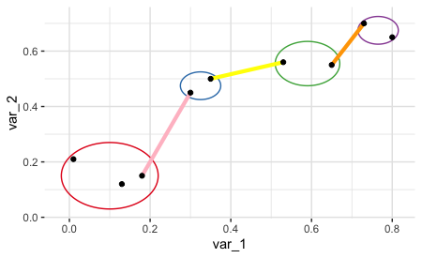
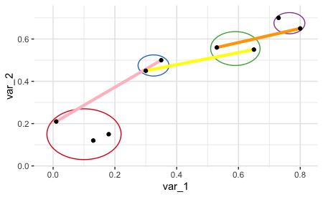
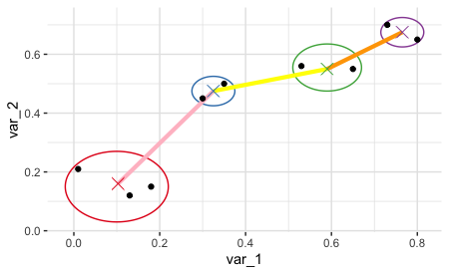
Single Linkage
Complete Linkage
Centroid Linkage

Slide 12
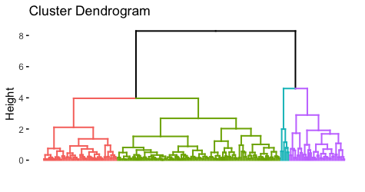
Dendrograms
Dendrograms provide a visualize representation of how units were clustered together
Height values show the distances between clusters when two clusters were joined
Helpful to view for determining the number of clusters to extract
Data example: 200 credit card customers measured on three quantitative variables cut into four clusters

Slide 13
Principal Components
Principal components describe a set of correlated variables in terms of a new set of uncorrelated variables
The first principal component is a linear combination of the original set of variables whose sample variance is greatest among all such linear combinations
The second principal component is a linear combination of the original set of variables whose sample variance is greatest among all such linear combinations while being uncorrelated with the first principal component
Uses:
Reduce the total number of variables to a fewer subset of variables
Visualize results in two-dimensions for analyses involving many variables (e.g., cluster analyses)

Slide 14
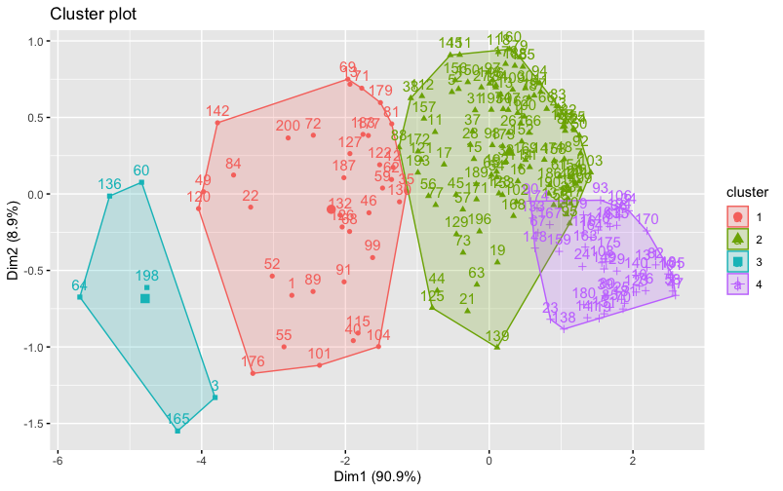
Clusters on Principal Components

Slide 15
K-Means Clustering
Data preparation:
Include only numeric variables
No non-numeric nominal or ordinal variables
Standardize all variables
Otherwise, variables with large variance will dominate the clustering
Approximate algorithm includes the following steps:
Step 1: Specify the number of desired clusters (k) and randomly assign units to k clusters
Step 2: Compute the centroids of the k clusters
Step 3: Assign units to closest cluster using the squared distance between each unit and cluster centroids
Step 4: Repeat the second and third steps until all units no longer change clusters
Output:
View cluster assignments as a table
Visualize clusters with principal components

Slide 16
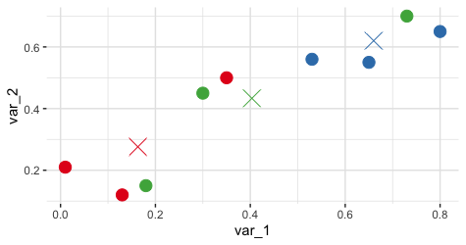
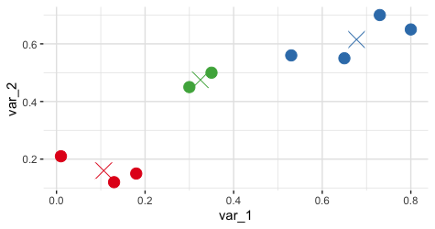
Initial
Final

Slide 17
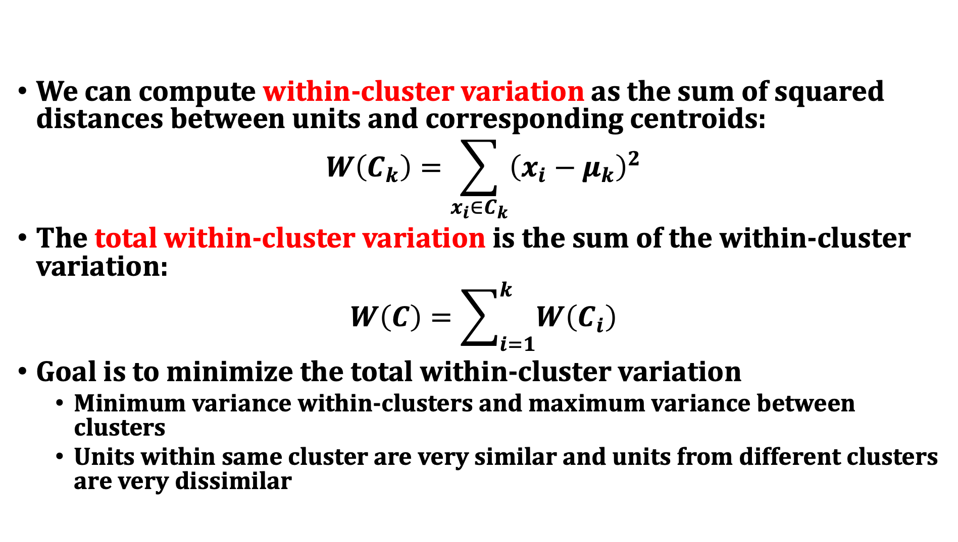
Within-Cluster Sum of Squares
We can compute within-cluster variation as the sum of squared distances between units and corresponding centroids:
$$W\left(C_{k}\right)=\sum_{x_{i}∈C_{k}}{{\left(x_{i}−μ_{k}\right)}^{2}}$$
The total within-cluster variation is the sum of the within-cluster variation:
$$W\left(C\right)=\sum_{i=1}^{k}{W\left(C_{i}\right)}$$
Goal is to minimize the total within-cluster variation
Minimum variance within-clusters and maximum variance between clusters
Units within same cluster are very similar and units from different clusters are very dissimilar

Slide 18
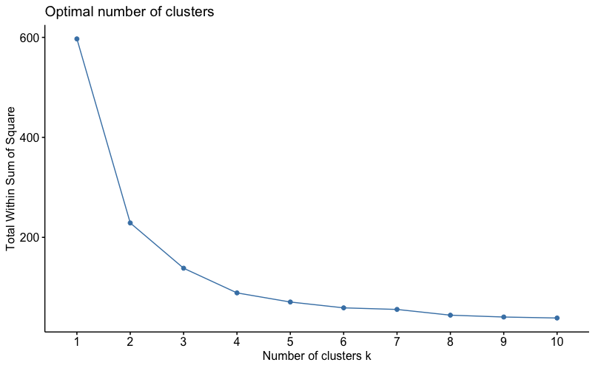
Number of Clusters: Total Within-Cluster Sum of Squares

Slide 19
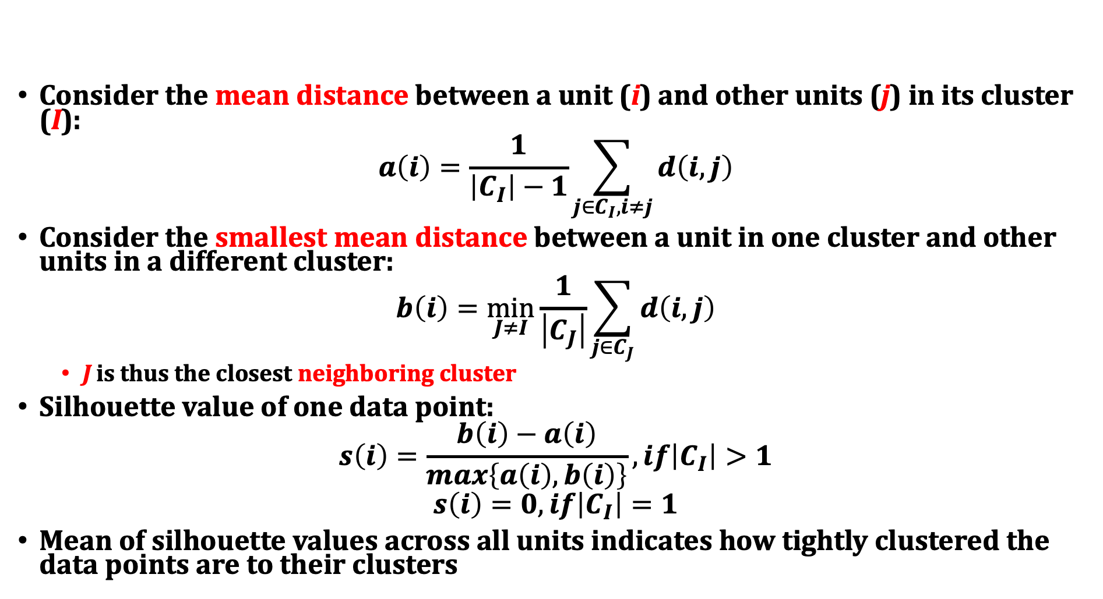
Number of Clusters: Average Silhouette Width
Consider the mean distance between a unit (i) and other units (j) in its cluster (I):
$$a\left(i\right)=\frac{1}{\left|C_{I}\right|−1}\sum_{j∈C_{I},i≠j}{d\left(i,j\right)}$$
Consider the smallest mean distance between a unit in one cluster and other units in a different cluster:
$$b\left(i\right)=\min_{J≠I}{\frac{1}{\left|C_{J}\right|}\sum_{j∈C_{J}}{d\left(i,j\right)}}$$
J is thus the closest neighboring cluster
Silhouette value of one data point:
$$s\left(i\right)=\frac{b\left(i\right)−a\left(i\right)}{max\left\{a\left(i\right),b\left(i\right)\right\}},if\left|C_{I}\right|>1$$
$$s\left(i\right)=0,if\left|C_{I}\right|=1$$
Mean of silhouette values across all units indicates how tightly clustered the data points are to their clusters

Slide 20
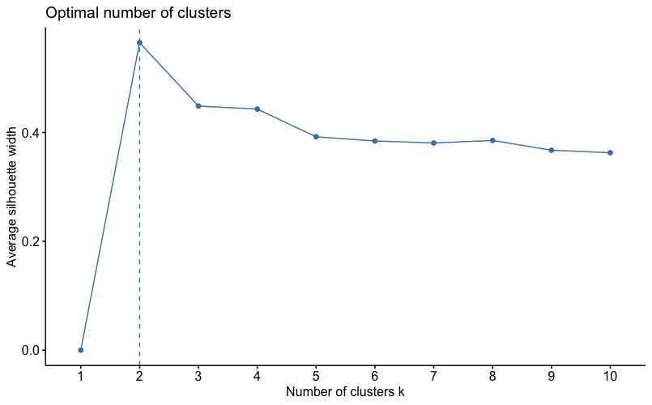
Number of Clusters: Average Silhouette Width

Slide 21
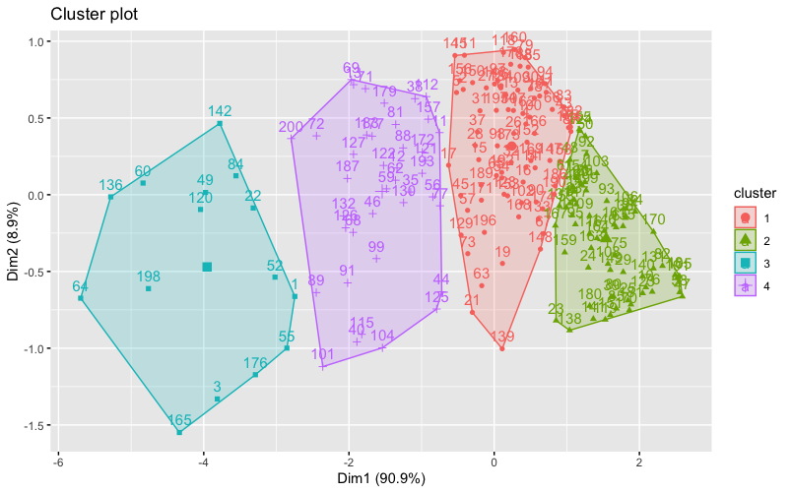
Data Example: Clusters on Principal Components

Slide 22
K-Medoids (PAM) Clustering
Comparison to k-means clustering:
k-medoids can handle both quantitative and qualitative variables
k-medoids always selects an actual unit as the representative centroid (easier to interpret) whereas k-means computes an average
k-medoids can use any distance measure whereas k-means uses Euclidean distance
k-medoids is more robust to noise and outliers than k-means
Data preparation:
Include any combination of variables
It is possible to mix nominal variables with other types of variables
Compute distance metric (e.g., Gower’s distance)
Approximate algorithm includes the following steps:
Step 1: Select k units as the initial medoids
Step 2: Assign all other units to the closest medoid using distance metric
Step 3: Consider swapping current medoids with all other non-medoid units
Step 4: Swap out current medoids if another unit does a better job of minimizing distance between itself and remaining non-medoid units (i.e., minimize total cost)
Step 5: Repeat steps 3 and 4 until no more swaps can improve the total cost
Output:
View cluster assignments as a table
Visualize clusters with principal components

Slide 23
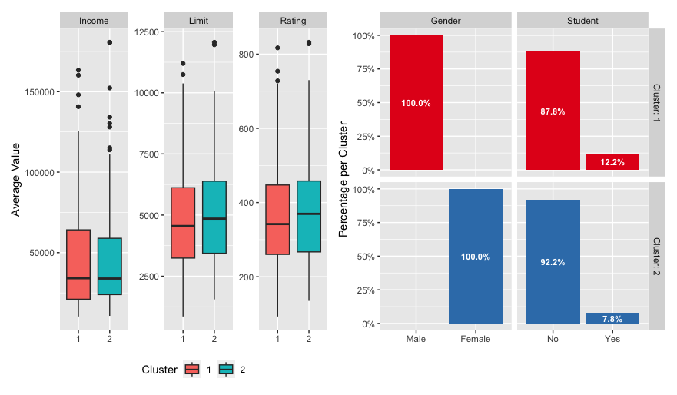
Data Example: Clusters on Original Variables

Slide 24
Clustering Units: Practice

Slide 25
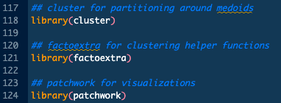
Activating Packages
New packages must be downloaded and installed via install.packages() function
Any RStudio session might consist of using previously installed packages and some new packages
Image shows new packages installed for this topic
In order to use downloaded packages, they must be activated in a working RStudio session with the library() function

Slide 26
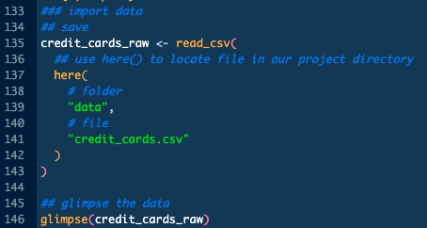
Importing Data
Import csv files from the project directory using the here() and read_csv() functions
This code navigates to the data folder to find the credit_cards.csv data file

Slide 27
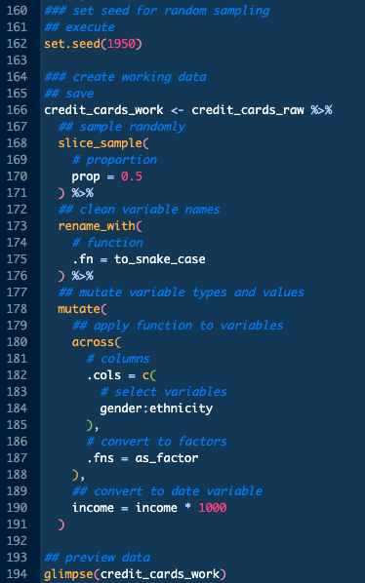
Cleaning Data
We perform multiple data cleaning operations:
Randomly slicing for a subset of observations
Renaming variables
Convert character variables to factor variables
Updating a numeric variable to a new scale

Slide 28
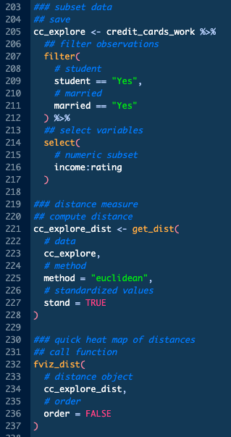
Unit Distances
We can compute a variety of distance metrics for quantitative (numeric) variables
Example shows the computation of Euclidean distance via the get_dist() function for a subset of quantitative variables
Manhattan, Minkowski, etc., distances available as well
We can visualize unit distances with heat maps
Example shows the use of fviz_dist() to generate a heat map

Slide 29
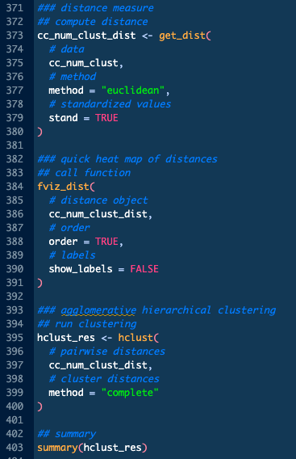
Agglomerative Hierarchical Clustering
To perform agglomerative hierarchical clustering, we:
Prepare the data (e.g., standardize variables)
Calculate unit distances
Example computes Euclidean distances
Apply the algorithm to the unit distances with a cluster distance metric
Example uses the hclust() function to apply the complete cluster distance method

Slide 30
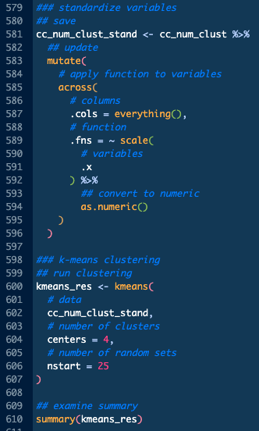
K-Means Clustering
To perform k-means clustering, we:
Prepare the data (e.g., standardize variables)
Apply an algorithm to the prepared data with specified number of clusters
Example uses the kmeans() function to apply the default algorithm (Hartigan-Wong) to create four clusters

Slide 31
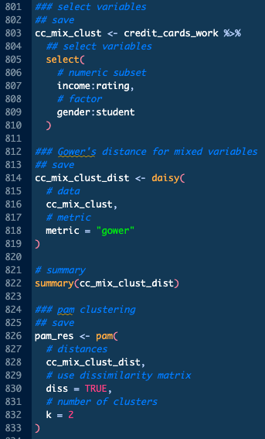
K-Mediods (PAM) Clustering
To perform k-mediods (PAM) clustering, we:
Prepare the data (e.g., select variables of interest)
Calculate the unit distances
Example uses Gower’s distance due to the use of a mixture of quantitative and qualitative variables
Apply an algorithm to the prepared data with specified number of clusters
Example uses the pam() function to apply the default algorithm to create two clusters

Slide 32
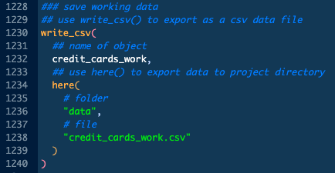
Saving Objects
We can save single R objects to our project directory in an R data format using the here() and write_csv() functions
Example code below navigates to the data folder of the project directory to save the data object credit_cards_work as a data file named credit_cards_work.csv
Save plots created with the ggplot2 functions using ggsave()
We can save multiple plots at once using walk()

