Slide 1
Business Questions: Credit Cards

Slide 2
Credit Cards: Focal Business Questions
Goal: better understand groups of credit card customers
Focal questions:
To what degree are various credit card customers similar to each other?
What groups of credit card customers emerge from their characteristics?

Slide 3
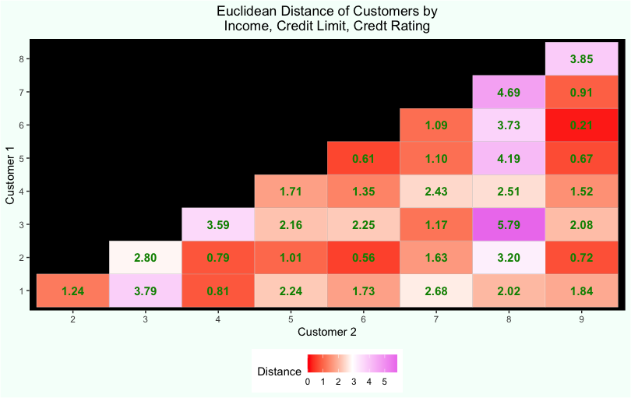
Customer Similarity
We visualize the distance between nine credit customers with a heat map based on three quantitative measurements
In this example, we see that one customer differs quite a bit from the others

Slide 4
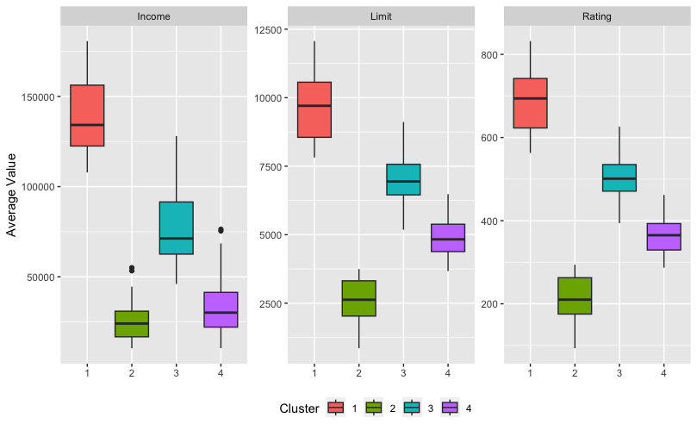
Clusters of Credit Card Customers
Post cluster analysis, we visualize the differences between groups of customers on measured variables
In this example, we see that each cluster has a unique profile with respect to the three measured variables

