Slide 1

Introduction to CS

Slide 2
Content
Architecture of a computer
What is programming?
Why Python?

Slide 3
Architecture of a computer
4 parts we’ll talk about:
CPU (Central Processing Unit)
GPU (Graphics Processing Unit)
RAM (Random-Access Memory)
HDD (Hard Disk Drive)

Slide 4
CPU (Central Processing Unit)
Brain of your computer
Does all the computations -> want it quick!

Slide 5
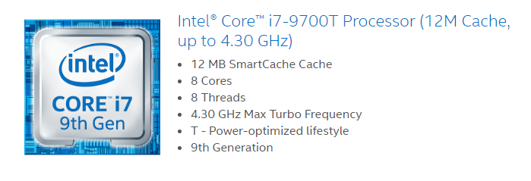
Properties of a CPU: Cores
Cores
Individual processing units
More cores allows for parallel processing (= faster)
Cores can be same (homogenous) or different (heterogenous)

Slide 6
Properties of a CPU: Threads
Threads
Number of simultaneous ‘trains of thought’
Depends on the number of cores
Sometimes 2 threads per core (hyperthreading)

Slide 7
Properties of a CPU: Clock
Clock
Number of computations processor does per second
Determined by an oscillator in the core
Limited by time it takes for system to settle and heat created

Slide 8
Properties of a CPU: Cache
Cache
Memory inside the CPU
On same integrated circuit
Store frequently used data
Fast but small

Slide 9
GPU: Graphics processing unit
Part of the video card-> originally made to generate output images
Nowadays: massive parallel programming
Tens of cores, but each is limited

Slide 10
GPU: What task?
Repeated task
Simple calculation
Calculations are independent (e.g. on each pixels in an image separately)
Workload can be divided ahead of time

Slide 11
Cache vs RAM
RAM | Cache
Slower writing/reading | Quicker writing/reading
Larger storage size | Smaller storage size
Program and data currently used by CPU | Frequently used data
Physically further away from CPU | Physically close to CPU

Slide 12
RAM: random-access memory
Random access -> access any location directly using address
Can erase/write at same time (symmetrical read/write)
Physically closer to CPU (1 bus)
Often no direct link between CPU and hard disk
Uses DMA (direct memory access)

Slide 13
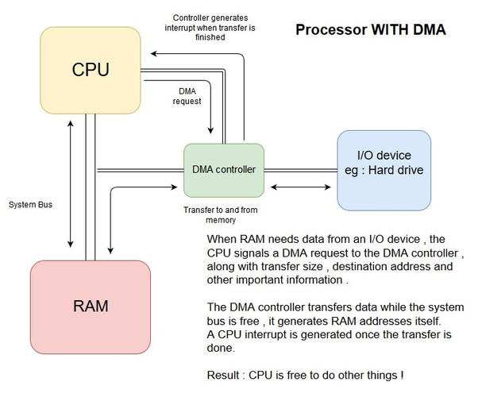
RAM: DMA
CPU sends signal to hard disk to retrieve information
Other subsystem handles data transfer
CPU gets notified when data (including code to execute) is loaded
Can only use data and code in RAM

Slide 14
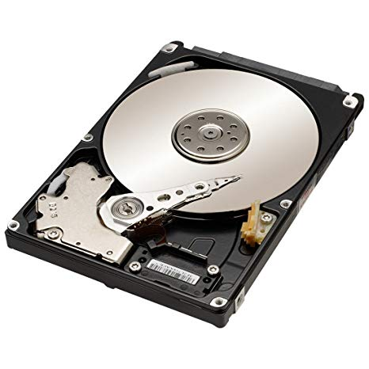
HDD (Hard Disk Drive)
Large but slow
Blocks of data transferred to RAM
Non-volatile: data will remain without power

Slide 15
Different type of memory storage: SSD
Solid State Drive
No moving parts -> memory in microchips
More sturdy
Faster than HDD
But more expensive

Slide 16
Why programming languages?
Translate human language to machine language
Compiling and interpreting
Keywords translate to particular set of machine instructions
Why so many:
Written for specific purposes
Personal preferences
Trade-off: convenience vs speed vs safety

Slide 17
Syntax of a programming language
Syntax = grammar/writing rules of language
Examples:
End of line: newline
Comment: #
Usually the first thing you learn about a language

Slide 18
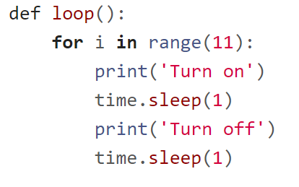
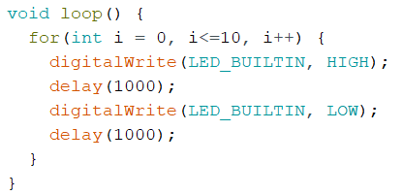
Python vs Arduino syntax

Slide 19
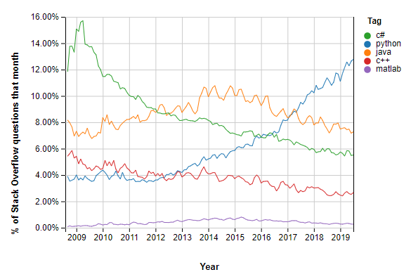
Why Python?
Open-source (free!)
Fast-growing and widely used
(relatively) easy to learn
(relatively) easy to use
Source: https://insights.stackoverflow.com/trends

Slide 20
Python 2 vs Python 3
Python 2 – released Oct 2000
Minor releases: now Python 2.7
Support for Python 2.x will stop 2020
Python 3 – released Dec 2008
Goal was to reduce feature duplication
Now on version 3.7.4
Not completely backward compatible!

Slide 21
Python: compiling and interpreted
Python is translated from programming language to bytecode
This is all automatic
Python keeps bytecode for faster performance
Only recompile when source has changed
Bytecode is interpreted line-by-line by the machine
Runtime errors

Slide 22
Arduino: compiled language
Code is translated to machine code in one go (no bytecode)
Compilation (and thus checking errors) happens before code is uploaded to Arduino

Slide 23
Variables and types
Notes:
Title slide variables

Slide 24
Content
Primitive data types
Composite data types
Abstract data types
Type safety and type error
Notes:
Content of the presentation:
What is a variable?
Data types
Mutability (constant vs variable)
Scope and visibility
Preallocation

Slide 25

What is a variable
Location where a value is stored
Variable consists of:
Variable name (identifier)
Value
In Python value has the type, not variable
Notes:
Every variable has an associated type (in statically typed languages), a variable name and a value. So in the java example of ‘int a = 5;’, int is the type, a is the variable name and 5 is the value.

Slide 26
What is a variable
Location where a value is stored
Address | Value
000 | NULL
001 | 5
002 | 8
003 | NULL
Variable: a
Notes:
A variable is the location of where a value is stored. So for the computer the variable represent a physical address in the memory, in which the value (that we associate with the variable) is stored.

Slide 27
Scope
Lifetime of a variable
Important for memory allocations
Be aware of scope: prevent unwanted variables!
Notes:
The scope determines the lifetime of a variable; or another way to look at it, were the computer can read the variable. Matlab is an exception and will have its own slide. Scope is important for memory allocations, and it’s good to keep an eye on it.

Slide 28
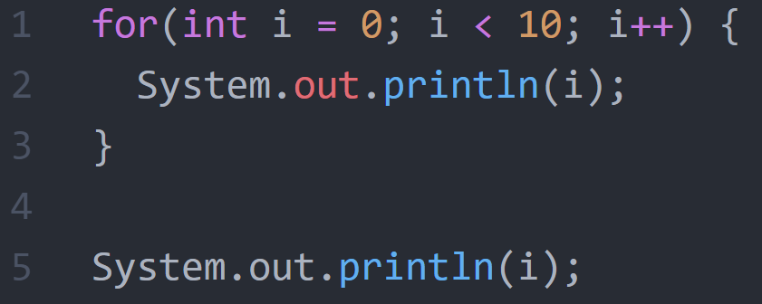
Scope
Output: ?
Output: ?
Notes:
In this Java example, a for-loop is shown where the println displays the value of i. The question is what the output in each case is.
For(int I = 0; I < 10; i++) {
System.out.println(i);
}
System.out.println(i);

Slide 29
Why data types?
Allocation of memory
Define operations possible
Type safety
Notes:
A variable is the location of where a value is stored. So for the computer the variable represent a physical address in the memory, in which the value (that we associate with the variable) is stored.

Slide 30
Python: Strong, dynamical and implicit
Strong:
When you have assigned a type to a value (not the variable!) it will keep that type
E.g. string of numbers will not suddenly become number
Dynamically:
Variables (not values) can change type
Implicit:
Do not declare the type of variables beforehand

Slide 31
Primitive data types in Python
Name | Shorthand | What
Integer | int | Whole numbers
Floating-point number | float | 32-bit number with digits after decimal place
Double precision float | double | 64-bit number with digits after decimal place
Boolean | bool | Value that’s either true or false (0 or 1)
String | str | A list of ASCII characters

Slide 32
Composite data types in Python
Name | Shorthand | What
List | list | Collection of elements of any type
Dictionary | dict | ‘Rows’ of data

