Slide 1
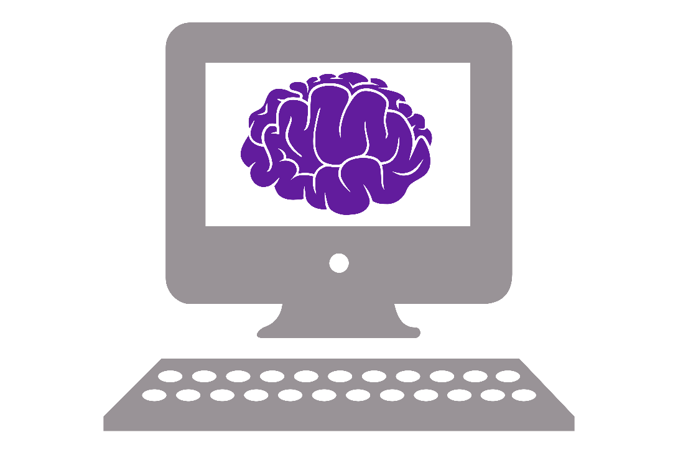
Further resources

Slide 2
Learning == doing
The only way to get better at programming is doing more programming!
For example:
Use Python for automation
Make a game in Python (pygame module)

Slide 3
Other suggestions
Try a Kaggle competition
Join local clubs/events
Codebar Brighton (https://codebar.io/brighton)
BNA Neuroinformatics SIG (https://www.bna.org.uk/members/sigs/neuroinformatics/)
Pydata Conference (https://pydata.org/london2019/)
Look at (and join in on) open source projects
E.g. https://github.com/matplotlib/matplotlib

Slide 4

Codewars
My personal favourite!
Small coding problems to solve in increasing difficulty
See best/most elegant solutions afterwards
https://www.codewars.com/dashboard

Slide 5
More to learn
Git
Version control
Sharing code
Tutorial: https://guides.github.com/activities/hello-world/
Object-oriented programming (OOP)
https://www.py4e.com/lessons/Objects

Slide 6
Further reading
Frontiers Python in Neuroscience special edition: https://www.frontiersin.org/research-topics/8/python-in-neuroscience
Effective Python: 59 Ways to Write Better Python by Brett Slatkin

Slide 7
Please give me feedback!
https://tinyurl.com/SNPython

Slide 8
This afternoon
Start on data analysis
Be able to ask any questions and discuss problems you run into
BYOD (Bring your own dataset) or use these suggested datasets:
Frontiers in Neuroscience articles: https://www.kaggle.com/markoarezina/frontiers-in-neuroscience-articles#neuroscience_articles.csv
Ephys data: https://janelia.figshare.com/articles/Recordings_of_ten_thousand_neurons_in_visual_cortex_during_spontaneous_behaviors/6163622
EEG data: https://www.kaggle.com/wanghaohan/confused-eeg

