Slide 1
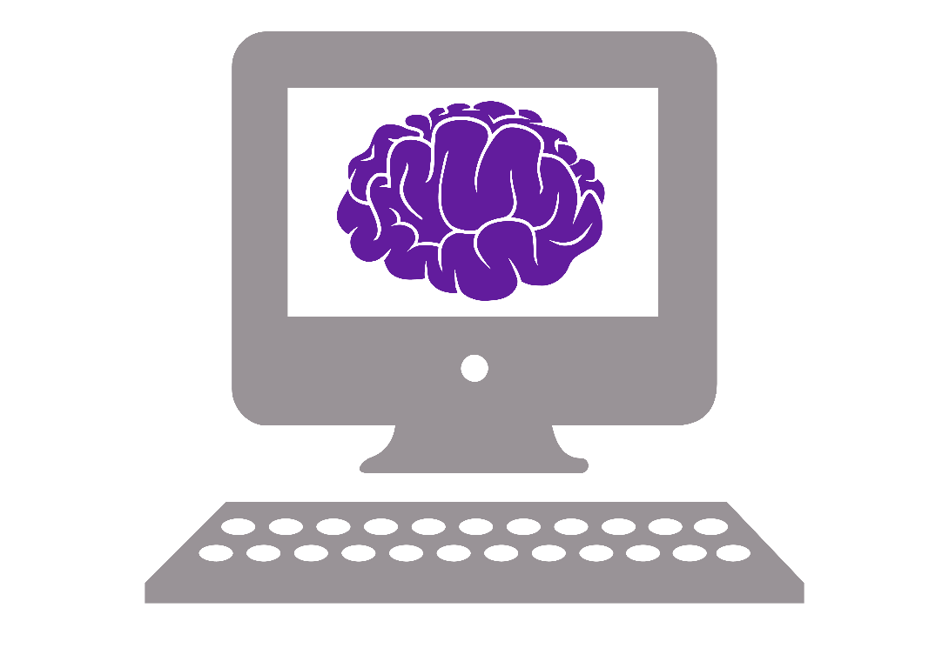
Introduction to CS

Slide 2
Content
Architecture of a computer
What is programming?
Why Python?

Slide 3
Architecture of a computer
4 parts we’ll talk about:
CPU (Central Processing Unit)
GPU (Graphics Processing Unit)
RAM (Random-Access Memory)
HDD (Hard Disk Drive)

Slide 4
CPU (Central Processing Unit)
Brain of your computer
Does all the computations -> want it quick!

Slide 5
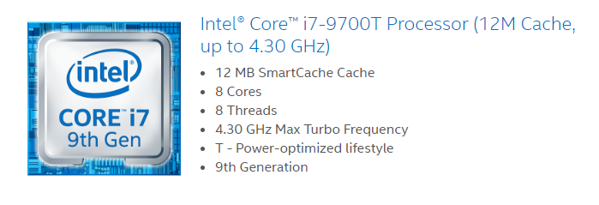
Properties of a CPU: Cores
Cores
Individual processing units
More cores allows for parallel processing (= faster)
Cores can be same (homogenous) or different (heterogenous)

Slide 6
Properties of a CPU: Threads
Threads
Number of simultaneous ‘trains of thought’
Depends on the number of cores
Sometimes 2 threads per core (hyperthreading)

Slide 7
Properties of a CPU: Clock
Clock
Number of computations processor does per second
Determined by an oscillator in the core
Limited by time it takes for system to settle and heat created

Slide 8
Properties of a CPU: Cache
Cache
Memory inside the CPU
On same integrated circuit
Store frequently used data
Fast but small

Slide 9
GPU: Graphics processing unit
Part of the video card-> originally made to generate output images
Nowadays: massive parallel programming
Tens of cores, but each is limited

Slide 10
GPU: What task?
Repeated task
Simple calculation
Calculations are independent (e.g. on each pixels in an image separately)
Workload can be divided ahead of time

Slide 11
Cache vs RAM
RAM | Cache
Slower writing/reading | Quicker writing/reading
Larger storage size | Smaller storage size
Program and data currently used by CPU | Frequently used data
Physically further away from CPU | Physically close to CPU

Slide 12
RAM: random-access memory
Random access -> access any location directly using address
Can erase/write at same time (symmetrical read/write)
Physically closer to CPU (1 bus)
Often no direct link between CPU and hard disk
Uses DMA (direct memory access)

Slide 13
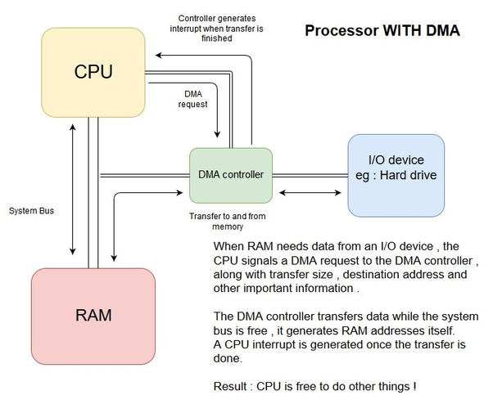
RAM: DMA
CPU sends signal to hard disk to retrieve information
Other subsystem handles data transfer
CPU gets notified when data (including code to execute) is loaded
Can only use data and code in RAM

Slide 14
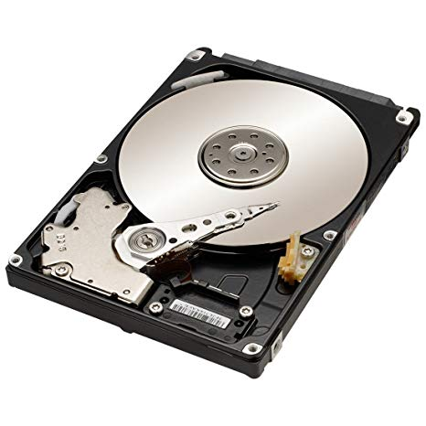
HDD (Hard Disk Drive)
Large but slow
Blocks of data transferred to RAM
Non-volatile: data will remain without power

Slide 15
Different type of memory storage: SSD
Solid State Drive
No moving parts -> memory in microchips
More sturdy
Faster than HDD
But more expensive

Slide 16
Why programming languages?
Translate human language to machine language
Compiling and interpreting
Keywords translate to particular set of machine instructions
Why so many:
Written for specific purposes
Personal preferences
Trade-off: convenience vs speed vs safety

Slide 17
Syntax of a programming language
Syntax = grammar/writing rules of language
Examples:
End of line: newline
Comment: #
Usually the first thing you learn about a language

Slide 18
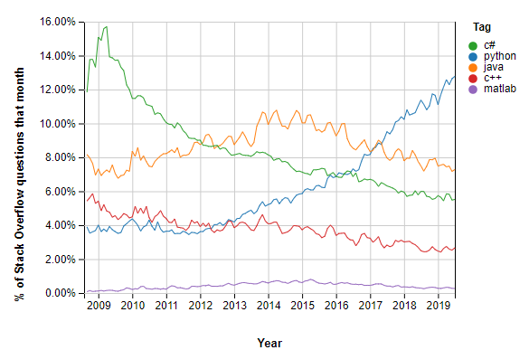
Why Python?
Open-source (free!)
Fast-growing and widely used
(relatively) easy to learn
(relatively) easy to use
Source: https://insights.stackoverflow.com/trends

Slide 19
Python 2 vs Python 3
Python 2 – released Oct 2000
Minor releases: now Python 2.7
Support for Python 2.x will stop 2020
Python 3 – released Dec 2008
Goal was to reduce feature duplication
Now on version 3.7.4
Not completely backward compatible!

Slide 20
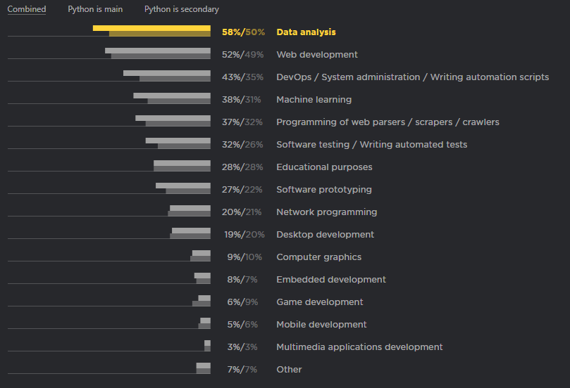
What is Python used for?
Data analysis
Web development (Django)
Source: https://www.jetbrains.com/research/python-developers-survey-2018/

Slide 21
Python uses
Dropbox
YouTube
Instagram
BitTorrent
The Sims 4
More: https://en.wikipedia.org/wiki/List_of_Python_software

Slide 22
Python: compiling and interpreted
Python is translated from programming language to bytecode
This is all automatic
Python keeps bytecode for faster performance
Only recompile when source has changed
Bytecode is interpreted line-by-line by the machine
Runtime errors

Slide 23
Let’s do some Python!!
Open the jupyter notebook:
Go to anaconda prompt
Type: ‘jupyter notebook’
Find the notebook ‘Python lesson 1’

Slide 24
Architecture of a program
3 levels of code:
Programming language
Bytecode
Machine code
Compile
Interpreter
Compile
Interpreted language:
Python
Compiled languages:
C, BASIC, LabVIEW
Notes:
Not all interpreted languages compile to bytecode, some compiled languages are sort of interpreted, it’s basically all a mess.

Slide 25
Programming language
Written for humans to understand
Why so many:
Written for specific purposes
Personal preferences
Trade-off: convenience vs speed vs safety
Eventually all programming languages are translated to code machine can understand

Slide 26
Python: interpreting
Python interpreter takes bytecode and executes line by line
Execution happens on a virtual machine
If error occurs, it happens during runtime
Python also allows line by line execution (see e.g. iPython)
Under the hood this includes compiling + interpreting
Important: You might have gotten some output when the error occurs!

