Slide 1

How to write good Python code
Notes:
Title slide: how to write good code part 3

Slide 2
Content
PEP 8: Python style
Functionising
Conceptualisation
Externalisation
Debugging
Testing
Notes:
Last time (part 1) we covered naming conventions, code layout and commenting.
We will cover part two today, discussing conceptualisation, externalisation and the use of functions.
Conceptualisation → thinking about the best way to organise your code and variables, e.g. – don’t copy and paste, don’t use numbers in variable names
Externalisation → if you run code on a different machine, it should still work, e.g. don’t use cd, don’t hard code variables, use fullfile to access saved files or to save figures and variables
Part three (next week) will cover debugging and testing your code

Slide 3
PEP8 – Python Style guide
PEP = Python Enhancement Proposal
Guidelines for writing Python code
Not necessary, but recommended!
Designed to make code more readable
https://www.python.org/dev/peps/pep-0008/#introduction

Slide 4
Layout:
Indentation = 4 spaces (no tabs!)
Line length = 79 characters
When exceeding line length: return and align with opening delimiter
When needed, add extra indentation.
Blank lines: use for readability (i.e. create paragraphs)
Imports on separate line
Group imports: standard -> third party -> local
Avoid ‘from X import *’
Use whitespace only to increase readability

Slide 5
Comments: the most important part of code
Don’t use them for ‘commenting out’ (you can if out stuff)
3 different types of comments:
Docstring
Block comments
Inline comments

Slide 6
Docstring
First comment of function, class or method
First thing you should write when making a function
Describes:
What a function does
The input variables
The output variables
Has its own PEP: https://www.python.org/dev/peps/pep-0257/

Slide 7
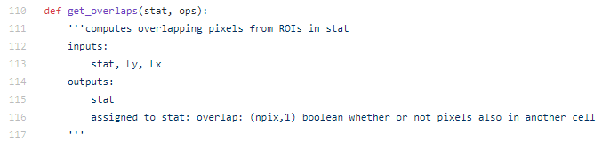
Example of a docstring (suite2p)
Short description of what the function does
Input variables (optional)
Output variables (optional)
Notes:
Always have triple quotes and explanation on first line. If whole explanation fits on a line, use one-line docstring, otherwise you need to do multiple lines, where last line is triple quotes.

Slide 8
Block comments
Multiple lines of code in the text
Start each line with # followed by space
Usually used to explain what a certain part of the code does
Good practice: write beforehand to have an outline of your code

Slide 9



Inline comments
Single line comment, usually after a line of code
Not always useful!

Slide 10
Variable naming
Variable and function names: lowercase_with_underscores
Class names: CapWords
Constants: UPPERCASE_WITH_UNDERSCORES
What to name your variables
Descriptive vs short
English
Don’t use l, I, O as variable names
No numbers

Slide 11
Use of functions
Compartmentalize
Easier to share
Easier to reuse
Reduce workspace clutter
Remember scope!
Make an API
Notes:
Why would you use functions?
It compartmentalizes your code, meaning you can use pieces of code in different analyses
It makes your code easier to share
It makes the code easier to reuse
It reduces your workspace clutter, which is related to the idea of scope. This is mainly seen in Matlab, where you only have the output of a function in your workspace, not all the intermediate variables
It allows you to make an API (Application programming interface) for other people to use

Slide 12
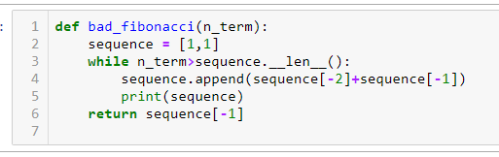
Importance of scope
Scope means the lifetime of a variable (i.e. in what parts of the code can I use a variable)
Variables made in a function are not saved in memory!
Notes:
In the example code, sequence is not saved outside, so you don’t have the list of Fibonacci in your memory.

Slide 13
Signs of poor conceptualisation
Copy and paste
Numbers in variable names
Using eval
Notes:
Another important thing for coding is conceptualisation. This means knowing the concepts in your code and using it to optimalize it. This slide lists examples of poor conceptualisation:
Copy and pasting code, this means that you could have written a loop or a function to do what you are trying to do.
Numbers in variable names. Unless it is a physical constant, you would ideally use arrays, cell arrays or vectors for these cases, because if you are numbering things, they are probably part of the same concept.
Using eval (in Matlab), this means you are transforming strings into code, which you should in principle never do.
Using clear/clear all. Functionising should take care of superfluous variables. Also, this causes your code to do unexpected things if there are already variables in the workspace previously.

Slide 14
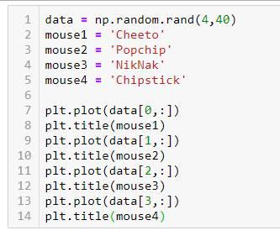
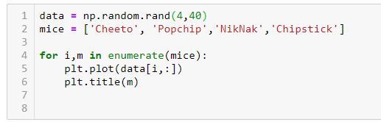
Example of poor conceptualisation

Slide 15
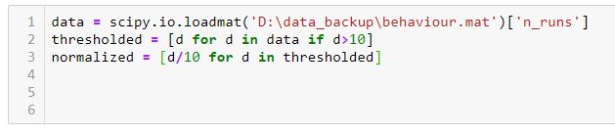
Signs of poor externalisation
Hardcoding numbers that are used more than once
Put into variable
Hardcoding any type of path
Use file separator
Notes:
Externalisation is important for your code to work as a separate entity, allowing it to work on a range of computers and by a range of users. Some signs of poor conceptualisation:
Using ‘cd’ in your code (i.e. moving to a certain folder). This will usually not work on other computers, and may even cause your function to not be able to run twice in a row.
Hardcoding numbers that are used more than once, or should be changed by a user. These should be variables (and in some cases even input variables).
Hardcoding any type of path, this will cause the code to error on other computers.
Adding code to your path in the code (this includes downloading packages, though in some cases it is allowed, e.g. when using jQuery).

Slide 16
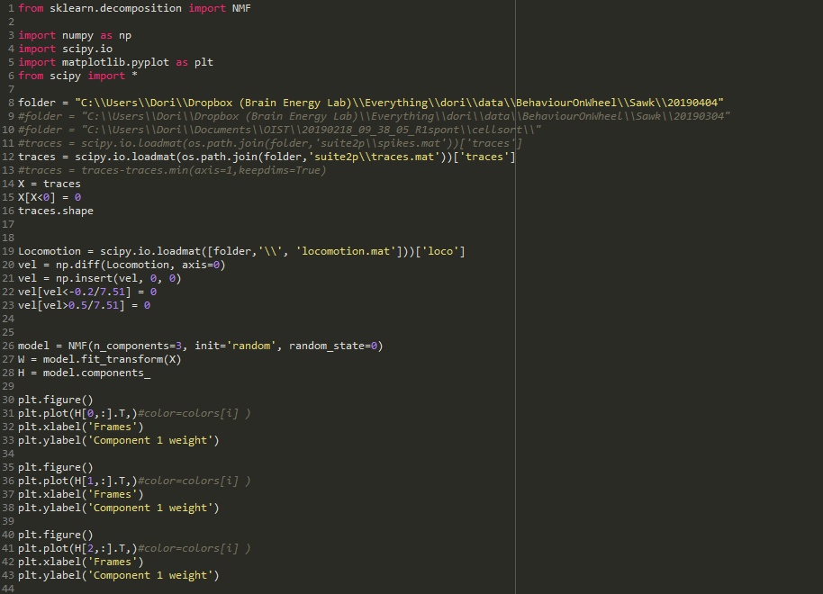
Fix this code

Slide 17
Debugging and tests
Notes:
Title slide: how to write good code part 3

Slide 18
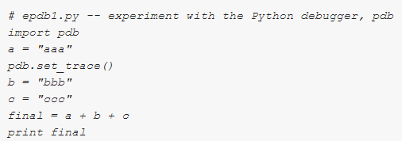
Python debugging
pdb module
Breakpoint:
Pdb -> pdb.set_trace()
Python 3.7 -> breakpoint()
Stepping through
n (next)
s (step)
> python epdb1.py
-> b = “bbb”
(Pdb)

Slide 19
Unit testing
pytest package (https://docs.pytest.org/en/latest/)
Test code on known input/output
Automated testing
Find errors early!

Slide 20
How to use pytest
Write test code in separate file called ‘test_{useful name}’
Call your function ‘test_{name of test}’
Execute py.test in command line
This will execute all files that are called ‘test_{useful name}’ in the folder
Use –k {name of test} to only try single test
Use –v to get more information

Slide 21
When to use it?
While writing a function
Divide functions into units
Larger functions -> Create mock data

Slide 22
Example
Write a program that takes a number n as input, and calculates the sum of all numbers 1 to n.
Workflow
Write test cases
Write function
Test function

Slide 23
Writing test cases
Standard cases
Empty input
Input wrong type (e.g. String)
Useful cases
N < 0
N = 0
N > 0

Slide 24
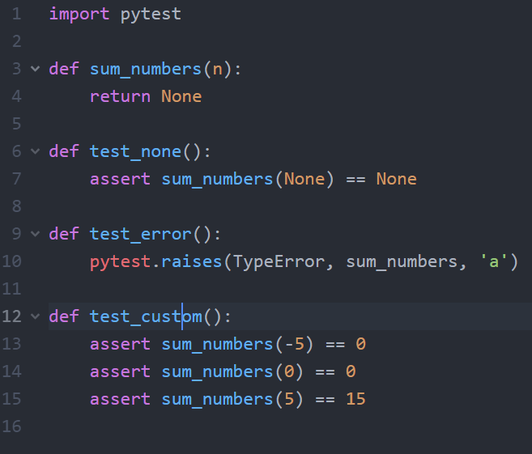

Slide 25
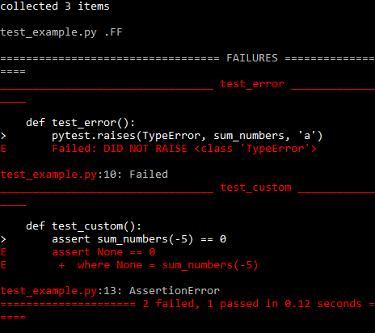

Slide 26
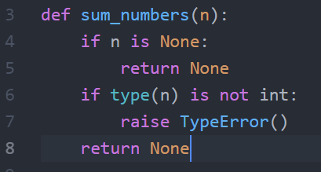
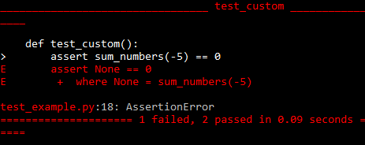

Slide 27
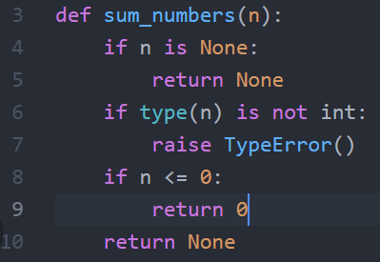
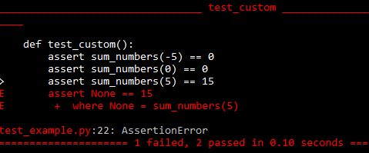

Slide 28
