Slide 1

Sussex Neuroscience Python Course

Slide 2
Your instructors
Dori
Sarah
Graeme

Slide 3
What you will (hopefully) come away with
Basic understanding of Python
Use Python to make graphs
Know how to use Python to analyse your own data
Know how to look for help

Slide 4
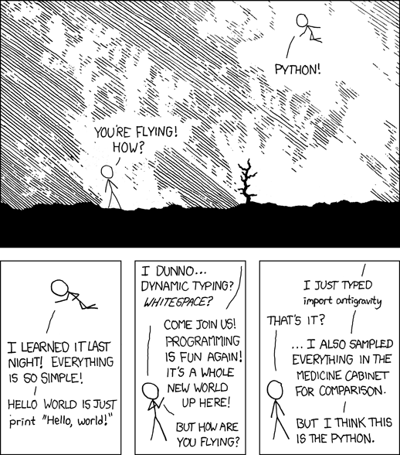
Source: https://xkcd.com/353/

Slide 5
However…
You can only learn how to code by doing!
This course is not a magic coding potion

Slide 6
Course program
Thursday 22 August
9:30 – 10:30 Introduction to computer science
10:30 – 12:00 Introduction to Python
12:00 – 13:00 Lunch (Pev 1 1A3)
13:00 – 14:00 Introduction to modules and Numpy
14:00 – 15:30 Introduction to Pandas (Sarah Wooller)
15:30 – 17:00 Introduction to data visualization with Matplotlib
Friday 23 August
9:30 – 11:30 Data analysis with Python
11:30 – 12:30 Good coding practices
12:30 – 13:30 Lunch (Pev 1 1A3)
13:30 – 16:00 Discussion + project work

Slide 7
Structure of each part
Lecture – slides with information
Tutorial follow along – Jupyter Notebook with code and explanations
Exercise – Apply what you just learned in an exercise
Exercise discussion – We will talk about how to find the answer

Slide 8
Rules for course
If you need to step out at any time, please do so (preferably quietly)
Ask questions any time
Be constructive when helping each other

