Slide 1









AVAA German
A Local AI Tutor for German
Agentic Retrieval Augmented Generation
for
Interactive Language Learning
Felipe F. Doria
March 13, 2026

Slide 2



AVAA: Learning German from Real Conversations
The Solution
AVAA retrieves relevant video transcripts and answers in context.
YouTube → grammar, examples, and exercises.
Dynamical quizzes with AI grading.
Multi-Modal by Design.
Local Architecture
The Problem
Textbooks are structured but artificial.
Real conversations are authentic too fast, too messy.

Slide 3
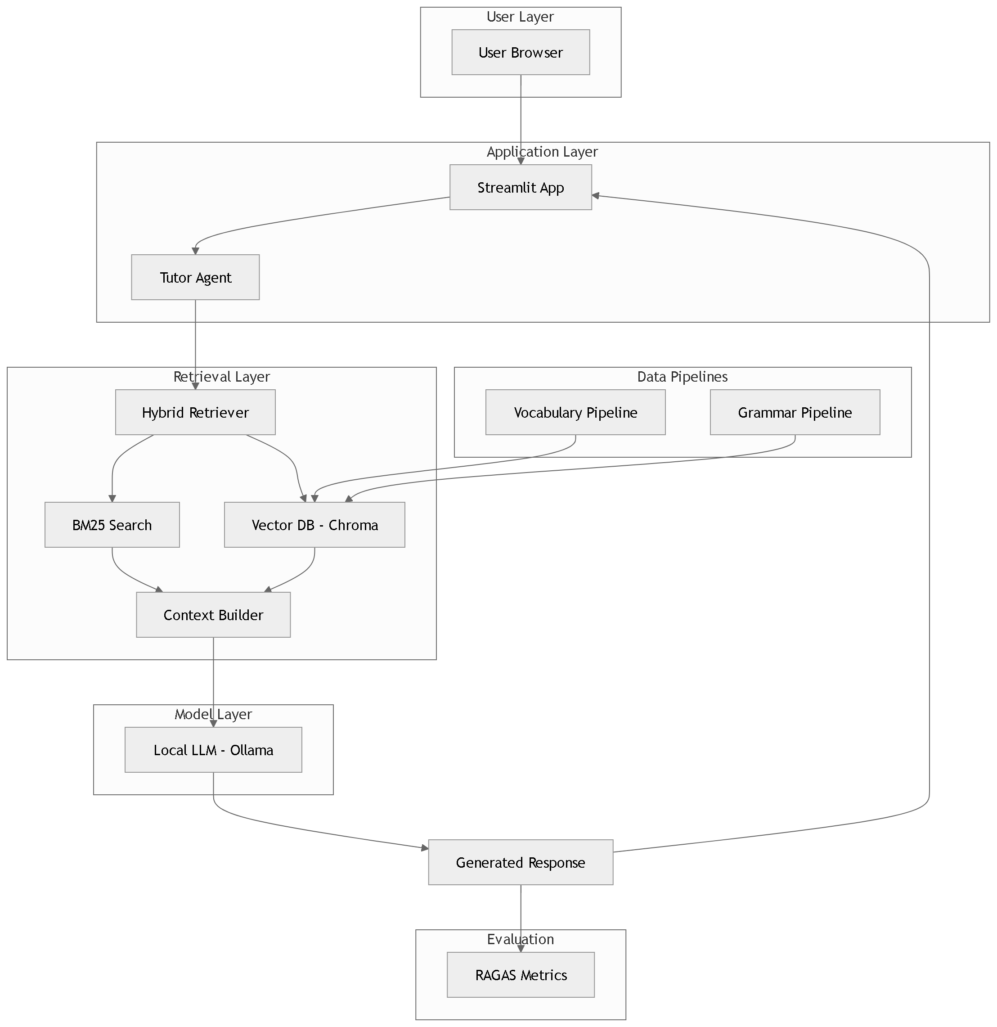
From Query to Answer: Agent, Tool & Hybrid Retrieval
LangChain Agent orchestrates reasoning, maintains conversation memory.
Single Custom Tool encapsulates retrieval + generation.
Hybrid Retrieval, BM25 keyword search + dense vector search.
Retrieved documents cleaned and injected into LLM prompt.
Four Modes, One Engine

Slide 4
Scraping, Chunking, Embedding, Storing
1. Data Source
Primary source:
Videos transcripts from YouTube playlist “Easy German” (A1 level videos).
3. Preprocessing
Transcript chunking and merging (300-900 characters).
Cleaning, removing empty lines and irrelevant metadata. Filter out very short chunks (<300).
4. Storage in Vector DB
Database: `ChromaDB`
Collection: `easy_german_a1_multi`
Stored elements:
Document: The merged transcript segment.
Embeddings:`paraphrase-multilingual-MiniLM-L12-v2`.
IDs: Unique IDs in the format `"{video_id}_{chunk_index}"`.
Metadata: `video_id` – YouTube video ID
`title` – Video title
`lang` – Language of the transcript (`de`)
`start` & `end` – Timestamps of the chunk
`playlist` – Playlist identifier (`easy_german_a1`)
2. Data Retrieval
Libraries:
`youtube_transcript_api`.
`yt-dlp`.
Techniques:
API fetching.
Backoff strategy.
CSV fallback.

Slide 5
One agent to rule them all
Core Components
Single-tool agent: GermanTutorTool
LLM handles responses; memory stores conversation history
Retriever fetches relevant context from Vector DB
Workflow
User asks question → Memory + Retriever → Tool → LLM → Answer
Structured prompt ensures:
Clear explanations
Context examples
German + English answers
Follow-up question
Features
Context-aware, multi-turn conversations
Beginner-friendly prompts (A1 level)
Hybrid retrieval + LLM reasoning
Scalable: can add vocab/quiz/grammar modes

Slide 6

One tool to bind them
GermanTutorTool
Purpose to direct LLM tutor for German learners (A1–C2)
Fetches relevant context/examples automatically.
Prompt ensures: clear answers, reasoning, examples from context, 2–3 German sentences with English translations, follow-up question
Responds in learner-friendly English + German, no sources cited

Slide 7
RAGAS 58 % of Answer relevancy and Manual checking with 86 % of correctness
RAGAS Pipeline
Generate answers from the agent.
Store results in a dataset with:
Question
Agent answer
Ground truth
Answer
Retrieved context
Clean answers
Run RAGAS.
Manual Evaluation
Manually reviewed all 99 answers.
Binary evaluation (Correct / Incorrect):
Error breakdown:
Issue | Count
Truncated answers | 13
Incorrect answers | 9
Question format | 4
Answer Relevancy: 58 %
Context Recall: 49 %
Accuracy: 73 %
Correctness: 86 %

Slide 8
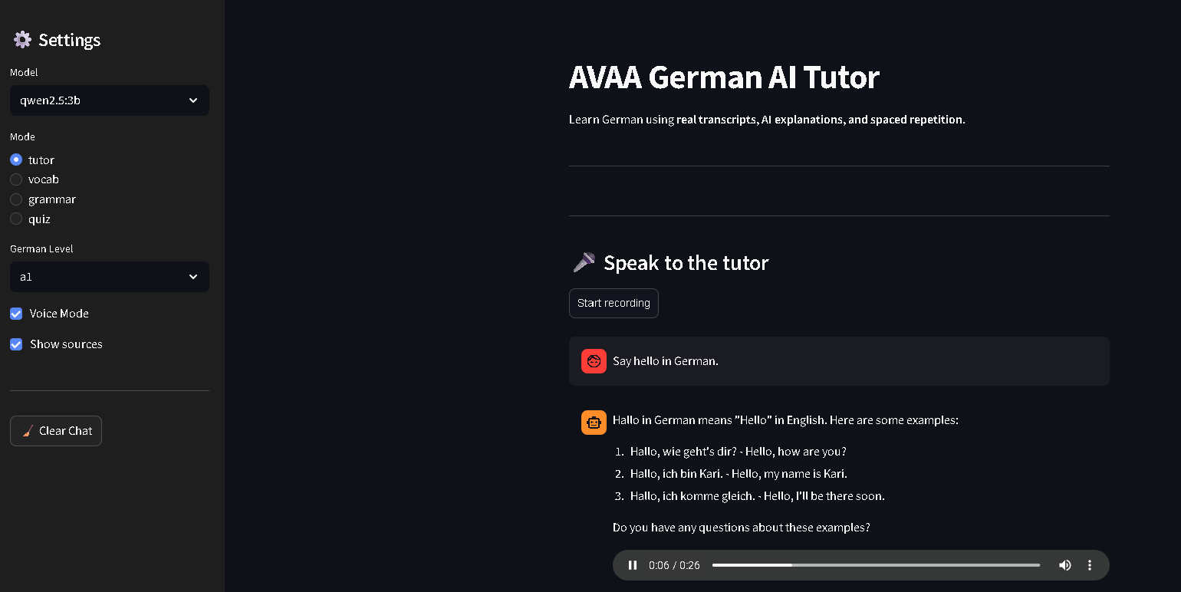
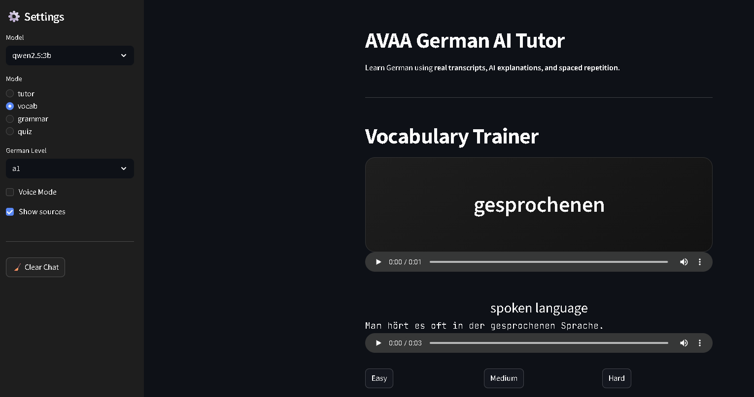
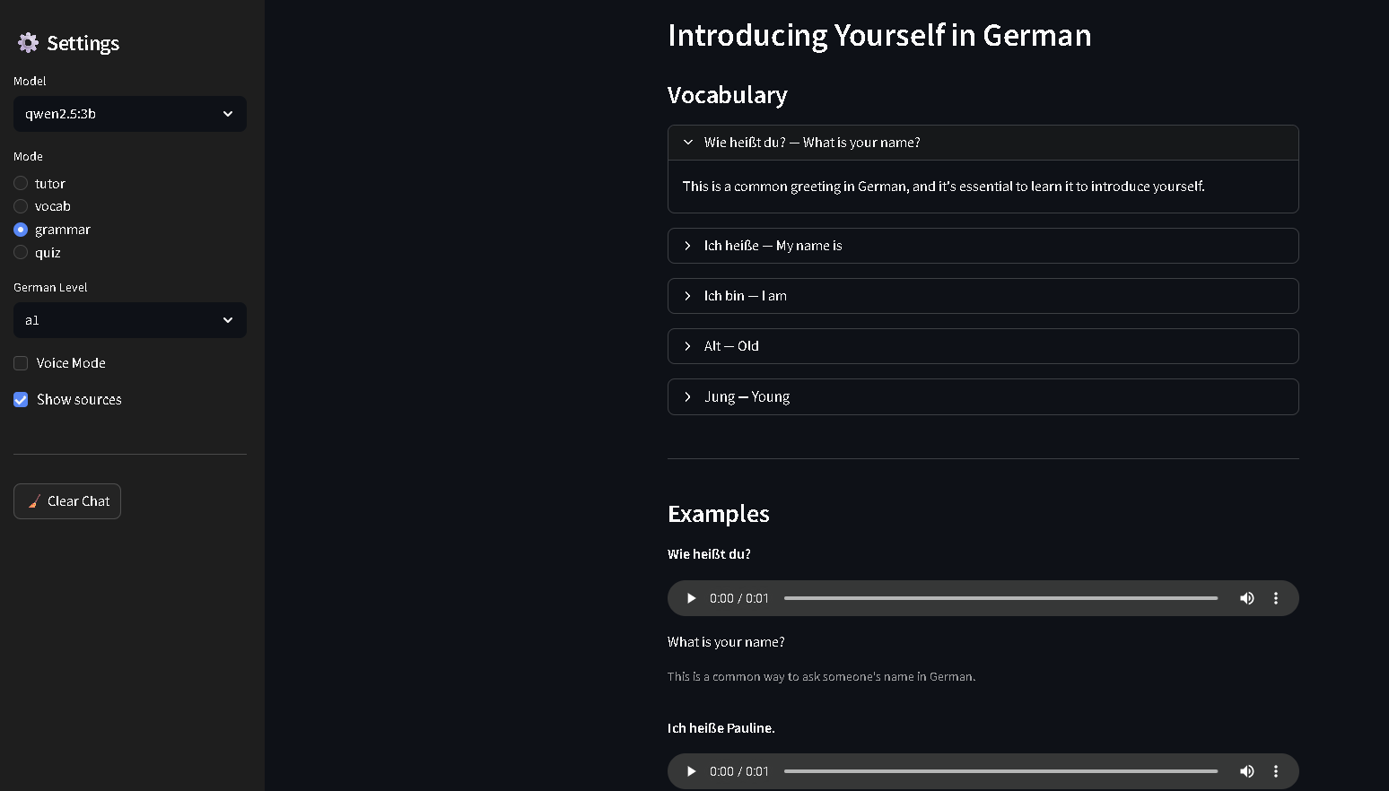
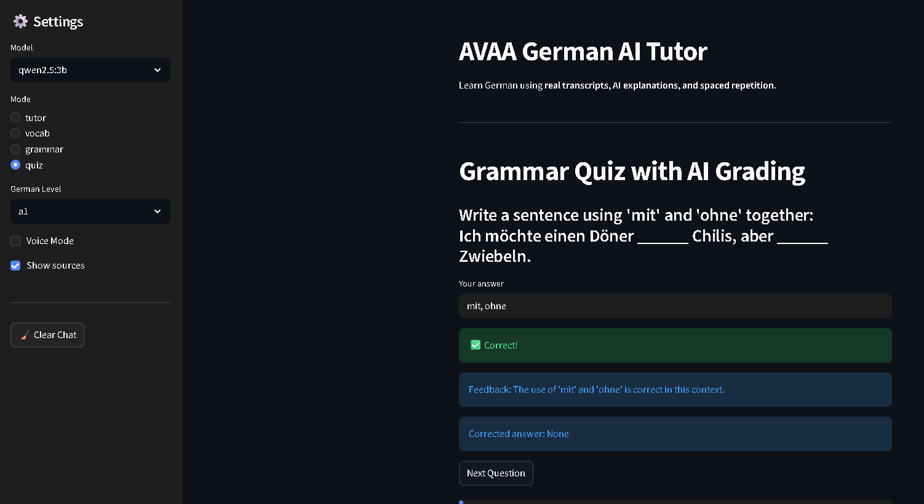

Slide 9
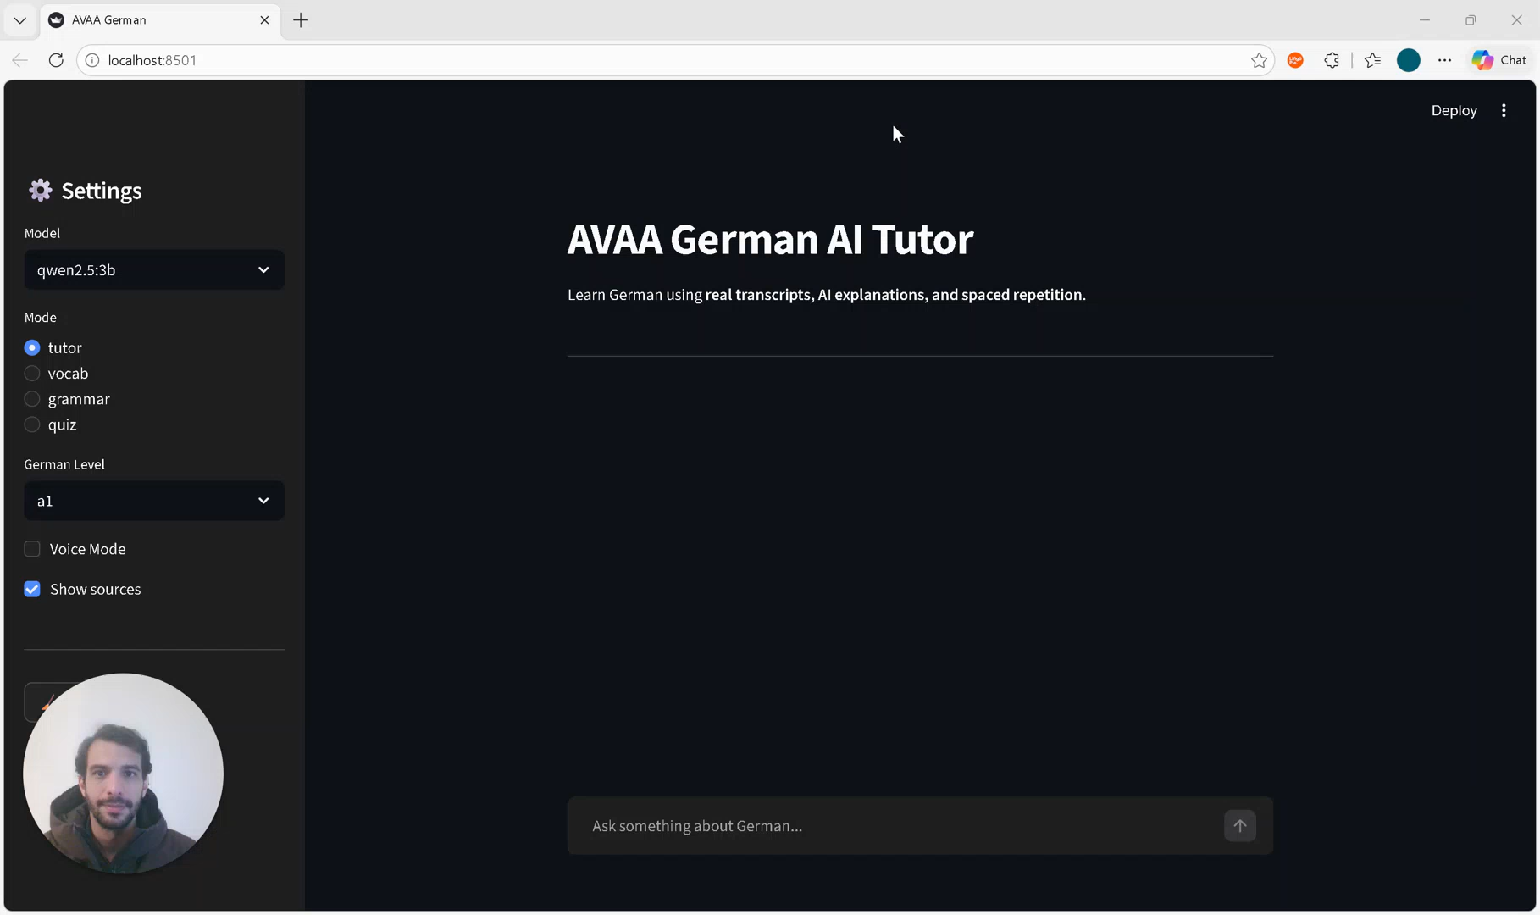
Demo

