Slide 1
Jam Buddies
James Byrne
C12526677
DT8265

Slide 2
Overview
Project description – why , what , how.
Working demonstration
Firebase
Authentication
Profiles
Messaging
Project Management - Scrum
Q & A

Slide 3
Project Description
Jam Buddies – android app that helps musicians connect and communicate .
It uses Firebase for back end functionality . The cloud based real-time data base and for its authentication .
Allows users to sign up , create and edit a profile , browse through other users and message them in real time .

Slide 4

Working Demonstration

Slide 5
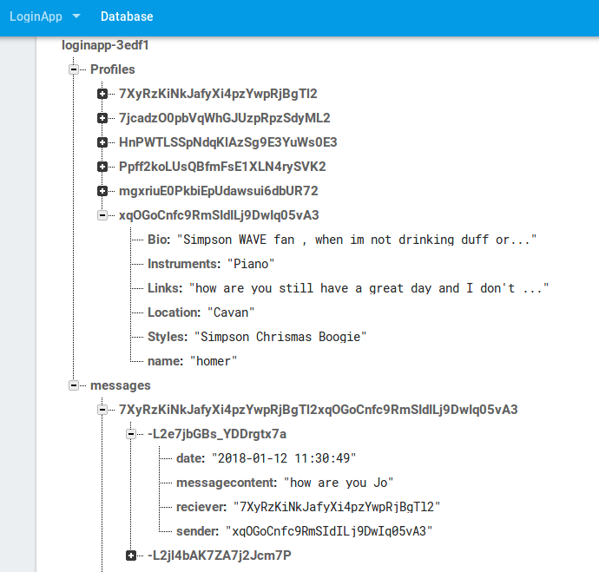
Firebase

Slide 6
Authentication
Firebase assigns a unique user id when a user sign up.
This id enables the user to interact with the firebase Database.
In order to sign up a user must enter a valid email , a password and a password confirmation.
A user can then login with those details and gain access to the rest of the application .

Slide 7
Profiles
Once a User has an ID they can edit their profile .
The user fills in the required inputs . Those strings are then used to create a profile object .
The profile is then added to firebase under the uid.
In order to view a profile , the users id would be used to pull the users data . That would be then mapped to a profile object .
The profile would then be displayed as a series of items in a list view

Slide 8
Messaging
Messaging required two users to have the ability to create and store messages in a specific location that only they could access
The Layout had to display user messages clearly differentiating the sender and the receiver .
The messages had to update in real time

Slide 9
Project Management
Scrum
ZenHub
Time Management

Slide 10
Q&A

