Slide 1
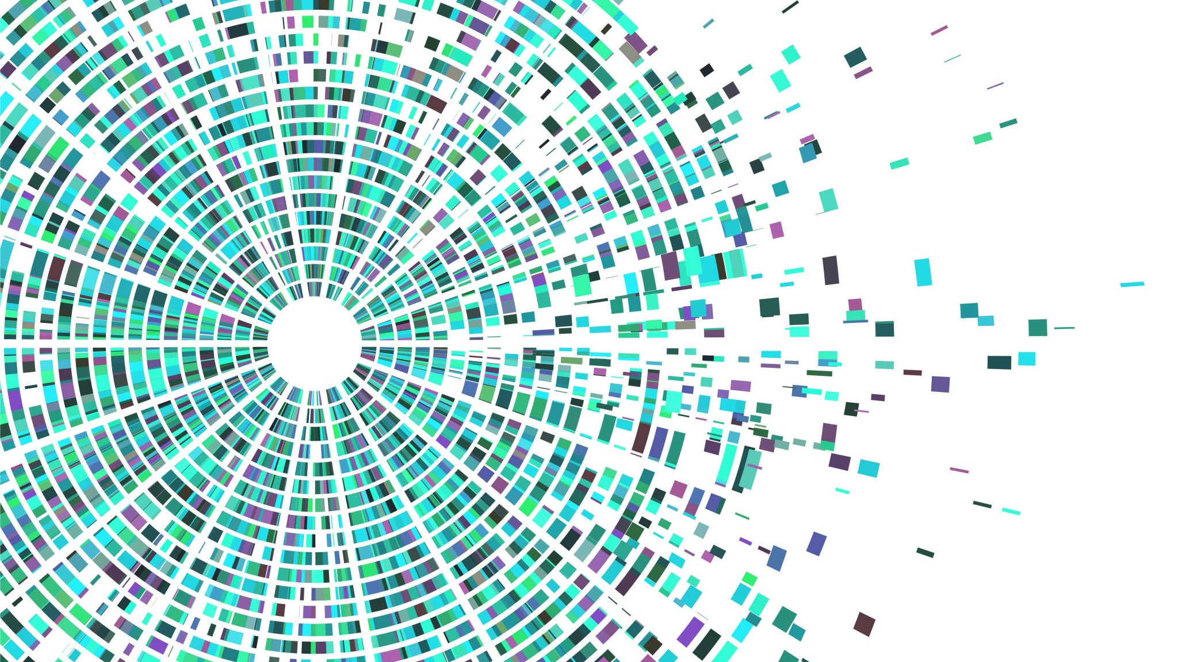
Big data and distributed systems project
CC2

Slide 2
Content
Dataset
Scripts
Demo
Tools

Slide 3
Our dataset
https://archive.ics.uci.edu/ml/machine-learning-databases/00519/heart_failure_clinical_records_dataset.csv
Heart failure clinical records
age
anaemia
creatinine_phosphokinase
diabetes
ejection_fraction
high_blood_pressure
platelets serum_creatinine
serum_sodium
sex
smoking
time
DEATH_EVENT

Slide 4
Tools used in the project
HDP (Hortonworks)
Kafka
Broker / Producer →
Send data to the Broker / Consumer → get the data
Hive → Store and request the data
PySpark → Analyze the data

Slide 5

Scripts

Slide 6

Demo

Slide 7

Thanks for your attention
Any Questions?

