Slide 1

QUICK RECAP OF LES 1.03
Represented by Kanco Abbas and Dorian Buchiotty

Slide 2


SUMMARY AND GOALS
REPRESENTATION OF CONTENT
THE ROLE OF EACH SCRIPT
THE DIFFICULTIES ECOUNTRED
WHAT WE LEARNED AT THE END

Slide 3
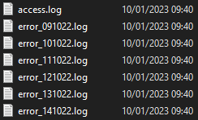
LIST OF FILES ( ACESS FILES AND ERROR FILES
CONNECTED TO A SITE VIA APACHE
GOAL : JOURNALING
IP ADRESS, USER, DATE, SIZE …
LOGGING MANAGMENT

Slide 4



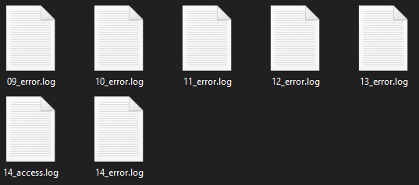
Script 1
ARCHIVE ALL FILES BASED ON DATE
NEW FILE UNDER FORMAT (DD_)
Problems :
Extract the date from the base file
EMPTEING THE BASE FILE

Slide 5
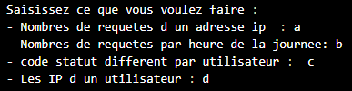
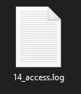
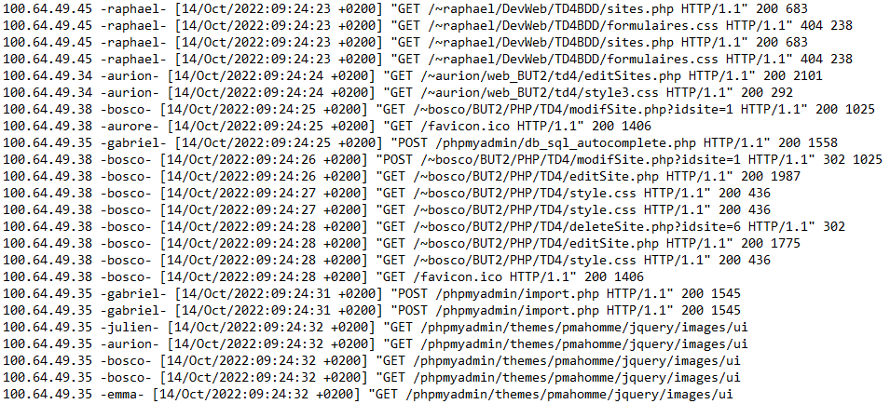
Script 2
CREATE A MENU OF TASKS
BASED ON AN ACCESS LOG OF ONE DAY
THE HARDEST SCRIPT (SEARCH, SORT, …)
tasks based on hour

Slide 6

Script 3
SAME AS THE LAST ONE
BASED ON A MONTH
FUSED ALL OF ACCESS LOG OF ONE month
NO PROBLEMS ENCOUNTRED

Slide 7
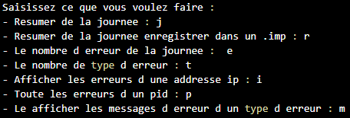
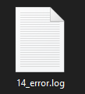
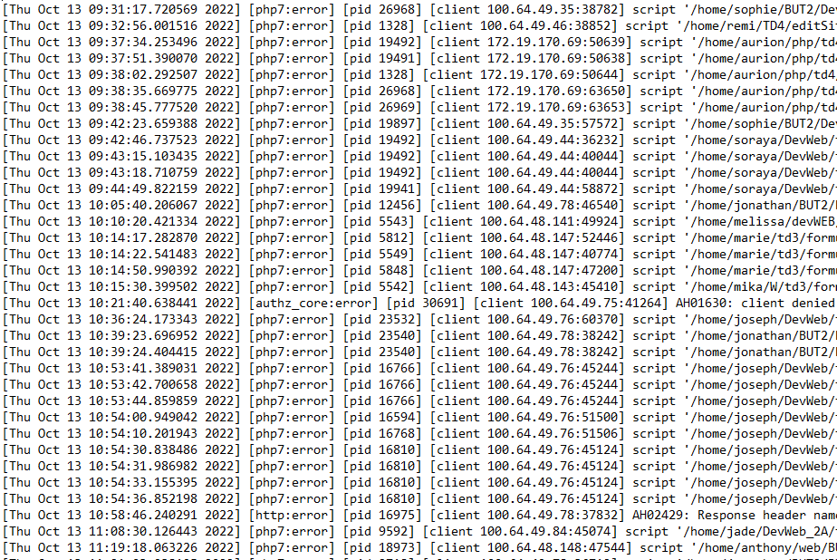
Script 4
CREATE A MENU OF TASKS
BASED ON AN ERROR LOG OF ONE DAY
THE SECOND HARDEST SCRIPT
SUMMARY OF A DAY ( REMOVING [, ], : )

Slide 8
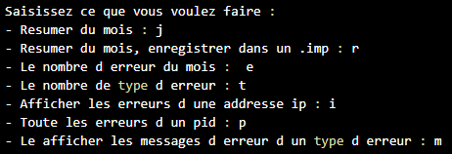
Script 5
SAME AS THE LAST ONE
BASED ON A MONTH
FUSED ALL OF ERROR LOG OF ONE month
NO PROBLEMS ENCOUNTRED

Slide 9

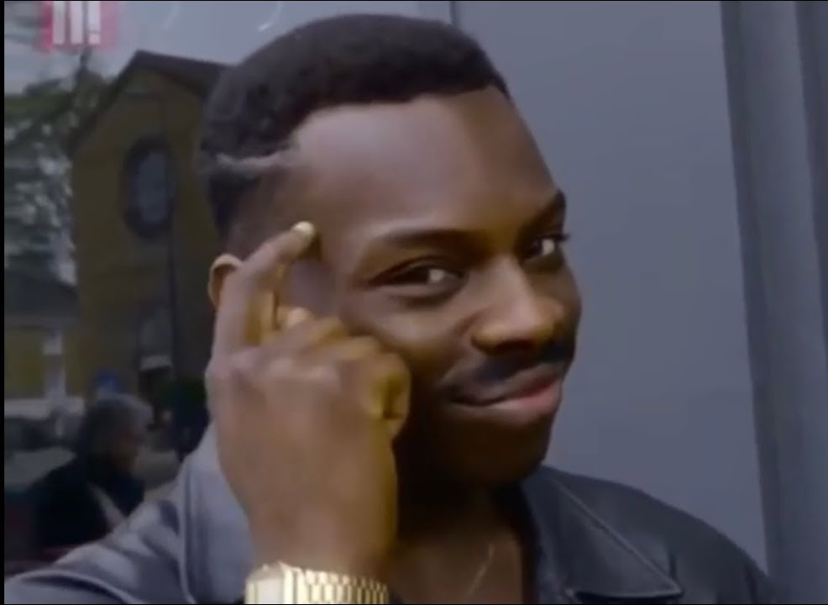
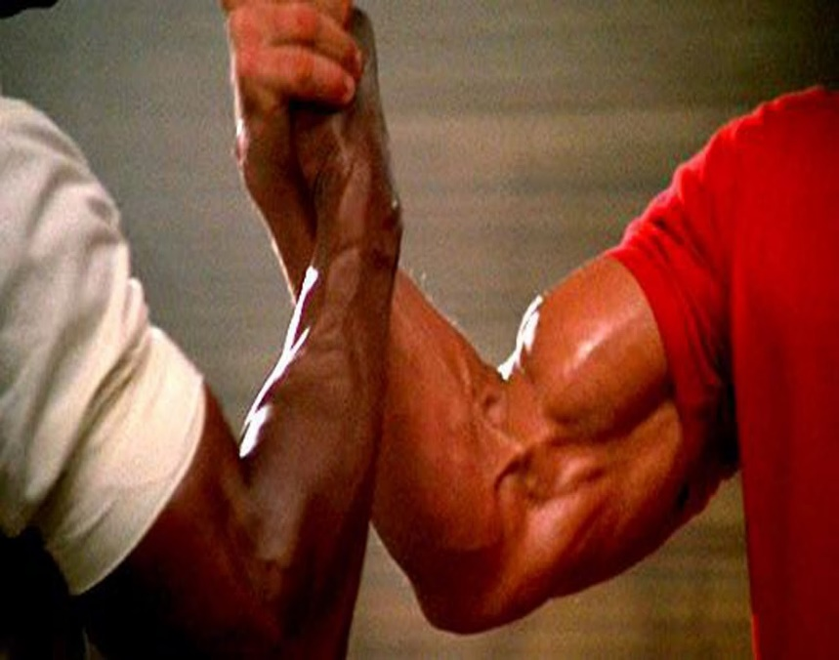
What we learned
DORIAN
ABBAS
MORE CHEMISTRY BETWEEN US
MORE ADAPTIVE INTO TEAM WORKING
MORE KNOWLEDGE SCRIPT CODING
EXTRA INFO FROM PERSONAL RESEARCHES

Slide 10

THANKS FOR LISTENING

